Slide 1
S. SHREE HAASAN
STUDENT REGISTRATION ,LIST VIEW AND SEARCH
HTML , CSS AND JAVASCRIPT

Slide 2
S.No | Screen Details
1 | Login Screen
2 | Add student & Validation
3 | Report - All Students
4 | Search - By Name
5 | Search - By Phone
6 | Exit

Slide 3
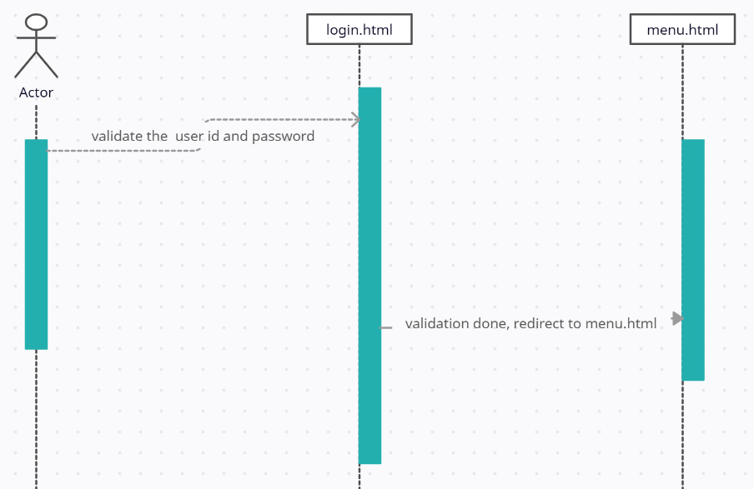
Sequence diagram login -> menu

Slide 4
ADD Student data in Local storage
Steps | Source code
1) make the object let user = { email: email, fname: fname, lname: lname, address: address, phone: phone, qualification: qualification, } 2)add the Object use push method userList = JSON.parse(localStorage.getItem('userList')) userList.push(user) window.localStorage.setItem('userList', JSON.stringify(userList)) | let user = { email: email, fname: fname, lname: lname, address: address, phone: phone, qualification: qualification, } let userList = [] const getCarStorage = localStorage.getItem('userList') if(getCarStorage){ userList = JSON.parse(localStorage.getItem('userList')) userList.push(user) window.localStorage.setItem('userList', JSON.stringify(userList)) }else{ userList.push(user) window.localStorage.setItem('userList', JSON.stringify(userList)) }

Slide 5
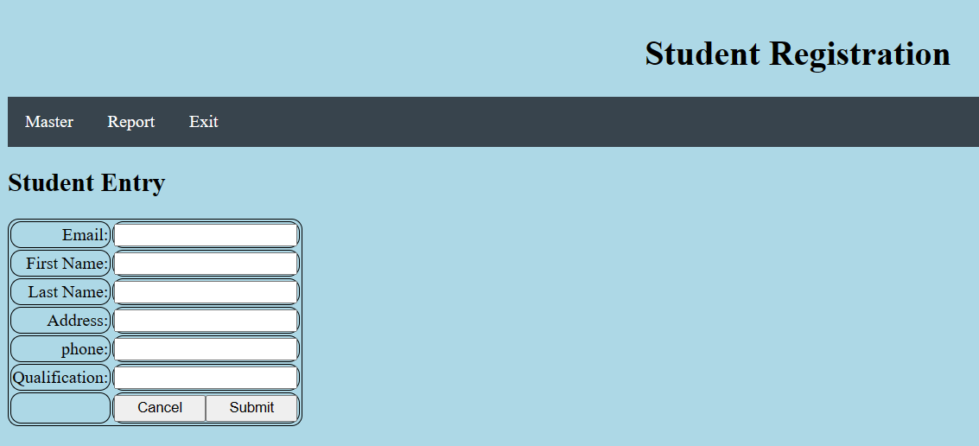
ADD Student Screen

Slide 6
ADD student Screen validation
Steps | Add student & Validation | Source code
1 | Get the value of email | let email= document.forms["myForm"]["email"].value;
2 | Validate the Email | var mailformat = /^\w+([\.-]?\w+)*@\w+([\.-]?\w+)*(\.\w{2,3})+$/; if(!email.match(mailformat)){ //check false
3 | Show the error messages | alert("Not correct email ID");
4 | focus on the same Text Box | document.myForm.email.focus();
5 | without redirect other screen | return false;

Slide 7
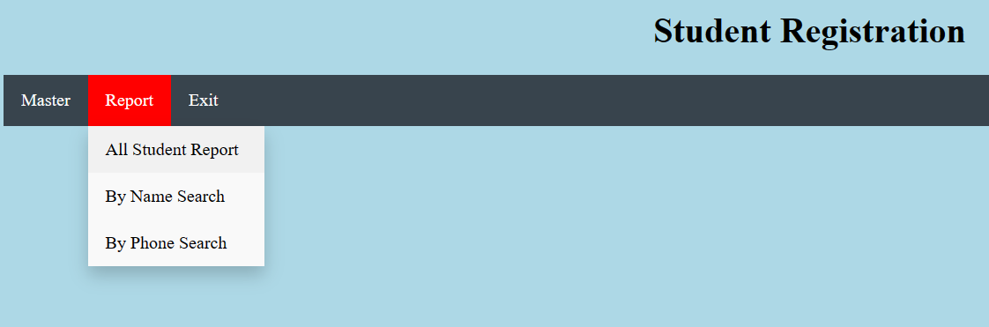
Menu on Click Event

Slide 8
Hide and Show menu- in Java script
Steps | Hi | Source code
1 | click on the Menu | <a href="javascript:listcustomer()">
2 | call the javascript method | function listcustomer(str)
3 | enable the current menu div id and other menu div id are disable | function listcustomer(str) { document.getElementById( 'listcustomer' ).style.display = 'block'; document.getElementById( 'addcustomer' ).style.display = 'none'; document.getElementById( 'phoneser' ).style.display = 'none'; document.getElementById( 'fnameser1' ).style.display = 'none'; }

Slide 9
TABLE -Style
Steps | Table Style | Source code
1 | click on the Menu | <style> table, th, td { border: 1px solid black; border-radius: 10px; } </style>

Slide 10
Local storage- display List
Steps | Source code
1) Get the Local storage var retrievedData = localStorage.getItem("userList"); 2) convert the arraylist var arr = JSON.parse(retrievedData); 3) display the array list let obj = arr.find((o, i) => { text1=text1+"<tr><td>"+o.email+"</td><td>"+o.fname +"</td><td>"+o.lname+"</td> <td>"+o.phone+"</td><td>"+o.qualification +"</td></tr>"; }); | let text1 =""; document.getElementById("msg").innerHTML = ""; text1 = "<table style='width:100%'><tr><th>Email</th><th>Firstname</th> <th>Lastname</th><th>Phone</th><th>Qualification</th></tr>"; var retrievedData = localStorage.getItem("userList"); var arr = JSON.parse(retrievedData); let obj = arr.find((o, i) => { text1=text1+"<tr><td>"+o.email+"</td><td>"+o.fname+"</td><td>"+o.lname+"</td> <td>"+o.phone+"</td><td>"+o.qualification+"</td></tr>"; }); text1=text1+"</table>"; document.getElementById("msg").innerHTML = text1;

Slide 11
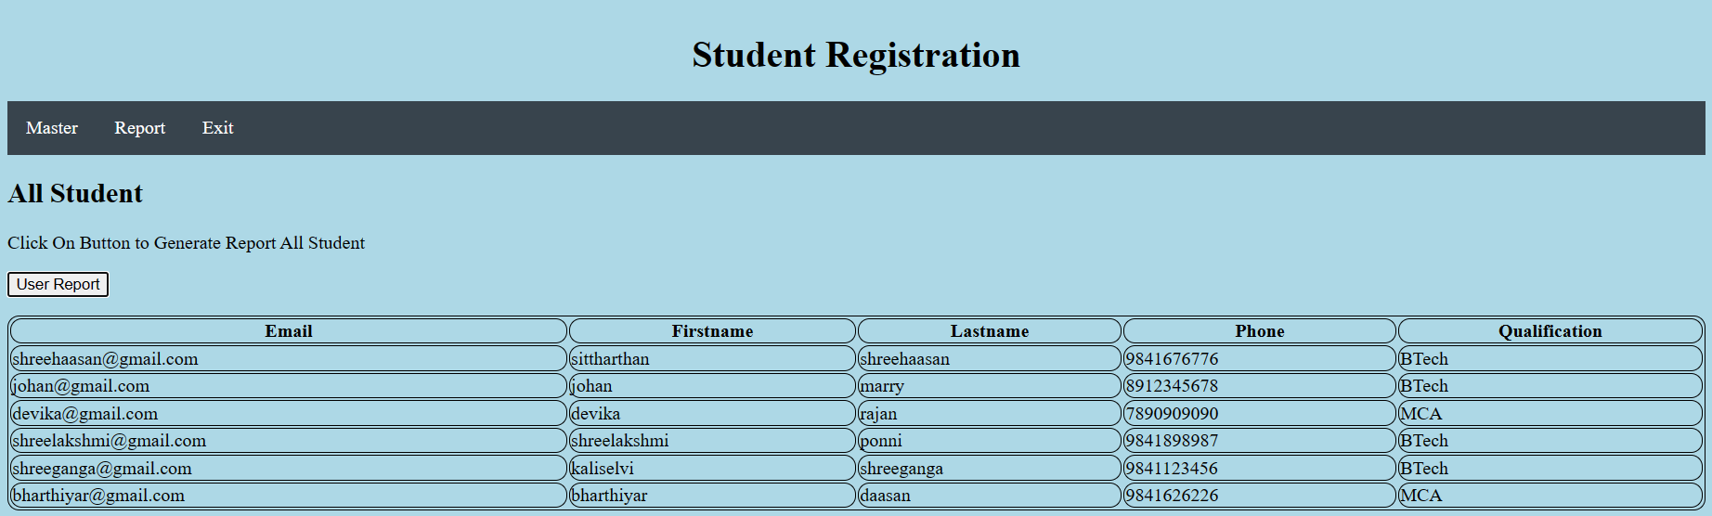
SEARCH ALL

Slide 12
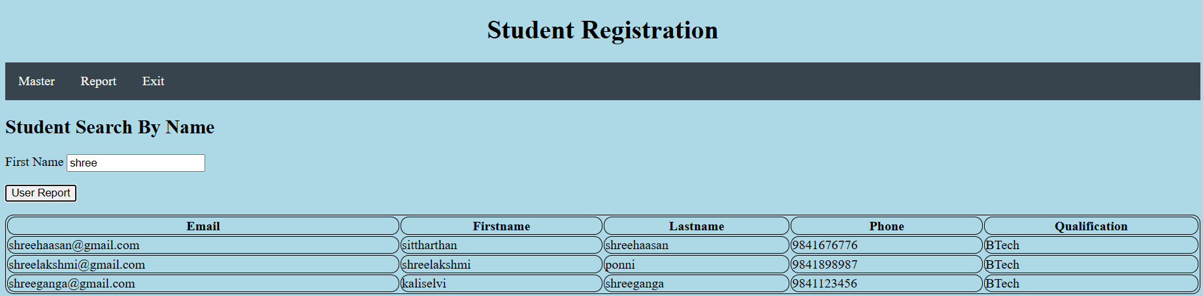
SEARCH BY NAME

Slide 13
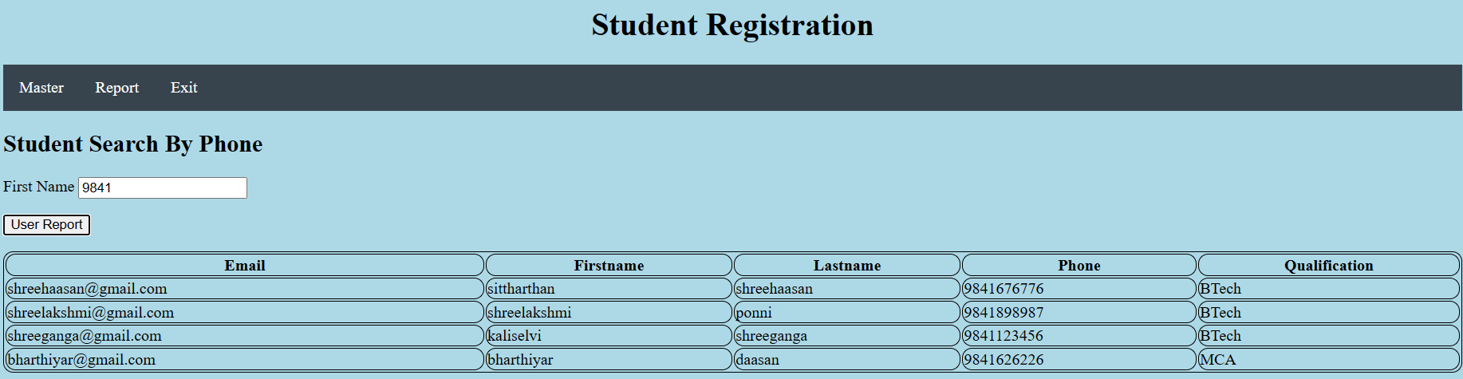
SEARCH BY PHONE

Slide 14
Exit Menu
Steps | Exit menu | Source code
1 | Exit menu and redirect to Login page | <li><a href="./login.htm">Exit</a></li>

Slide 15
***
END
***

