Slide 1

Bio-Inspired Optimization of LQR Controllers for Feedback-linearized Cruise Missiles (Paper ID ICISC-130)
Subbareddy Chitta, Ramakalyan Ayyagari, Shreehan Santosh Kate
Presented By :
Subbareddy Chitta, Shreehan Santosh Kate
National Institute of Technology,
Tiruchirappalli

Slide 2
Outline of the presentation
Introduction
Objectives and Motivation
Literature Review
Nonlinear Missile Model and Parameters
Differential Geometry
Feedback linearization using differential geometry
Control Techniques
Proposed Optimization Algorithms (GA and PSO)
Simulation Results and Discussions
Conclusion
References

Slide 3
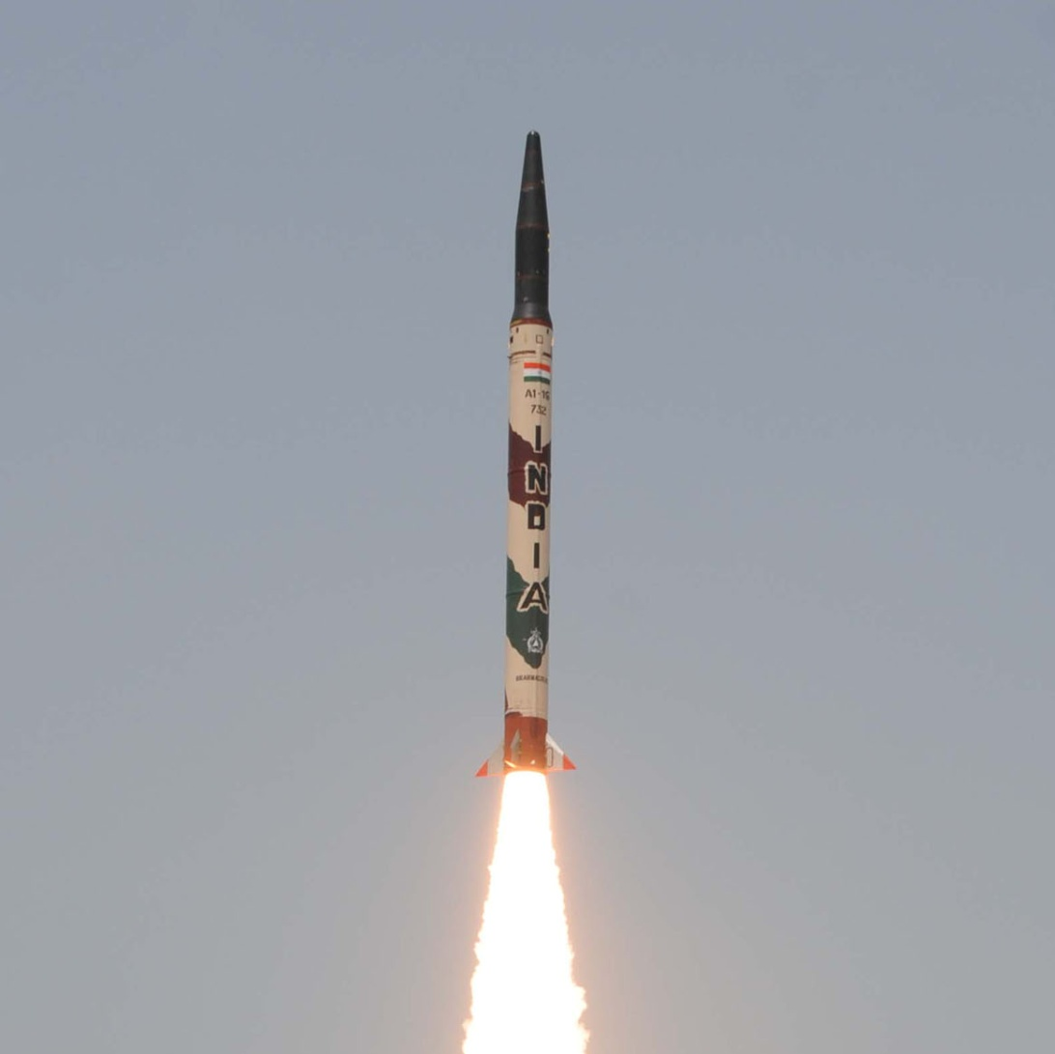
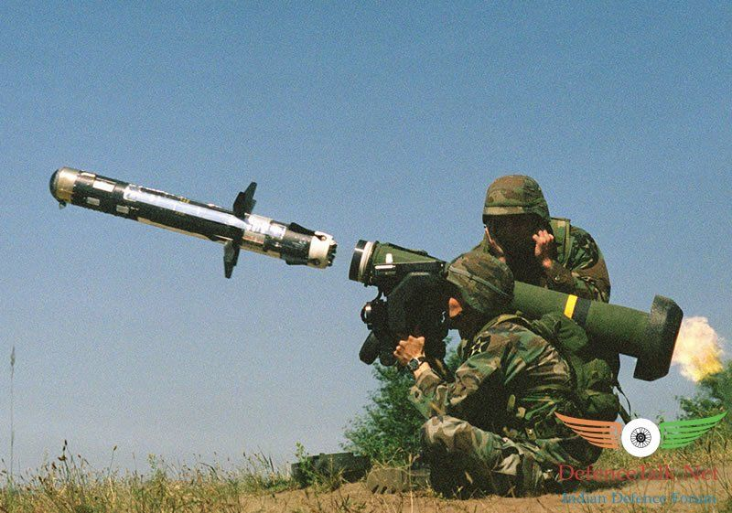
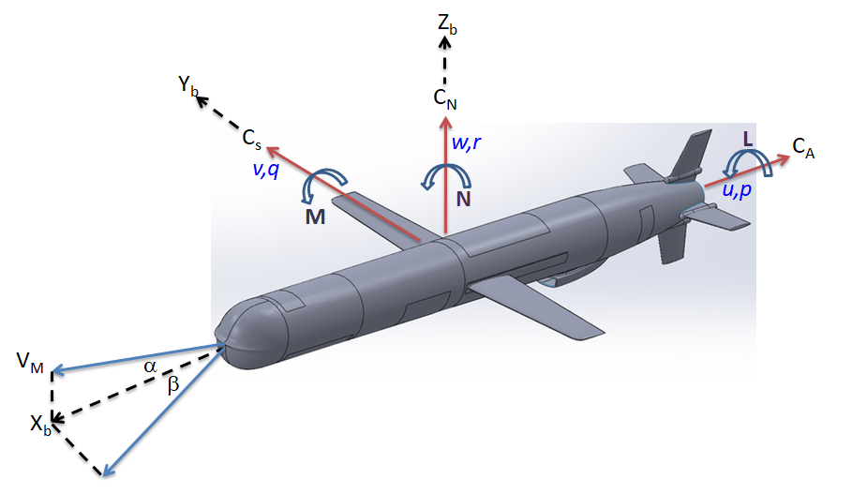
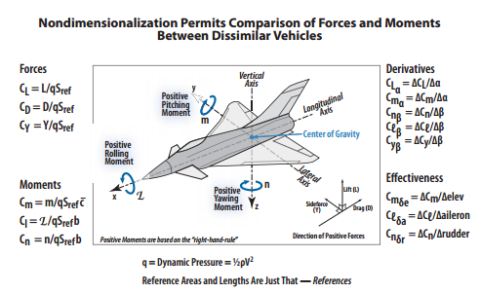
Introduction
Tactical Missiles
Long Range Strategic Missiles
Cruise Missiles
Higher maneuverability (in all direction 360 ⁰)
Quick Response
Configuration (Body-Wing -Tail)
Mach Number upto ≈5.0
High Angle of attack ≈ 30 ⁰
Altitude ≈ 35 km
Ballistic
Multistage
High Mach Number region ≈ 20
Separation Aerodynamics
Re-entry Aero thermo
Aerodynamic Force And Moments
Non-dimensional Aerodynamic Parameters / Input to Controls
These images are sourced from the US Department of Defense and DRDL, India.

Slide 4
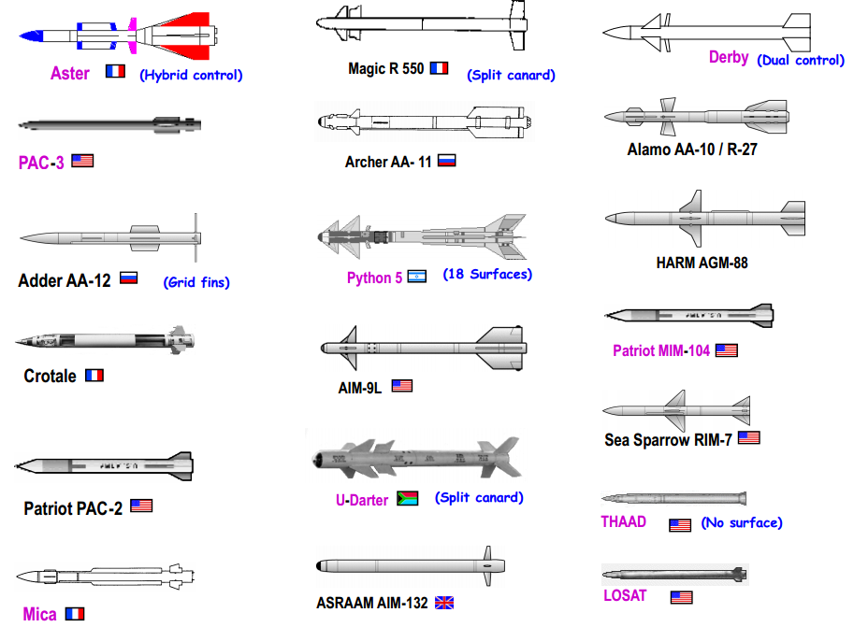
Multitude of Tactical Missile Configurations – World Scenario
These images are sourced from the US Department of Defense and DRDL, India.

Slide 5
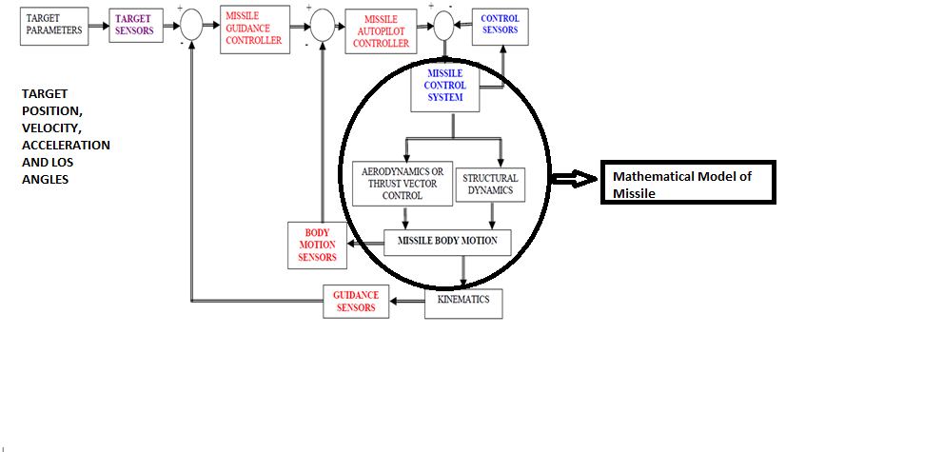
Cruise Missile Control and Guidance Blocks
Target Parameters
Guidance/ Autopilot Controller
Mathematical Model of Missile
Missile Parameters:
Missile Position
Velocity,
Acceleration, and Angle of attack
Target Position,
Velocity, Acceleration, and LOS Angles
Sensor

Slide 6
Missile Control and Guidance Blocks
Mathematical Model of Missile
Linear Model
Nonlinear Model
Feedback Linearization Control
Dynamic Inversion Control
Backstepping Control
Sliding Mode Control

Slide 7
Brief Literature Survey
Year | Title & Author | Highlights | Research gap
2020 | "Investigation on physical meaning of three-loop autopilot,'' International Journal of Control, Automation and Systems. C.H. Lee, et al. | Complete analysis of missile dynamics. Classical control approach. Time-scale separation principle. | The dynamics of the missile are linearized at equilibrium points. Classical control approach. The dynamics are separated into 1st order system using the Time-scale separation principle.
2022 | "Nonlinear Estimation and Control of Bending Soft Pneumatic Actuators Using Feedback Linearization and UKF,'' IEEE/ASME Transactions on Mechatronics M.S. Xavier, et al. | Comparative analysis of PI, SSF, and LQR. UKF FL approach. | The Q and R matrices in LQR are analytically selected, and have no proper explanation. The dynamics are separated into 2nd order system.
2022 | "Investigative design of missile longitudinal dynamics using LQR-LQG controller in presence of measurement noise and inaccurate model,‘’ Sādhanā. V.S. Arikapalli, et al | Complete analysis of missile dynamics. Comparative analysis of classical approach and LQR. LQR-LQG controller. | The dynamics of the missile are linearized at equilibrium points. The Q and R matrices in LQR are analytically selected, and have no proper explanation.

Slide 8
Brief Literature Survey
Year | Title & Author | Highlights | Research gap
2024 | Phichitphon Chitikunnan, Wanida Khotakham, ”Genetic Algorithm Optimized LQR for Enhanced Stability in Self-Balancing Wheel chair Systems” Control Systems and Optimization Letters, Vol. 2, No 3, 2024. | Improved stability, faster settling time. Demonstrating superior performance over conventionally tuned LQR designs. | Limited exploration of robustness
2025 | Subbareddy Chitta and Ramakalyan Ayyagari, ”On the Nonlinear Con trol of a Class of Cruise Missiles,” International Journal of Control, Automation, and Systems, vol. 23, no. 3, pp. 788-797, 2025. | Missile model is transformed by employing FL into a quasi-linearized fourth order model. an attempt is made to place all the four poles at the right locations via the Q and R matrices. | Analytical and expertise-based approach to LQR tuning.
2025 | Hau Nguyen Binh 1, Dat Tran Dinh, Anh Doan Cong in ”Optimization of LQR for Reaction Wheel Inverted Pendulum using Particle Swarm Optimization: Simulation and Experiment” Journal of Fuzzy Systems and Control, Vol. 3, No 1, 2025 | Lack of comparative evaluation with other modern optimization and control techniques Limited analysis of robustness against parameter uncertainties, external disturbances, and performance | Lack of comparative evaluation with other modern optimization and control techniques Limited analysis of robustness against parameter uncertainties, external disturbances, and performance

Slide 9
Motivation
While a missile is crucial to the defense sector of the country, modelling and controller design cannot be compromised for the sake of simplicity.
More details, in this case the coupled nonlinearities, would improve the understanding and hence a better design of control systems.
In particular, for cruise missiles
Moreover, as better analytical tools and algorithms are available, we attempted to incorporate all state variables in the feedback and place all poles in their respective positions, rather than discarding remaining the poles, as has been general practice from a classical control point of view.

Slide 10
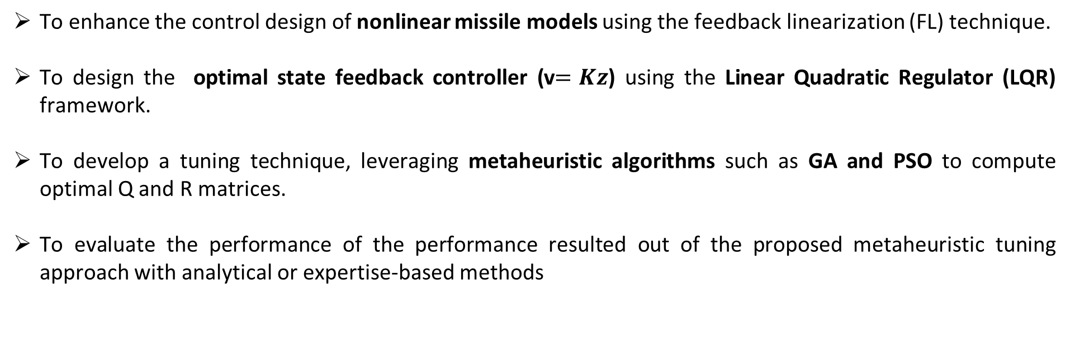
Objectives
To enhance the control design of nonlinear missile models using the feedback linearization (FL) technique.
To design the optimal state feedback controller (v$=Kz$) using the Linear Quadratic Regulator (LQR) framework.
To develop a tuning technique, leveraging metaheuristic algorithms such as GA and PSO to compute optimal Q and R matrices.
To evaluate the performance of the performance resulted out of the proposed metaheuristic tuning approach with analytical or expertise-based methods

Slide 11
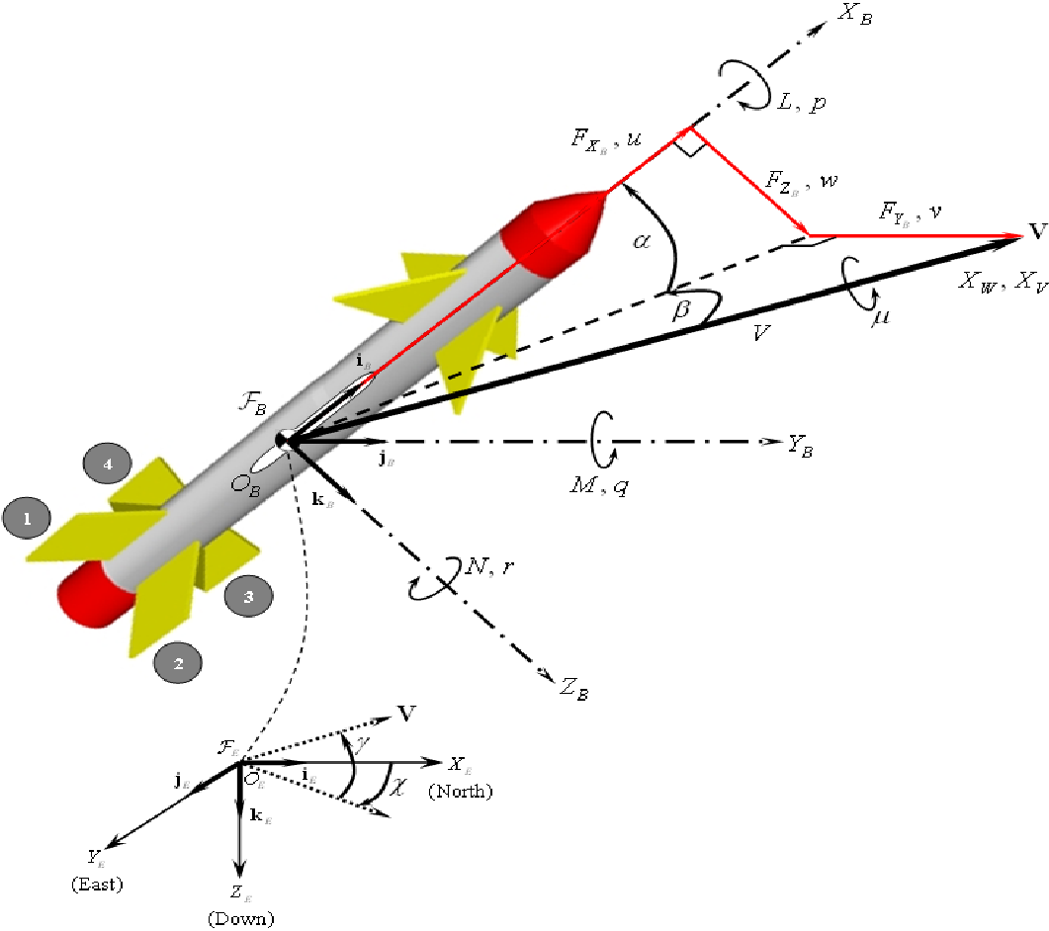
6-DOF of a Class of Cruise Missiles
The body axis system, denoted by (X_{B}, Y_{B}, Z_{B}), is fixed with respect to the cruise missile, and thus moves with the cruise missile.
The positive X_{B}-axis coincides with the cruise missile’s center line (or longitudinal axis) or forward direction.
The positive Y_{B}-axis is to the right of the X_{B}-axis in the horizontal plane and is designated as the pitch axis.
The positive Z_{B}-axis is the yaw axis and points down.
The Euler angles (ψ, θ, φ) are yaw, pitch, and roll respectively and the order of rotation is the same.
Fig. 1. Orientation of the cruise missile axes

Slide 12
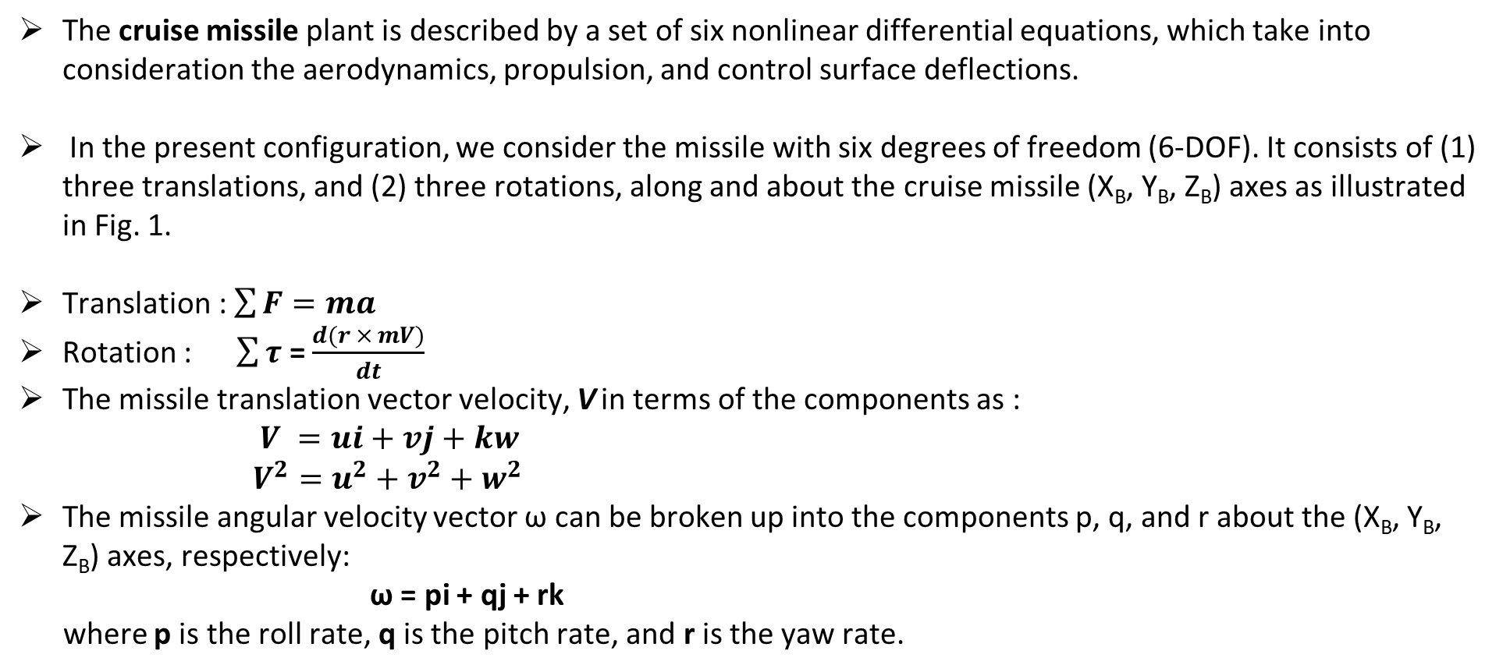
Rigid Body Equations based on Newton’s Second Law
The cruise missile plant is described by a set of six nonlinear differential equations, which take into consideration the aerodynamics, propulsion, and control surface deflections.
In the present configuration, we consider the missile with six degrees of freedom (6-DOF). It consists of (1) three translations, and (2) three rotations, along and about the cruise missile (X_{B}, Y_{B}, Z_{B}) axes as illustrated in Fig. 1.
Translation : $\sum{F=ma}$
Rotation : $\sum{τ}$ = $\frac{d(r × mV)}{dt}$
The missile translation vector velocity, V in terms of the components as :
$V =ui+vj+kw$
$V^{2}=u^{2}+v^{2}+w^{2}$
The missile angular velocity vector ω can be broken up into the components p, q, and r about the (X_{B}, Y_{B}, Z_{B}) axes, respectively:
ω = pi + qj + rk
where p is the roll rate, q is the pitch rate, and r is the yaw rate.

Slide 13
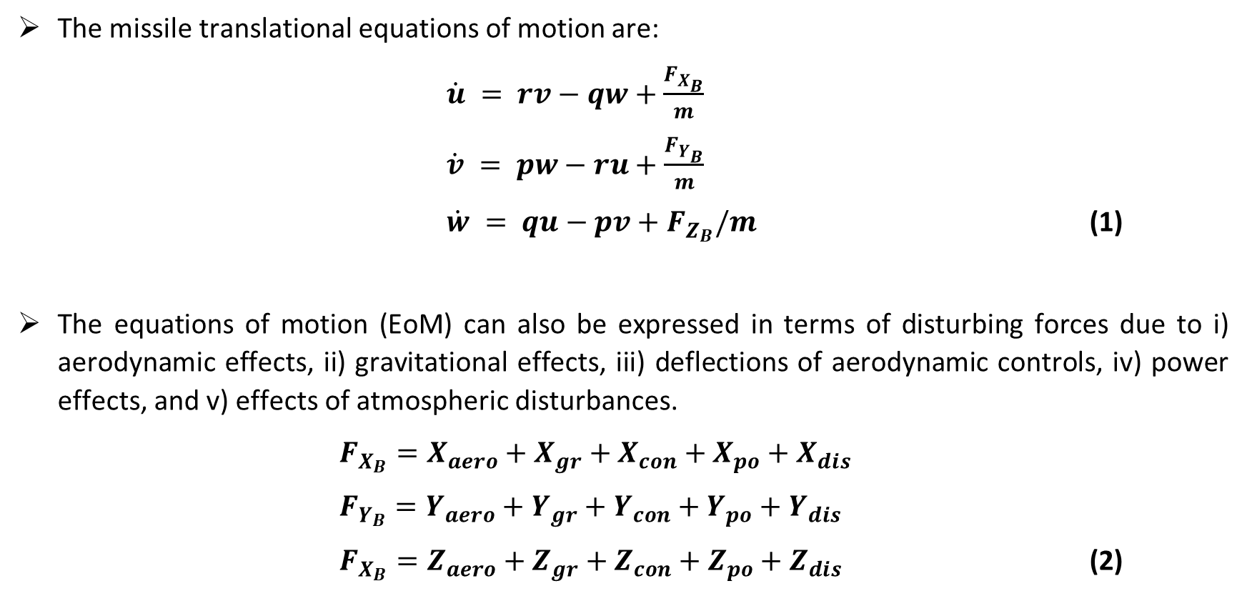
Rigid Body Translation Equations
The missile translational equations of motion are:
$\dot{u} = rv−qw+\frac{F_{X_{B}}}{m}$
$\dot{v} = pw−ru+\frac{F_{Y_{B}}}{m}$
$\dot{w} = qu−pv+F_{Z_{B}}/m$ (1)
The equations of motion (EoM) can also be expressed in terms of disturbing forces due to i) aerodynamic effects, ii) gravitational effects, iii) deflections of aerodynamic controls, iv) power effects, and v) effects of atmospheric disturbances.
$F_{X_{B}}=X_{aero}+X_{gr}+X_{con}+X_{po}+X_{dis}$
$F_{Y_{B}}=Y_{aero}+Y_{gr}+Y_{con}+Y_{po}+Y_{dis}$
$F_{X_{B}}=Z_{aero}+Z_{gr}+Z_{con}+Z_{po}+Z_{dis}$ (2)

Slide 14
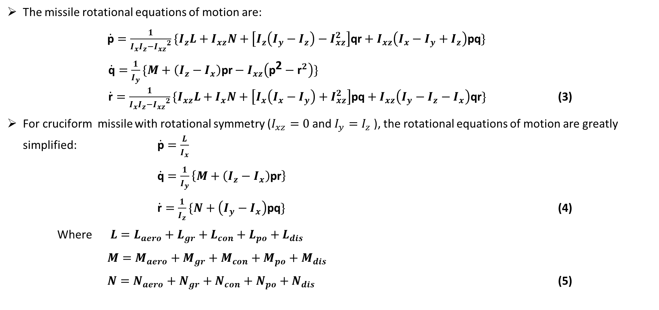
Rigid Body Rotational Equations
The missile rotational equations of motion are:
$\dot{\text{p}}=\frac{1}{I_{x}I_{z}−{I_{xz}}^{2}}\{I_{z}L+I_{xz}N+\left[I_{z}\left(I_{y}−I_{z}\right)−I_{xz}^{2}\right]\text{qr}+I_{xz}\left(I_{x}−I_{y}+I_{z}\right)\text{pq}\}$
$\dot{\text{q}}=\frac{1}{I_{y}}\{M+\left(I_{z}−I_{x}\right)\text{pr}−I_{xz}\left({\text{p}}^{\text{2}}−{\text{r}}^{2}\right)\}$ $\dot{\text{r}}=\frac{1}{I_{x}I_{z}−{I_{xz}}^{2}}\{I_{xz}L+I_{x}N+\left[I_{x}\left(I_{x}−I_{y}\right)+I_{xz}^{2}\right]\text{pq}+I_{xz}\left(I_{y}−I_{z}−I_{x}\right)\text{qr}\}$ (3)
For cruciform missile with rotational symmetry ($I_{xz}=0$and$I_{y}=I_{z}$ ), the rotational equations of motion are greatly simplified: $\dot{\text{p}}=\frac{L}{I_{x}}$
$\dot{\text{q}}=\frac{1}{I_{y}}\left\{M+\left(I_{z}−I_{x}\right)\text{pr}\right\}$
$\dot{\text{r}}=\frac{1}{I_{z}}\{N+\left(I_{y}−I_{x}\right)\text{pq}\}$ (4)
Where $L=L_{aero}+L_{gr}+L_{con}+L_{po}+L_{dis}$
$M=M_{aero}+M_{gr}+M_{con}+M_{po}+M_{dis}$
$N=N_{aero}+N_{gr}+N_{con}+N_{po}+N_{dis}$ (5)

Slide 15
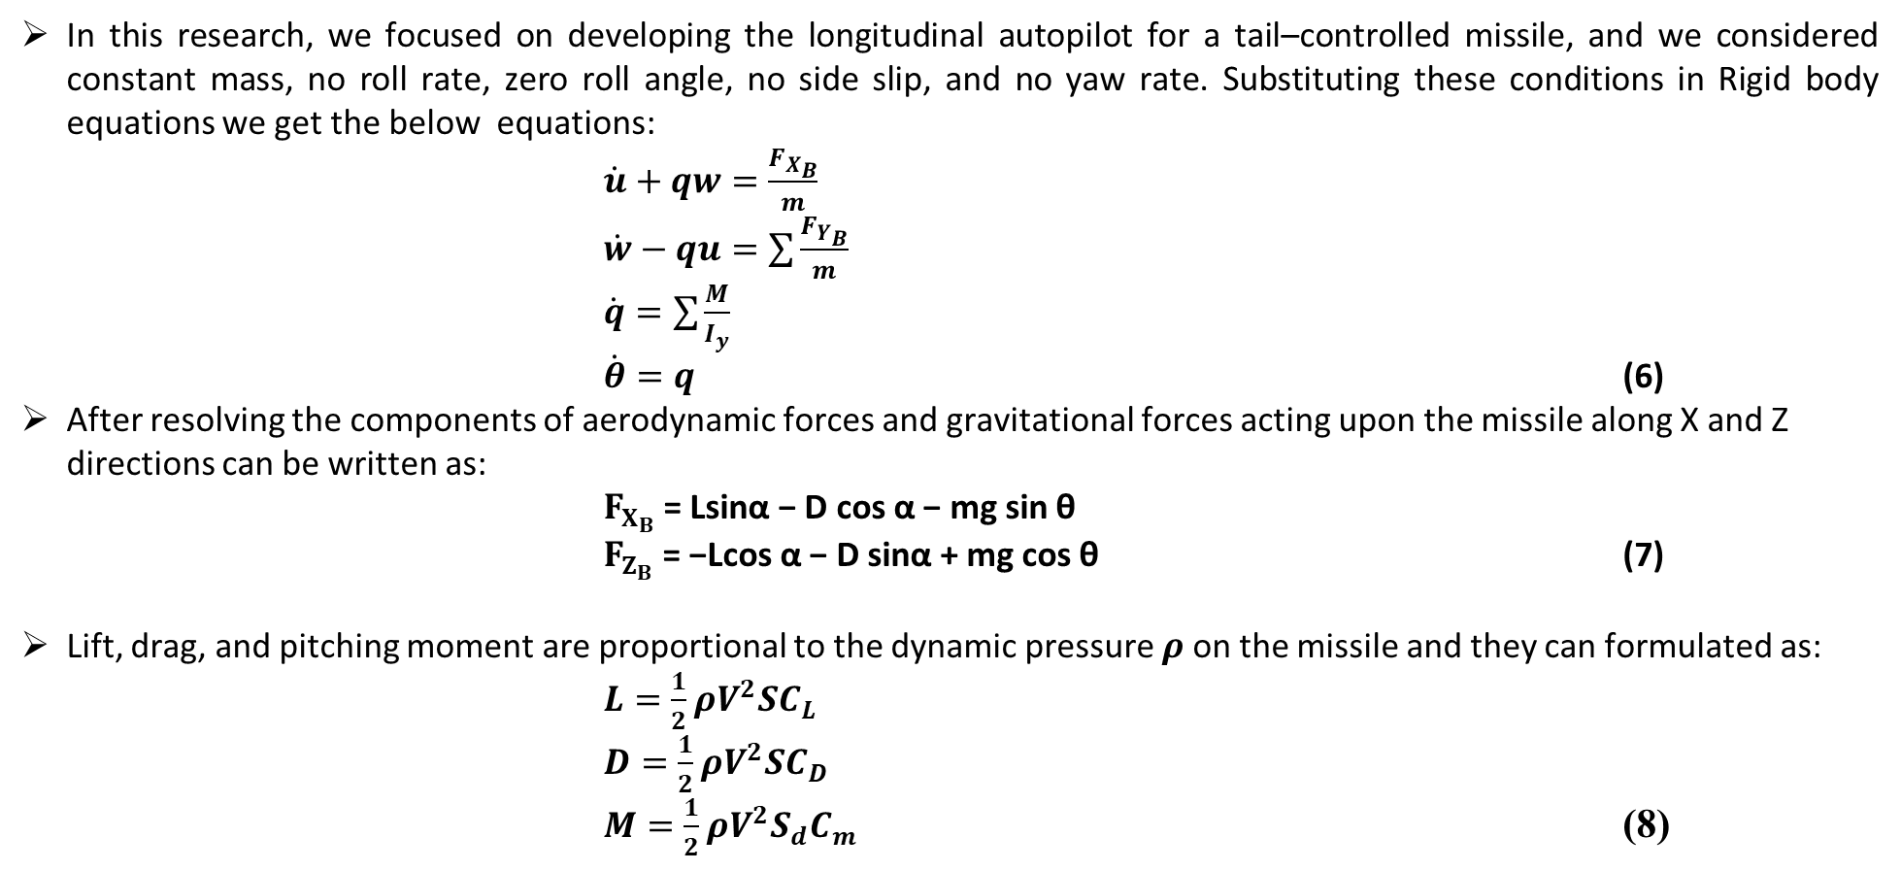
The Longitudinal Dynamics of a Class of Cruise Missiles
In this research, we focused on developing the longitudinal autopilot for a tail–controlled missile, and we considered constant mass, no roll rate, zero roll angle, no side slip, and no yaw rate. Substituting these conditions in Rigid body equations we get the below equations:
$\dot{u}+qw=\frac{F_{X_{B}}}{m}$
$\dot{w}−qu=\sum{\frac{F_{Y_{B}}}{m}}$
$\dot{q}=\sum{\frac{M}{I_{y}}}$
$\dot{θ}=q$ (6)
After resolving the components of aerodynamic forces and gravitational forces acting upon the missile along X and Z directions can be written as:
$F_{X_{B}}$= Lsinα − D cos α − mg sin θ
$F_{Z_{B}}$ = −Lcos α − D sinα + mg cos θ (7)
Lift, drag, and pitching moment are proportional to the dynamic pressure $ρ$ on the missile and they can formulated as:
$L=\frac{1}{2}ρV^{2}SC_{L}$
$D=\frac{1}{2}ρV^{2}SC_{D}$
$M=\frac{1}{2}ρV^{2}S_{d}C_{m}$ (8)

Slide 16
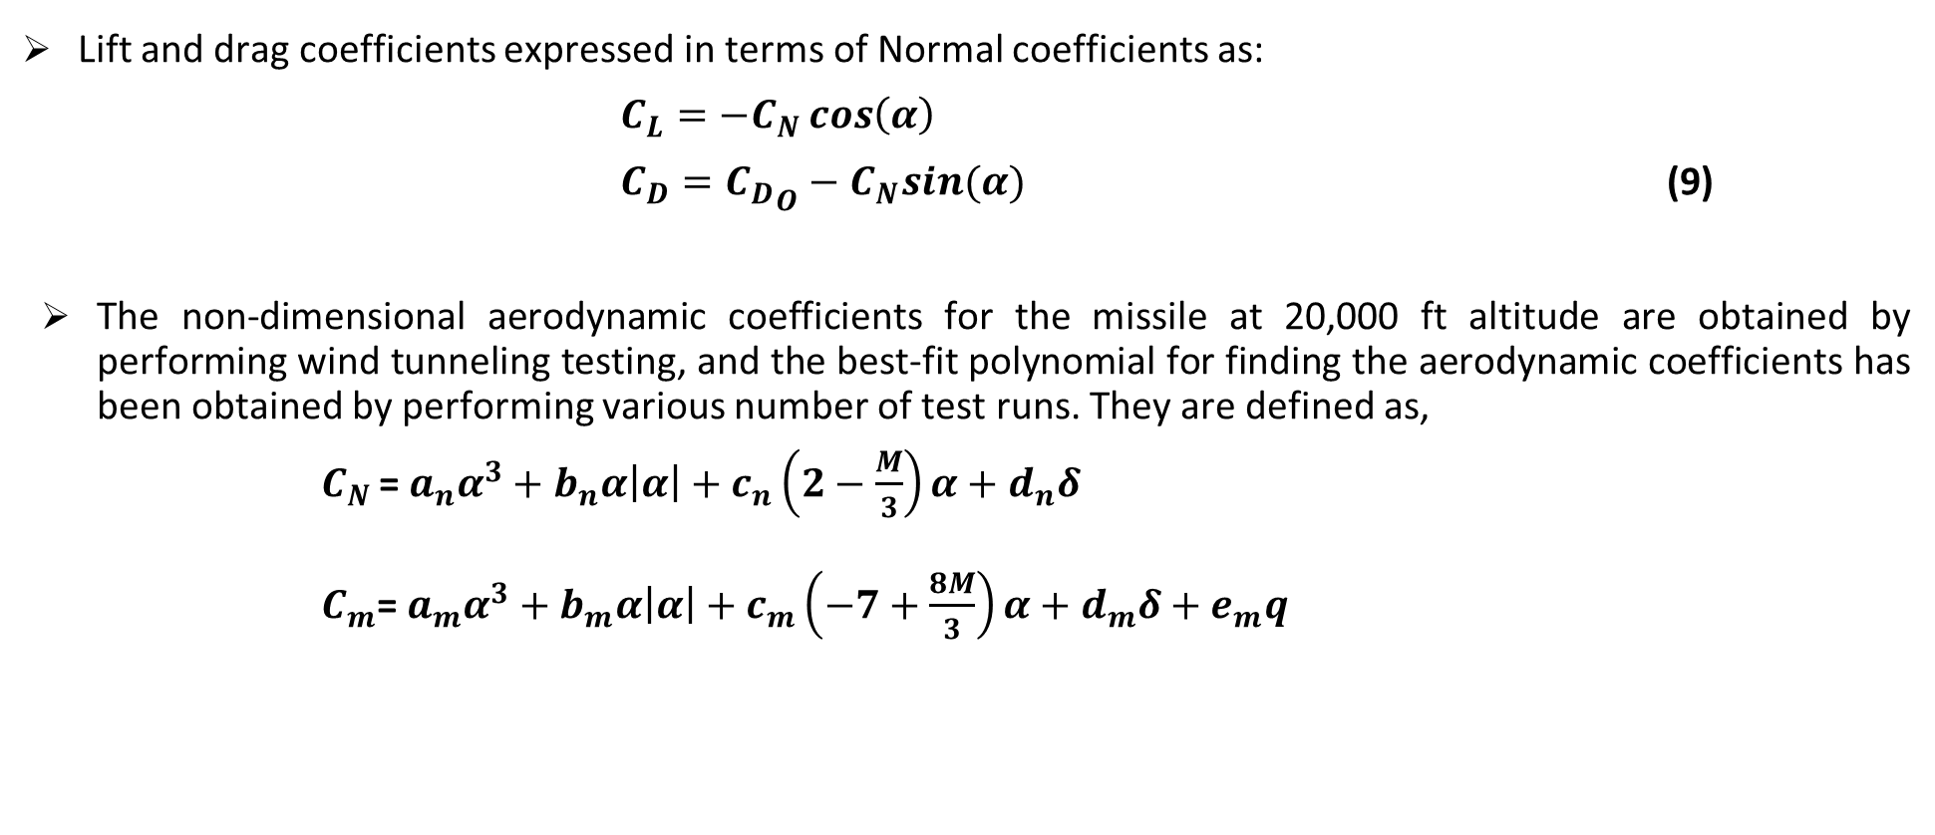
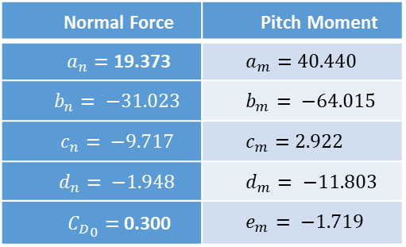
The Longitudinal Dynamics of a Class of Cruise Missiles
Lift and drag coefficients expressed in terms of Normal coefficients as:
$C_{L}=−C_{N}\cos\left(α\right)$
$C_{D}={C_{D}}_{O}−C_{N}sin(α)$ (9)
The non-dimensional aerodynamic coefficients for the missile at 20,000 ft altitude are obtained by performing wind tunneling testing, and the best-fit polynomial for finding the aerodynamic coefficients has been obtained by performing various number of test runs. They are defined as,
$C_{N }$=$a_{n}α^{3}+b_{n}α\left|α\right|+c_{n}\left(2−\frac{M}{3}\right)α+d_{n}δ$
$C_{m}$=${ a}_{m}α^{3}+b_{m}α\left|α\right|+c_{m}\left(−7+\frac{8M}{3}\right)α+d_{m}δ+e_{m}q$
Table 1. Aerodynamics coefficients
Normal Force | Pitch Moment
$a_{n}=$ 19.373 | $$a_{m}=40.440$$
$$b_{n}= −31.023$$ | $$b_{m}= −64.015$$
$$c_{n}= −9.717$$ | $$c_{m}=2.922$$
$$d_{n}= −1.948$$ | $$d_{m}= −11.803$$
${C_{D}}_{0}=$ 0.300 | $$e_{m}= −1.719$$

Slide 17
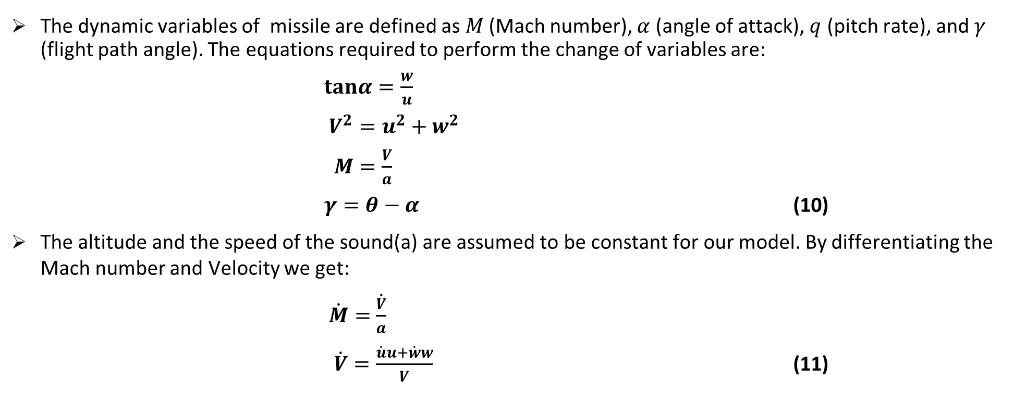
The Longitudinal Dynamics of a Class of Cruise Missiles
The dynamic variables of missile are defined as $M$ (Mach number), $α$ (angle of attack), $q$ (pitch rate), and $γ$ (flight path angle). The equations required to perform the change of variables are:
$tanα=\frac{w}{u}$
$V^{2}=u^{2}+w^{2}$
$M=\frac{V}{a}$
$γ=θ−α$ (10)
The altitude and the speed of the sound(a) are assumed to be constant for our model. By differentiating the Mach number and Velocity we get:
$\dot{M}=$ $\dot{\frac{V}{a}}$
$\dot{V}=\frac{\dot{u}u+\dot{w}w}{V}$ (11)

Slide 18
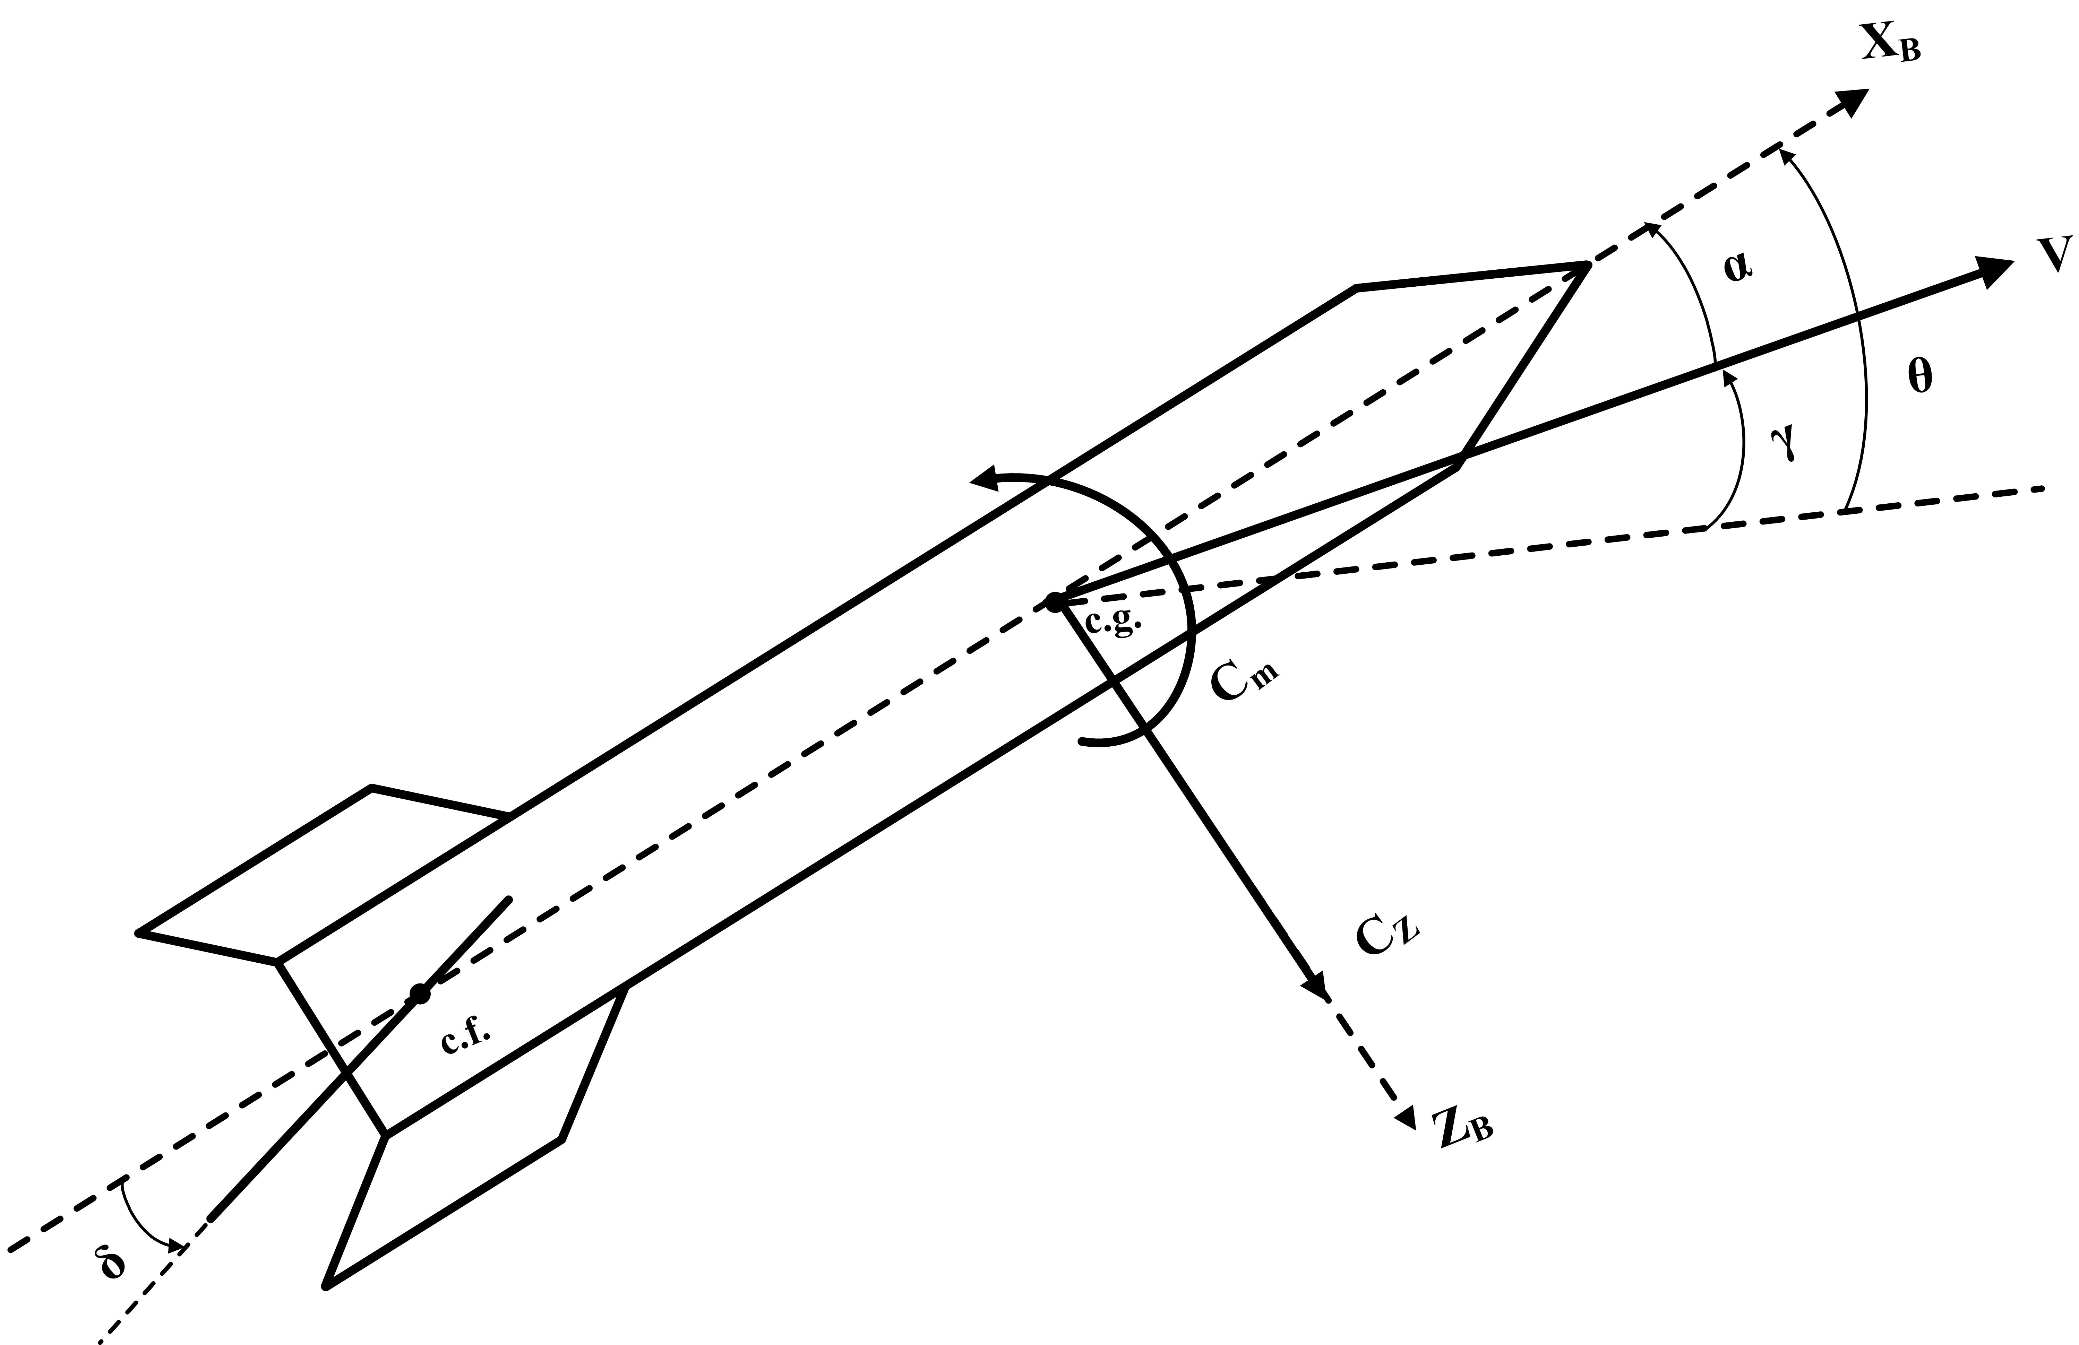
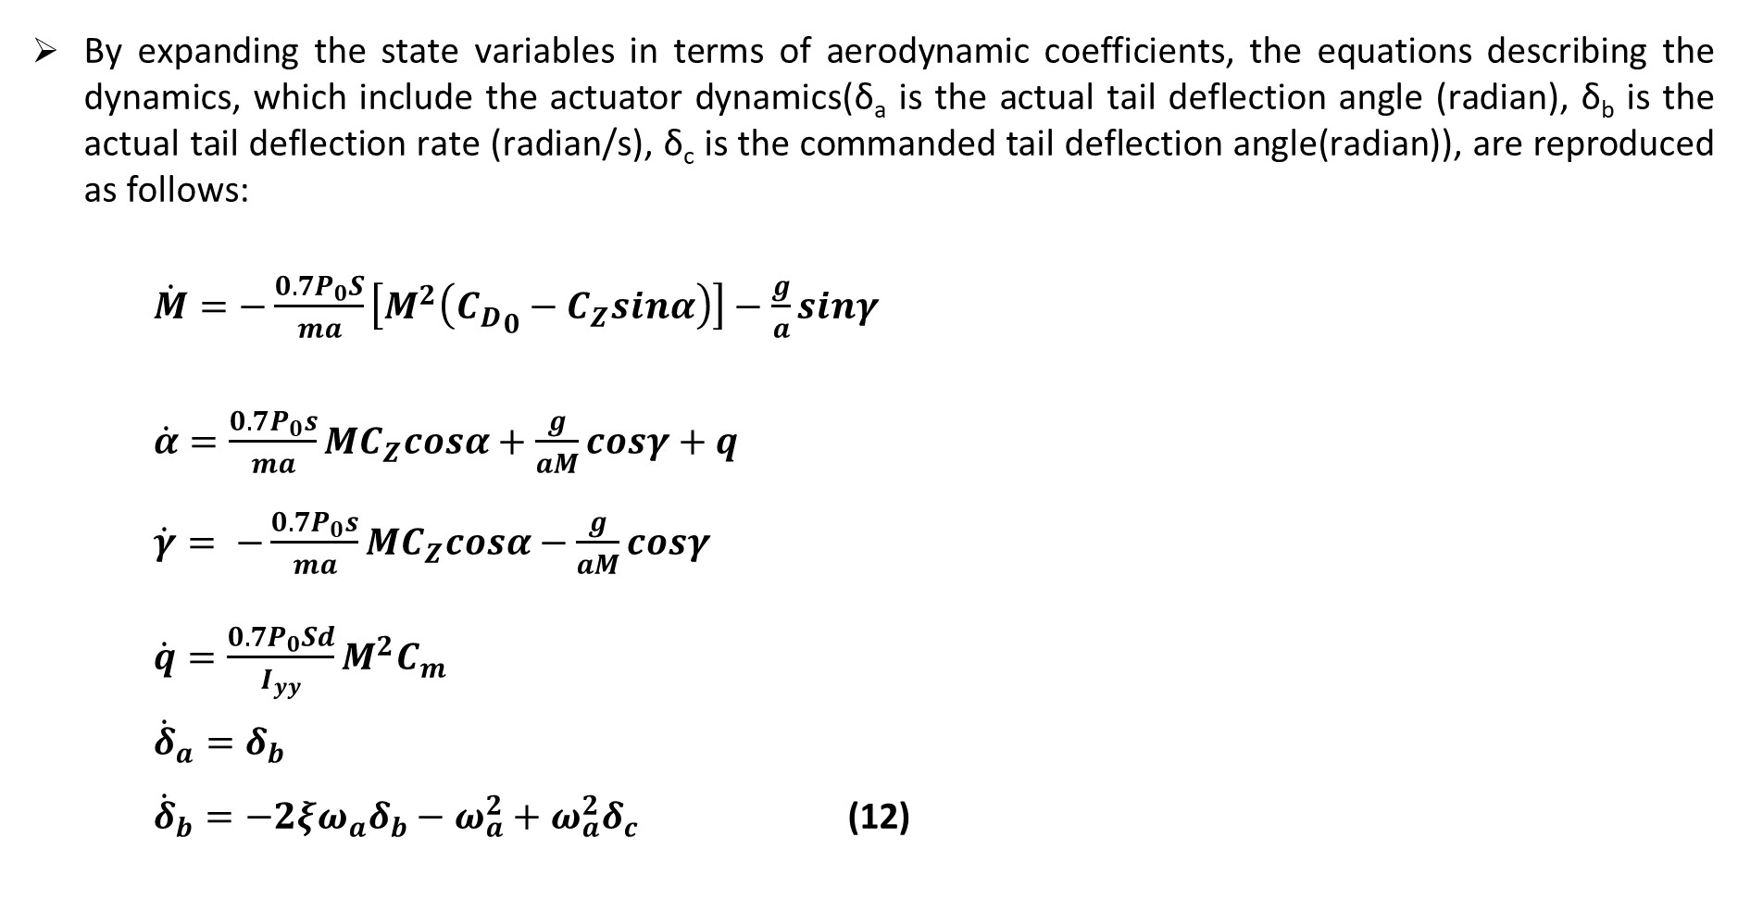
The Longitudinal Dynamics of a Class of Cruise Missiles
By expanding the state variables in terms of aerodynamic coefficients, the equations describing the dynamics, which include the actuator dynamics(δ_{a} is the actual tail deflection angle (radian), δ_{b} is the actual tail deflection rate (radian/s), δ_{c} is the commanded tail deflection angle(radian)), are reproduced as follows:
$\dot{M}=−\frac{0.7P_{0}S}{ma}\left[M^{2}\left({C_{D}}_{0}−C_{Z}sinα\right)\right]−\frac{g}{a}sinγ$
$\dot{α}=\frac{0.7P_{0}s}{ma}MC_{Z}cosα+\frac{g}{aM}cosγ+q$ $\dot{γ}= −\frac{0.7P_{0}s}{ma}MC_{Z}cosα−\frac{g}{aM}cosγ$ $\dot{q}=\frac{0.7P_{0}Sd}{I_{yy}}M^{2}C_{m}$ ${\dot{δ}}_{a}=δ_{b}$ ${\dot{δ}}_{b}=−2ξω_{a}δ_{b}−ω_{a}^{2}+ω_{a}^{2}δ_{c}$ (12)
Fig. 2. Missile airframe in longitudinal motion.

Slide 19
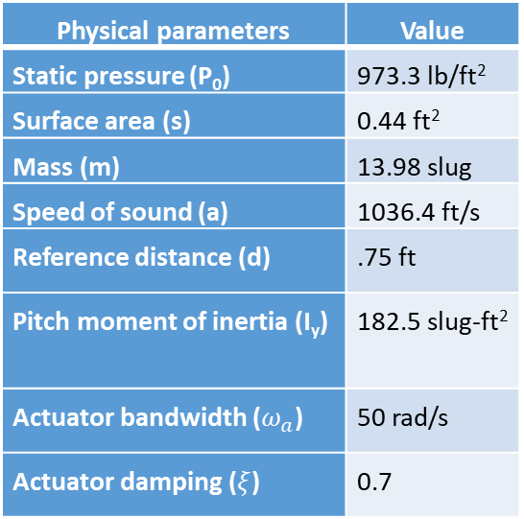
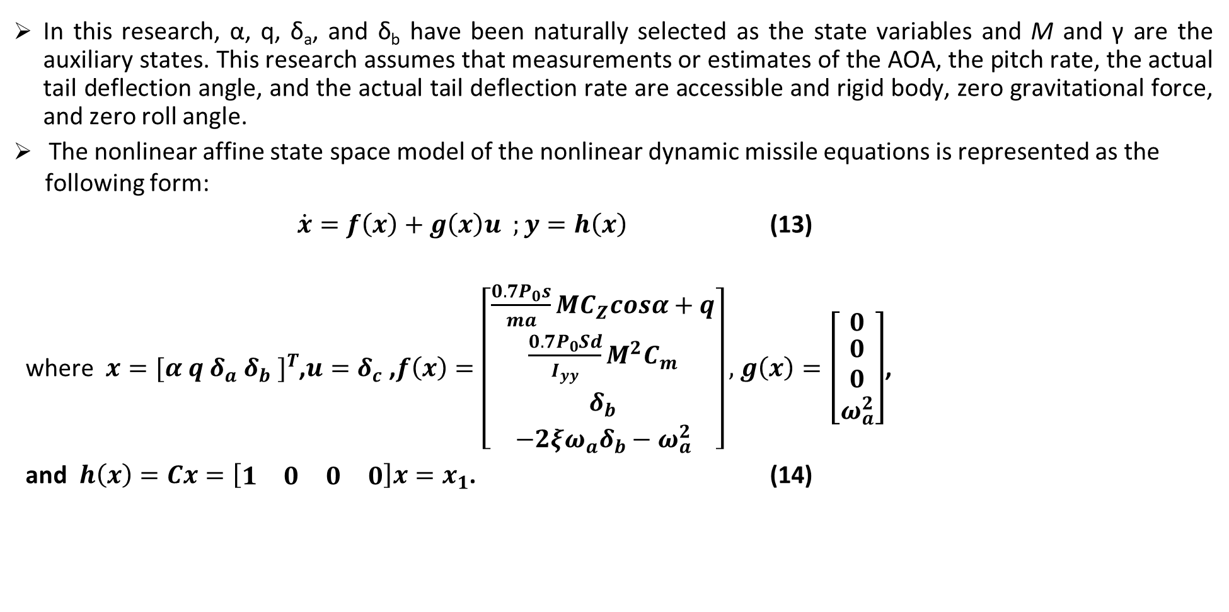
The State Variables of a Class of Cruise Missiles for Control Design
In this research, α, q, δ_{a}, and δ_{b} have been naturally selected as the state variables and M and γ are the auxiliary states. This research assumes that measurements or estimates of the AOA, the pitch rate, the actual tail deflection angle, and the actual tail deflection rate are accessible and rigid body, zero gravitational force, and zero roll angle.
The nonlinear affine state space model of the nonlinear dynamic missile equations is represented as the following form:
$\dot{x}=f\left(x\right)+g\left(x\right)u ;y=h\left(x\right)$ (13)
where $x={[α q δ_{a} δ_{b} ]}^{T}$,$u=δ_{c}$ ,$f\left(x\right)=\left[\begin{matrix}\frac{0.7P_{0}s}{ma}MC_{Z}cosα+q \\ \begin{matrix}\frac{0.7P_{0}Sd}{I_{yy}}M^{2}C_{m} \\ δ_{b}\end{matrix} \\ −2ξω_{a}δ_{b}−ω_{a}^{2}\end{matrix}\right],$ $g\left(x\right)=\left[\begin{matrix}0 \\ \begin{matrix}0 \\ 0\end{matrix} \\ ω_{a}^{2}\end{matrix}\right]$,
and $h\left(x\right)=Cx=\left[\begin{matrix}1 & 0 & 0 & 0\end{matrix}\right]x=x_{1}$. (14)
Table 2. Physical parameters
Physical parameters | Value
Static pressure (P₀) | 973.3 lb/ft²
Surface area (s) | 0.44 ft²
Mass (m) | 13.98 slug
Speed of sound (a) | 1036.4 ft/s
Reference distance (d) | .75 ft
Pitch moment of inertia (I_{y}) | 182.5 slug-ft²
Actuator bandwidth ($ω_{a}$) | 50 rad/s
Actuator damping ($ξ$) | 0.7

Slide 20
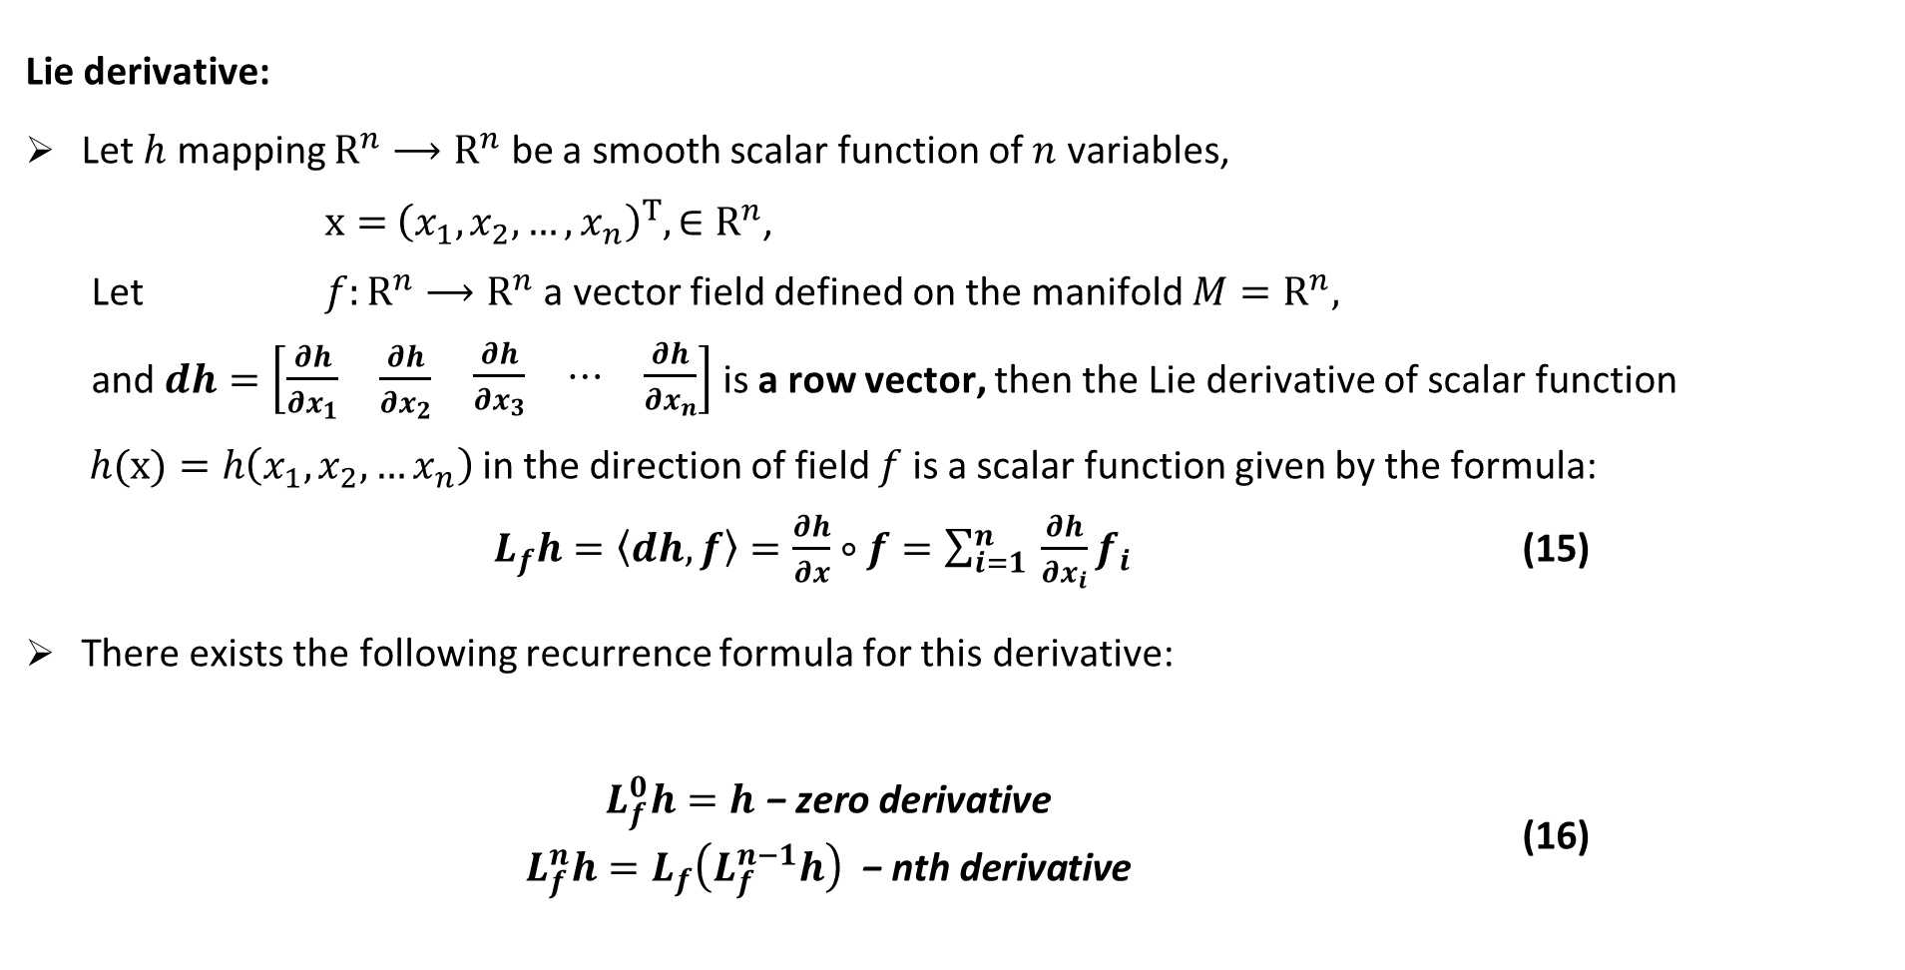
Differential Geometry
Lie derivative:
Let $h$ mapping $R^{n}⟶R^{n}$ be a smooth scalar function of $n$ variables,
$x=$ ${\left(x_{1},x_{2},…,x_{n}\right)}^{T},∈R^{n}$,
Let $f:R^{n}⟶R^{n}$ a vector field defined on the manifold $M=R^{n},$
and $dh=\left[\begin{matrix}\frac{∂h}{∂x_{1}} & \frac{∂h}{∂x_{2}} & \begin{matrix}\frac{∂h}{∂x_{3}} & ⋯ & \frac{∂h}{∂x_{n}}\end{matrix}\end{matrix}\right]$ is a row vector, then the Lie derivative of scalar function
$h(x)=h\left(x_{1},x_{2},…x_{n}\right)$ in the direction of field $f$ is a scalar function given by the formula:
$L_{f}h=\left\langle dh, f\right\rangle =\frac{∂h}{∂x}∘f=\sum_{i=1}^{n}{ }\frac{∂h}{∂x_{i}}f_{i}$ (15)
There exists the following recurrence formula for this derivative:
$\begin{matrix} & L_{f}^{0}h=h\text{ − }\text{zero} \text{derivative} \\ & L_{f}^{n}h=L_{f}\left(L_{f}^{n−1}h\right) \text{ − }\text{nth} \text{derivative} \end{matrix}$ (16)

Slide 21
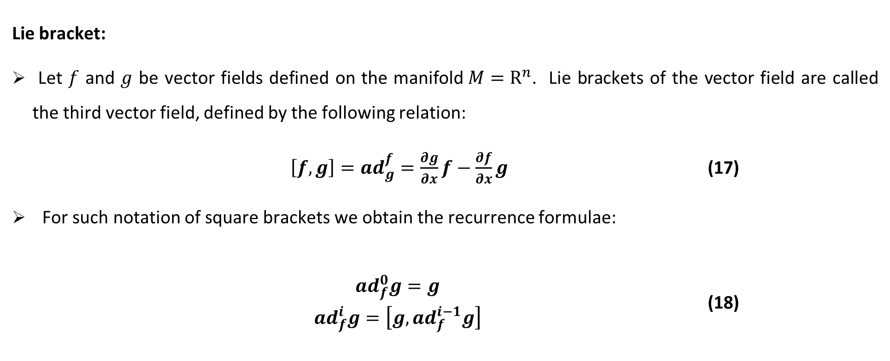
Differential Geometry
Lie bracket:
Let $f$ and $g$ be vector fields defined on the manifold$M=R^{n}$. Lie brackets of the vector field are called the third vector field, defined by the following relation:
$\left[f,g\right]={ad}_{g}^{f}=\frac{∂g}{∂x}f−\frac{∂f}{∂x}g$ (17)
For such notation of square brackets we obtain the recurrence formulae:
$\begin{matrix} & ad_{f}^{0}g=g \\ & ad_{f}^{i}g=\left[g,ad_{f}^{i−1}g\right]\end{matrix}$ (18)

Slide 22
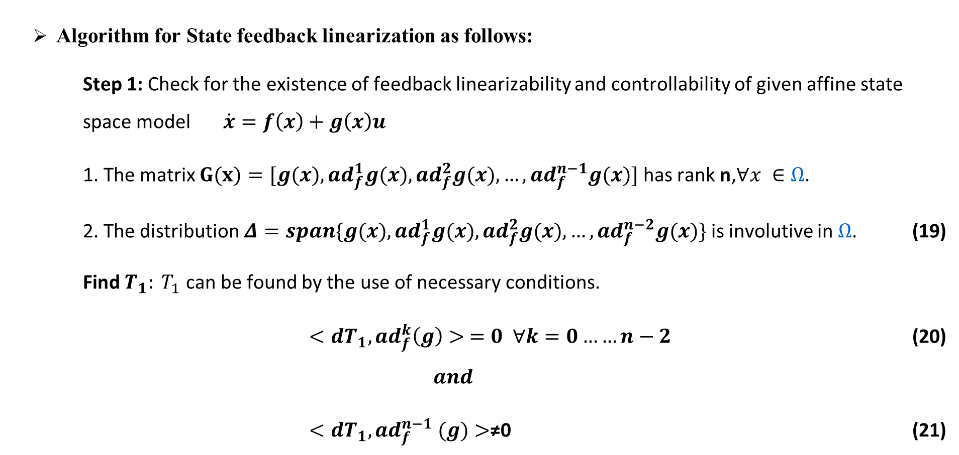
Feedback Linearization using Differential Geometry
Algorithm for State feedback linearization as follows:
Step 1: Check for the existence of feedback linearizability and controllability of given affine state space model $\dot{x}=f\left(x\right)+g\left(x\right)u$
1. The matrix $G(x)=[g(x),ad_{f}^{1}g(x),ad_{f}^{2}g(x),…,ad_{f}^{n−1}g(x)]$ has rank n,$∀x ∈Ω$.
2. The distribution $Δ=span\{g(x),ad_{f}^{1}g(x),ad_{f}^{2}g(x),…,ad_{f}^{n−2}g(x)\}$ is involutive in $Ω$. (19)
Find $T_{1}: T_{1}$ can be found by the use of necessary conditions.
$<dT_{1},ad_{f}^{k}\left(g\right)> =0 ∀k=0……n−2$ (20)
$$and$$
$<dT_{1},ad_{f}^{n−1} (g)>$≠0 (21)

Slide 23
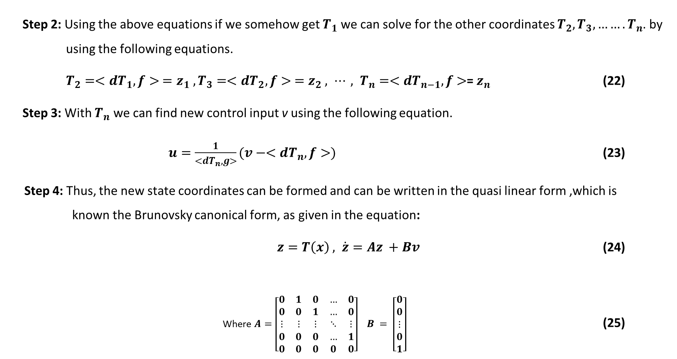
Feedback Linearization using Differential Geometry
Step 2: Using the above equations if we somehow get $T_{1}$ we can solve for the other coordinates $T_{2},T_{3},…….T_{n}$. by using the following equations.
$T_{2}=<dT_{1},f> =z_{1} , T_{3}=<dT_{2},f> =z_{2} , ⋯, T_{n}=<dT_{n−1},f$ $>$= $z_{n}$ (22)
Step 3: With $T_{n}$ we can find new control input v using the following equation.
$u=\frac{1}{<dT_{n},g>}(v−<dT_{n},f>)$ (23)
Step 4: Thus, the new state coordinates can be formed and can be written in the quasi linear form ,which is known the Brunovsky canonical form, as given in the equation:
$z=T\left(x\right) , \dot{z}=Az +Bv$ (24)
Where $A=\left[\begin{matrix}0 & 1 & 0 & … & 0 \\ 0 & 0 & 1 & … & 0 \\ ⋮ & ⋮ & ⋮ & ⋱ & ⋮ \\ 0 & 0 & 0 & … & 1 \\ 0 & 0 & 0 & 0 & 0\end{matrix}\right] B = \left[\begin{matrix}0 \\ 0 \\ ⋮ \\ 0 \\ 1\end{matrix}\right]$ (25)

Slide 24
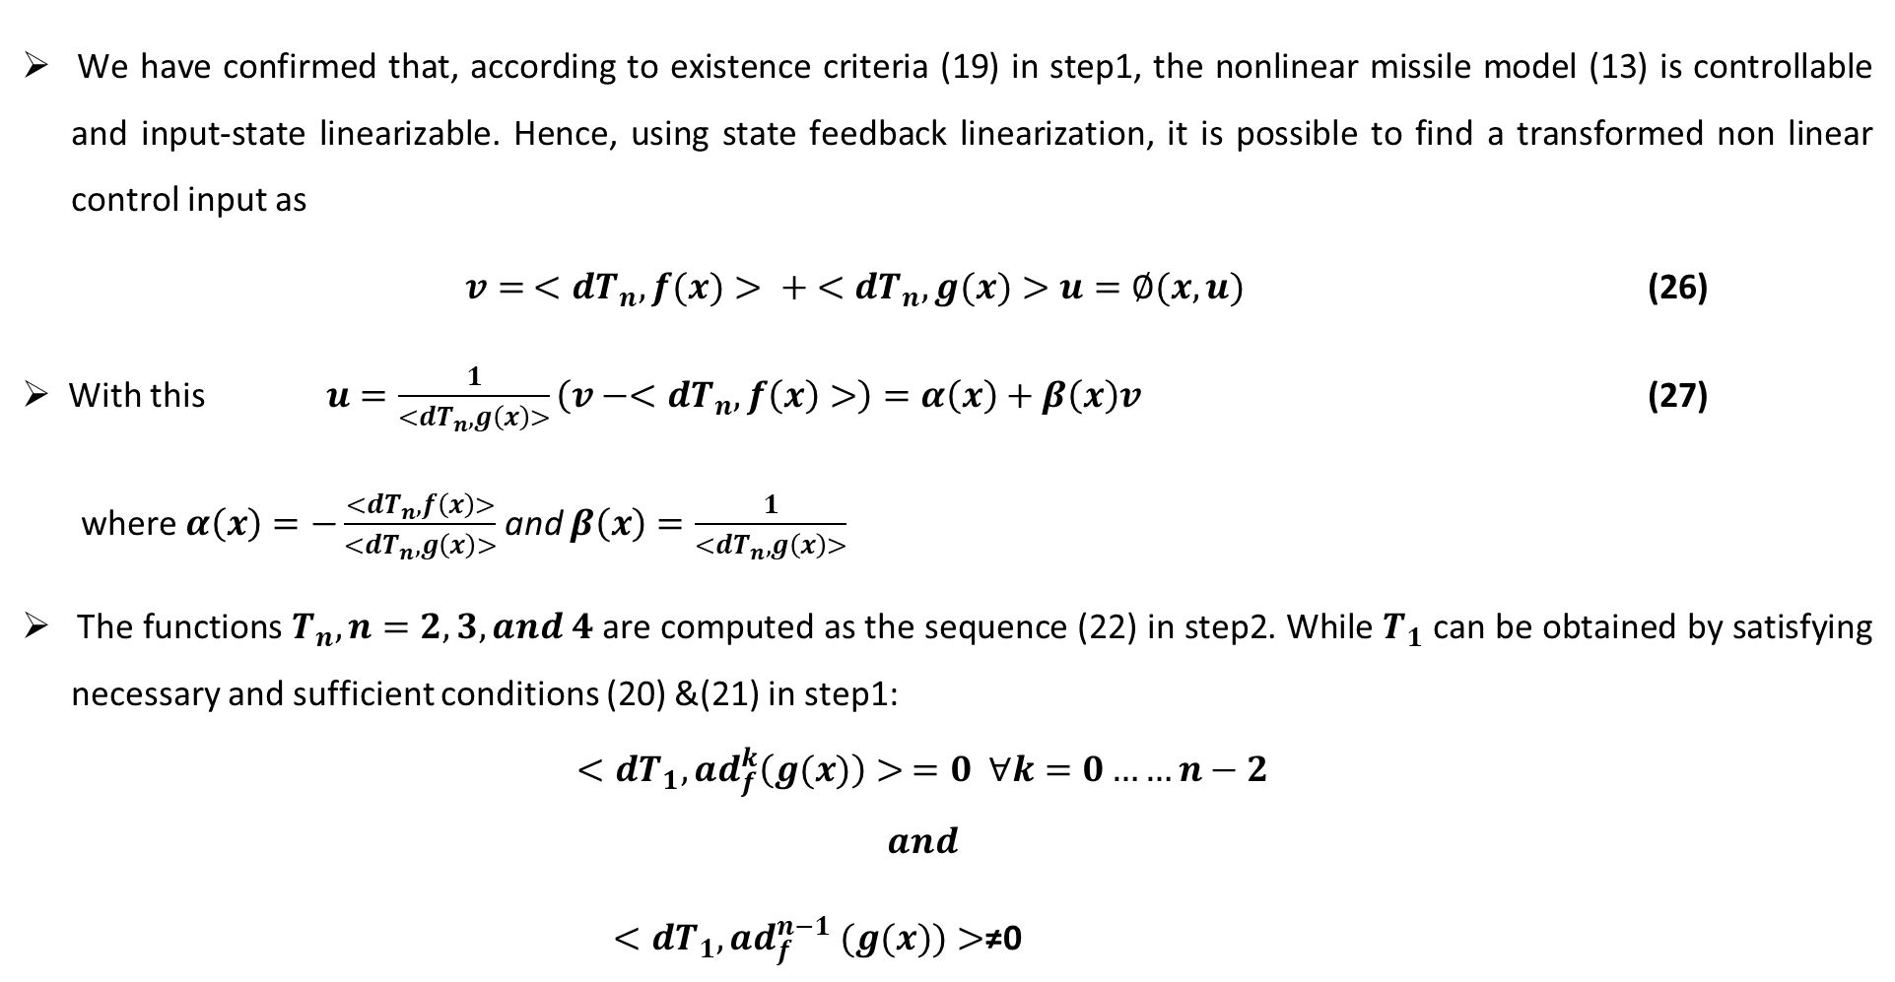
Feedback Linearization of a Class of Cruise Missiles
We have confirmed that, according to existence criteria (19) in step1, the nonlinear missile model (13) is controllable and input-state linearizable. Hence, using state feedback linearization, it is possible to find a transformed non linear control input as
$v= <dT_{n},f(x)> + <dT_{n},g(x)>u=∅(x,u)$ (26)
With this $u=\frac{1}{<dT_{n},g\left(x\right)>}\left(v−<dT_{n},f\left(x\right)>\right)=α\left(x\right)+β\left(x\right)v$ (27)
where $α\left(x\right)=−\frac{<dT_{n},f\left(x\right)>}{<dT_{n},g\left(x\right)>}$ and $β\left(x\right)=\frac{1}{<dT_{n},g\left(x\right)>}$
The functions $T_{n},n=2,3, and 4$ are computed as the sequence (22) in step2. While $T_{1}$ can be obtained by satisfying necessary and sufficient conditions (20) &(21) in step1:
$$<dT_{1},ad_{f}^{k}\left(g(x)\right)> =0 ∀k=0……n−2$$
$$and$$
$<dT_{1},ad_{f}^{n−1} (g(x))>$≠0

Slide 25
Feedback Linearization of a Class of Cruise Missiles
The mathematical derivations presented here include worthy observations that play a crucial role in the subsequent designs for the controller. From the given nonlinear dynamic missile model (13), the selection of T₁ has multiple choices satisfying (20) and (21).
For example, T₁ can be as simple as x₁, or some trigonometric functions, or a more complicated nonlinear function of all the state variables; for instance, if T₁ = cos(x₁ +x₂) then T₂ = ⟨dT₁, f(x) ⟩, T₃ = ⟨dT₂, f(x) ⟩, T₄ = ⟨dT₃, f ⟩ become more involved and higher powers of x₁ and x₂ start creeping.
Therefore, the choice of T₁ must benefit the design process despite its complexity. The choice of T₁ represents a trade-off between simplicity and difficulty, and it has significant implications on later derivations, results, and overall system performance.

Slide 26
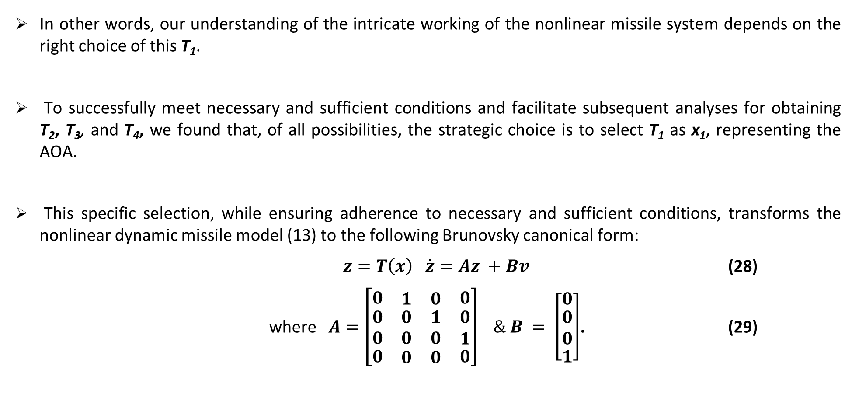
Feedback Linearization of a Class of Cruise Missiles
In other words, our understanding of the intricate working of the nonlinear missile system depends on the right choice of this T₁.
To successfully meet necessary and sufficient conditions and facilitate subsequent analyses for obtaining T₂, T₃, and T₄, we found that, of all possibilities, the strategic choice is to select T₁ as x₁, representing the AOA.
This specific selection, while ensuring adherence to necessary and sufficient conditions, transforms the nonlinear dynamic missile model (13) to the following Brunovsky canonical form:
$z=T\left(x\right) \dot{z}=Az +Bv$ (28)
where$A=\left[\begin{matrix}0 & \begin{matrix}1 & 0\end{matrix} & 0 \\ \begin{matrix}0 \\ 0\end{matrix} & \begin{matrix}\begin{matrix}0 \\ 0\end{matrix} & \begin{matrix}1 \\ 0\end{matrix}\end{matrix} & \begin{matrix}0 \\ 1\end{matrix} \\ 0 & \begin{matrix}0 & 0\end{matrix} & 0\end{matrix}\right] \& B = \left[\begin{matrix}0 \\ \begin{matrix}0 \\ 0\end{matrix} \\ 1\end{matrix}\right]$. (29)

Slide 27
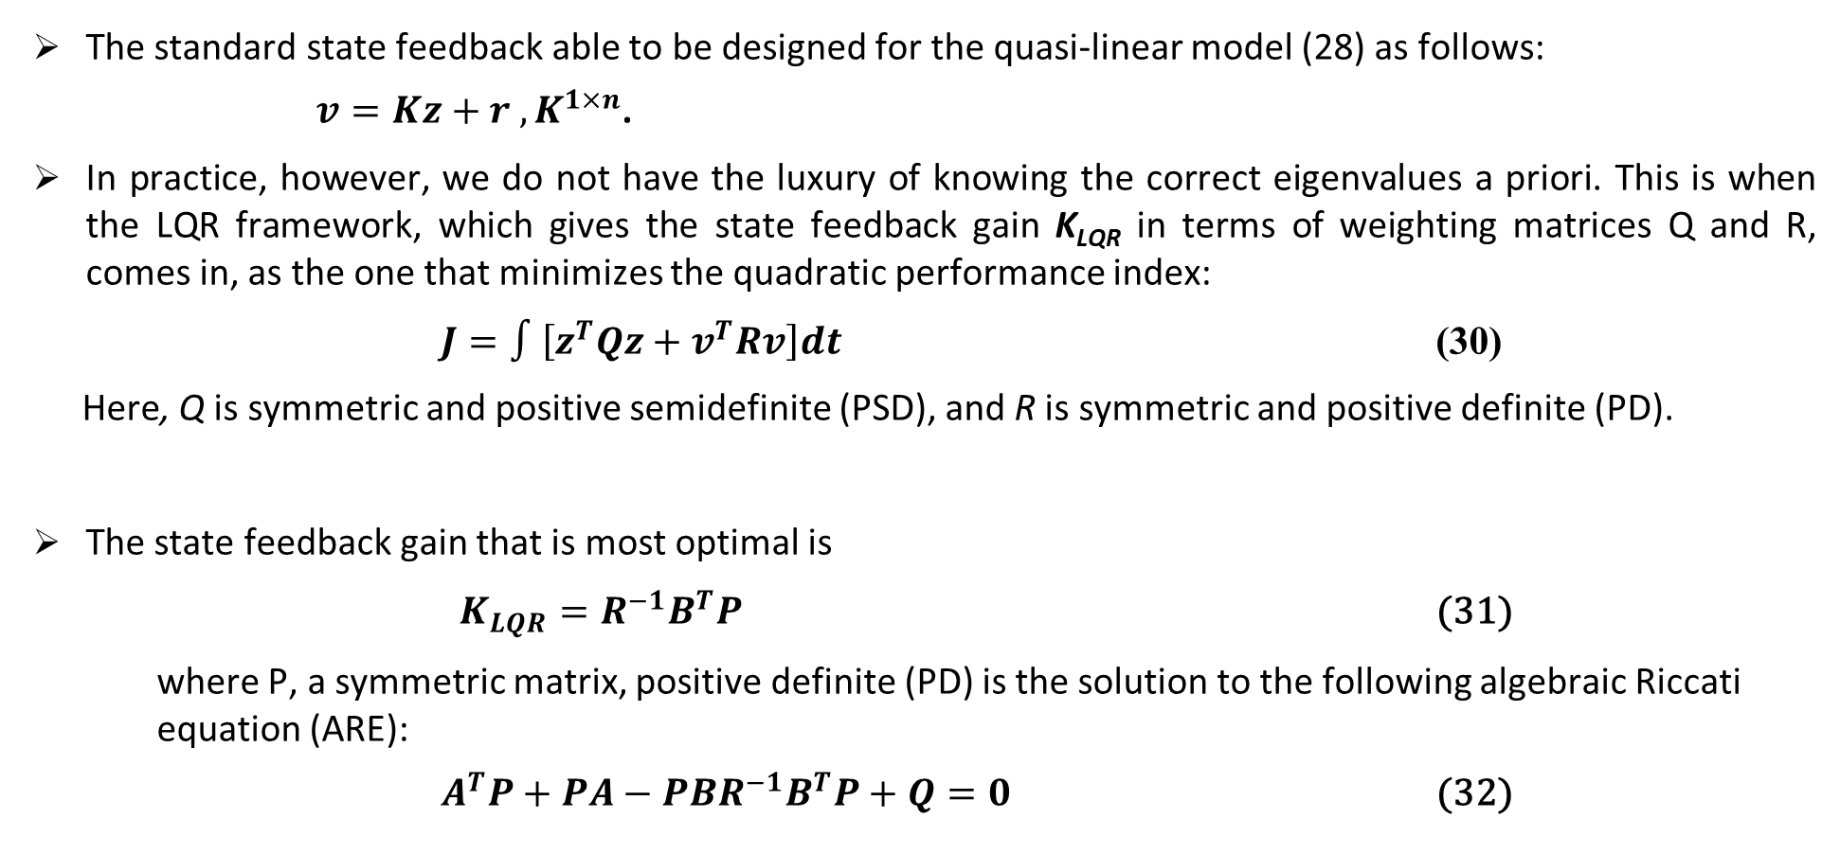
Control Techniques
The standard state feedback able to be designed for the quasi-linear model (28) as follows:
$v=Kz+r , K^{1×n}$.
In practice, however, we do not have the luxury of knowing the correct eigenvalues a priori. This is when the LQR framework, which gives the state feedback gain K_{LQR} in terms of weighting matrices Q and R, comes in, as the one that minimizes the quadratic performance index:
$J=∫\left[z^{T}Qz+v^{T}Rv\right]dt$ (30)
Here, Q is symmetric and positive semidefinite (PSD), and R is symmetric and positive definite (PD).
The state feedback gain that is most optimal is
$K_{LQR}=R^{−1}B^{T}P$ (31)
where P, a symmetric matrix, positive definite (PD) is the solution to the following algebraic Riccati equation (ARE):
$A^{T}P+PA−{PBR}^{−1}B^{T}P+Q=0$ (32)

Slide 28
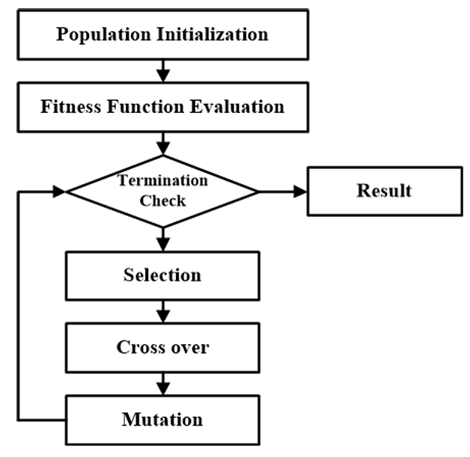
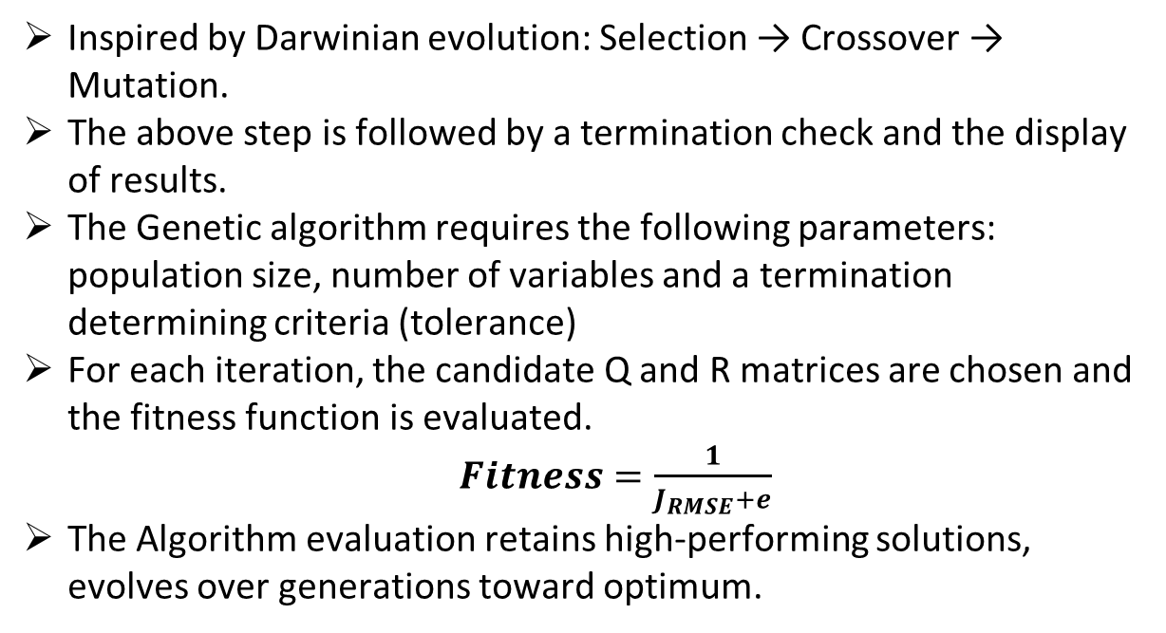
Proposed Optimization Algorithms
The objective of introducing a metaheuristic approach to LQR tuning is to reduce the time taken to tune LQR controllers manually.
In this research, we propose the implementation of Genetic Algorithm and Particle Swarm Optimization Algorithm to search for optimal Q and R matrices by minimising a performance metric, that is the Root Mean Square Error (RMSE).
Genetic Algorithm:
Inspired by Darwinian evolution: Selection → Crossover → Mutation.
The above step is followed by a termination check and the display of results.
The Genetic algorithm requires the following parameters: population size, number of variables and a termination determining criteria (tolerance)
For each iteration, the candidate Q and R matrices are chosen and the fitness function is evaluated.
$Fitness=\frac{1}{J_{RMSE}+e}$
The Algorithm evaluation retains high-performing solutions, evolves over generations toward optimum.
Fig 3. Genetic Algorithm workflow

Slide 29
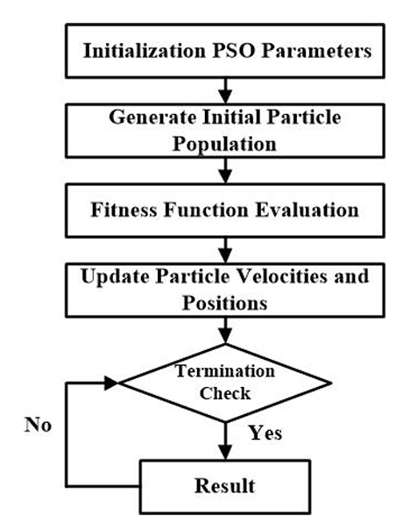
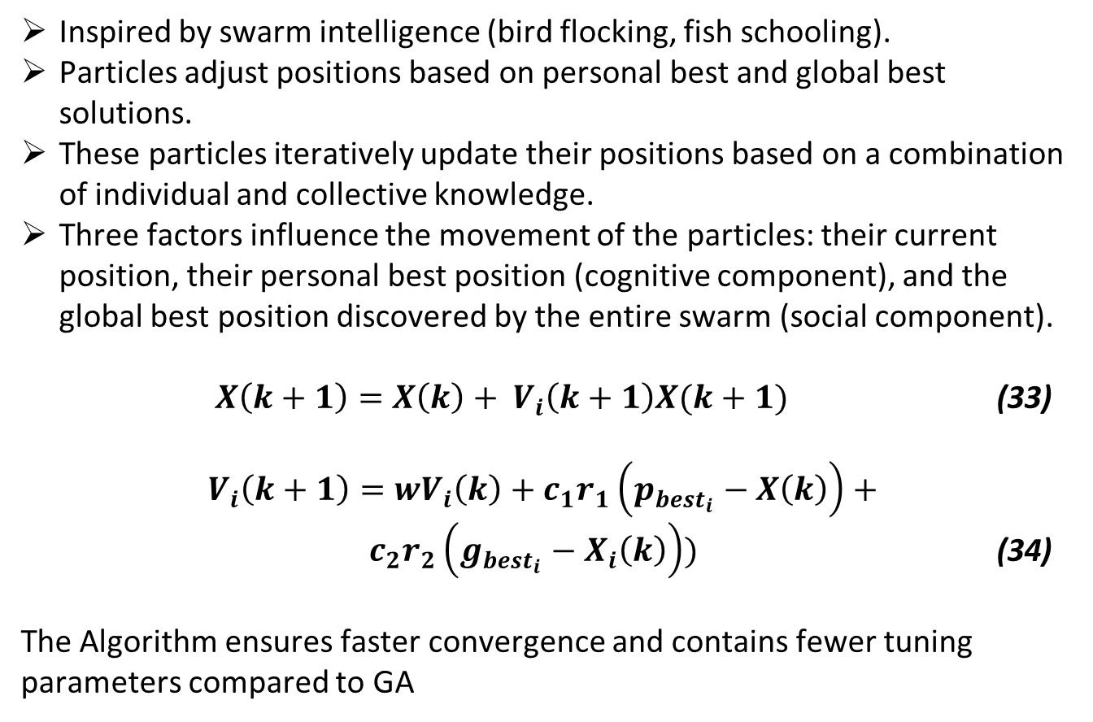
Proposed Optimization Algorithms
Particle Swarm Optimization:
Inspired by swarm intelligence (bird flocking, fish schooling).
Particles adjust positions based on personal best and global best solutions.
These particles iteratively update their positions based on a combination of individual and collective knowledge.
Three factors influence the movement of the particles: their current position, their personal best position (cognitive component), and the global best position discovered by the entire swarm (social component).
$X\left(k+1\right)=X\left(k\right)+ V_{i}\left(k+1\right)X(k+1)$ (33)
$V_{i}\left(k+1\right)=wV_{i}\left(k\right)+c_{1}r_{1}\left(p_{{best}_{i}}−X\left(k\right)\right)+$ ${ c}_{2}r_{2}\left(g_{{best}_{i}}−X_{i}\left(k\right)\right))$ (34)
The Algorithm ensures faster convergence and contains fewer tuning parameters compared to GA
Fig 4. Particle Swarm Optimization workflow

Slide 30
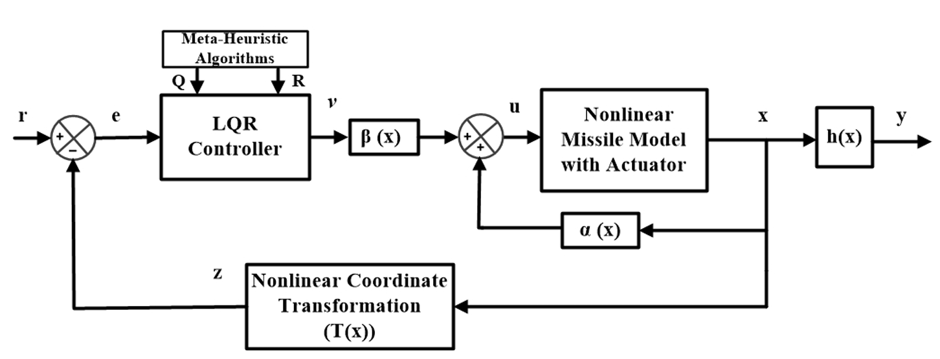
Simulation Results and Discussions
In this section, we discuss the simulation results that validate the efficacy of the GA and PSO-tuned LQR. In particular, we devised a simulation framework of the closed-loop autopilot system, composed of the nonlinear missile model (13) with M=2.5 and the control techniques as shown in Fig. 5.
Fig.5. Configuration of the designed FL with advanced control strategies and metaheuristic-based LQR tuning

Slide 31
Simulation Results and Discussion
The performance goals for the intended design involve guiding the missile to follow a specified AOA, achieving a settling time of 1 second, ensuring an overshoot of less than 5%, and maintaining a steady-state error below 2%.
It must be emphasized here that although the client would give such numbers as specifications (keeping in mind a standard 2nd-order model), they do not have any meaningful interpretation in a fourth-order model. Nevertheless, we handle all four eigenvalues in what follows. Since the transformed missile model is a linear state space model, a natural solution can be obtained on the LQR framework.
The performance of the proposed tuned LQR framework is benchmarked against results obtained through analytical methods.

Slide 32
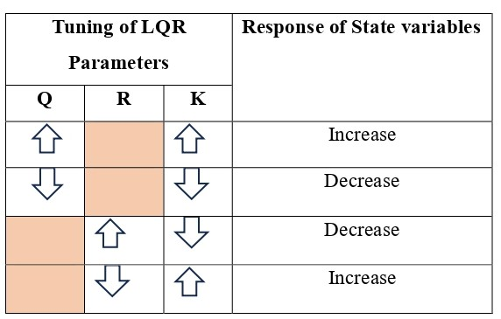
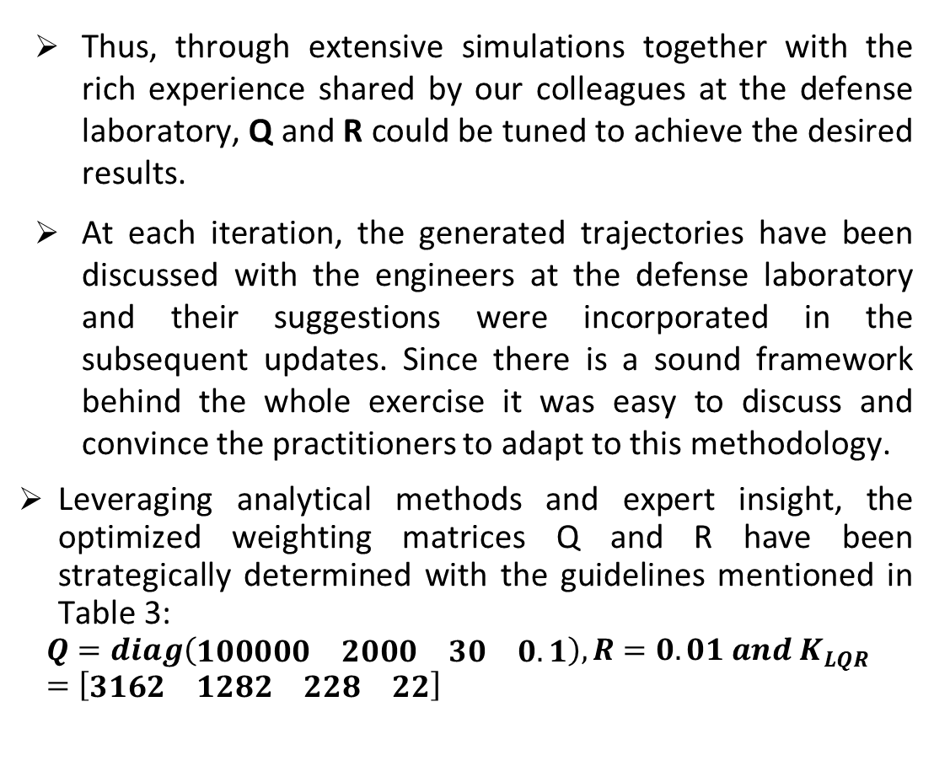
Analytical Tuning framework
Thus, through extensive simulations together with the rich experience shared by our colleagues at the defense laboratory, Q and R could be tuned to achieve the desired results.
At each iteration, the generated trajectories have been discussed with the engineers at the defense laboratory and their suggestions were incorporated in the subsequent updates. Since there is a sound framework behind the whole exercise it was easy to discuss and convince the practitioners to adapt to this methodology.
Leveraging analytical methods and expert insight, the optimized weighting matrices Q and R have been strategically determined with the guidelines mentioned in Table 3:
$$Q=diag\left(\begin{matrix}\begin{matrix}100000 & 2000\end{matrix} & \begin{matrix}30 & 0.1\end{matrix}\end{matrix}\right), R=0.01 and K_{LQR}=\left[\begin{matrix}\begin{matrix}3162 & 1282\end{matrix} & \begin{matrix}228 & 22\end{matrix}\end{matrix}\right]$$
Table 3. The tuning guideline of LQR

Slide 33
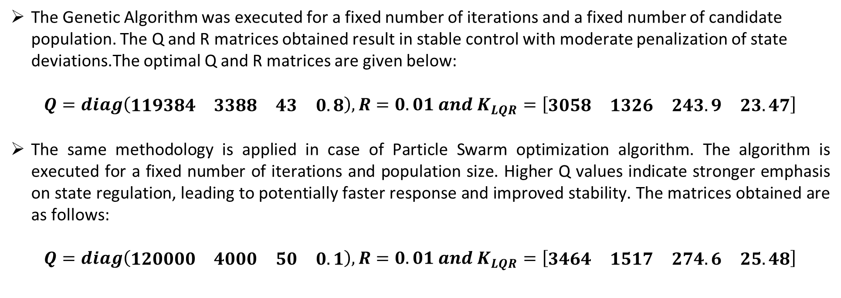
Proposed Tuning Framework
The Genetic Algorithm was executed for a fixed number of iterations and a fixed number of candidate population. The Q and R matrices obtained result in stable control with moderate penalization of state deviations.The optimal Q and R matrices are given below:
$$Q=diag\left(\begin{matrix}\begin{matrix}119384 & 3388\end{matrix} & \begin{matrix}43 & 0.8\end{matrix}\end{matrix}\right), R=0.01 and K_{LQR}=\left[\begin{matrix}\begin{matrix}3058 & 1326\end{matrix} & \begin{matrix}243.9 & 23.47\end{matrix}\end{matrix}\right]$$
The same methodology is applied in case of Particle Swarm optimization algorithm. The algorithm is executed for a fixed number of iterations and population size. Higher Q values indicate stronger emphasis on state regulation, leading to potentially faster response and improved stability. The matrices obtained are as follows:
$$Q=diag\left(\begin{matrix}\begin{matrix}120000 & 4000\end{matrix} & \begin{matrix}50 & 0.1\end{matrix}\end{matrix}\right), R=0.01 and K_{LQR}=\left[\begin{matrix}\begin{matrix}3464 & 1517\end{matrix} & \begin{matrix}274.6 & 25.48\end{matrix}\end{matrix}\right]$$

Slide 34
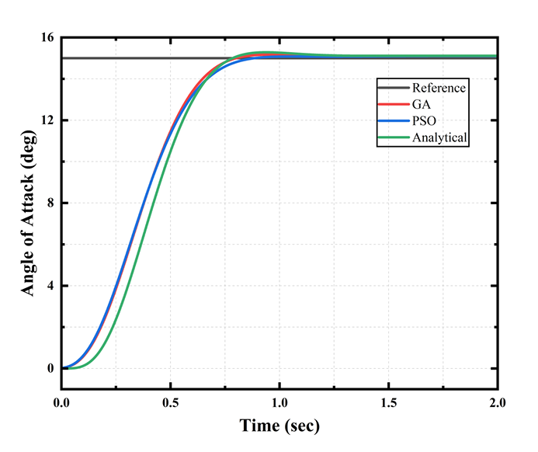
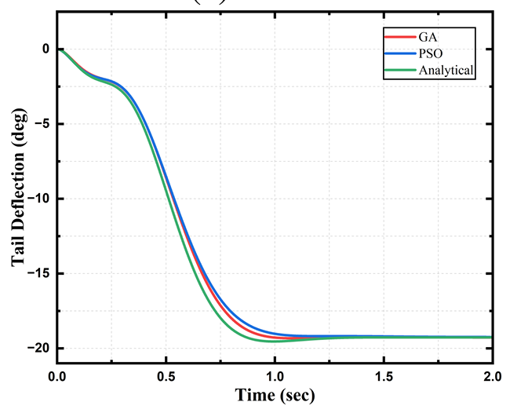
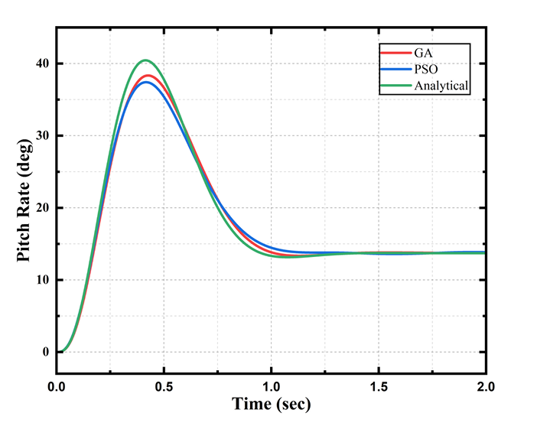
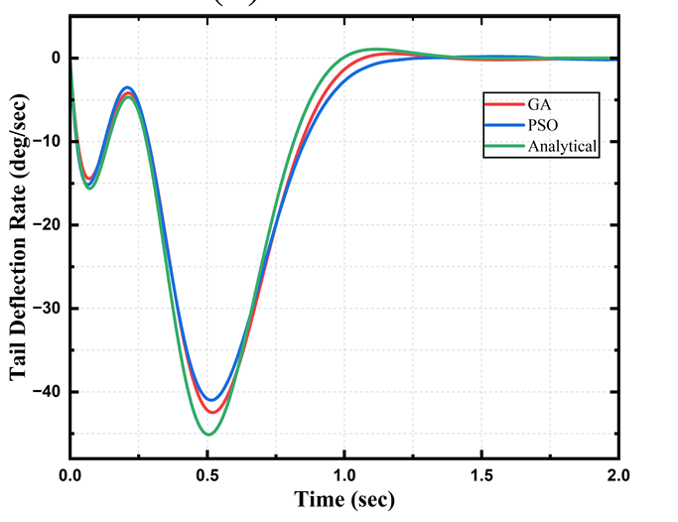
The performance of the Proposed LQR controller enhanced using FL
Fig.6. The simulation results of the LQR controller to the desired step input of 15◦

Slide 35
The performance of the Proposed LQR controller enhanced using FL
Table 4. Time domain specifications of all tuning frameworks.
Table 5. Error metrics.
Time domain specifications | Tuning frameworks
 | GA | PSO | Analytical
Rise Time (sec) | 0.287 | 0.306 | 0.4077
Settling Time (sec) | 0.6421 | 0.688 | 0.7167
Peak Time (sec) | 0.84 | 1.88 | 0.8770
Overshoot (%) | 0.3287 | 0.0014 | 1.5507
Peak (rad) | 0.264 | 0.263 | 0.8770
Settling Min (rad) | 0.238 | 0.239 | 0.2375
Settling Max (rad) | 0.264 | 0.263 | 0.2678
Errors | Tuning Frameworks
 | GA | PSO | Analytical
RMSE | 3.287e-05 | 2.651e-05 | 3.302e-05
IAE | 0.1234 | 0.2122 | 0.1172
ISE | 0.02309 | 0.037 | 0.02213
The GA-LQR and PSO-LQR achieve a significantly lower root mean squared error (RMSE) of 3.287e⁻⁵ and 2.651e⁻⁵ indicating its ability to closely track the desired response and the specifications that are demanded in practice.
GA-tuned LQR achieves an overshoot of 0.32% and 0.0014% being for PSO-tuned LQR. GA-LQR achieves a rise time of 0.287 seconds and a quicker settling time of 0.6421 seconds. PSO-LQR achieves a rise time of 0.306 seconds and a quicker settling time of 0.688 seconds

Slide 36
References
M. Xin and S.N. Balakrishnan, ”Nonlinear H∞ missile longitudinal autopilot design with θ-D method,” IEEE Transactions on Aerospace and Electronic Systems, vol. 44, no. 1, pp. 41–56, 2008.
A. A. Godbole and T R Libin, “State observer-based robust pitch autopilot design for tactical missiles,” Journal of Guidance, Control, and Dynamics, vol. 43, no. 5, pp. 975-980, 2020.
Y. M. Tavares and J. Waldmann, ”H∞ Loop Shaping Using Polytopic Weights and Pole Assignment to Missile Autopilot,” IEEE Access, vol. 11, no. 11, pp. 125-133, 2023.
S.U.N. Zonghua, W.U. Liaoni WU and Y.O.U. Yancheng, ”Robust gain scheduled missile autopilot design based on multifrequency extended state observers,” Chinese Journal of Aeronautics, vol. 36, no. 12, pp. 390-407, 2023.
Subbareddy Chitta and Ramakalyan Ayyagari, ”On the Nonlinear Control of a Class of Cruise Missiles,” International Journal of Control, Automation, and Systems, vol. 23, no. 3, pp. 788-797, 2025.
S. Lee, Y. Kim, Y. Lee, G. Moon, and B.E. Jeon, ”Robust-Backstepping Missile Autopilot Design Considering Time-Varying Parameters and Uncertainty,” IEEE Transactions on Aerospace and Electronic Systems, vol. 56, no. 6, pp. 4269-4287, 2020.
Shan, and H. Sun, ”Anti-disturbance autopilot design for missile system via finite time integral sliding mode control method and nonlinear disturbance observer technique,” Transactions of the Institute of Measurement and Control, vol. 38, no. 6, pp. 693–700, 2015

Slide 37
References
Z. Beheshtipour, H. Khaloozadeh, and R. Amjadifard, ”On the Solvabil ity of Feedback Complete Linearization of Nonlinear Stochastic Systems,” IEEE Transactions on Systems, Man, and Cybernetics: Systems, vol. 50, no. 3, pp. 1074-1082, 2020.
Rajan S and Rajan Shalini P ”Design Of Robust LQR Control For Nonlinear System Using Adaptive Dynamic Programming” International Journal of Aquatic Science, Vol 12, no. 02, pp. 3900-3912, 2021.
Sahrir. N.Hand and Basri.M.A.M. , ”PSO–PID Controller for Quad copter UAV: Index Performance Comparison,” Arabian Journal for Science and Engineering, vol. 48, pp. 15241–15255, 2023.
Kelin Li, Yalei Bai, and Haoyu Zhou, ”Research on Quadrotor Control Based on Genetic Algorithm and Particle Swarm Optimization for PID Tuning and Fuzzy Control-Based Linear Active Disturbance Rejection Control”, Electronics, Vol. 13, no. 22, pp. 4386, 2024.
Jia Song, Yunlong Hu, Jiangcheng Su Mingfei Zhao and Shaojie Ai, ” Fractional-Order Linear Active Disturbance Rejection Control Design and Optimization Based Improved Sparrow Search Algorithm for Quadrotor UAV with System Uncertainties and External Disturbance”, Drones, vol. 6, no. 9, pp. 229, 2022., 2015
Phichitphon Chitikunnan, Wanida Khotakham, ”Genetic Algorithm Optimized LQR for Enhanced Stability in Self-Balancing Wheel chair Systems” Control Systems and Optimization Letters, Vol. 2, No 3, 2024.
Hau Nguyen Binh 1, Dat Tran Dinh, Anh Doan Cong in ”Optimization of LQR for Reaction Wheel Inverted Pendulum using Particle Swarm Optimization: Simulation and Experiment” Journal of Fuzzy Systems and Control, Vol. 3, No 1, 2025

Slide 38


