Slide 1
Go, change the world
Experiential Learning:
COMPUTER SCIENCE AND ENGINEERING
Customizing Kernel and Bootloader Development
USN | Admission No. | Name | Email Id
1RV22CS186 | RVCE22BCS146 | Shreehari G Bhat | shreeharigbhat.cs22@rvce.edu.in
1RV22CS233 | RVCE22BCS2134 | Vishruth V | vishruthv.cs22@rvce.edu.in

Slide 2
CONTENTS
Go, change the world
Problem Statement
Literature Survey
Softwares used
commands
Future Scope

Slide 3
PROBLEM STATEMENT
Go, change the world
Develop a bootloader program compatible with the QEMU emulator for x86 architecture. The bootloader should be capable of initializing the system and loading a basic operating system kernel. The primary focus is on simplicity and functionality, with minimalistic design and code footprint. Our aim is to Ensure that the bootloader successfully loads and transfers control to the kernel without errors.

Slide 4



SOFTWARE COMPONENTS USED
Go, change the world
Integrated Development Environment (IDE):
VISUAL STUDIO CODE -FOR .asm and .c files
An assembler is needed to convert the assembly language code (.asm) into machine code.
NASM (Netwide Assembler)
Compiler (for C code integration): GNU Compiler Collection
A Linker
QEMU Emulator:
QEMU is a versatile emulator that can emulate various CPU architectures. It's commonly used for testing bootloader code.

Slide 5
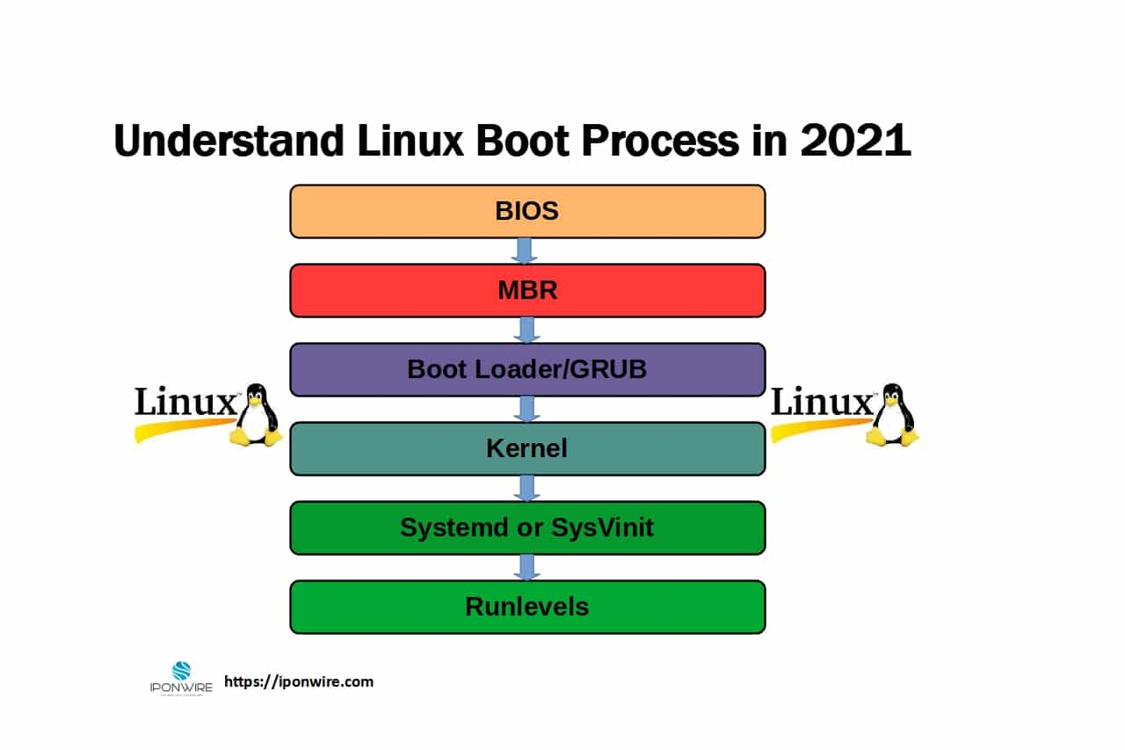
UNIX BOOT PROCESS STEPS
Go, change the world

Slide 6
CODING COMPONENT(X86 , C and Kernel)
Go, change the world
boot.asm:
This file contains the bootloader code you provided, written in assembly language.
boot.bin:
This is the binary output file generated by assembling the boot.asm file. It contains the machine code of the bootloader.
build.sh
cc -o program.out program.c
nasm -f bin boot.asm -o boot.bin
qemu-system-i386 -fda boot.bin

Slide 7
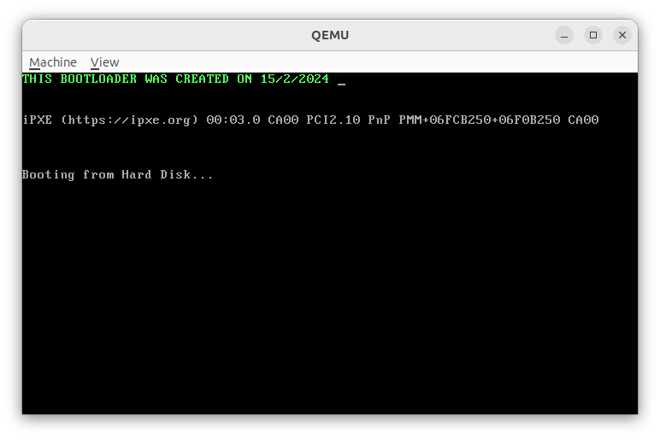
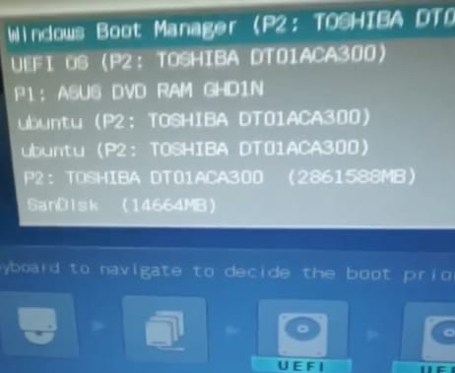
OUTPUTS IN QEMU
Go, change the world

Slide 8
FUTURE SCOPE
Go, change the world
Multiboot Support:
Enhance the bootloader to support loading and booting multiple operating systems or kernels. Implementing the Multiboot specification can enable compatibility with a wider range of operating systems.
User Interface Improvements:
Develop a more user-friendly interface, such as a graphical boot menu with options for selecting different operating systems or boot configurations.
File System Support:
Add support for reading files from a file system, such as FAT or ext4, to load kernel images or other data files. This could involve implementing file system drivers within the bootloader.
Boot Configuration:
Implement a configuration mechanism to allow users to customize boot options, such as kernel parameters or boot-time settings.
Boot Performance Optimization:
Optimize the bootloader code and boot process to reduce boot time and improve overall system startup performance.

Slide 9
REFERENCES
Go, change the world
"Intel 64 and IA-32 Architectures Software Developer's Manual" (Intel)
"Programming with 64-Bit Intel® Core™ Processors" by Vladimir Brazhnikov and Anatoly Korniltsev
"OSDev Wiki"
"Bare Bones" by Nick Blundell
"The Art of Assembly Language Programming" by Randall Hyde
Online forums and communities

Slide 10
Go, change the world
THANK YOU

