Slide 1


Namma Hack
Team Details
Team name: Novex 🌠
Team leader name: Shreehari S Kulkarni
Problem Statement: Open Innovation

Slide 2


Problem Statement
Students miss out on hackathons, events, internships, and workshops because information is scattered across WhatsApp groups, emails, posters, and personal networks. As a result, opportunities are under utilised and reach only a small, well-connected group of students.
Solution Overview
Novex is a single platform that aggregates all campus opportunities in one place, personalised for each student. It ensures verified events, easy discovery, and clear access to organisers, so students can confidently participate in real opportunities.

Slide 3
How different is it from any of the other existing ideas?
        Currently, most students rely on WhatsApp groups, emails, and notice boards to learn about campus events and opportunities. However, not every student is part of every group, and information is often scattered, outdated, or even unverified.
How will it be able to solve the problem?
        We will create a common platform — either a website or an app — accessible to all students. Event organisers or admins can create events and tag them according to type, branch, and relevance. Using AI-based recommendation, Novara will match each student’s personal interests with relevant events and opportunities, and suggest them to join, ensuring that every student sees verified and meaningful opportunities tailored to them.

Slide 4
List of features offered by the solution
• Centralised Opportunity Hub
All campus events, hackathons, workshops, internships, and announcements in one common platform.
• AI-Based Personalised Recommendations
The system suggests events to students based on their interests, profile, and past activity.
• Verified Events Only
Events can be posted only by authorised admins or organisers, reducing fake or misleading information.
• Equal Access for All Students
Every student sees the same verified opportunities, removing dependency on private networks or WhatsApp groups.

Slide 5
Google Technologies used in the solution
• Firebase Authentication – Free user login (Google / Email)
• Firebase Firestore – Free-tier database for events and users
• Firebase Hosting – Free website hosting
• Firebase Cloud Functions (Free tier) – Backend logic
• Flutter (by Google) – Free, open-source app / web development
• Google AI Studio / Gemini API – Event recommendation logic

Slide 6
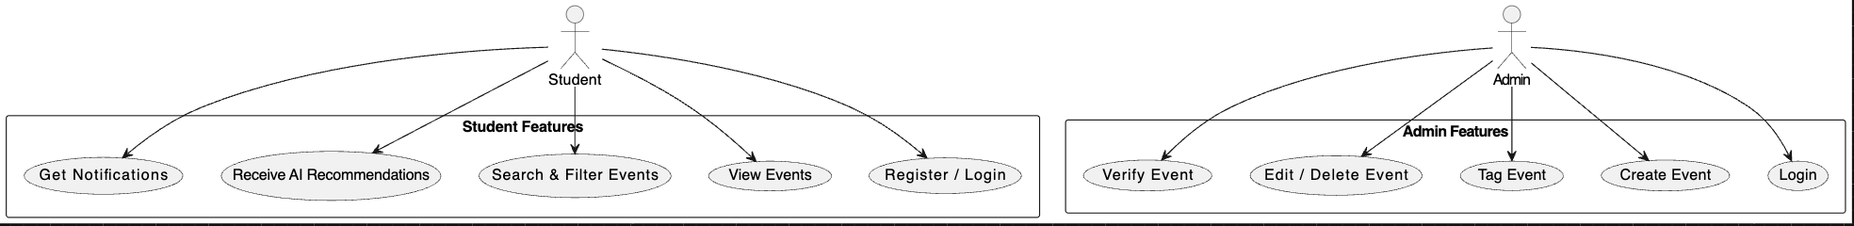
Process flow diagram or Use-case diagram

Slide 7
Wireframes/Mock diagrams of the proposed solution (optional)

Slide 8
Architecture diagram of the proposed solution

Slide 9
Snapshots of the MVP

Slide 10
Additional Details/Future Development (if any)

Slide 11
Provide links to your:
GitHub Public Repository
Demo Video Link (3 Minutes)
MVP Link

Slide 13
Namma Hack
Thank you!

