Slide 1
Acoustic models for speech recognition in Reading Miscue detection
MTP Presentation
Shreeharsha B S
EE1 18307R002

Slide 2
Motivation
Literacy is an important measure of prosperity and also critical to the well being of an individual and his/her community.
ASER (Annual Status of Education Report) survey^{[1]}:
27.2% of class VIII students sampled unable to read a text that is meant for a class II student^{[2]}.
The ASER annual survey is an important tool to guide education interventions that is widely respected by governments and NGOs.
Goal: Build a reliable and scalable system for school level reading skill assessment based on automatic speech recognition (ASR) and fluency detection.
Notes:
‘Reliable’ means it performs like a human expert but has the advantage of being more ‘objective’ (rather than subjective). ‘Scalable’ means human resource usage is minimal.
Fluency involves detecting prosody from ASR-aligned word sequences.

Slide 3
Introduction
Challenges:
Scarcity of labeled target speech
High degree of variability:
Variation in speaking and reading abilities due to possible L2 context
Variation in accents due to regional differences and other influences
Noisy environments
Helpful factors: Reading of known text
Approach:
Use a baseline system trained on more widely available adult speech in the target language
Investigate data augmentation and transfer learning using available target domain data
Notes:
Noise is also a factor to mention.

Slide 4
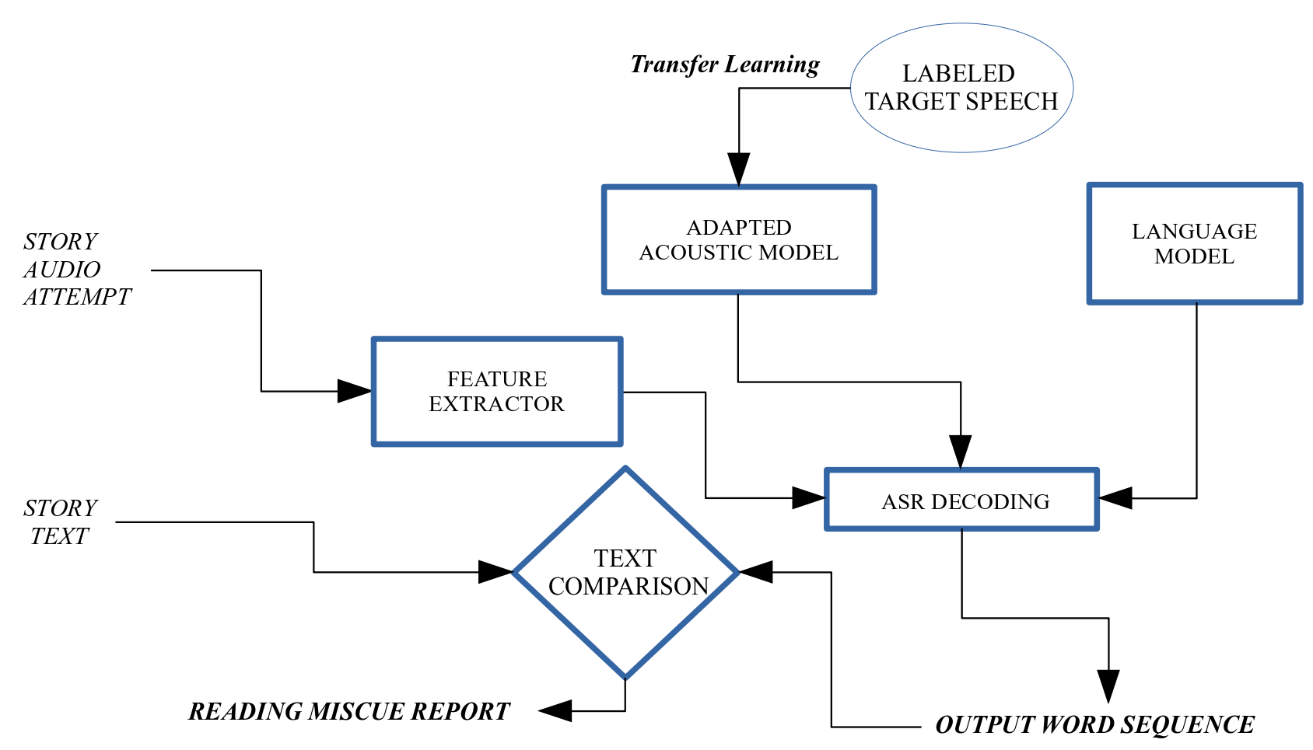
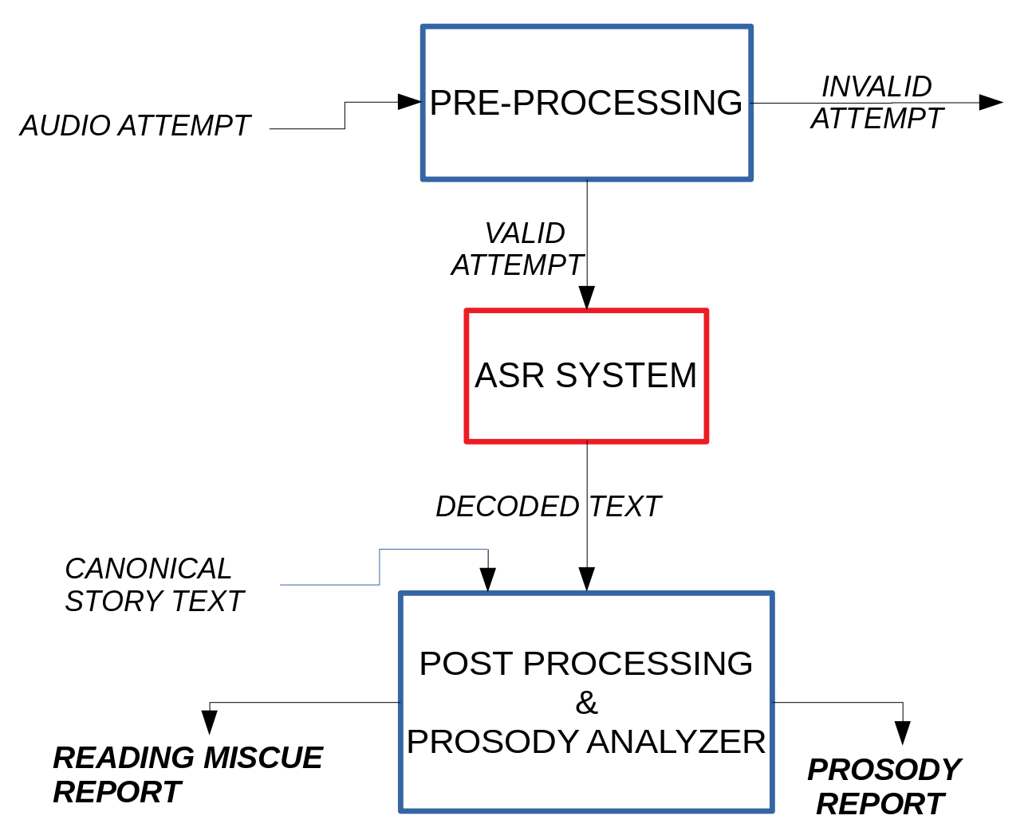
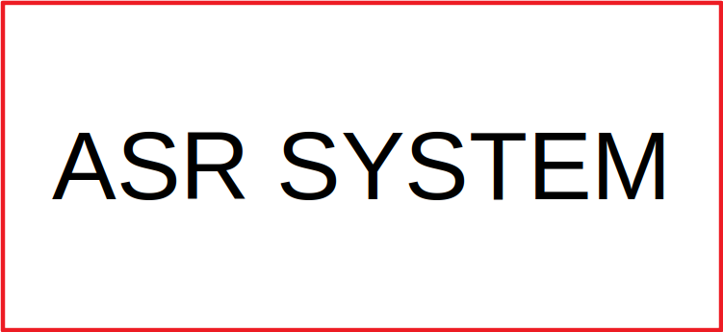
Overall System for Automatic Reading Assessment
ASR System
# OF MISCUES, WCPM
PACE, HESITATION etc.
Notes:
Reading miscue report contains WCPM and other lexical analysis, Prosody report: information about how well text was read (pace, hesitation etc.)
Include all these outputs on the slide just as I had shown you. They have been included now. A widely accepted rubric for reading skill evaluation is the WCPM (words correct per minute). This metric has been shown previously to be strongly correlated with reading ability

Slide 5
ASR System - Kaldi baseline Acoustic models
13 TDNN layers + 2 linear layers + 2 output layers model trained on MMI and cross entropy loss functions
relu-batchnorm-dropout-layer name=tdnn1 dim=1024
tdnnf-layer name=tdnnf2 dim=1024 time-stride=1
tdnnf-layer name=tdnnf3 dim=1024 time-stride=1
tdnnf-layer name=tdnnf4 dim=1024 time-stride=1
tdnnf-layer name=tdnnf5 dim=1024 time-stride=0
tdnnf-layer name=tdnnf6 dim=1024 time-stride=3
tdnnf-layer name=tdnnf7 dim=1024 time-stride=3
tdnnf-layer name=tdnnf8 dim=1024 time-stride=3
tdnnf-layer name=tdnnf9 dim=1024 time-stride=3
tdnnf-layer name=tdnnf10 dim=1024 time-stride=3
tdnnf-layer name=tdnnf11 dim=1024 time-stride=3
tdnnf-layer name=tdnnf12 dim=1024 time-stride=3
tdnnf-layer name=tdnnf13 dim=1024 time-stride=3
linear-component name=prefinal-l dim=192
prefinal-layer name=prefinal-chain input=prefinal-l big-dim=1024 small-dim=192 output-layer name=output dim=3080
prefinal-layer name=prefinal-xent input=prefinal-l big-dim=1024 small-dim=192
output-layer name=output-xent dim=3080
Use two different output layers (cross entropy and MMI loss) while training. Only MMI layer used in decoding
Notes:
More on LM/GM during evaluation metric slides. This is just about the AMs in the ASR system from previous slide.

Slide 6
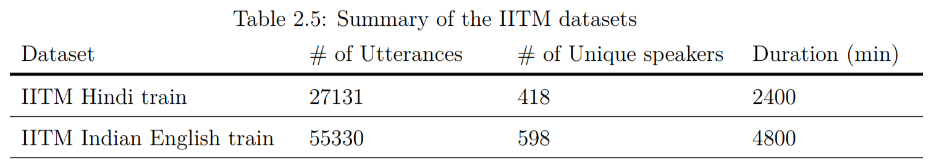
Baseline system and Tasks
Train a Hindi baseline model and an Indian English baseline model using Adult speech in Hindi and Indian English respectively
Baseline model recipe and Data: IITM Hindi and English ASR challenge^{[3]}
Hindi Task: Transfer learning & data augmentation experiments on Hindi baseline model using ASER Hindi data^{[4]}
English Task: Similar experiments on Indian English baseline model using children’s English data
Manual phone mappings made between retraining data lexicons and IITM baseline lexicon

Slide 7
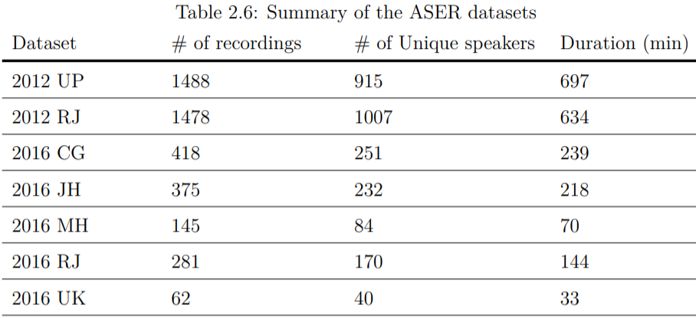
Hindi task
Recordings of ASER survey conducted by trained volunteers to manually evaluate literacy levels of students
Task: Automate the process of reading evaluation through ASR on audio recordings of tests
Datasets:
Notes:
Will talk about differences between the two sets here in terms of noise and mistakes made. It will be highlighted again when I show the miscue rates in the 2016 set.

Slide 8
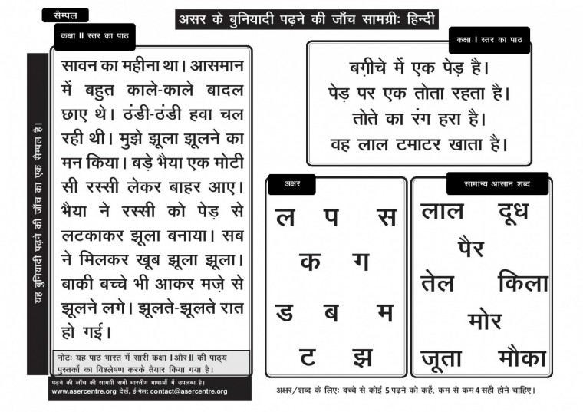
Hindi task: ASER survey sample test
An ASER sample test^{[2]} containing letter, words, paragraphs and stories.
In this work, only the stories and paragraphs are used.

Slide 9
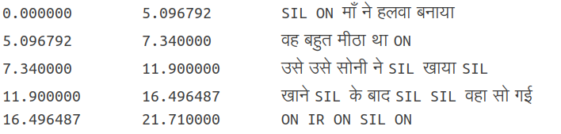

Manual Transcription
Canonical text: उसे सोनी ने खाया खाने के बाद वह सो गई
Training transcription: उसे उसे सोनी ने SIL खाया SIL खाने SIL के बाद SIL वहा सो गई ON IR ON SIL ON
True transcription: उसे उसे सोनी ने खाने के बाद वहा सो गई तुम्हारा पहला ही सेट नही हो पाया, जल्दी जल्दी करो, हो गया?
Miscues: ICCCCCCSCC ;Miscue rate = (I+S+D)/(# of words in story) b/w Training transcript and Canonical
IR: Irrelevant speech BR: Breathing in/out MB: Undecipherable mumbling ON: Other noise FP: Filled pauses
SIL: Silences > 200 ms
Audacity sentence level Label Track: 1560_08_aser_up_HI-S1-P_2
Notes:
Transcriptions available at sentence level. In this case IR is after the child has finished reading, IR isn’t considered for miscue rate calculation as it is not uttered by child. if it overlaps with child speaking the whole sentence is removed if part of train set. No splitting done for valid and test sets while decoding.

Slide 10
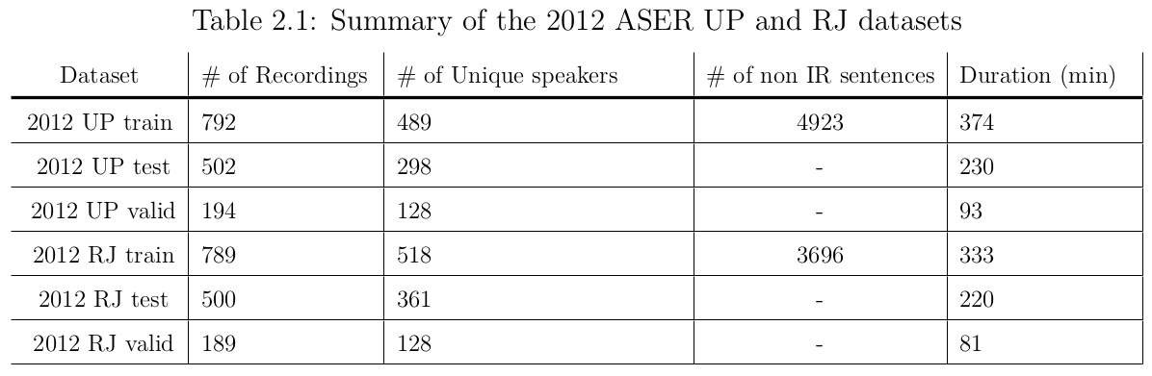
ASER 2012 Data Splits
ASER Data
Train, valid and test splits made from 2012 data. 12 unique Hindi stories
2012 UP+RJ Train set combined (12 hrs) split at sentence level; used for retraining baseline along with Hindi data from campus school
No speaker overlap between train, valid and test splits

Slide 11
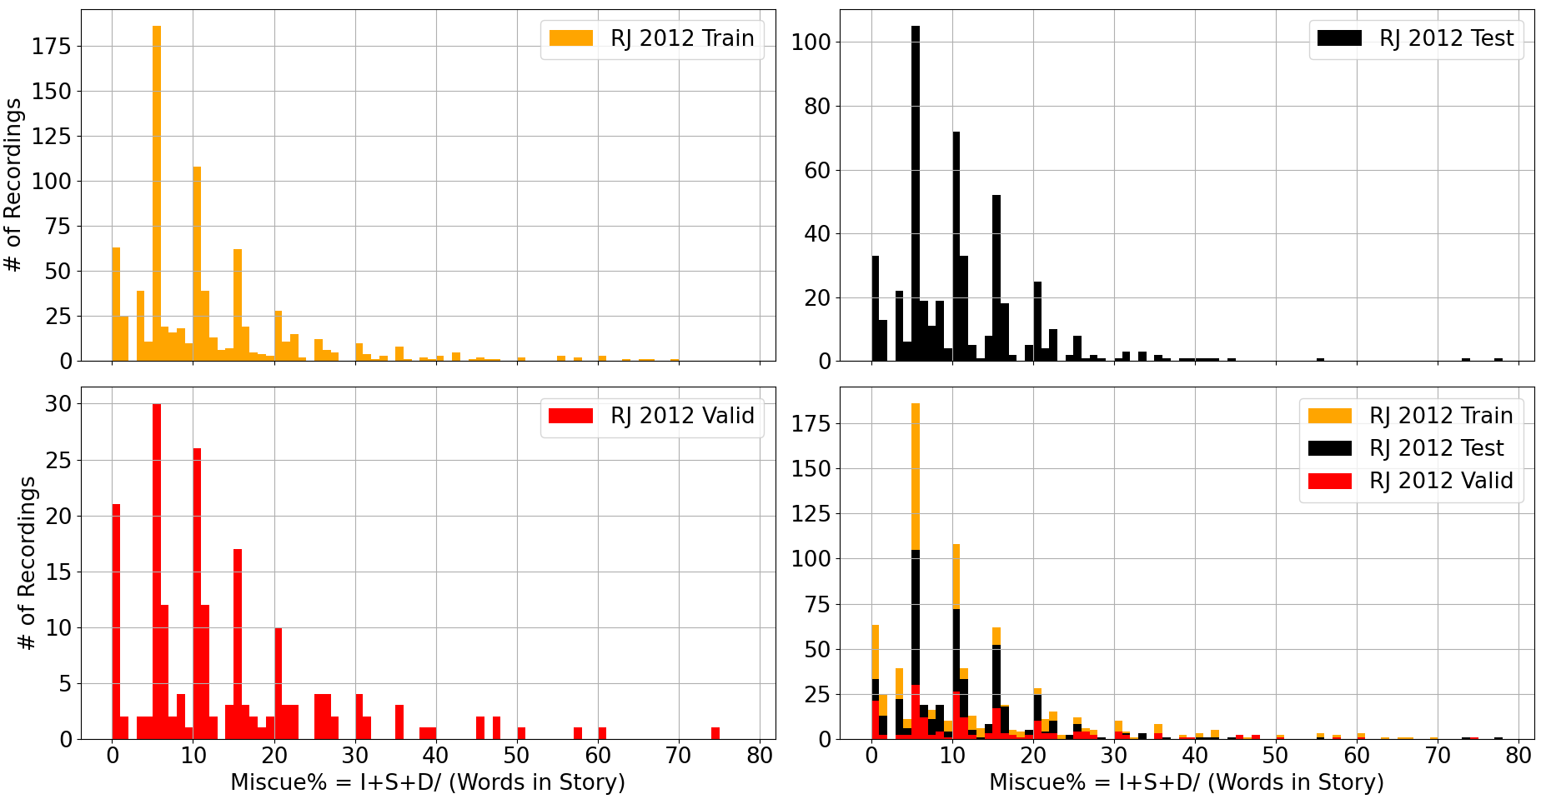
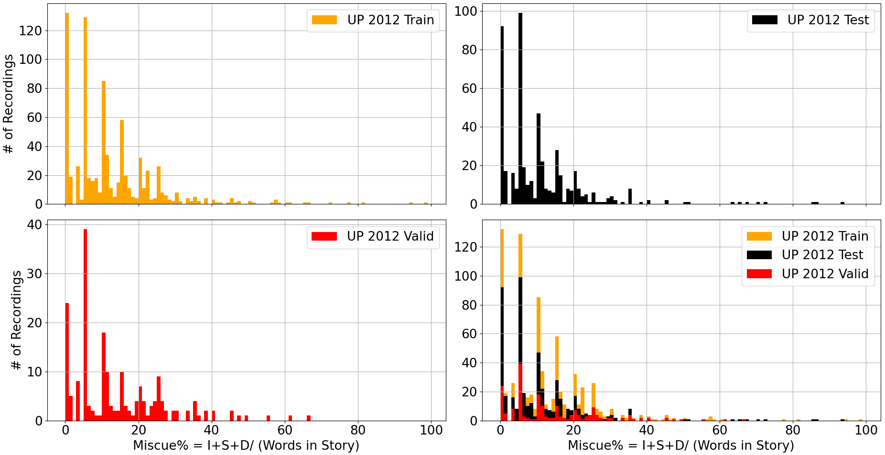
2012 splits Miscue rate distribution
Many recordings have miscue rates b/w 0-10%
Notes:
Majority of recordings have miscue rates < 10%

Slide 12
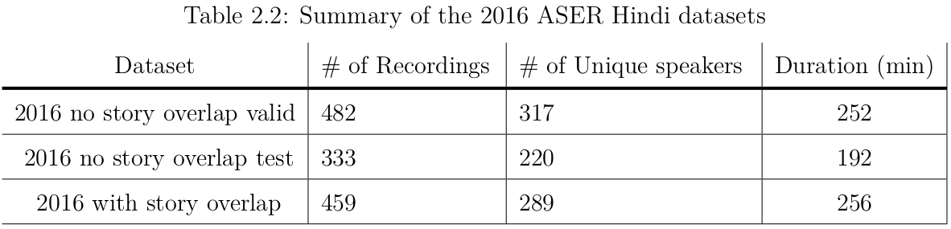
ASER 2016 Data splits
2016 set used only for decoding and testing.
Two subsets: With and without story overlap with 2012 data.
No story overlap (8 new unique Hindi stories) further split into valid and test.
More challenging dataset because of noisier conditions, children are from 5 different states (CG, JH, MH, RJ, UK) and make more mistakes while reading.

Slide 13
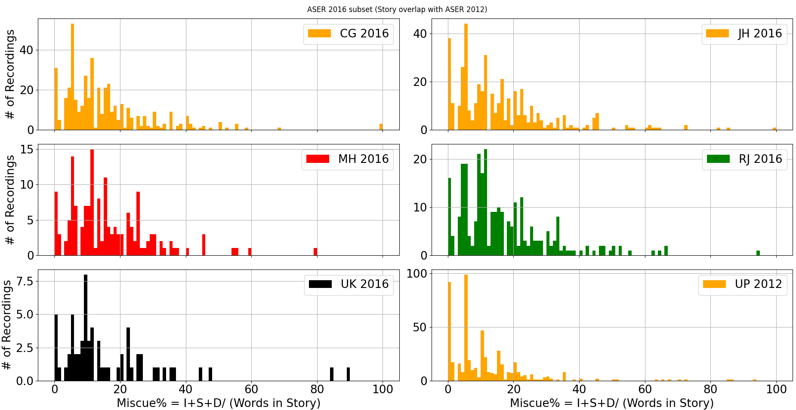
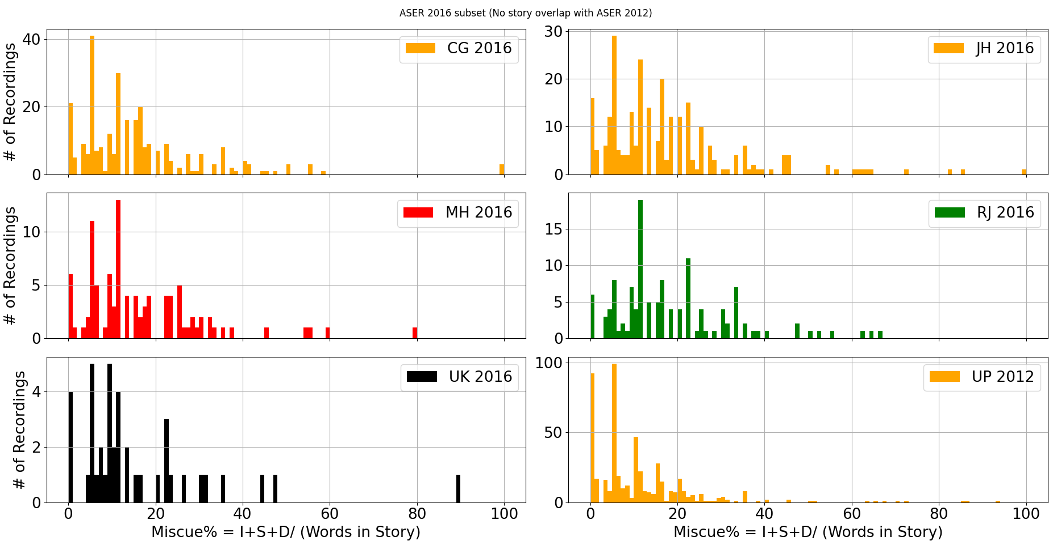
2016 splits Miscue rate distribution
Many recordings have miscue rates b/w 10-20%
Notes:
Anyway, you are not using story distribution to make any specific point, or are you? Just make that point instead.
Harsha: Ok, The only point is that the story distributions are similar across train, valid test splits

Slide 14
Data Augmentation
Data augmentation → Apply certain transforms on the training data to:
Enhance amount of training data
Groom the model towards certain test scenarios
Augmentation techniques:
VTLP (Vocal tract length perturbation) ^{[5]}
SpecAugment^{[6]} and SpecSwap^{[7]}
Speed perturbation, Tempo perturbation, VTLP examined in kaldi^{[8]}
Pitch perturbation ^{[9]} and Noise augmentation
A mix of augmentation techniques are used in baseline model and during transfer learning depending on the scenario of interest

Slide 15
Data Augmentation procedure
Two techniques used during baseline model training:
Vocal tract length perturbation (VTLP) warping
Speed perturbation at 1.1x and 1.2x
During retraining on ASER 2012 data:
Overlaying noise sources (IITB exam recordings, wind, babble, rain, traffic etc) at various SNR. (2x versions of the retraining acoustic data (original+noisy))
Original and noisy used for SpecAugmentation once (4 versions)
Speed perturbation of above 4 versions at 0.9x, 1.0x, 1.1x (12 versions)
Pitch perturbation of the 4 versions from 2) by upshifting and downshifting at ~0.9x and ~1.1x pitch of each individual recording (8 versions)
In total, there would be 20 versions (12 hrs → 240 hrs) of the retraining acoustic data available

Slide 16
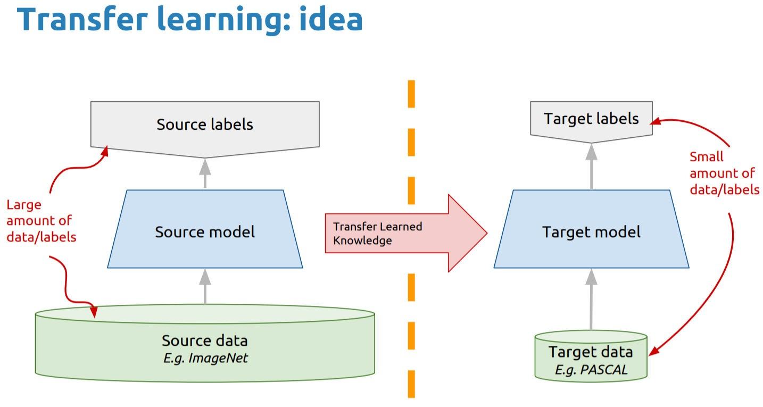
Transfer learning
Use source model trained on large amount of data and adapt it to target data that is more scarce
A general block diagram of transfer learning^{[9]}

Slide 17
Transfer learning parameters tuned
Regularization:
L2-regularization: adding −0.5c*|y|₂ to the loss function, where y is the output of any node in the MMI ’output’ layer
xent-regularization: scales xent (cross entropy) layer output (output/xent-regularize)
# of epochs:
# of passes of retraining data through the model. Determines total # of training iterations along with mini-batch size (64).
Global initial and final effective learning rates:
Learning rate at each iteration. Starts at the initial learning rate on first iteration and decreases at each iteration until it reaches the final learning rate
In all experiments, the final effective learning rate is 1/10th the initial learning rate.

Slide 18
Transfer learning parameters tuned
Differential learning rates:
Train different layers of the baseline model at different rates.
Represented like so: ”5(4)-0(9)-0.625(2)*1e-6”: first 4 TDNN layers have initial learning rates 5e-6, the next 9 layers are frozen and the final 2 output layers have initial learning rate 0.625e-6.
The middle layers of the network are frozen and the top and bottom layers retrained^{[10]}:
Acoustic variability in the features is captured by the layers near input of the model
Pronunciation variability is seen only at the layers near the output of the model.
Chunk-width (C/chkwidth):
Each training mini-batch consists of an 64 x C x 140 tensor. Since the loss function can be computed on any sequence of frames, the network can be made to learn text contexts of length C (along with the acoustic characteristics of the speakers) during retraining.
Notes:
C by default in kaldi is 1.4 seconds

Slide 19
Evaluation
Word Error Rate (WER)
WER calculated using a tri-gram LM trained on canonical stories’ text with a unigram garbage model (words from retrain + valid transcript that occurred at least twice).
Other labels (IR, FP, SIL etc) removed from GT (Ground truth) text before computing WER
F-score of Detected Correct words
Precision (P): Of the total number of correct words identified by the ASR system how many were actually correctly spoken by the child in the GT.
Recall (R): Of the total number of correctly spoken words by the child according to the GT, how many were identified by the ASR system.
Here, a correct word is a word present in the canonical text and correctly spoken by the child. The F-score is then (2 ∗ P ∗ R)/(P + R)
Notes:
lmwt 10..50 wip -0.5, 0.0, 0.5, 1.0
One way to support the use of F-score measure is to understand that it is of slightly less import to find out what
the exact mistake a child made while reading was, as long as a mistake is identified. By reducing the effect of the deficiencies of the ASR system, this metric can be useful for identifying the best ASR for quantifying literacy levels. THIS metric IS USEFUL on its own (WCPM is a standard reading rubric as I’ve tried to bring up to you earlier as well), NOt because it “reduces deficiencies of ASR”!!!!! Don’t say things like that that show your lack of perspective in the work you are doing!!
Yes, I do understand that it’ll be useful and directly related to WCPM. That is why I say at the end it is useful for identifying best ASR for quantifying literacy levels. It is another point in support of using the F-score metric

Slide 20
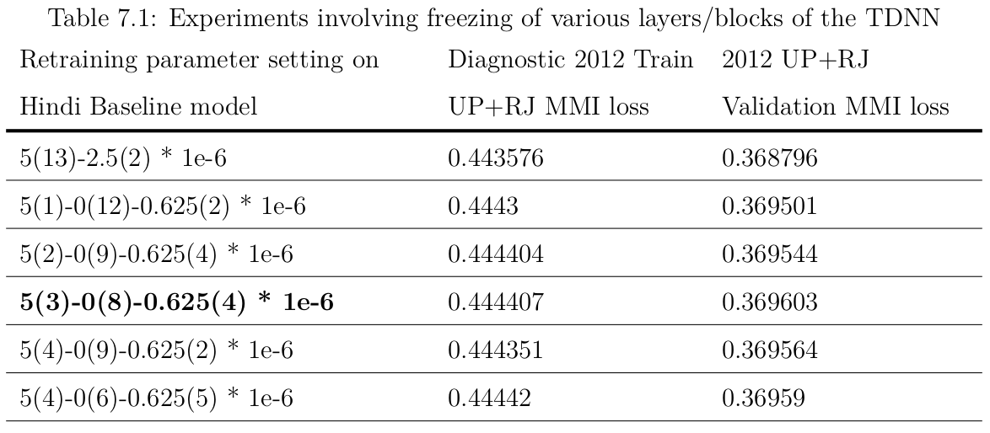
Hindi task results
Best results with freezing middle 8 layers; used for all further experiments
Notes:
–chain.xent-regularize 0.001 –chain.l2-regularize 0.0 –trainer.num-epochs 4 –egs.chunk-width 140 | Other retraining settings

Slide 21
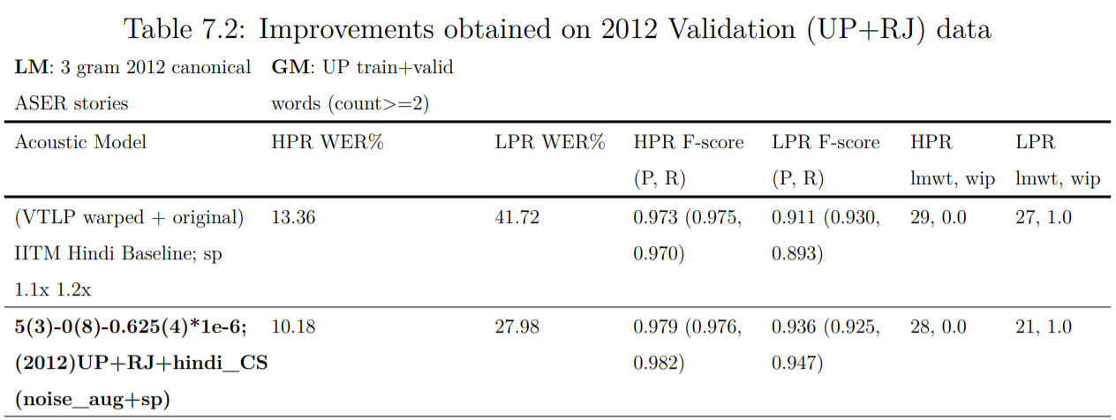
ASER 2012 Decoding results
High Proficiency Recordings (HPR): miscue rate <=20%
LPR Proficiency Recordings (LPR): miscue rate >20%
LPR WER, F-score worse than HPR. # of words in LPR sets are much lower than HPR sets
Notes:
It will be useful to provide HPR, LPR performances on this slide (so we can understand better the system behaviour for different skill levels).
LPR F-score of detected correct words lower cause more errors in LPR sets of the type s:भर,भरा | s:दिनों,दोनों | s:दिनों,नों etc...

Slide 22
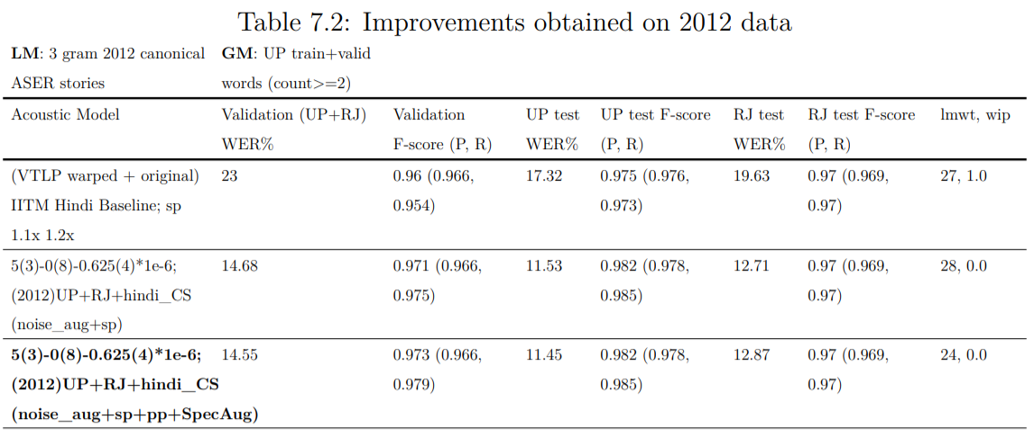
ASER 2012 Decoding results
Improvements with retraining but not much improvement with more augmentation

Slide 23
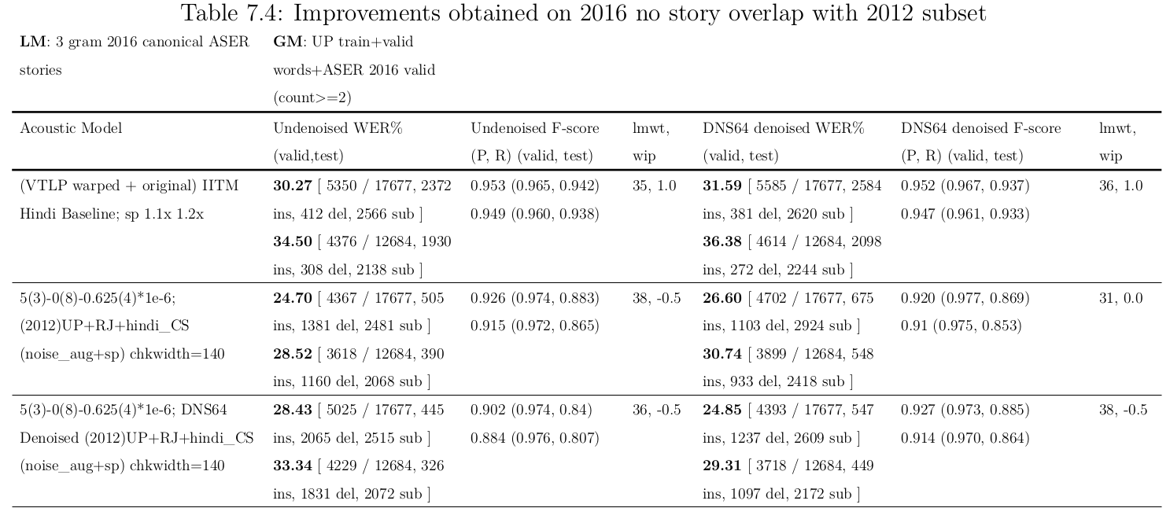
ASER 2016 Decoding results (with/without denoising)
No improvements with denoising
Notes:
Denoiser abandoned for all further experiments

Slide 24
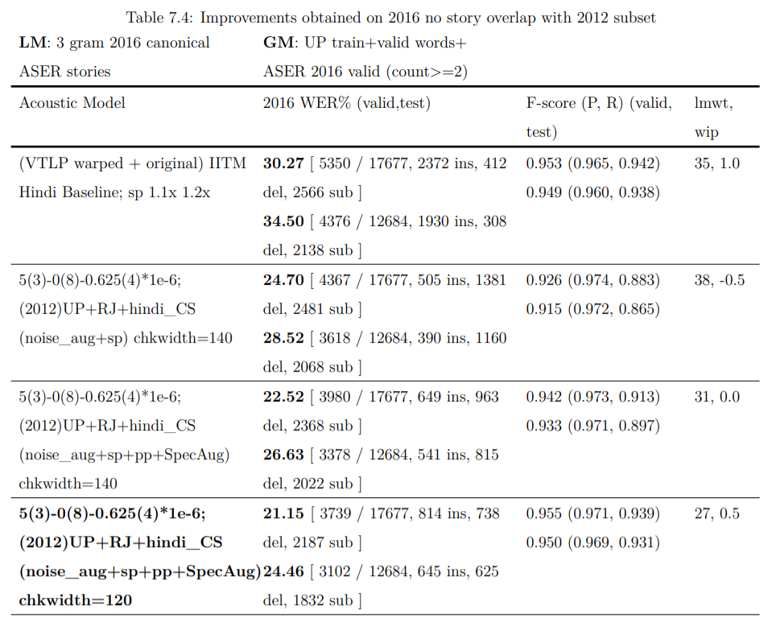
2016 Data augmentation and chkwidth effects
More augmentations and reduced chunk-width: Key contributors to improved performance
9-10% improvement in WER but minor improvements in F-score of correct words over baseline

Slide 25
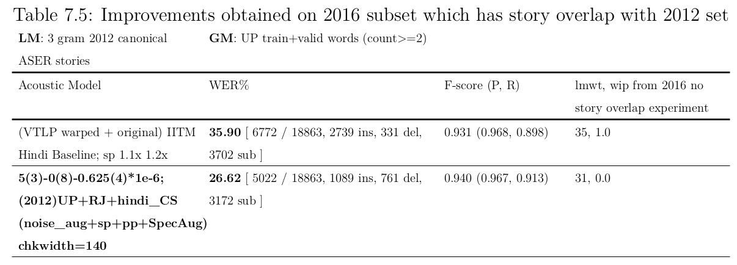
ASER 2016 Decoding results
Improvements obtained with retraining. More insertions in baseline model, compared to more deletions in retrained model (seen throughout)

Slide 26
Discussion of Results
Going from 6 to 20 versions of data augmentation, minor improvements in 2012 data but large improvement (~2% in WER) in 2016 data because of speaker variations between regions.
Reducing chunk-width in 2016 no story overlap case leads to further improvements.
Reducing effect of text contexts during retraining helpful → No story overlap between 2012 retrain and 2016 test sets
Comparing the 2016 and 2012 sets, WERs and F-scores on 2016 sets worse:
Higher miscue rates and noisy nature of 2016 sets:
ASER test+valid 2016 data: 18 ON tags/min and 1.7 IR tags/min
ASER 2012 (UP+RJ test+valid) data: 14 ON tags/min and 0.8 IR tags/min.
Noises and irrelevant speech sections lead to a higher amount of insertions, substitutions and higher WER in the 2016 set compared to the 2012 set.

Slide 27
Discussion of Results
Difference in WER between the baseline and the retrained model:
More insertion counts in baseline; more deletions in retrained irrespective of lmwt, wip because of ON-SIL phone map during retraining. (IITM phone set has only one silence phone SIL)
Both models stumped a little by IR speech, retrained not so much by ON (other noise).
2016 set: Improvements in WER but only minor improvement in F-score with retrained model
Few correct words spoken in a sea of noise lost (decoded as SIL due to ON-SIL map)
Trade-off to be dealt with because of the ON-SIL mapping:
Better at ignoring noise in most cases for better WER but similar at detecting correct words in noisy 2016 recordings.

Slide 28
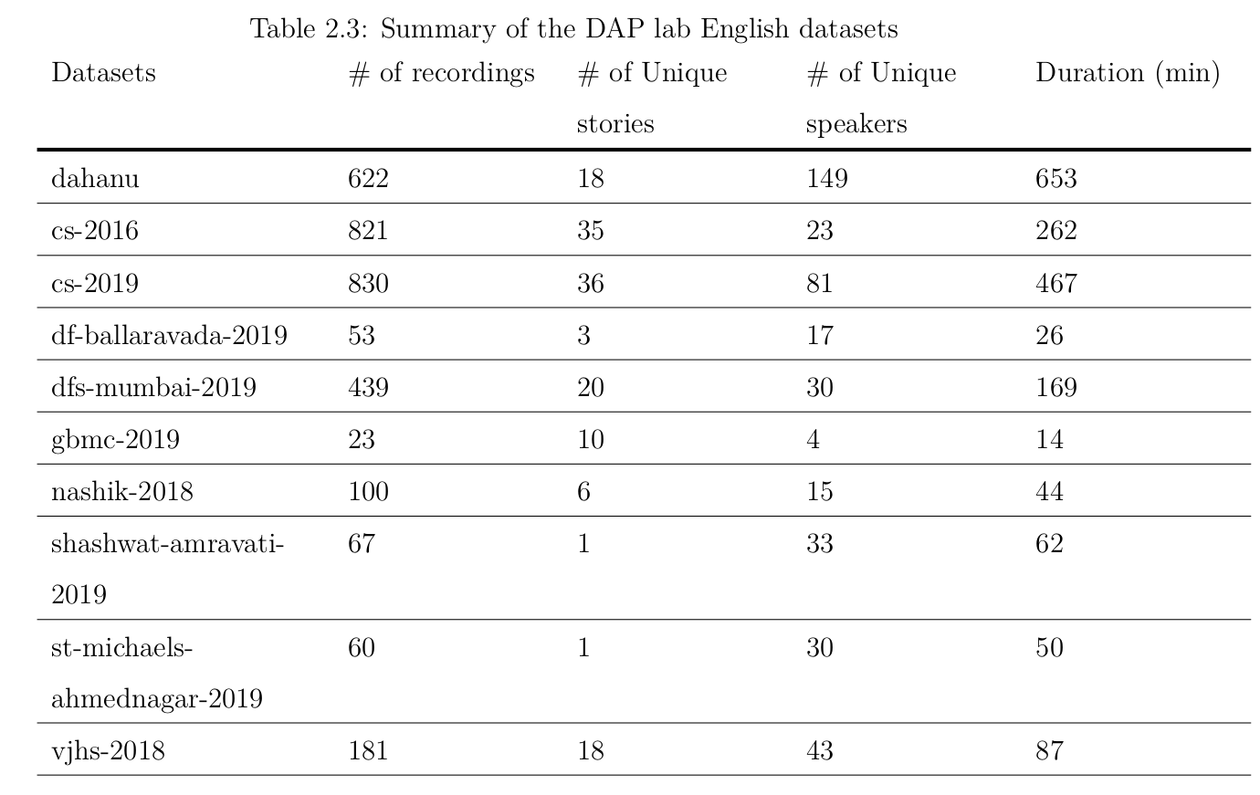
English Task & DAP lab English data
Notes:
Dahanu set transcriptions don’t have substituted words. Only sentences with correct words present were taken. Sentence count and recording count is accurate.

Slide 29
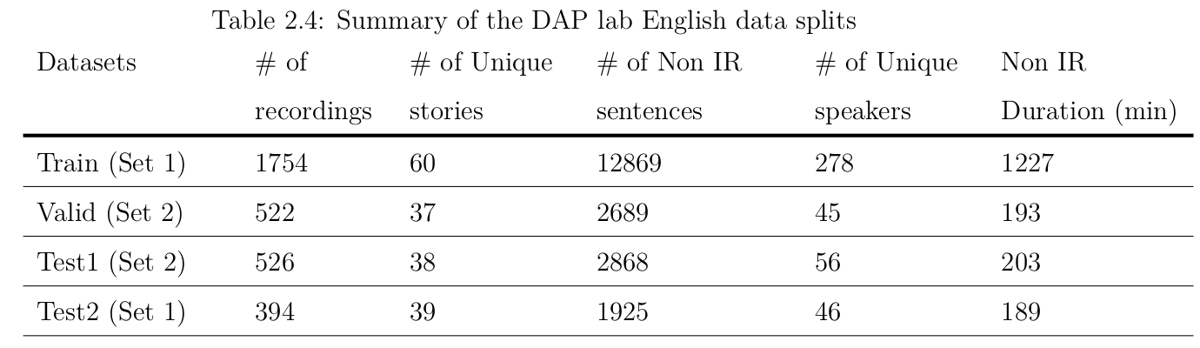
English Task & DAP lab English data
Sentence split data used in all cases. Train and Test2 set have common stories (Set 1). Valid and Test1 have common stories (Set 2).
No story overlap otherwise and no speaker overlap as always between any of the splits
Notes:
Dahanu set transcriptions don’t have substituted words. Only sentences with correct words present were taken. Sentence count and recording count is accurate.

Slide 30
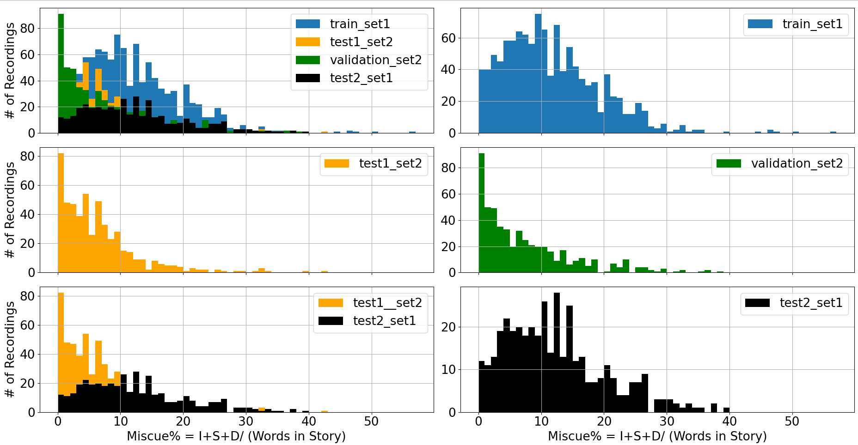
English splits miscue distribution
Test2 set has broader miscue range compared to test1 and valid

Slide 31
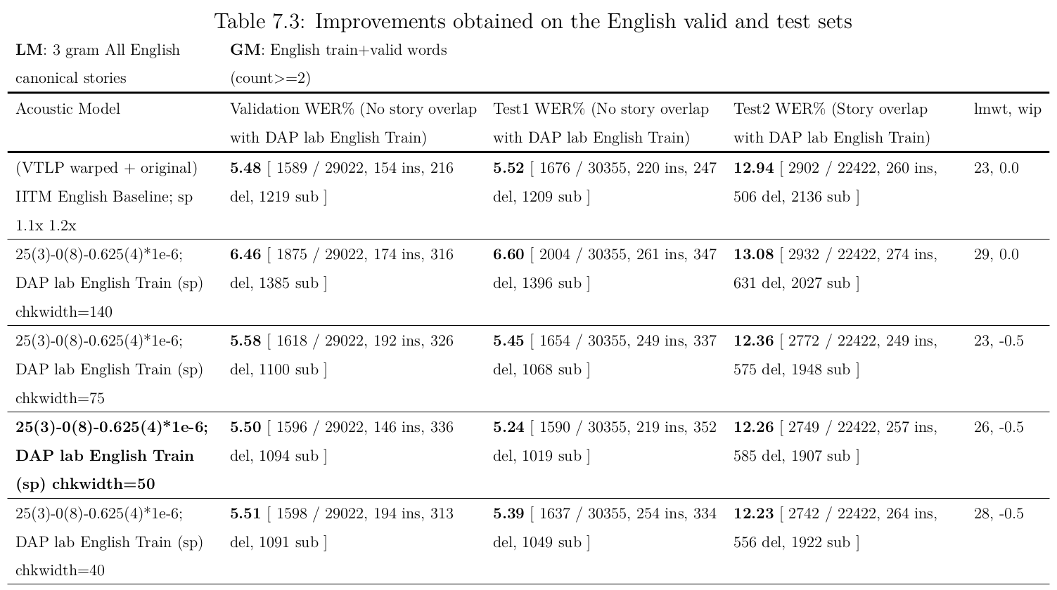
English decoding results
Notes:
–chain.xent-regularize 0.001 –chain.l2-regularize 0.0 –trainer.num-epochs 1 Other retraining parameters for English

Slide 32
Discussion of results
Improvements obtained only after reducing chunk-width because reduced effect of the text contexts during retraining particularly helpful:
No story overlap. Similar to ASER 2016 No story overlap scenario
Larger variety of stories (8-12 in ASER vs 30-40 English stories)
Reduced size of speaker set compared to ASER Hindi (1000 in ASER vs 250 in English)
In the 140 chkwidth retrained model, drop-off in WER on Test2 set (which has story overlap with retrain set) is the lowest: 0.1% compared to 1-1.5% on valid and Test1 set
The reduced chunk-width is a way to eliminate the inherent text contexts present in this retraining data and “clean” it for a general transfer learning purpose. It controls a new aspect of transfer learning and changes the construction of the mini-batch itself.
Notes:
Generally small minibatch size = noisier estimates but not in our case: Because the retraining data also consists of recordings from a fixed set of stories, all the training examples are also very similar in their text contexts. And so are mini-batches. Changing mini-batch size from 64 = no significant effect.

Slide 33
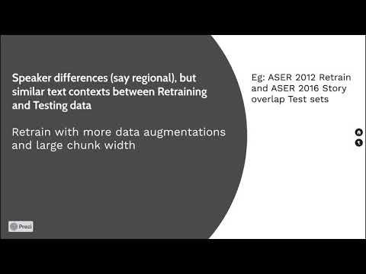
Summarizing transfer learning scenarios
Video/Animation that summarizes scenarios examined

Slide 34
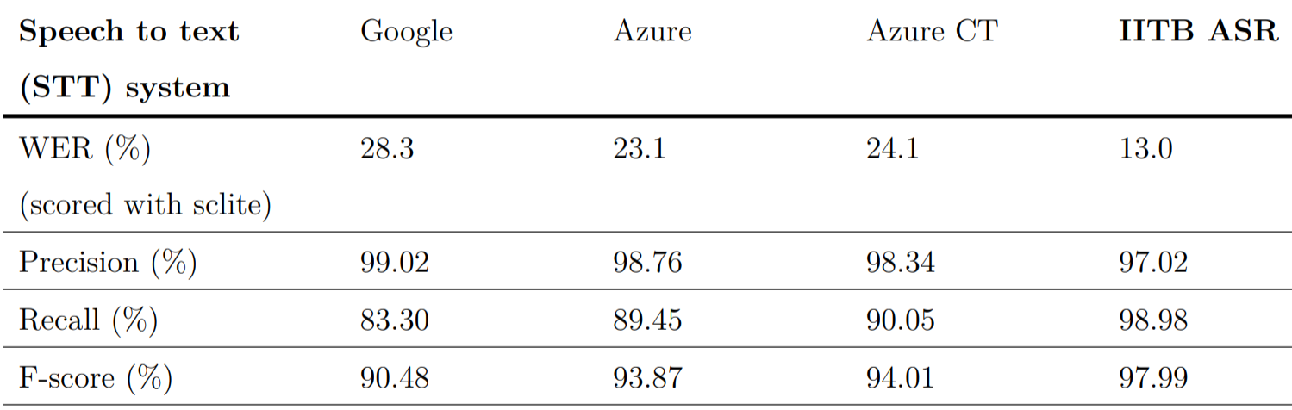
Comparison with off-the-shelf ASR systems
Results from a recent system testing by Pratham on a 100 paragraph test set (ASER 2012) :
Total # of reference words: 4755
The STT output is post-processed for alignment with the canonical text in order to obtain the words uttered correctly.

Slide 35
Conclusion and Future Work
Techniques of data augmentation and transfer learning were investigated
Improvements in miscue detection obtained on test sets over a baseline model
Data augmentation useful when speaker dissimilarities are prominent
Reducing chunk-width for curtailing effect of text context particularly helpful
FUTURE WORK:
Train a (simpler) denoiser using ASER samples for better noise profile
Cross language transfer learning (from Hindi to Marathi). Initial experiments: mixed results, More experiments on English transfer learning
Further improvements that can be made to the LM (sub-word modeling) and GM.

Slide 36
Submissions made to IITM ASR challenges
IITM ASR Challenge | Test set WER (%) | Approach | Ranking
Hindi closed task | 7.47 | kaldi TDNN chain model + RNNLM | 7
Hindi open task | 9.48 | “” + fine tuned on dev | 5
English closed task | 5.33 | kaldi TDNN chain model + RNNLM | 2
English open task | 5.27 | “” + fine tuned on dev | 3

Slide 37
References
[1] ASER. ASER Report for the year 2018. http://img.asercentre.org/docs/ASER2018/ReleaseMaterial/aser2018nationalfindingsppt.pdf, Last accessed October 2020
[2] The Hindu. Basic literacy, numeracy skills of rural Class VIII students in decline.https://www.thehindu.com/news/national/basic-literacy-numeracy-skills-of-rural-class-viii-students- on-a-decline-aser-2018/article26004114.ece, Last accessed October 2020
[3] Speech Processing Lab IIT Madras. Hindi ASR challenge. https://sites.google.com/view/asr-challenge, last accessed: September 2020
[4] Dolly Agarwal, Jayant Gupchup, and Nishant Baghel. A dataset for measuring reading levels in india at scale. In ICASSP 2020-2020 IEEE International Conference on Acoustics, Speech and Signal Processing (ICASSP), pages 9210–9214. IEEE, 2020
[5] Navdeep Jaitly and Geoffrey E Hinton. Vocal tract length perturbation (vtlp) improves speech recognition. In Proc. ICML Workshop on Deep Learning for Audio, Speech and Language, volume 117, 2013

Slide 38
References
[6] Daniel S Park, William Chan, Yu Zhang, Chung-Cheng Chiu, Barret Zoph, Ekin D Cubuk, and Quoc V Le. Specaugment: A simple data augmentation method for automatic speech recognition. arXiv preprint arXiv:1904.08779, 2019
[7] Xingchen Song, Guangsen Wang, Zhiyong Wu, Yiheng Huang, Dan Su, Dong Yu, and Helen Meng. Speech- xlnet: Unsupervised acoustic model pretraining for self-attention networks. arXiv preprint arXiv:1910.10387, 2019
[8] Tom Ko, Vijayaditya Peddinti, Daniel Povey, and Sanjeev Khudanpur. Audio augmentation for speech recognition. In Sixteenth Annual Conference of the International Speech Communication Association, 2015
[9] Kevin McGuinness. 2nd Workshop on Deep Learning for Multimedia, Insight Dublin City University . https://github.com/telecombcn-dl/2018-dlmm/raw/master/D2L02 Transfer.pdf, Last accessed October 2020
[10] Prashanth Gurunath Shivakumar and Panayiotis Georgiou. Transfer learning from adult to children for speech recognition: Evaluation, analysis and recommendations. Computer speech & language, 63:101077, 2020.

Slide 39
Thank you

Slide 40
Extra slides: Examples of decoded texts and discussing results
biju_aser_cg_S3-P_2 (Example for more insertions in baseline)
(a) Ground Truth: SIL ON IR ON आज मामा आए
(b) Baseline model decoded text: हँ स चा बड़ी पर लौट रंग की गया आज मामा आए
(c) Retrained model decoded text: पढ़ने लौट है आज मामा आए
Fewer words in the retrained model text. When evaluating WER: GT is just ”आज मामा आए “ so fewer insertions in retrained model text
mukesh_aser_uk_S4-P_2 (Worst case example for only slight improvement in F-score)
(a) Ground Truth: ON IR ON मोर ON मोर चाचा की MB ON सादी हुई ON IR ON सबको ON नई ON ON IR FP ON IR
(b) Baseline model decoded text: हर साथ्याें मौज चाँ द सुरन की में एक लगाए हुई आती ही मोर खाकर रही थी सब को नी मं गाकर यह गाय ह
(c) Retrained model decoded text: की सब को नहीं

Slide 41
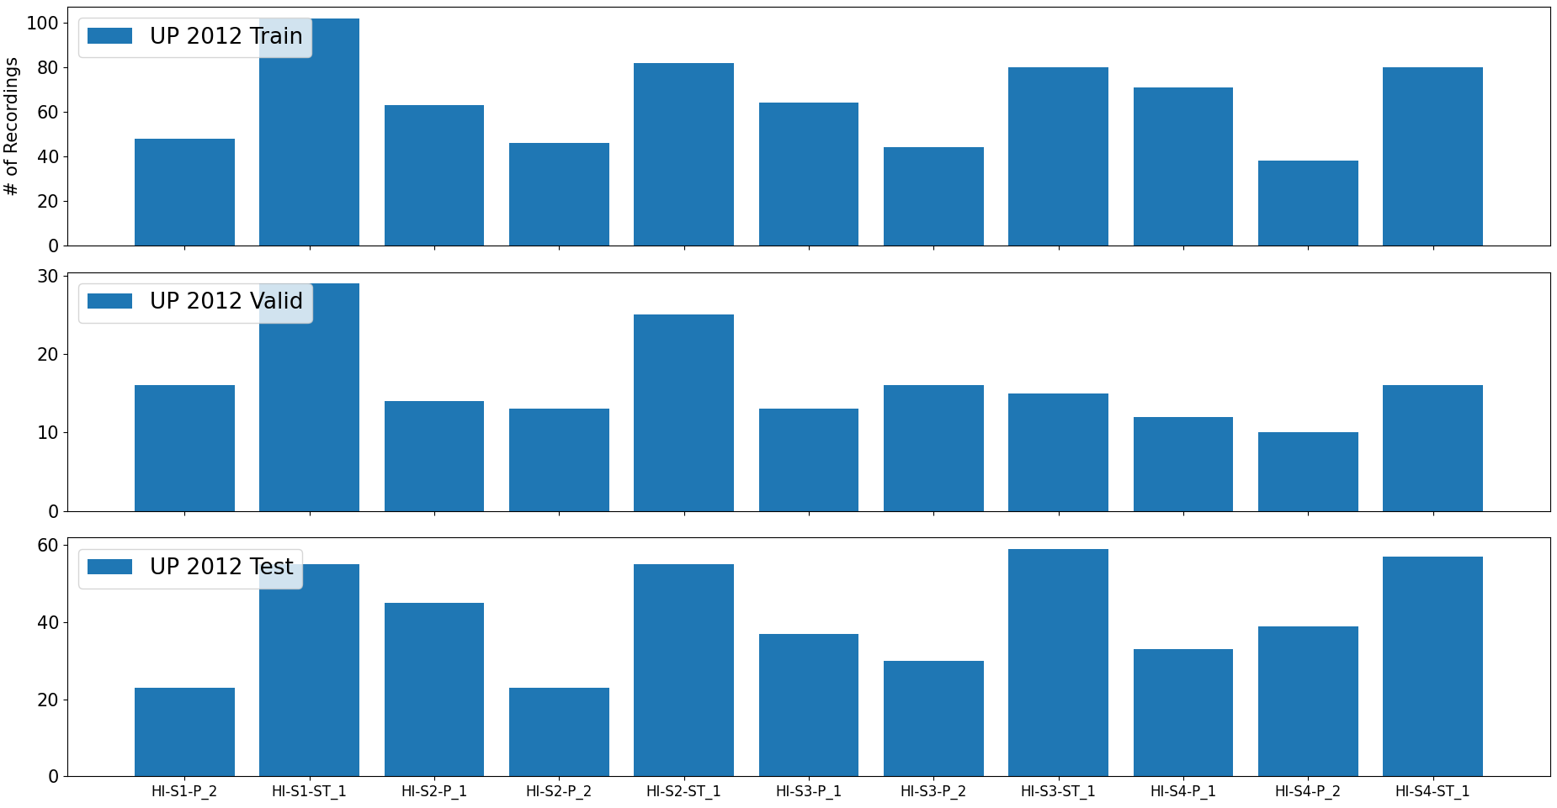
Extra slides on story distribution
Notes:
UP 2012

Slide 42
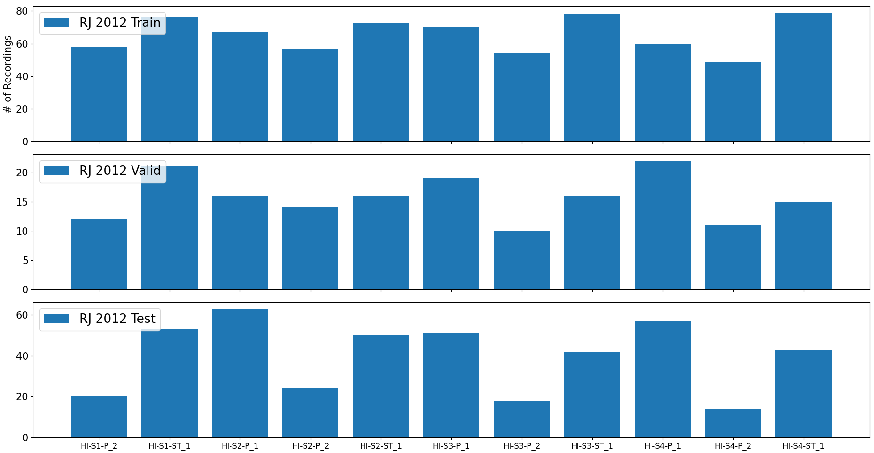
Extra slides on story distribution
Notes:
RJ 2012

Slide 43
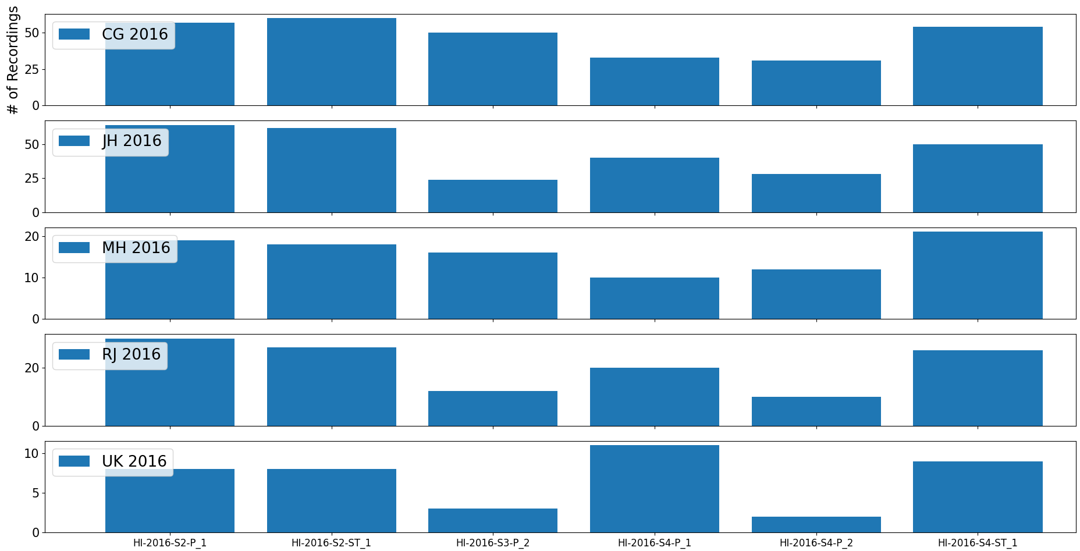
Extra slides on story distribution
Notes:
2016 No story overlap with 2012

Slide 44
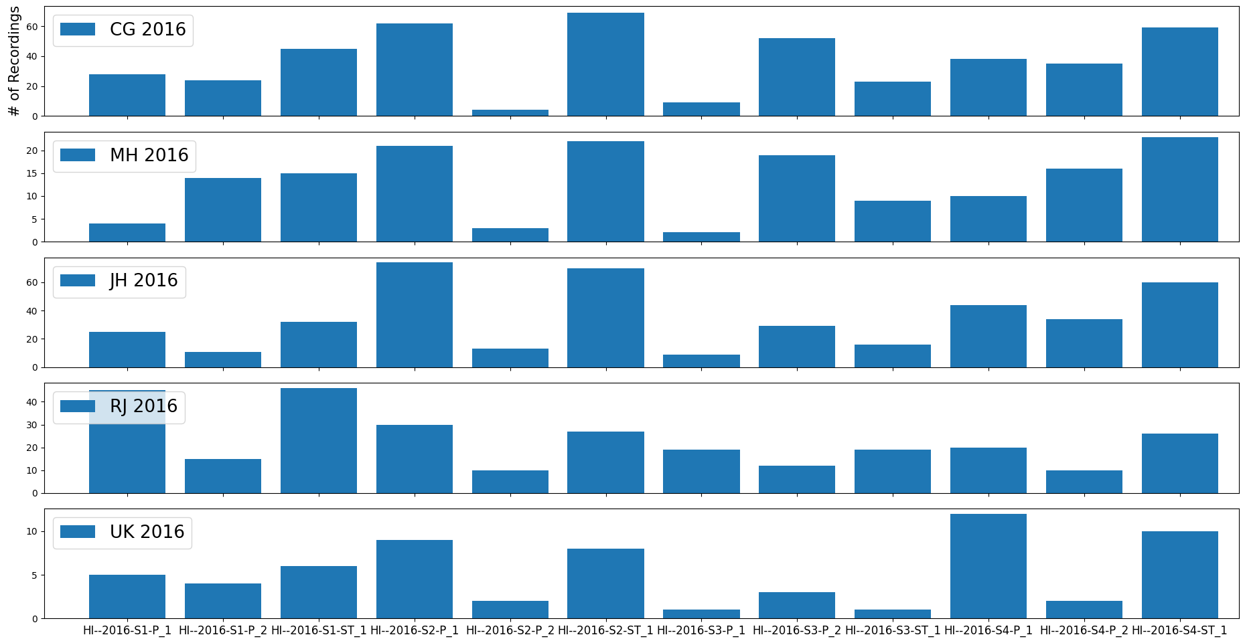
Extra slides on story distribution
Notes:
2016 story overlap with 2012

