Slide 1

EVENT TICKET BOOKING SYSTEM
Shreedevi R H

Slide 2

Aim:
This system helps you to
manage tickets for small events, college fests, or workshops.
By creating tables for event listings, seat categories, and user bookings, you see how to maintain concurrency when multiple individuals try to book the same spot.

Slide 3
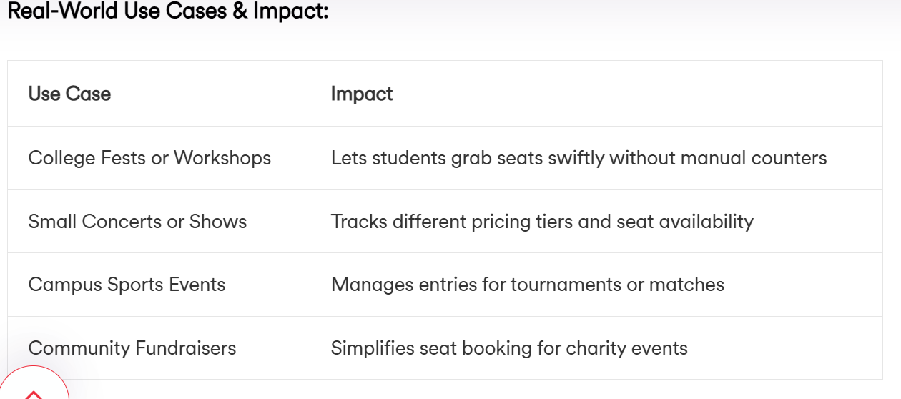

Slide 4
What Will You Learn?
Designing Event and Ticket Tables: Linking seat availability, price tiers, and user info.
SQL Queries for Booking and Cancellations: Ensuring seat counts adjust correctly after each transaction.
Concurrency Control: Avoiding duplicate bookings or seat overcount.
Indexing for Quick Lookups: Searching which seats remain available in specific sections.

Slide 5
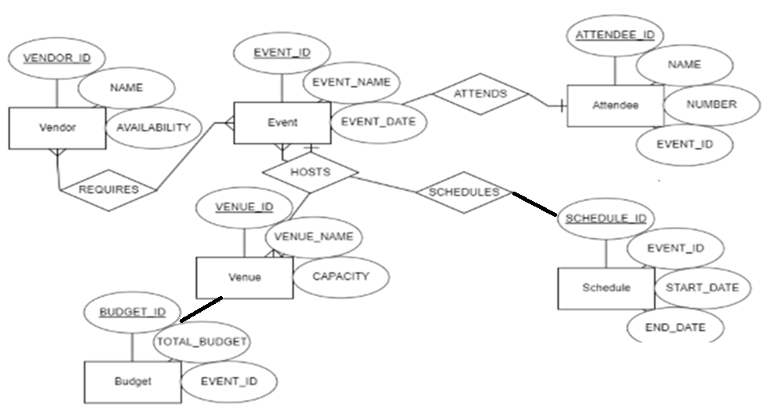
ER diagram
Attributes
Relationship (JOINs)
Entities

Slide 6
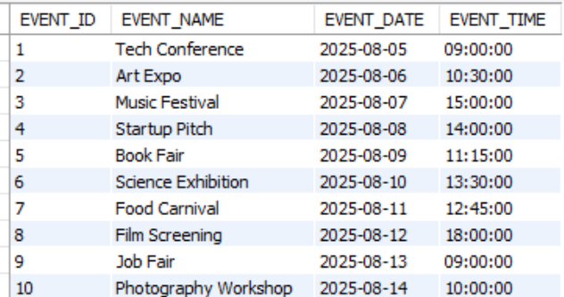
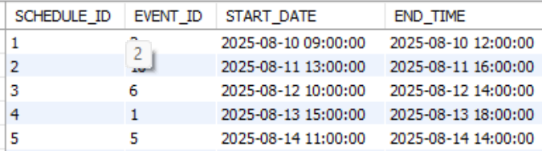
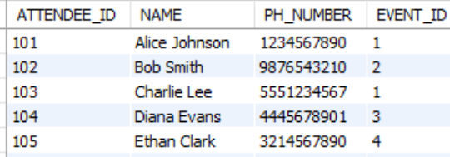
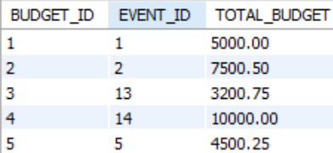
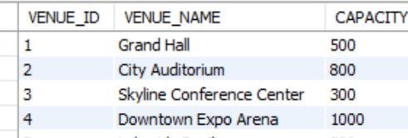
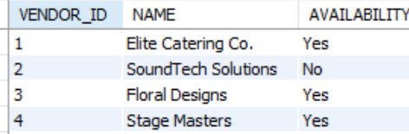
Relational Database Model for Event Management

Slide 7
1. Event table: Stores event information
EVENT_ID (Primary key): Unique identifier for each event.
EVENT_NAME: It describes the name of the event.
EVENT_DATE: It describes the Date of the Event.
2. Attendee table: Store attendee's information
ATTENDEE_ID (Primary key): Unique identifier for each attendee.
NAME: It describes the name of the attendee.
NUMBER: It describes the phone number of the attendee.
EVENT_ID: It is a foreign key(references EVENT_ID in the Event table).

Slide 8
3. Venue table: Contains information about the event
VENUE_ID(Primary key): unique identifier for each venue.
VENUE_NAME: It describes the name of the venue.
CAPACITY: It describes the maximum capacity of the venue.
4. Vendor table: Provides goods for the event
VENDOR_ID(Primary key): unique identifier for each vendor.
NAME: It describes the name of the vendor.
AVAILABILITY: It checks the availability of the event.

Slide 9
5. Schedule table: Arrange to take place at a particular time
SCHEDULE_ID(Primary Key): unique identifier for each Schedule.
EVENT_ID: It is a foreign key(references EVENT_ID in the Event table).
START_DATE: It describes the starting date of the event.
END_DATE: It describes the ending date of the event.
6. Budget table: A financial planning
BUDGET_ID(Primary Key): unique identifier for each budget.
EVENT_ID: It is a foreign key(references EVENT_ID in the Event table).
TOTAL_BUDGET: It describes the total budget of the event.

Slide 10
Some queries related to the
Event Management System

Slide 11
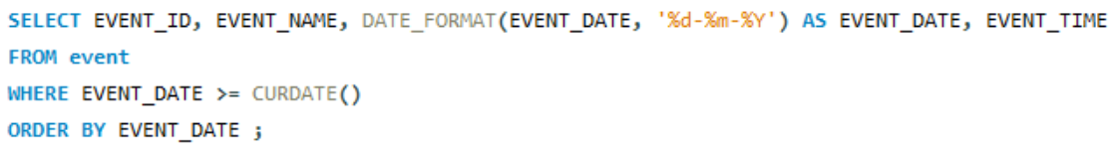
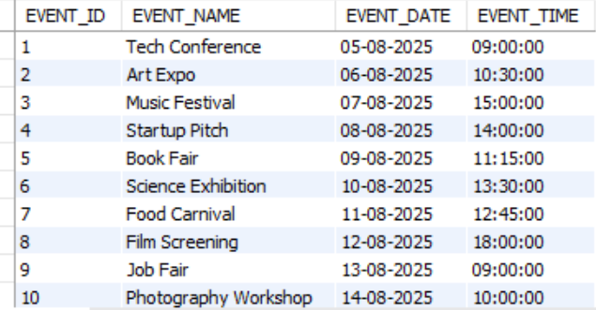
Retrieve all upcoming events:

Slide 12
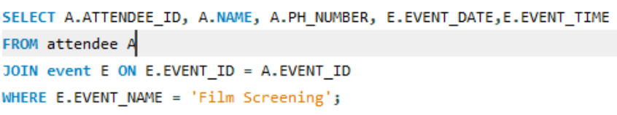
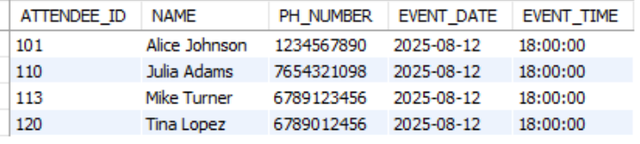
Find attendee details for a specific event:

Slide 13
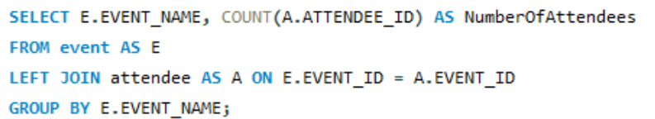
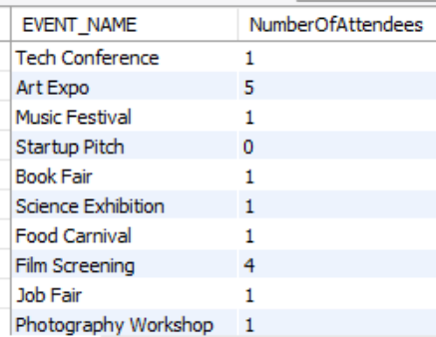
Count the number of attendees for each event:

Slide 14
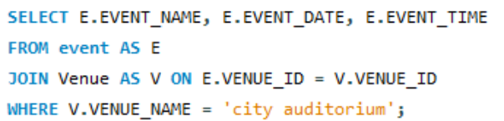

List all events held at a particular venue:

Slide 15
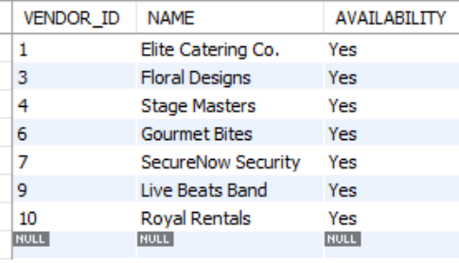
List all vendors who are available

Slide 16
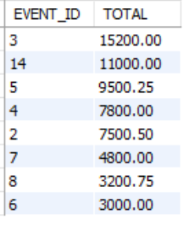
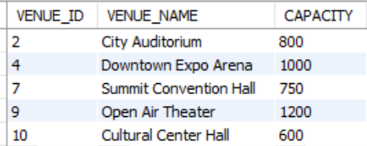
Find the total budget for each event
Seating capacity

Slide 17
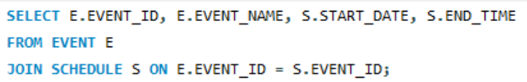
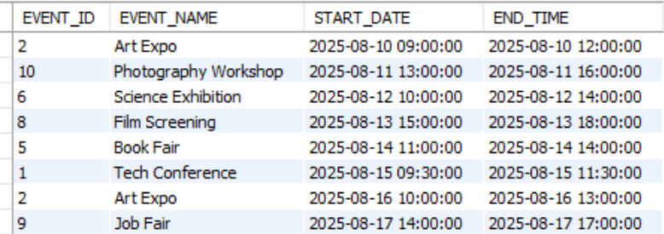
List events with their schedule

Slide 18
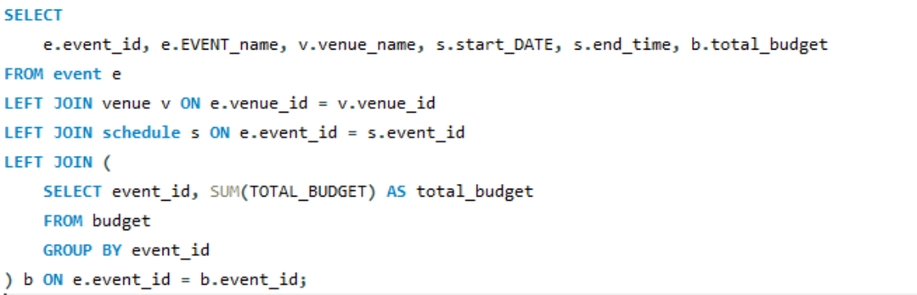
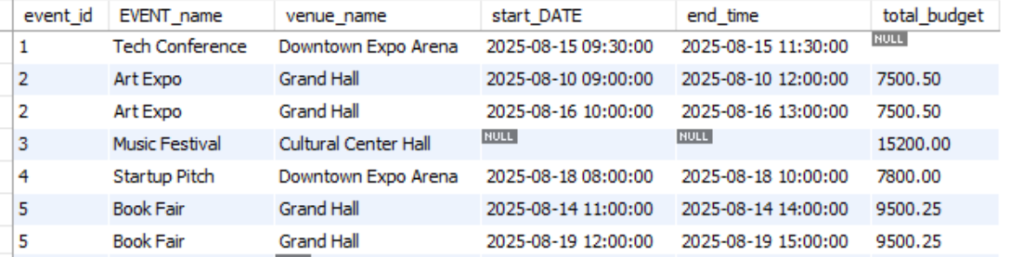
Get event details with venue name, vendor name, schedule time,
and total budget (via subquery)

Slide 19
Thank you

