Slide 1
The Learning Hub
Shreejal Shrestha
TU Reg No: 6-2-469-32-2024
Supervisor: Pesal Rai
Department of Computer Application, D.A.V. College

Slide 2
Introduction
Easy platform to share and access notes.
Notes are organized by semester and subject.
Admin approves notes before publishing.
Students can rate and bookmark notes.
Subject-wise quizzes to test knowledge.
Leaderboard to compare performance.
Review wrong answers and improve.

Slide 3
Problem Statement
Academic notes are scattered across different platforms.
Finding notes for specific subjects and courses is time-consuming.
There is no centralized platform to share and manage notes.
Students have limited tools to test their knowledge
A system is needed for organized notes, admin approval, and subject-wise quizzes.

Slide 4
Objectives
Develop a web-based Notes Sharing System for students.
Make notes easy to upload, download, search, and manage.
Organize notes by course, semester, and subject.
Ensure quality through admin approval, ratings, and bookmarks.
Support learning with quizzes, leaderboards, and result tracking.

Slide 5
Scope and Limitation
Scope
Limitation
Internet Dependency
Manual Verification
Content Quality
Limited Academic Features
Notes Upload & Download
Admin Management
Rating & Bookmarking
Subject-wise Quiz

Slide 6
Methodology
Uses the Waterfall Model of SDLC.
Follows a step-by-step development process.
Main phases: Requirements → Analysis → Design → Development → Testing → Implementation.
Suitable because the requirements and features are clearly defined.
Helps with proper planning, documentation, and project management.

Slide 7
Literature Review
Mero Notes [1] provides subject-wise notes, study materials, model questions, and exam preparation resources.
TU Papers [2] provides previous-year question papers, syllabi, notes, and other academic materials for TU students.
Wong et al. [6] found that regular engagement with digital learning platforms is associated with better academic performance, highlighting the importance of accessible and organized learning resources.

Slide 8
Feasibility Study
Technical — HTML, CSS, JavaScript, PHP, MySQL, and XAMPP for development and database management
Operational — Simple and user-friendly interface for students and administrators
Economic — Uses free and open-source technologies, keeping development costs low

Slide 9
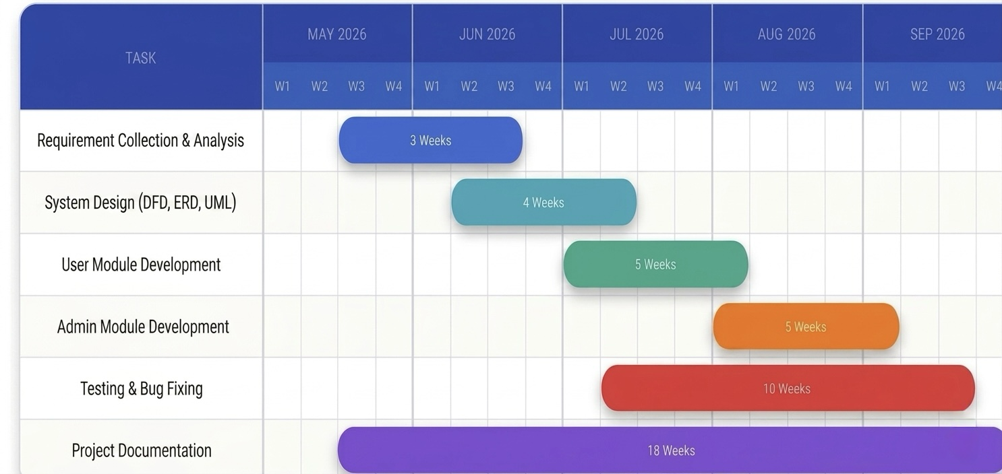
Schedule feasibility
Planned development using a Gantt Chart

Slide 10
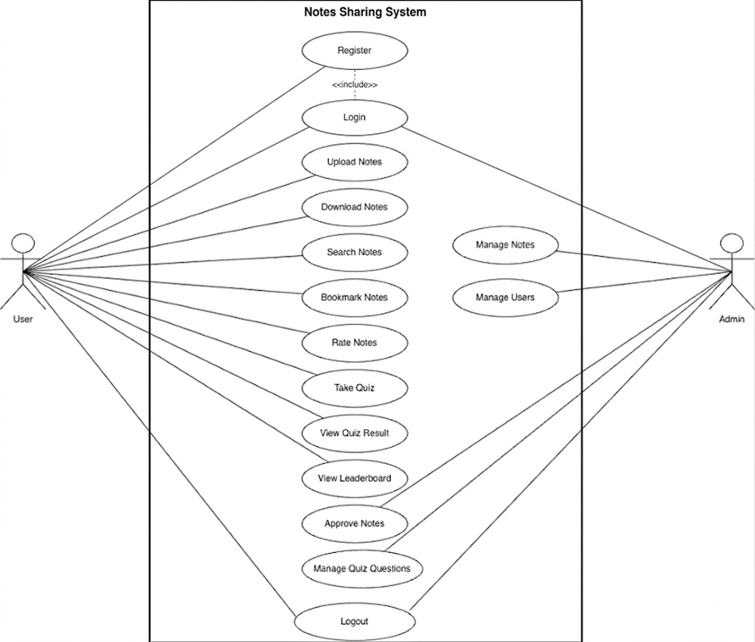
Use Case Diagram

Slide 11
ER-DIAGRAM

Slide 12
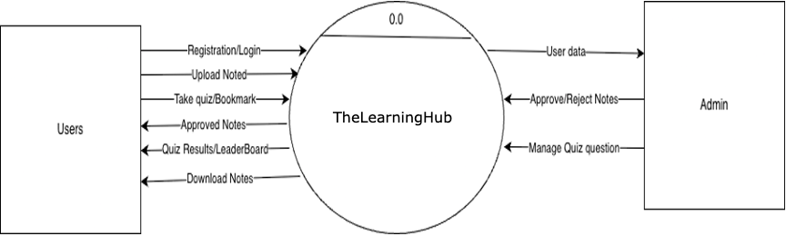
Process Modeling-Context Diagram

Slide 13
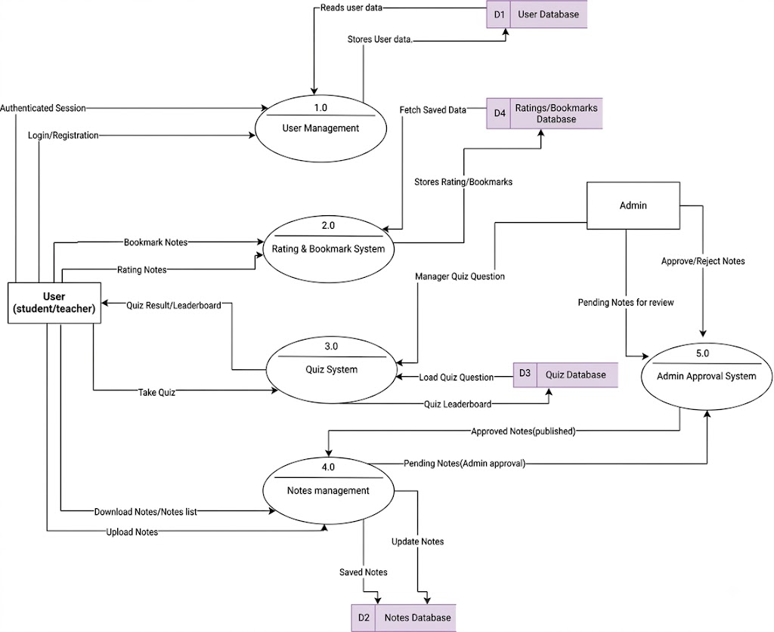
Process Modeling- DFD Level 0

Slide 14
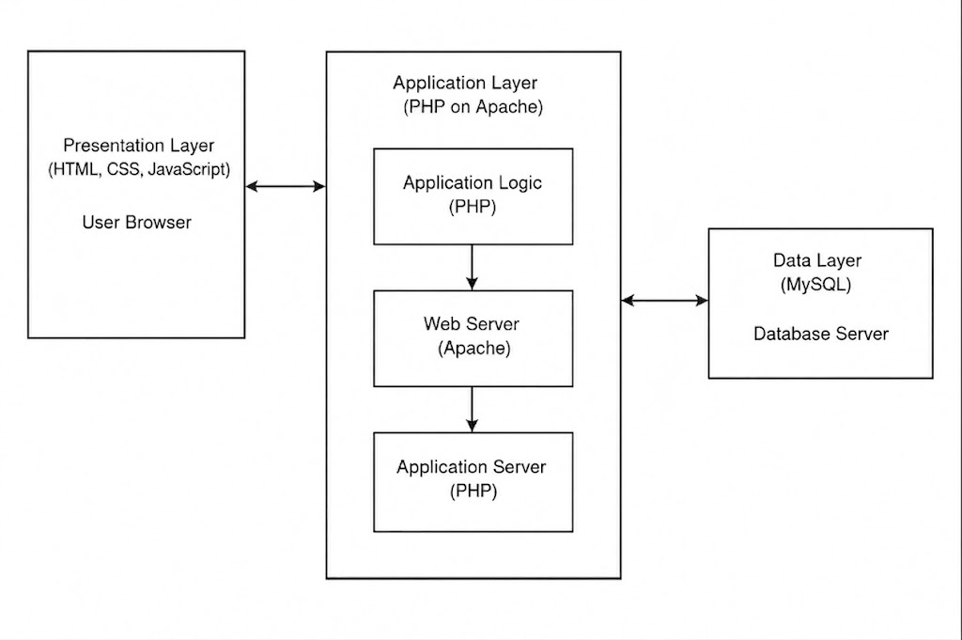
System Architecture

Slide 15
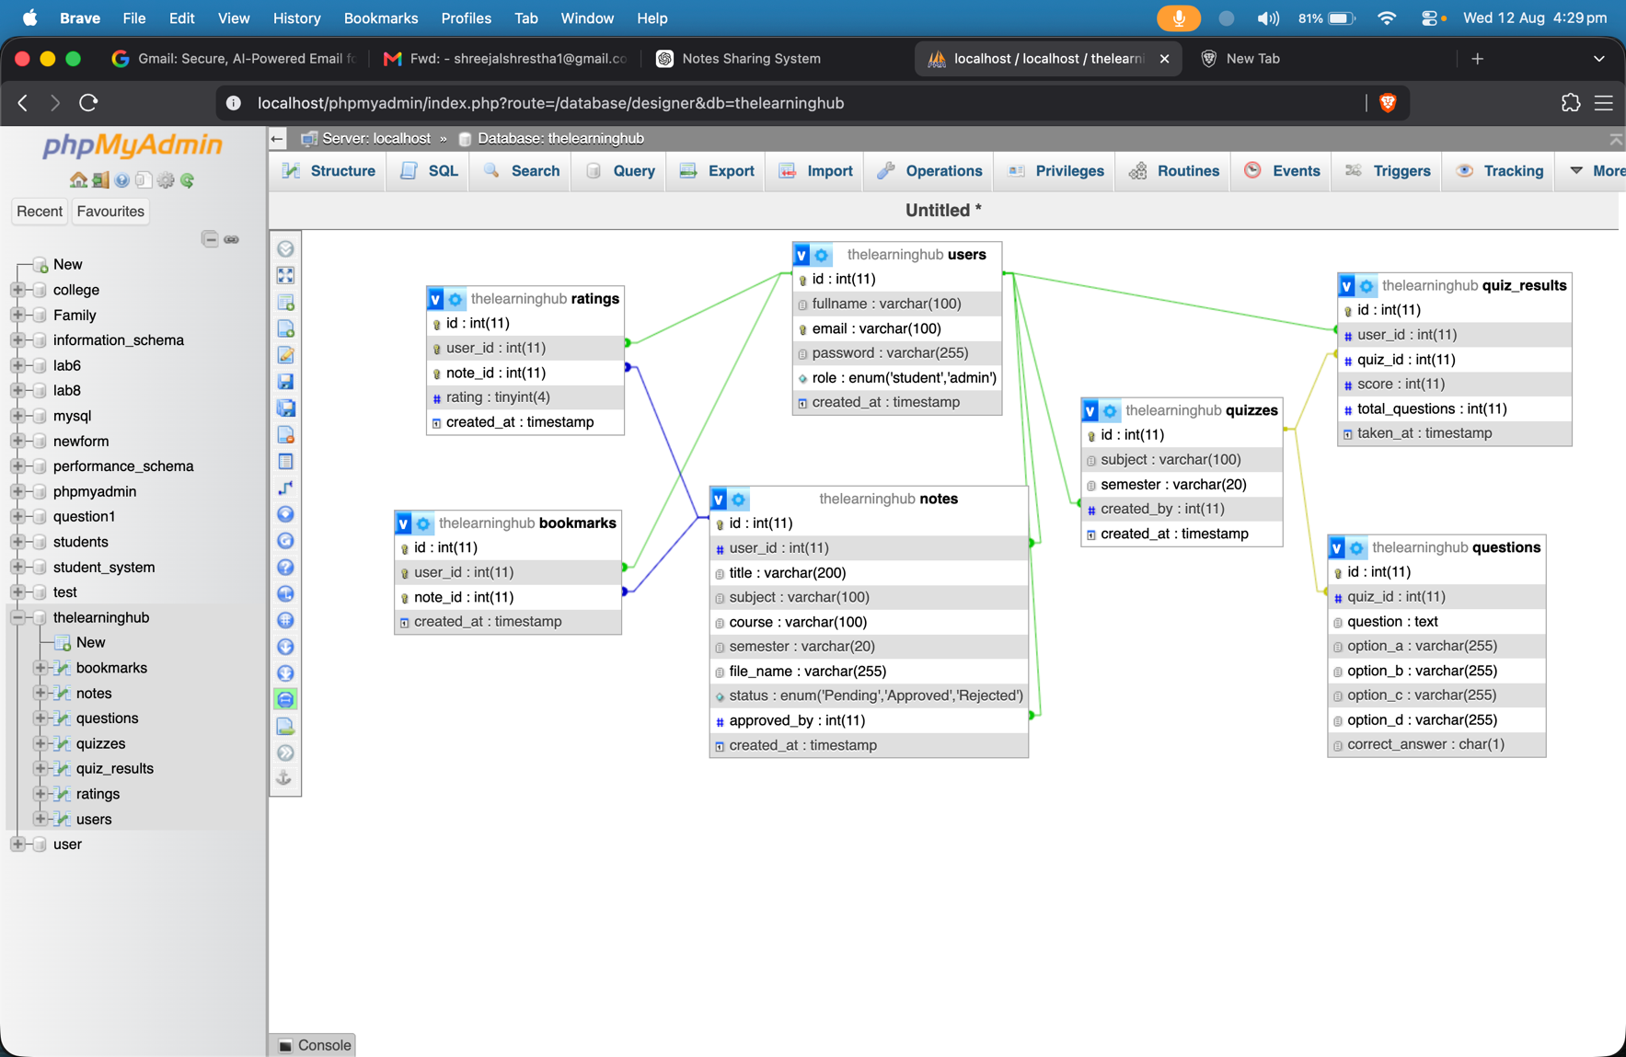
Database Schema

Slide 16
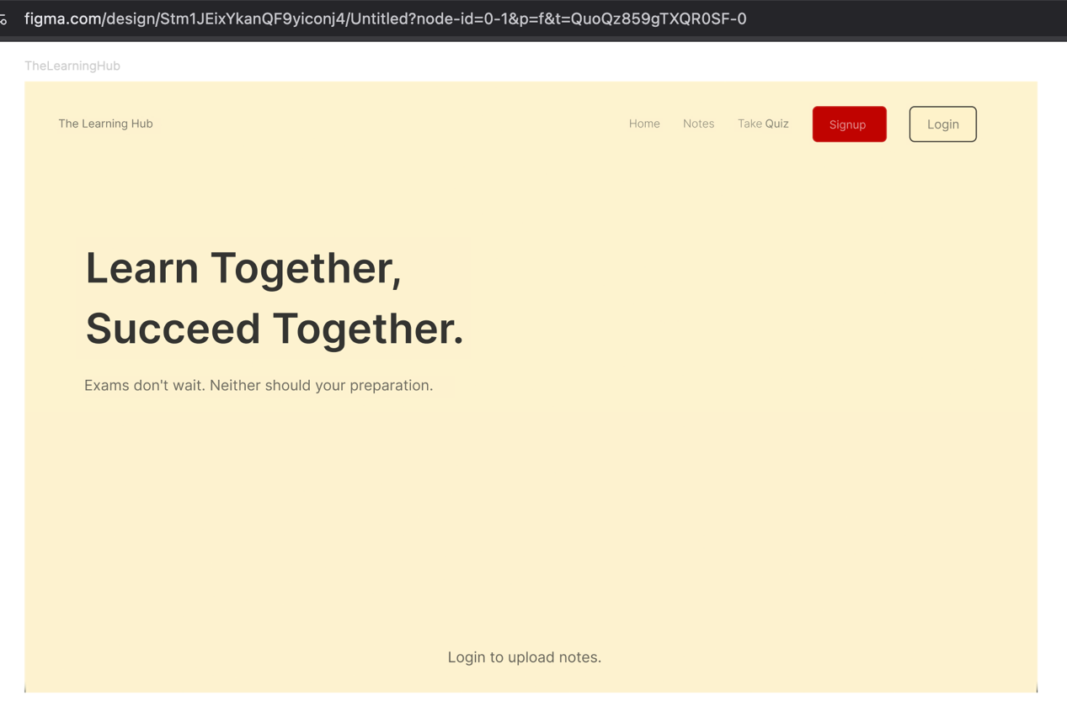
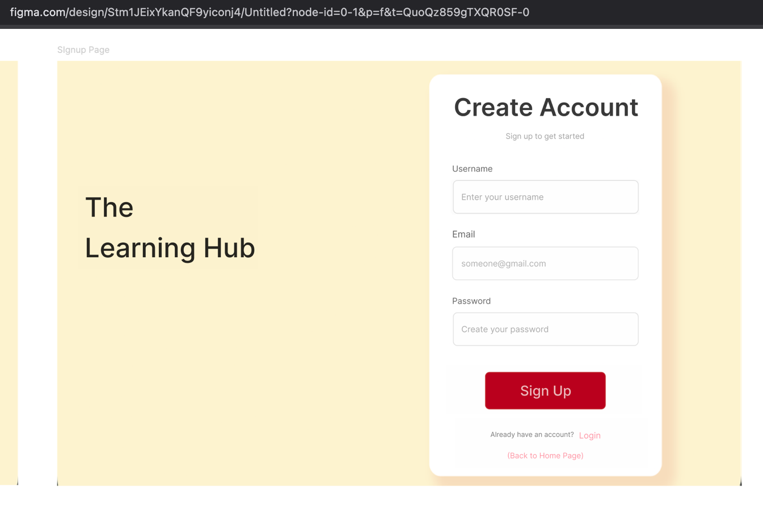
UI/UX DESIGN

Slide 17
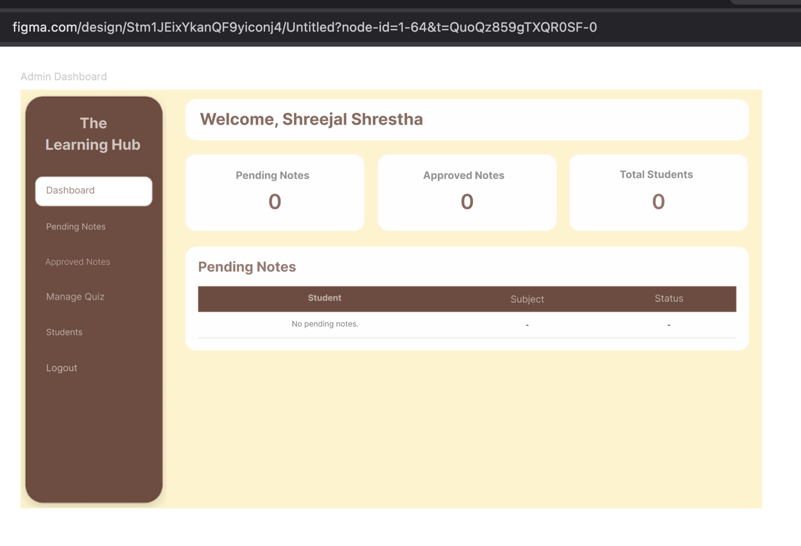
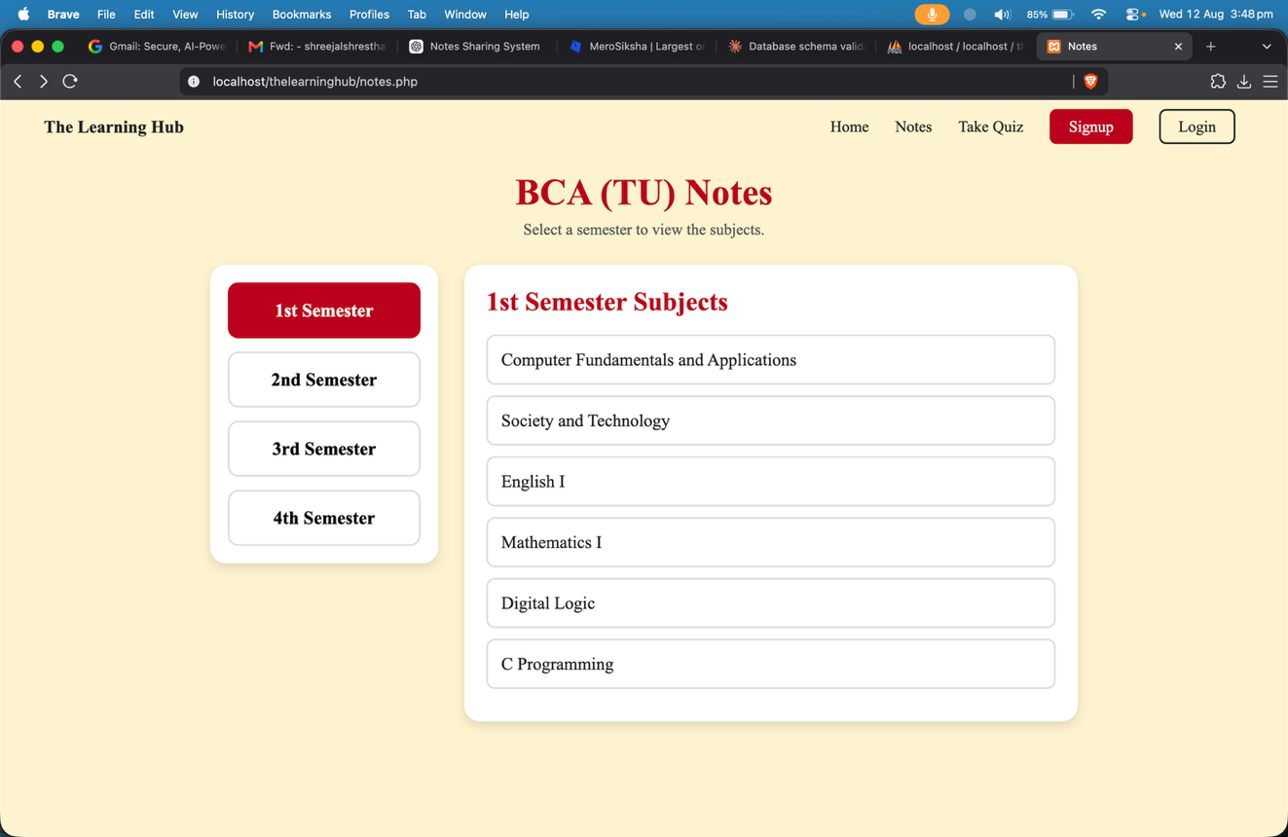

Slide 18
Completed
To be Completed
Login Module
Signup Module
Dashboard Modules
Quiz Module
Notes Module.
Admin Approval
Logout Module
Quiz Enhancement
Leaderboard Module
Notes Enhancement
Upload Limit
Final Testing

Slide 19
References
[1] Mero Notes, “All Your Study Notes in One Place,” Mero Notes. [Online]. Available: Mero Notes.
[2] TU Papers, “About TU Papers,” TU Papers. [Online]. Available: TU Papers.
[3] Uni Bytes, “Uni Bytes – Educational Resources Platform,” Uni Bytes. [Online]. Available: Uni Bytes.
[4] MeroSiksha, “What is MeroSiksha?,” MeroSiksha. [Online]. Available: MeroSiksha.
[5] xA. Wong, W. L. Lee, M. S. L. Chan, Y. E. Tan, J. M. K. Huang, and Y. H. Lee, “Digital learning resources and student success: Analyzing engagement and academic performance,” Journal of Applied Learning and Teaching, vol. 8, no. Sp. Iss. 2, 2025

Slide 20
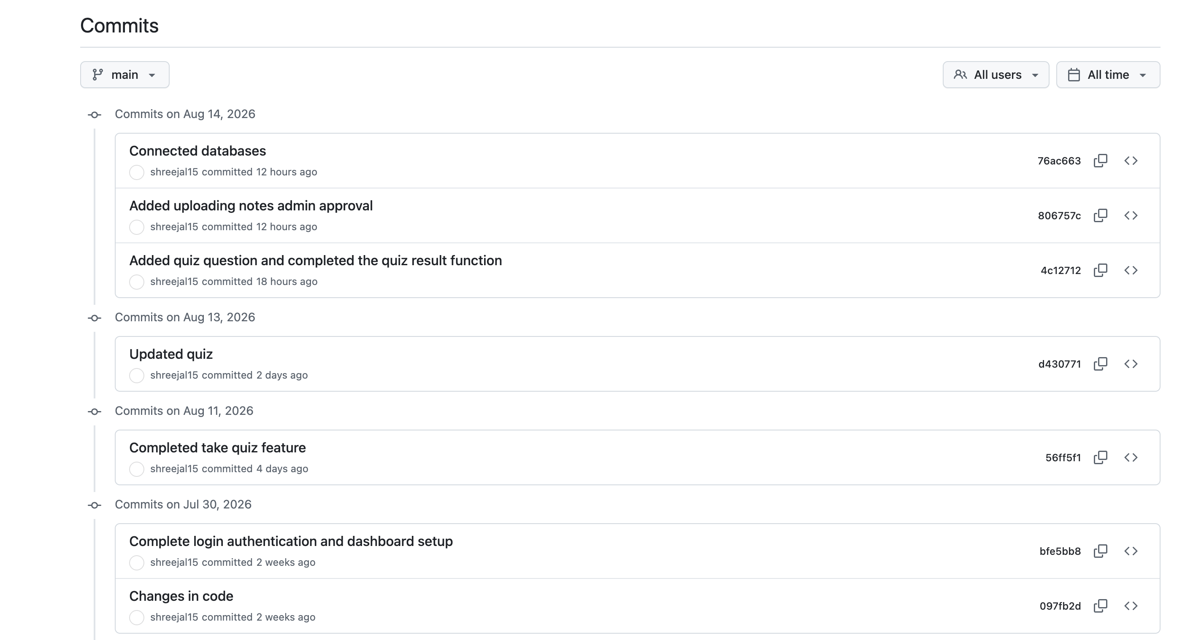
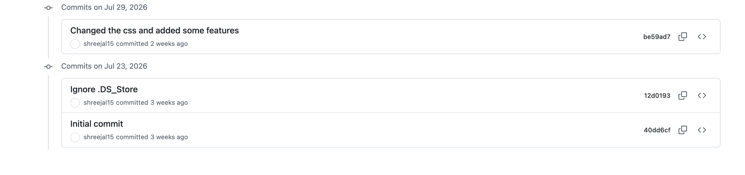
Git Commit History

Slide 21
THANK YOU

