Slide 1
Chapter 1
Basics in Website Design

Slide 2
What is internet?
The internet is a global network of computers and other devices that are connected together to share information and communicate with each other. It allows people all over the world to connect with each other, access information, and share resources.
The internet is made up of many different technologies, including routers, switches, servers, and cables, which work together to ensure that data can travel from one device to another quickly and efficiently.
Through the internet, people can send emails, access websites, stream videos, play games, and much more.
The internet has become an essential part of modern life, connecting people and businesses across the world and transforming the way we communicate and share information.

Slide 3
How was the internet created?
The internet was created because people needed a way for computers to talk to each other without being interrupted. Before the internet, computers used a slow method called circuit switching, where all the data had to be sent at once. If something went wrong during the transfer, the whole thing would fail.
So, scientists came up with a new way called packet switching. With packet switching, data is broken into smaller pieces called packets, and each packet is sent separately. If something goes wrong, only that packet is affected, not the whole transfer. Once all the packets arrive, they are put back together to create the original message. This is how the internet works!

Slide 4
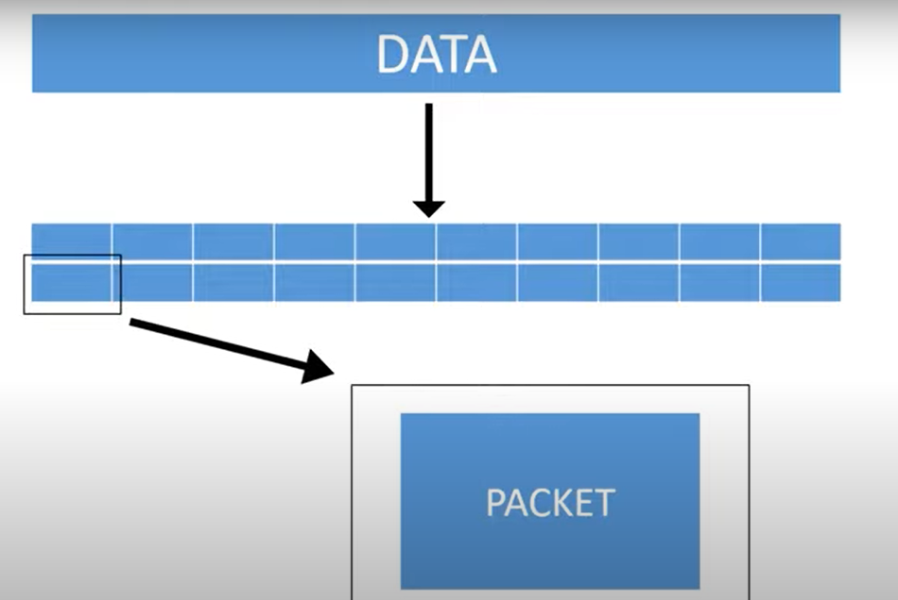


Slide 5
Evolution of Internet
The internet evolved from packet switching, allowing computers to connect through a network called ARPANET( Advanced Research Projects Agency Network ).
Then, the World Wide Web (WWW) was developed, which is an internet-based global information system that allows people to view web pages containing text, images, videos, and other multimedia and navigate between them by using hyperlinks.

Slide 6
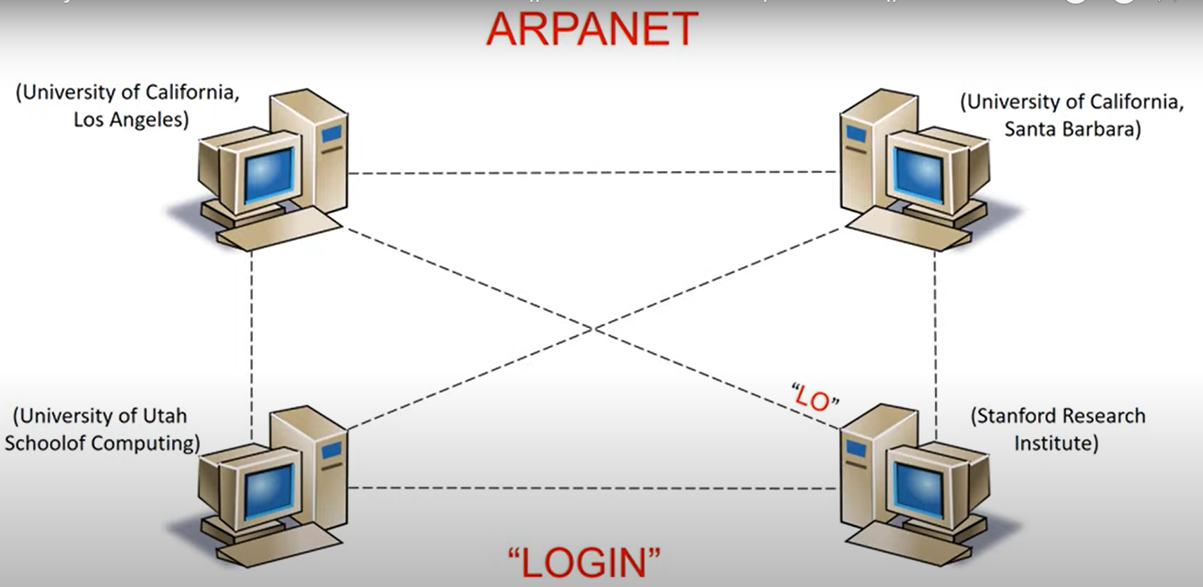
Evolution of Internet

Slide 7
Evolution of Internet
Here is a timeline of the important events in the history of the internet:
➢1965: First two computers are connected via packet switching at MIT.
➢1969: ARPANET, the first widely used computer network, is launched.
➢1971: Email is developed, allowing electronic messages to be sent between computers.
➢1973: Nodes in Norway and Great Britain are connected to ARPANET, making it a global network.
➢1974: The first ISP, Internet Service Provider, is launched. The initial design for TCP is published.
➢1981: The National Science Foundation establishes CSNET, a network for computer scientists at research universities.
➢1982: ARPANET computers switch to the TCP/IP protocols.
➢

Slide 8
1983: The Domain Name System (DNS) establishes the naming conventions for websites, such as .com, .org, .edu, and .gov.
➢1988: IRC, Internet Relay Chat, was launched, a precursor (ansestor) of our current instant messaging apps.
➢1990: Tim Berners-Lee develops HTML, which has a huge impact on how people interact with the internet.
➢1991: The World Wide Web is introduced to the public.
➢1993: The first browser accessible for the general user, Mosaic, is launched. The White House and the United Nations create web pages.
➢1995: Commercial businesses begin operating on the internet, including eBay and Amazon.
➢1996: Hotmail, the first web-based email service, is launched.
➢1998: Google goes online, revolutionizing the way users locate resources on the internet.
➢2004: Web 2.0 becomes popular, which refers to websites that are user-driven and interactive. Facebook launches.
➢2005: YouTube and Reddit launch.
2010: The internet records 400 million active users for the first time.➢

Slide 9
WWW
The World Wide Web (WWW) (Also known as w3 and the Web) is a global information system that operates on the Internet.
It is a system of interlinked hypertext documents contained on the internet. With the help of a web browser, you can access web pages that may contain text, images, videos, and other multimedia, and navigate between them by using hyperlinks.
The main purpose behind the development of the World Wide Web was to create a platform for sharing and accessing vast amounts of information on a global scale which would allow collaborators in remote sites to share their ideas and all aspects of a common project.
In simple terms, the web is the most popular Internet service, which can access a higher variety of data like text, image, audio, video, and many more service on the internet. It has revolutionized the way we share and access information, and has made it possible for people from all over the world to collaborate on projects and ideas.

Slide 10
WWW’s features
The World Wide Web has several features that make it a powerful tool for accessing and sharing information:
Hypertext Technology: The WWW is built on Hypertext technology, which makes it easy to access linked documents on the Internet and navigate between them.
Efficient Connection: Each time you access a new document through a link, a connection is made with the web server that the document is on, and once the appropriate document is retrieved, the connection is broken. This makes the WWW efficient and fast.
Browser Interface: The interface for the WWW is a browser, which allows users to search, traverse, and use many types of information at numerous sites and in multiple forms.
Notes:
Note: HTTP (Hypertext Transfer Protocol) is a stateless protocol. This means that each request sent from a client to a server is considered independent and does not rely on any previous requests or responses. The server does not maintain any information about the client's previous requests. Therefore, each HTTP request is processed independently by the server. To maintain state between requests, web developers use cookies, session variables, or other techniques.

Slide 11
Operating System Compatibility: The WWW is accessible on multiple operating systems, including Apple, UNIX, Macintosh, DOS, and Windows.
Hypertext Transfer Protocol: The WWW has a protocol called Hypertext Transfer Protocol (HTTP), which acts as an interface between a Web Client Software like Netscape Navigator. HTTP helps to facilitate the transfer of data between web servers and clients.
URLs: To access different types of information on the Internet, you use different kinds of URLs. Most URLs begin with http:// , which indicates a file at an actual web site. If you want to get to a file on the Web using FTP, you would use a URL that looks like ftp://name_of_site/directory/f1_name.

Slide 12
Advantages of WWW
1)Easy accessibility: The WWW is accessible to anyone with an internet connection and a browser, making it easy to access information from anywhere in the world.
2)Wide range of information: The WWW contains a vast amount of information on virtually every topic, making it a valuable resource for research, learning, and entertainment.
3)Easy navigation: The use of hyperlinks on the WWW makes it easy to navigate between different pages and websites, allowing users to quickly find the information they need.
4)Universal access: The WWW is designed to be accessible to anyone, regardless of their location or the device they are using, making it a powerful tool for global communication and collaboration.

Slide 13
Advantages of WWW
5)Interactive content: The WWW allows for the creation of interactive content, such as videos, animations, and games, which can engage and entertain users in new ways.
6)User-generated content: The WWW enables users to create and publish their own content, such as blog posts, videos, and social media updates, allowing for greater participation and collaboration in online communities.
7)Cost-effective: The WWW is a relatively low-cost way to share information and promote products and services, making it an important tool for businesses and organizations of all sizes.
8)Real-time communication: The use of instant messaging, chat rooms, and video conferencing on the WWW enables real-time communication between individuals and groups, regardless of their location.

