Slide 1



MEMS & Microsystem

Slide 2
Explain MEMS?
MEMS, an acronym that originated in the United States, is also referred to as Microsystems Technology (MST) in Europe and Micro machines in Japan.
Micro-electromechanical systems (MEMS) is a process technology used to create tiny integrated devices or systems that combine mechanical and electrical components.
It can range in size from a few micrometers to millimeters.
These devices (or systems) have the ability to sense, control and actuate on the micro scale, and generate effects on the macro scale.

Slide 3
MEMS consist of mechanical microstructures, micro sensors, micro actuators and microelectronics, all integrated onto the same silicon chip.
Micro sensors detect changes in the system’s environment by measuring mechanical, thermal, magnetic, chemical or electromagnetic information or phenomena.
Microelectronics process this information and signal the micro actuators to react and create some form of changes to the environment
The device's electronic components are crafted using computer chip technology, whereas the small mechanical parts are created using a technique called micromachining. This involves carefully manipulating materials like silicon to either carve away sections or add new layers.

Slide 4
Materials for Micromachining
The size of the microsystem has been decreasing continuously, fabrication of device component is not possible using traditional drilling milling casting and forging. The device used to produce these minute components are called microfabrication technology or micromachining.
MEMS works by adding or removing thin layers on a substrate , usually silicon, using physical or chemical etching processing.
The most common substrate material for micromachining is silicon. It has been successful in the microelectronics industry

Slide 5
Silicon as a Substrates
The most common substrate material for micromachining is silicon. It has been successful in the microelectronics industry due to following reason:
i) silicon is abundant, inexpensive, and can be processed to unparalleled purity
ii) silicon’s ability to be deposited in thin films is very amenable to MEMS
iii) high definition and reproduction of silicon device shapes using photolithography are perfect for high levels of MEMS precision
iv) it can be readily oxidized to form a chemically inert and electrically insulating surface layer of SiO2 on exposure to steam.

Slide 6
Chemical and Biological Sensors
Chemical and biological sensors encompass a large and wide variety of devices that interact with solids, gases and liquids of all types and are therefore extremely diverse and interdisciplinary. They are different from previously described sensors in that they must directly interact with a chemical medium to connect the chemical and electrical domains. Hence they require ‘openings’ within their packaging to enable this interaction (like pressure sensors).

Slide 7
Biological Sensors
The short form of the biological sensor is known as a biosensor. In this sensor, a biological element is maybe an enzyme, a nucleic acid otherwise an antibody. The bio-element communicates through the analyte being checked & the biological reply can be changed into an electrical signal using the transducer. Based on the application, biosensors are classified into different types like bio-computers, glucometers & biochips.
The working principle of biosensors involves a few key components:
Recognition: The biological element selectively interacts with the target analyte present in the sample.
Transduction: This interaction leads to a change in the biological element, such as a change in electrical conductivity, pH, or light emission.
Signal Amplification: Sometimes, additional components in the biosensor amplify the signal generated by the interaction between the biological element and the analyte.
Detection and Output: The transducer detects the change and converts it into a measurable signal, which is then displayed or processed for interpretation by the user or an electronic device.

Slide 8
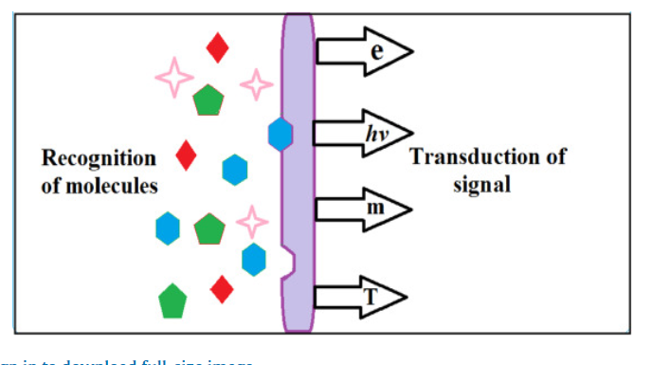
Chemical sensors are sensor devices that convert chemical information (i.e., the amount of some individual compound) into a signal that can be analyzed. The sensing material and the transducer are generally the two main components. The target molecule interacts with the sensing material. This binding contact causes changes in a material attribute, such as mass and electrical conductivity, which will be converted into a quantifiable signal, generally an electronic signal, by the transducer
The ideal chemical sensor should be an inexpensive, portable, reusable, and reliable device that quickly responds with a perfect choice for a certain target analyte present in any medium, at any concentration level.
The magnitude of the measurable signal is proportional to the concentration of analyte. There are two major detection mechanisms in chemical sensors. They are photochemical and photometric, and are used to find the concentration or changes in the chemical reactions with most accuracy

Slide 9
Some applications of chemical and biosensor technology include:
General healthcare monitoring
Screening for disease
Clinical analysis and diagnosis of disease
Veterinary and agricultural applications
Industrial processing and monitoring
Environmental pollution control
Glucometers are a type Biosensors, which measure the concentration of glucose in blood.
Agriculture Industry: Biosensors used for detection of pesticides and concentration of important nutrients.

