Slide 1

Microsoft Corporation ANLY 610-50-B-2019 Analytical Methods III
The project is prepared by: Shreejit Pillai, Anton Mokhovikov, Karan Gangwani, Mariia Vishniakova

Slide 2
Overview
Introduction
Deduplication of Data
Entity Identification
LDA Topic Modeling
Top Topics (Topic Taxonomy)

Slide 3
Introduction
Data crawled from Webhose.io
Applied Filters:
Company: Microsoft
Language: English
Site type: news articles
Date range: May 15- June 15
Data results: 10,000 news feeds
Stored data in a JSON file
Step 1
Registration at Webhoseio
Step 2
Make 100 requests to download 10,000 news articles for Microsoft from 16th of May 2019
Step 3
Store data in a JSON file

Slide 4
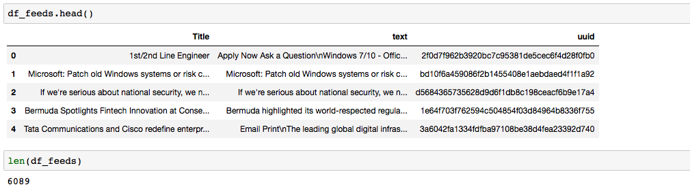
Deduplication of Titles
In order to clean the data we tried to remove all duplicate titles:
We used Word2Vec Google news model and SimHash technique to estimate quickly how similar articles are;
We use 15 number of positions for the hamming distance between two strings of equal length to identify number of the unique articles;
We also removed English stop words (e.g. “the”, “a”, “an”, etc
Total number of feeds after deduplication were 6,089
Data After Deduplication
Notes:
From 1000 feeds, we were down to 6089 feeds after deduplication

Slide 5
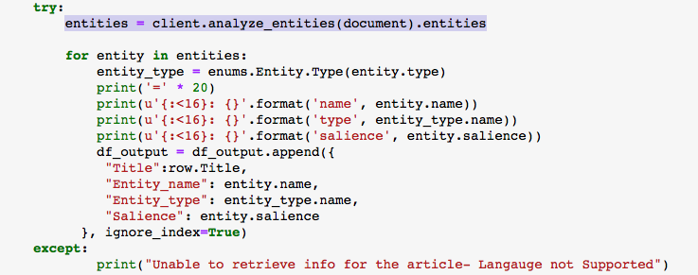
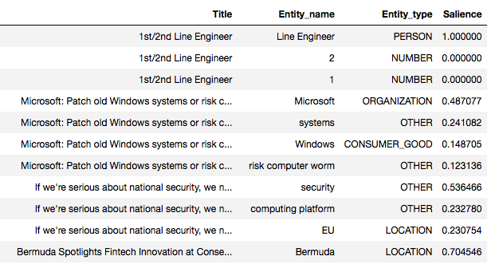
Entity Identification
Leveraged Google Cloud Natural Language API to recognize entities
An API call was made for each title in the dataset and the API returned entity name, entity type and salience for each title
However, entities were not recognized for titles that were in languages not supported by the API
API call
Output in dataframe
Notes:
Sailence= Important or Prominent

Slide 6
Entity Identification
Organization, Number, and Person were the top 3 entity types identified
In terms entity names, Sony, Google, Huawei had the most mentions
Counts by Entity Type
Counts by Entity Name
Entity Type | Count
OTHER | 8971
ORGANIZATION | 5808
NUMBER | 4217
PERSON | 2285
CONSUMER_GOOD | 1754
LOCATION | 1668
DATE | 893
WORK_OF_ART | 872
EVENT | 633
PRICE | 272
ADDRESS | 7
PHONE_NUMBER | 4
Entity Name | Entity Type | Count
Microsoft | ORGANIZATION | 1421
Sony | ORGANIZATION | 227
Google | ORGANIZATION | 170
Huawei | ORGANIZATION | 166
USA | ORGANIZATION | 163
Windows 10 | OTHER | 160
Windows | CONSUMER_GOOD | 150
Xbox | CONSUMER_GOOD | 103
AI | OTHER | 100
MSFT | ORGANIZATION | 94
Microsoft Co | ORGANIZATION | 83
IBM | ORGANIZATION | 77
Apple | ORGANIZATION | 68
Amazon | ORGANIZATION | 64
Xbox One | CONSUMER_GOOD | 64

Slide 7
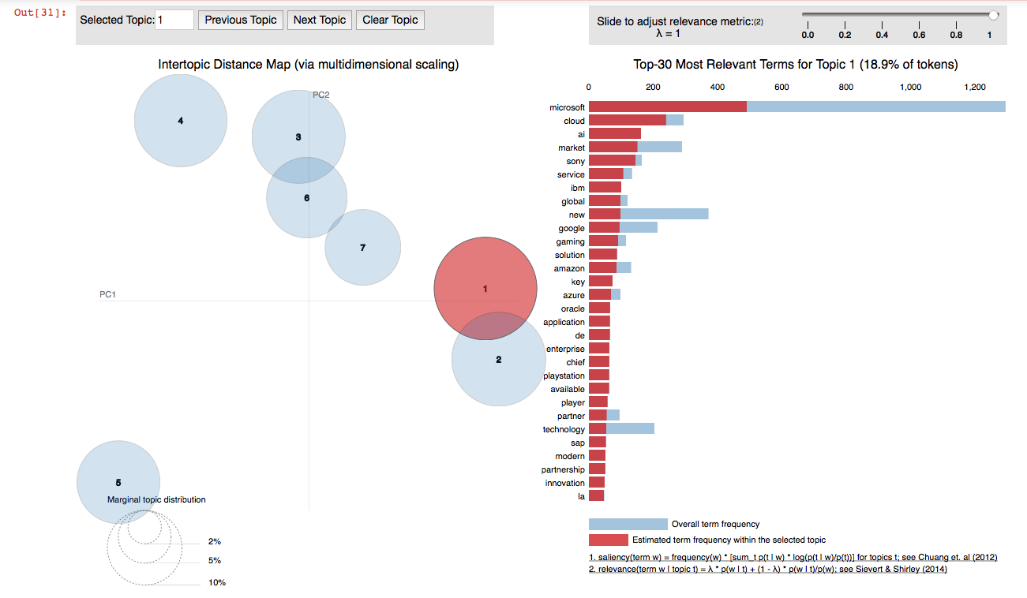
LDA Topic Clusters
Used Gensim and Spark Implementation for Topic Modeling on titles
Cluster Visualization (Gensim)

Slide 8
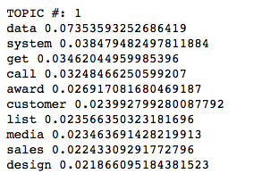
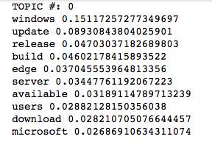
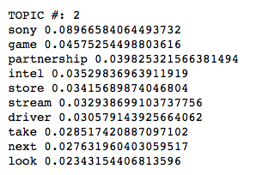
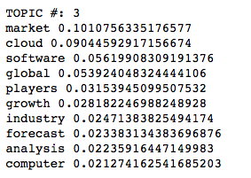
LDA Topic Clusters
4 Topic Clusters from Spark Implementation
Windows Software Update release
Product/Service Appreciation
Gaming Hardware/ Xbox vs. PS
Cloud Services- Azure vs. Others

Slide 9
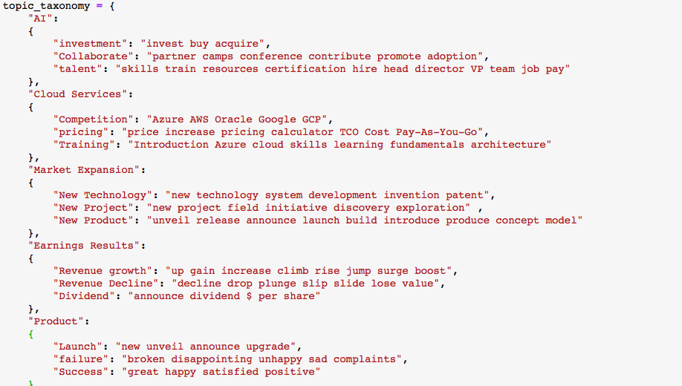
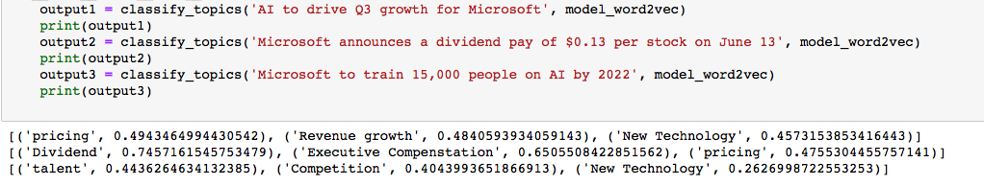
Topic Taxonomy
After analyzing the data, we built our own topic taxonomy
Using topic taxonomy and the Google Word2Vec model, we classified each title in the dataset
Topics with scores

Slide 10
Top Topics
To see which topics were the most evolving one’s, we summed up the scores by topic and created a total score
Competition, Pricing, training, new technology and talent were the top 5 evolving topics
Top Evolving Topics Identified using Taxonomy
Topic | Total Score
Competition | 2040
Pricing | 1015
Training | 503
New Technology | 408
talent | 355
New Product | 293
Collaborate | 270
New Project | 252
Dividend | 240
Launch | 116
Revenue growth | 102
Revenue Decline | 94
Success | 84
Executive Resignation | 81
Executive Compenstation | 64
failure | 56
investment | 35
Executive Appointment | 30

Slide 11
Thank you!

