Slide 1
Hello,

Slide 2

Verification of Hardware Accelerator for Cryptographic Applications
By ,
Bhuvana Chandra Deepak M - 201038003
Shree Jnanesh - 201038012
Abhishek M H - 201038026
Under the guidance of Mr. Shridhar Nayak

Slide 3
Contents
Specification of Design Units
Verification Plan
Verification Environment
Testcases for Encryption
Testcases for Decryption
Testcases for Memory
Results
References

Slide 4
Specification of Design Units
1GHz operating frequency (clk)
115 pipelines stages
64-bitlength input data
64-bitlength Output data Encryption & decryption
64-bitlength Key
512 Bytes Memory
Pin Details
Encryption DUT
Clk – 1 bit
Msg – 64 bit
Key – 64 bit
Cipher – 64 bit
Decryption DUT
Clk – 1 bit
Cipher – 64 bit
Key – 64 bit
Msg – 64 bit
Memory DUT
Clk – 1bit
Read/Write Enable – 1bit
Data IO line – 64bit
Key IO line – 64bit
Address Input line – 6bit
4

Slide 5
Verification Plan
Project schedule
Verification approach
Test definitions
Testbench requirements
Results Checking
Issue tracking

Slide 6
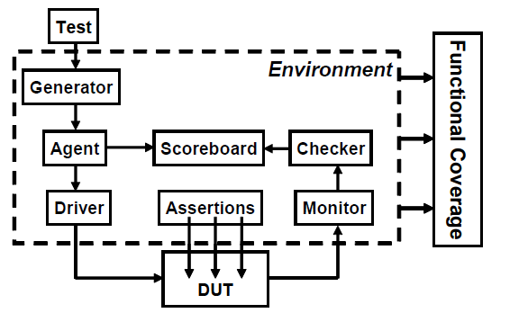
Verification System Verilog Environment

Slide 7
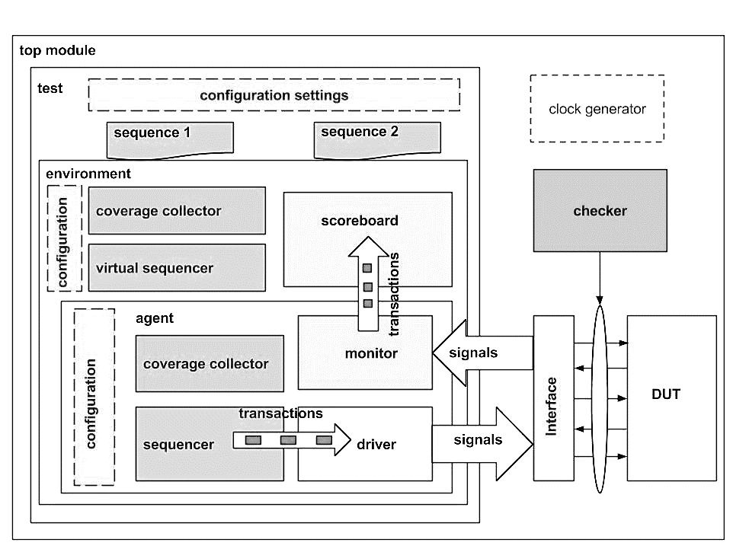
Verification UVM Environment

Slide 8
Testcases for Encryption
Test Case Number | Test Case | Signal | Signal Value | Expected Output | Expected Result
1 | Negative clock edge | clk | LOW | Cipher is not changed, previous output are held as it is | PASS
 | Positive clock edge |  | HIGH | Cipher should vary according to DES Algorithm | PASS
2 | key given is 64 bit wide | key | 64 bit | Cipher will be as expected according to DES Algorithm | PASS
 | key length is less than 64 bit |  | <64 bit | An unknown value comes across the Cipher terminals | FAIL
 | key length is more than 64 bit |  | >64 bit | The first 64 bits are considered from key and Cipher is as per DES Logic | FAIL
3 | Message input is 64 bit wide | msg | 64 bit | Cipher will be as expected according to DES Algorithm | PASS
 | Message is less than 64 bit wide |  | <64 bit | An unknown value comes across the Cipher terminals | FAIL
 | Message is more than 64 bit wide |  | >64 bit | The first 64 bits are considered from msg and Cipher is as per DES Logic | FAIL
4 | When keys are changed for the same message | Msg,key | 64 bit | Different Cipher texts should be obtained. | PASS
5 | When Same Key is used with different messages | Msg,key | 64 bit | Cipher will occur as per DES Logic in different cycles | PASS

Slide 9
Testcases for Decryption
Test Case Number | Test Case | Signal | Signal Value | Expected Output | Expected Result
1 | Negative clock edge | clk | LOW | Decrypt is not changed, previous output are held as it is | PASS
 | Positive clock edge |  | HIGH | Decrypt should vary according to DES Algorithm | PASS
2 | key given is 64 bit wide | key | 64 bit | Decrypt will be as expected according to DES Algorithm | PASS
 | key length is less than 64 bit |  | <64 bit | An unknown value comes across the Decrypt terminals | FAIL
 | key length is more than 64 bit |  | >64 bit | The first 64 bits are considered from key and Decrypt is as per DES Logic | FAIL
3 | cipher input is 64 bit wide | cipher | 64 bit | Decrypt will be as expected according to DES Algorithm | PASS
 | cipher is less than 64 bit wide |  | <64 bit | An unknown value comes across the Decrypt terminals | FAIL
 | cipher is more than 64 bit wide |  | >64 bit | The first 64 bits are considered from cipher and Decrypt is as per DES Logic | FAIL
4 | When keys are changed for the same message | cipher,key | 64 bit | Original message should not be obtained at Decrypt for different Key | PASS
5 | When Same Key is used with different messages | cipher,key | 64 bit | Decrypt will occur as per DES Logic in different cycles | PASS

Slide 10
Testcases for Memory Block
Test Case Number | Test Case | Signal | Signal Value | Expected Output | Expected Result
1 | Negative clock edge | clk | LOW | Output lines should not change values even if Input given is changed. | PASS
 | Positive clock edge |  | HIGH | Output lines should read data from memory as per the Read Enable input whereas Input lines should write data as per the Write Enable Input | PASS
2 | Clearing the data | reset | HIGH | Reset, when high clears every bit of memory block and makes it 0. | PASS
 | Storing the data |  | LOW | Reset, when low allows the memory to store data as per its operation | PASS
3 | Stopping the data to be written to memory | Wr_en | LOW | Input lines should not be able to write any data into memory | PASS
 | Allowing the data to be written to memory |  | HIGH | Input lines should be able to write the data into memory | PASS
4 | Stopping the data to be read from memory | r_en | LOW | Output lines should not be able to read any data from memory | PASS
 | Allowing the data to be read from memory |  | HIGH | Output lines should be able to read data from memory | PASS
5 | When key/message input is less than 64 bits wide | Msg, key_in | <64bits | Input Data lines should be saved as it is and don’t care(x) will fill the rest in those empty slots | FAIL
6 | When key/message input is more than 64 bits wide | Msg, key_in | >64bits | Input Data lines will be taken till 64 bits and rest of the bits are truncated. | FAIL

Slide 11
Results
Results of Verification using System Verilog

Slide 12
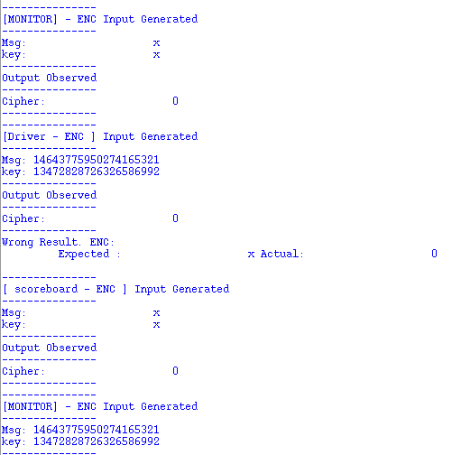
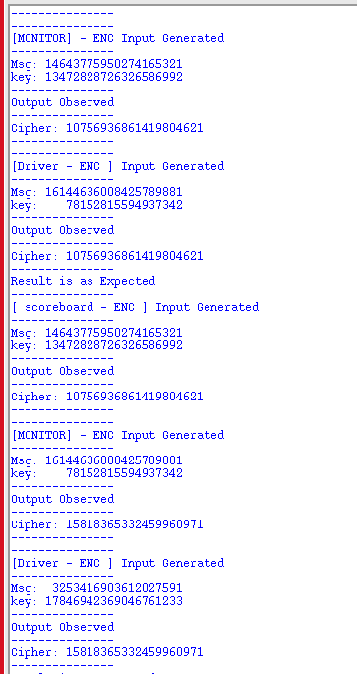
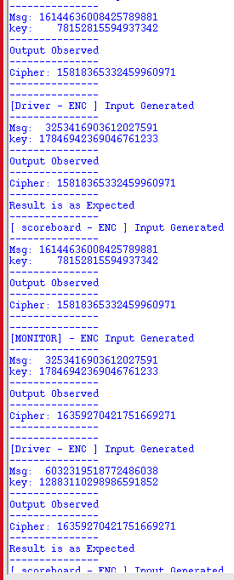
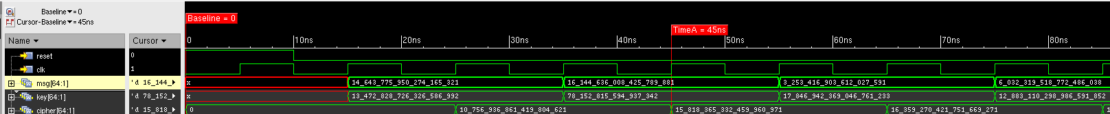
Encryption Block Result and Waveform

Slide 13
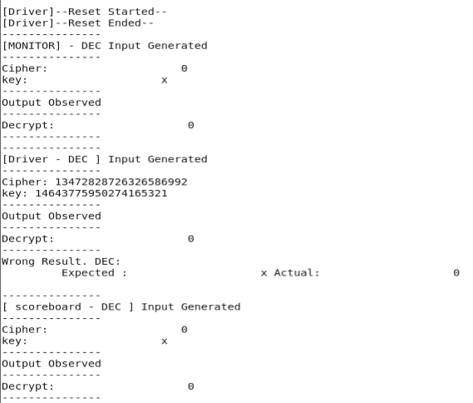
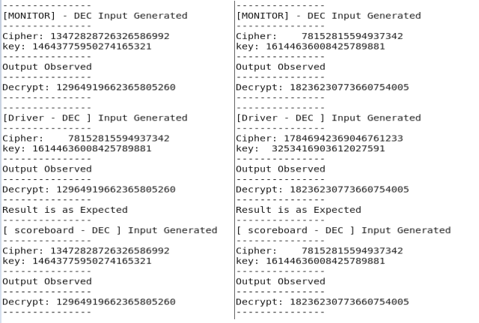
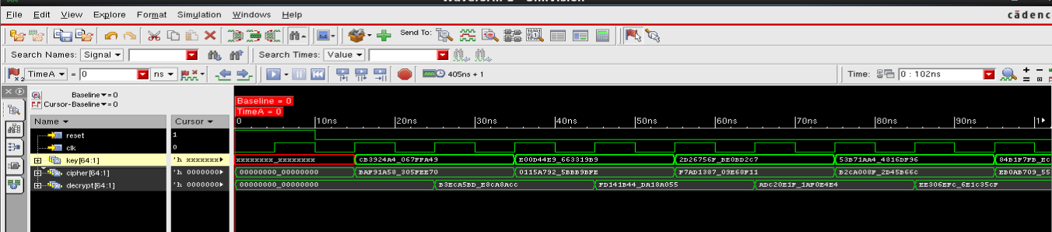
Decryption Block Result and Waveform

Slide 14
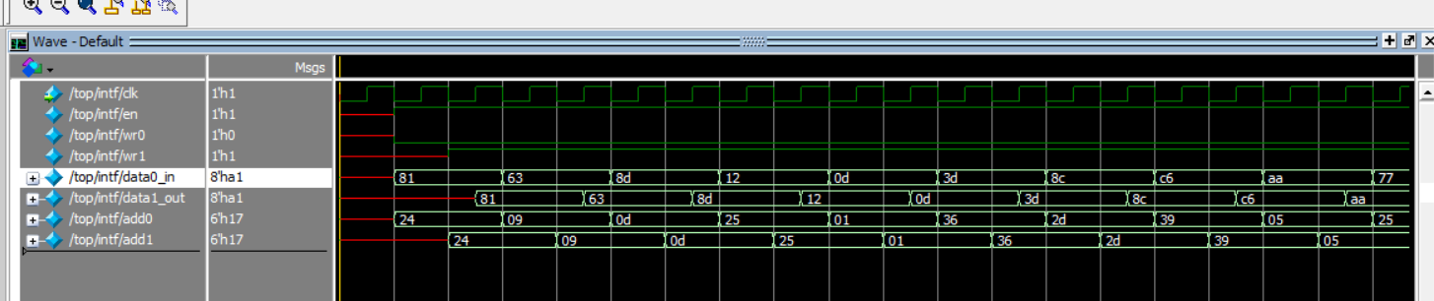
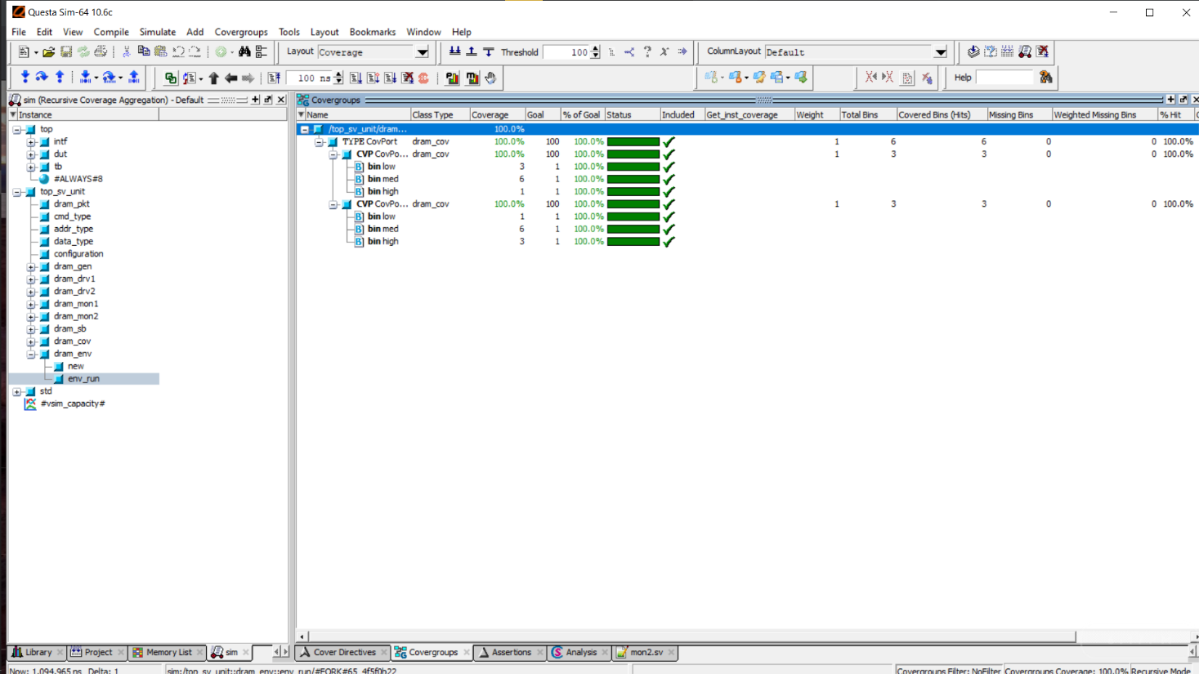
Memory Block Result and Coverage Analysis

Slide 15
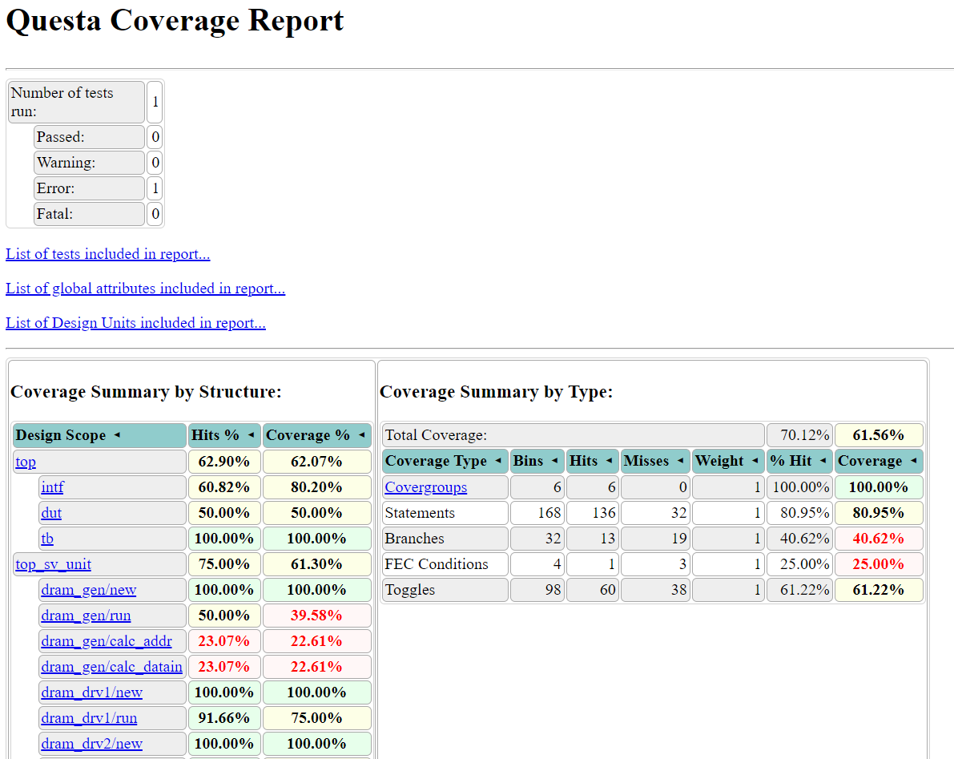
Coverage report of Memory Block

Slide 16
Results
Results of Verification using UVM

Slide 17
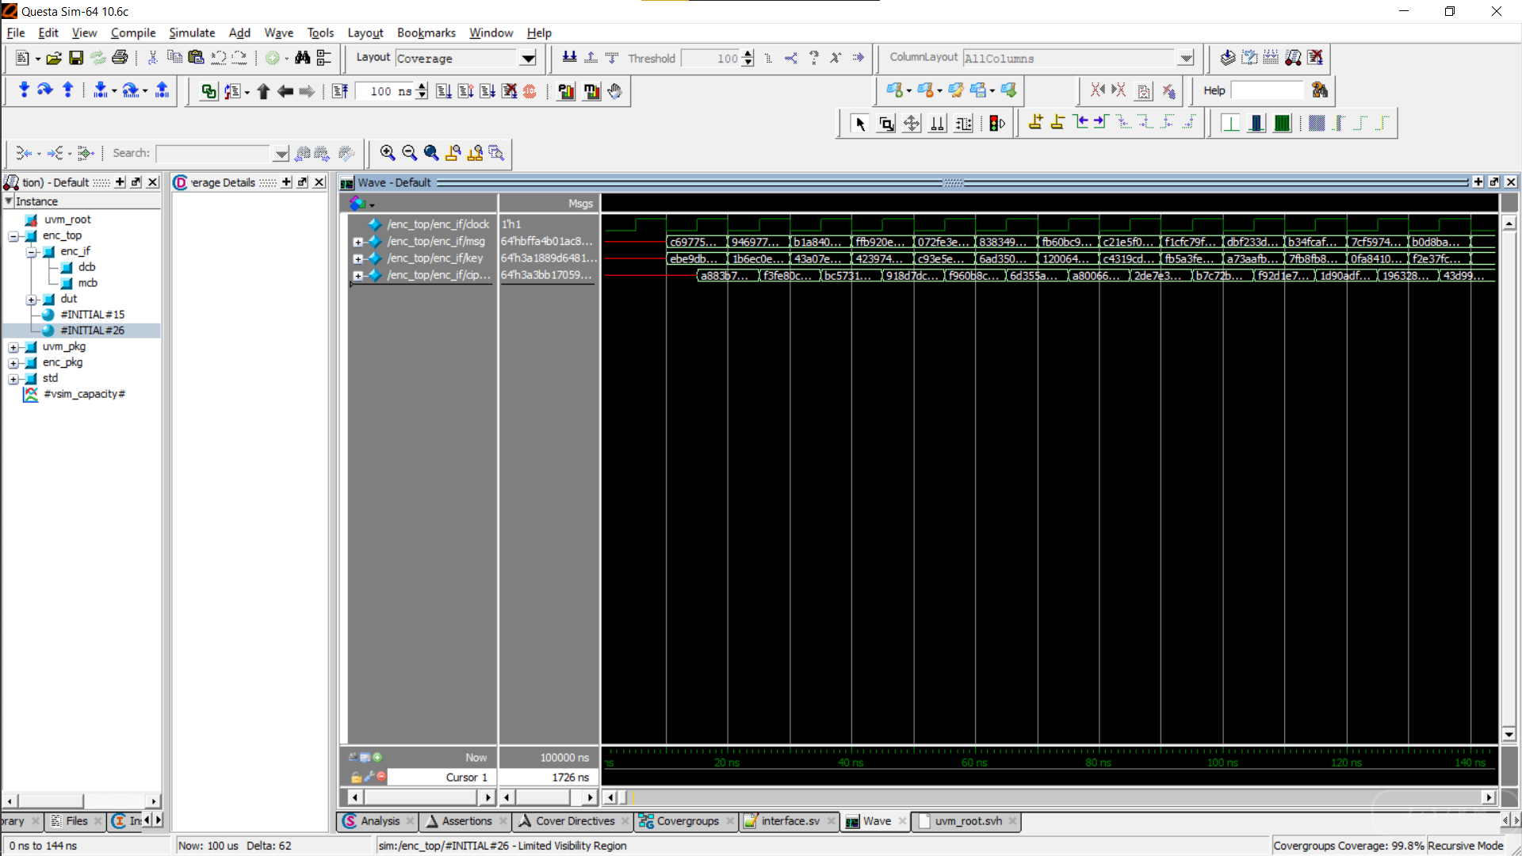
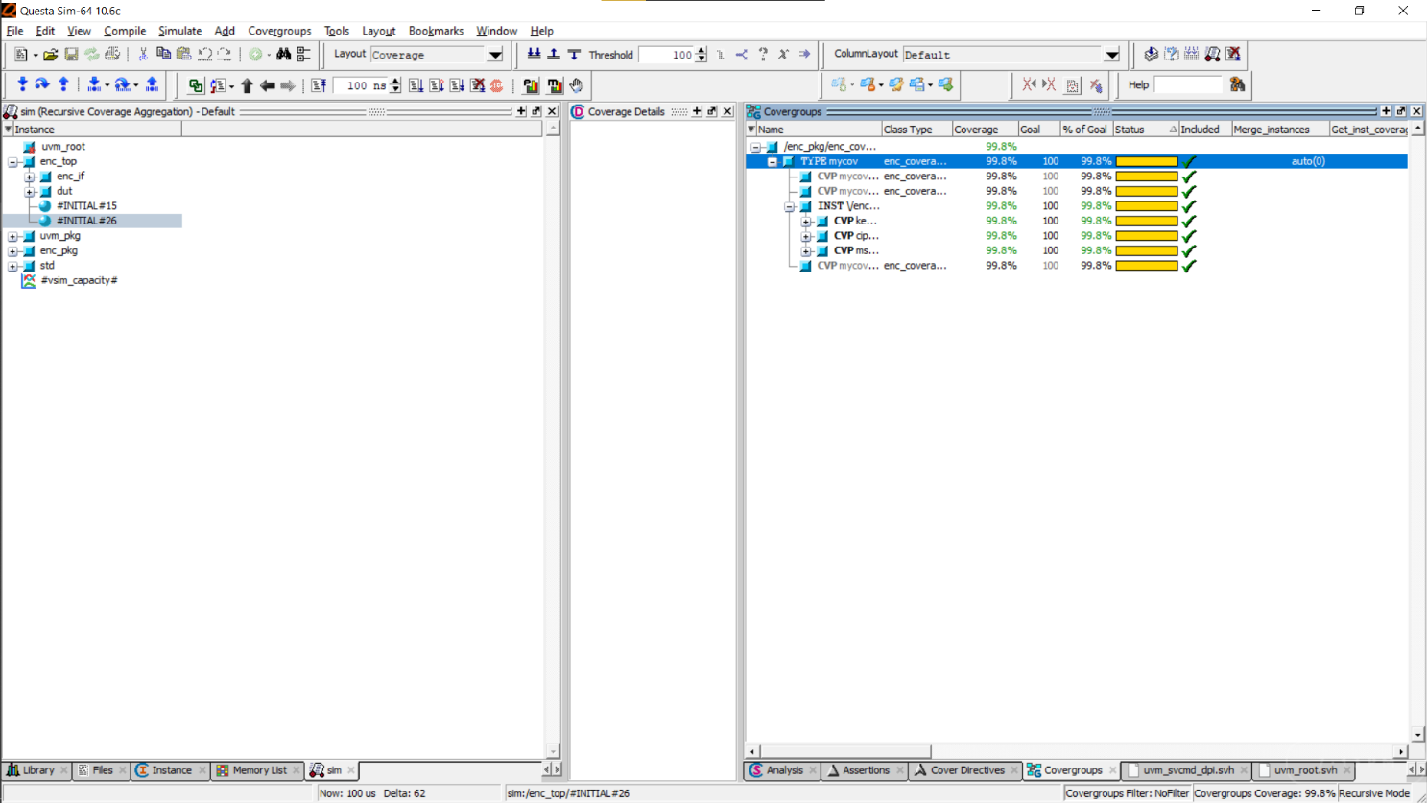
Encryption Block Result and Coverage Analysis

Slide 18
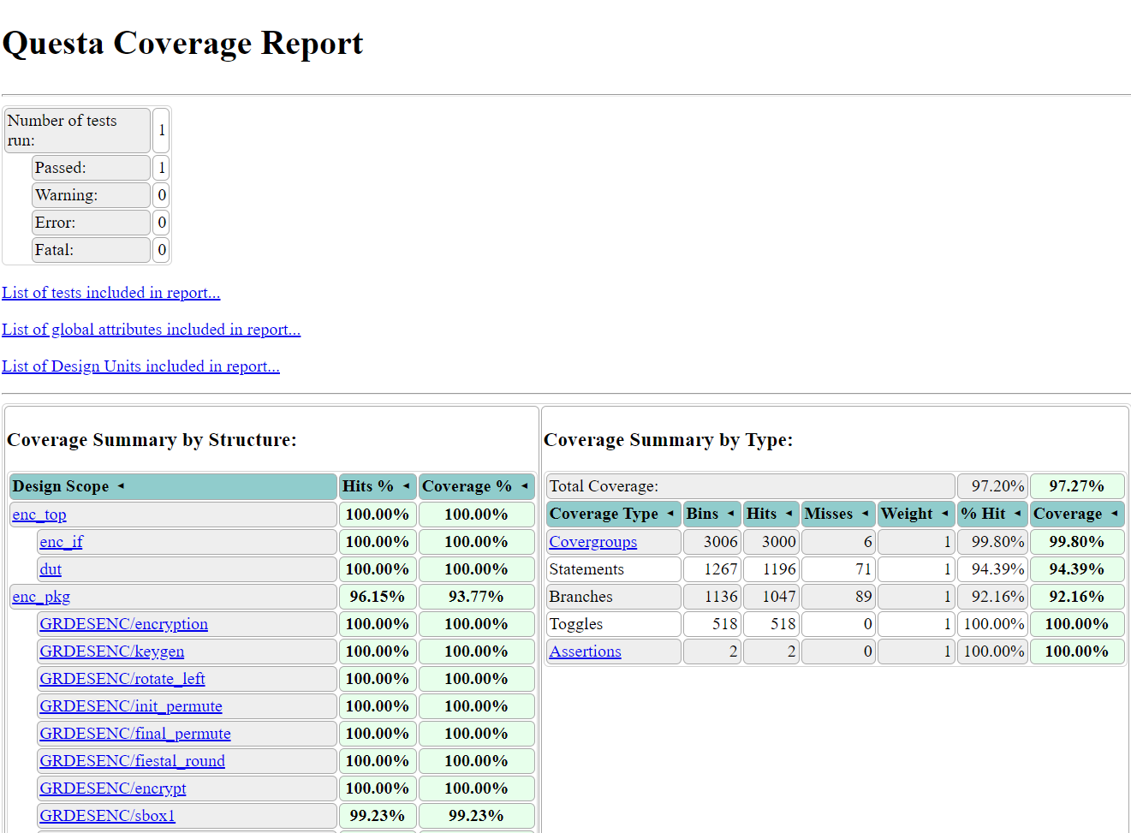
Coverage report of Encryption Block

Slide 19
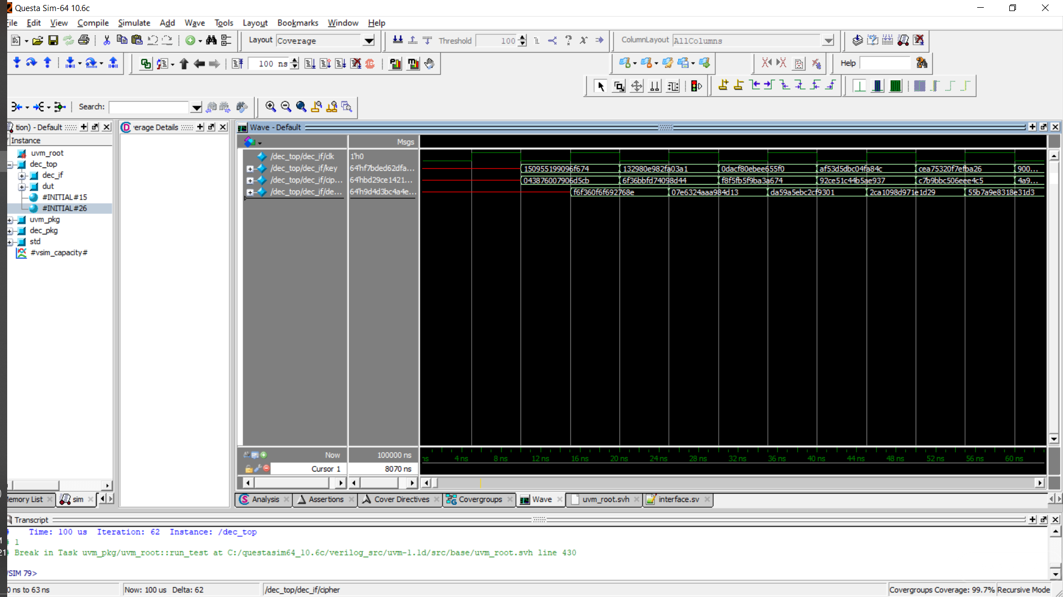
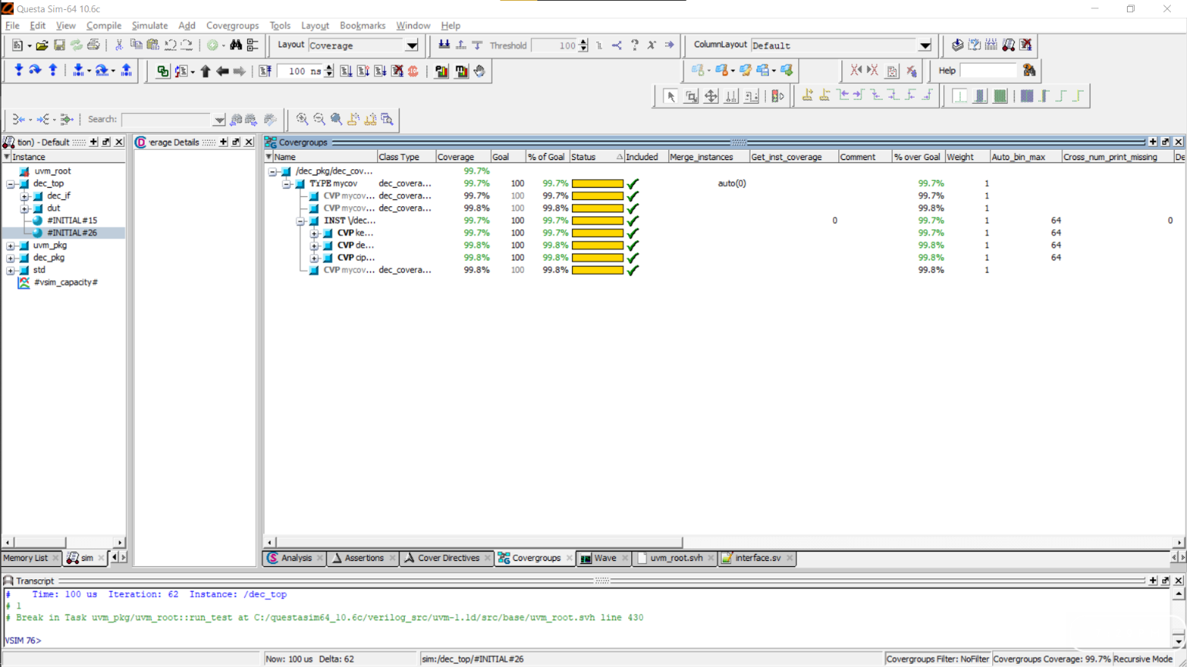
Decryption Block Result and Coverage Analysis

Slide 20
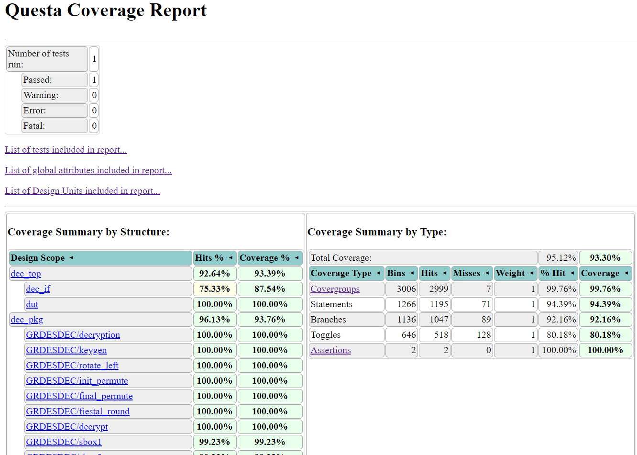
Coverage report of Decryption Block

Slide 21
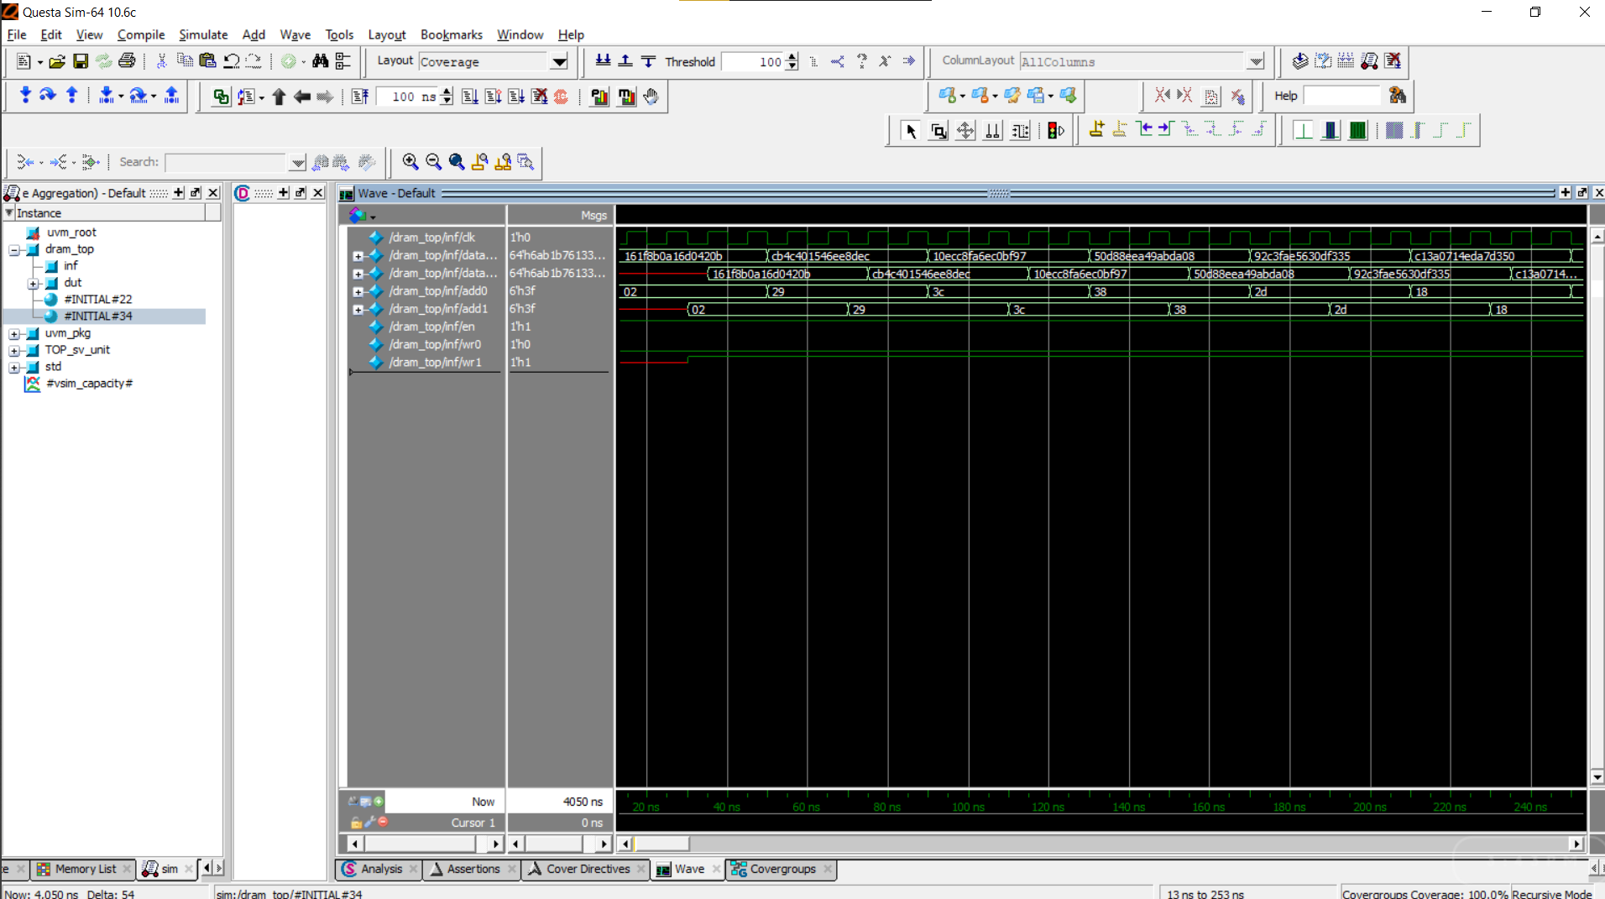
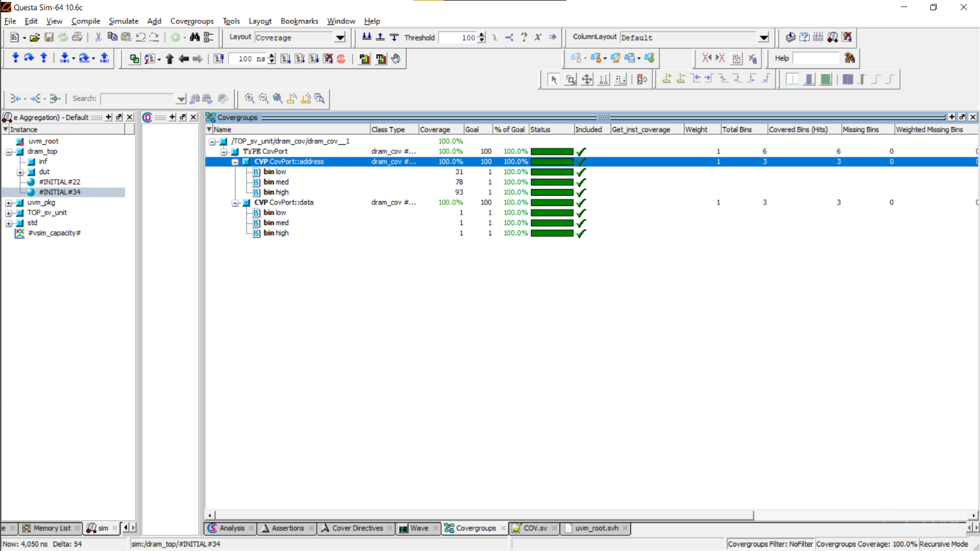
Memory Block of Result and Coverage Analysis

Slide 22
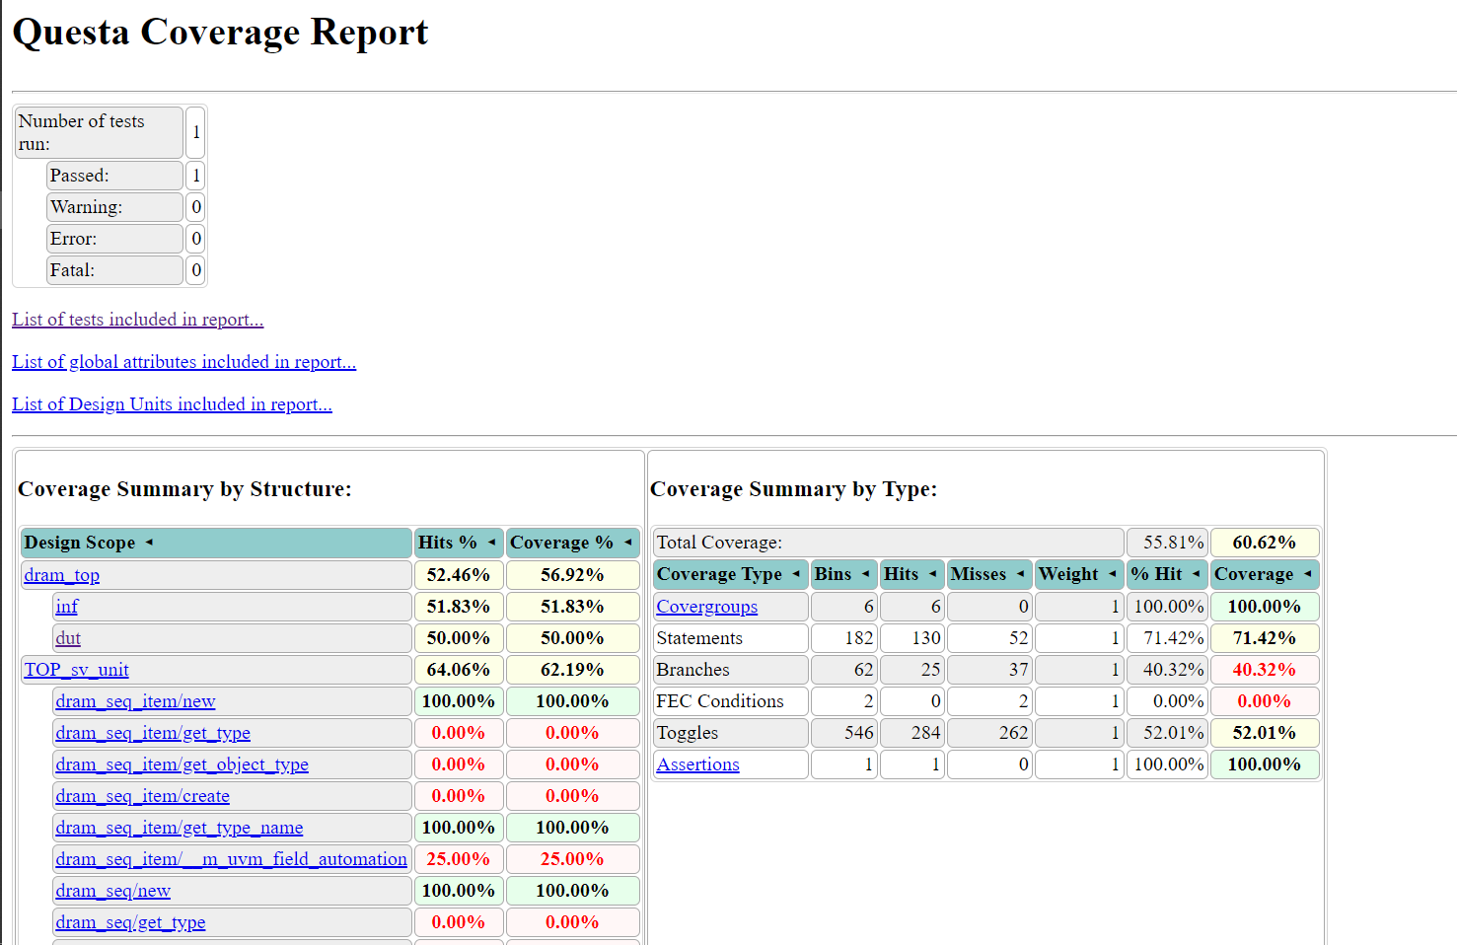
Coverage report of Memory Block

Slide 23
References
http://page.math.tu-berlin.de/~kant/teaching/hess/krypto-ws2006/des.htm
https://verificationguide.com/systemverilog-examples/
http://www.testbench.in/TS_24_VERIFICATION_PLAN.html
https://www.design-reuse.com/articles/16141/verification-planning-for-core-based-designs.html
https://www.chipverify.com/systemverilog/systemverilog-tutorial

Slide 24
Thank You.

