Slide 1
RAZORPAY AI BUILDER INTERNSHIP 2026
Track 2 — AI Risk Manager
RiskGraph AI
Agentic Payment Fraud Detection Platform
Real-time ML risk scoring + fraud-ring graph detection + policy-grounded AI investigation agent
SHREEKANTH A GUTTEDAR
MCA — AI/ML & Data Science, S-VYASA Deemed University, Bengaluru

Slide 2
Problem Statement
Payment fraud is a network problem hiding inside individual transactions
🔗
Fraud rings, not isolated events
📏
Rule-based systems miss the unknown
Shared devices, IPs, and beneficiaries link seemingly unrelated transactions into coordinated fraud rings that single-transaction checks miss.
Static rules catch known patterns but can't adapt to evolving fraud behavior or subtle statistical anomalies.
🕸️
ML alone has no relationships
🧑‍💼
Manual investigation doesn't scale
A classifier scores a transaction in isolation — it has no notion of who else shares this device, IP, or payee.
Analysts reviewing flagged cases without structured, evidence-grounded assistance is slow and inconsistent.
RiskGraph AI | Razorpay AI Builder Internship 2026 — Track 2: AI Risk Manager
2

Slide 3
Proposed Solution
A layered decision pipeline — detection, investigation, and human authority stay architecturally separate
Transaction
→
Feature Analysis
+ Graph
→
ML Risk
Engine
→
Risk Score
0–100
→
Low / Medium /
High / Critical
→
Action
HIGH / CRITICAL cases route to an AI investigation agent (Claude) which gathers evidence and cites policy — but a human analyst always makes the final call.
Real-time
Explainable
Human-in-the-loop
Auditable
RiskGraph AI | Razorpay AI Builder Internship 2026 — Track 2: AI Risk Manager
3

Slide 4
Dataset
Real, non-synthetic transaction data — not the project's own synthetic generator
299,695
6,000
2.21%
17
Transactions
Unique customers
Real fraud rate
Raw columns
Raw columns
transaction_id, user_id, account_age_days, total_transactions_user, avg_amount_user, amount, country, bin_country, channel, merchant_category, promo_used, avs_match, cvv_result, three_ds_flag, transaction_time, shipping_distance_km, is_fraud
Target: is_fraud (binary) • No missing values in the raw file • Train/val/test split 60/20/20, stratified, seed 42
Honest disclosure
A separate synthetic generator (9 fraud archetypes with deliberately shared devices/IPs) exists only to demo the fraud-ring graph view, since this real dataset has no device/IP fields. It is clearly labeled synthetic and never mixed into the real-data model's reported metrics.
RiskGraph AI | Razorpay AI Builder Internship 2026 — Track 2: AI Risk Manager
4

Slide 5
Feature Engineering
25 model features, computed leakage-safe from the real dataset's own history
Customer History
Behavioral / Velocity
Transaction Signals
Geo & Channel
customer_age_days
customer_transaction_count
amount_to_baseline_ratio
velocity_1m / 10m / 1h / 24h (real, timestamp-based)
previous_fraud_alerts (leakage-safe)
amount
promo_used, avs_match, cvv_result, three_ds_flag
shipping_distance_km
is_suspicious_geo (real country mismatch)
channel, merchant_category (one-hot)
↓
→ Risk Features (25, model-ready)
Not fabricated: chargeback_history, is_new_beneficiary, and payment_method have no source signal in this dataset and are defaulted rather than invented (see ml/dataset_adapter.py).
RiskGraph AI | Razorpay AI Builder Internship 2026 — Track 2: AI Risk Manager
5

Slide 6
ML Architecture
Selected model: Random Forest (compared against a Logistic Regression baseline)
Dataset
(real)
→
Dataset
Adapter
→
Feature
Engineering
→
Model
(RF)
→
Prediction
API
→
Frontend
Also feeding the final risk score:
Graph Risk Engine
Anomaly Detector
Rule Engine
shared device/IP/beneficiary clustering (NetworkX)
Isolation Forest — behavior outside learned patterns
versioned YAML policy — deterministic, auditable
Risk Aggregator combines ML + Graph + Anomaly + Rules → risk_score (0–100) and LOW / MEDIUM / HIGH / CRITICAL. Threshold 0.389, chosen on validation to maximize F1 with a recall floor of 0.5.
RiskGraph AI | Razorpay AI Builder Internship 2026 — Track 2: AI Risk Manager
6

Slide 7
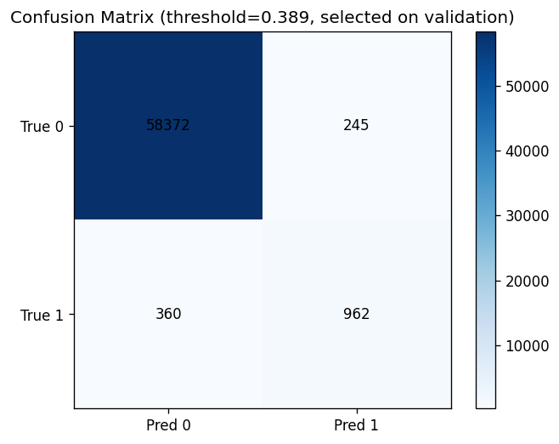
Model Performance
Actual test-set metrics — Random Forest, real dataset, threshold 0.389
Model | Precision | Recall | F1 | ROC-AUC
Logistic Regression (baseline, val) | 0.192 | 0.887 | 0.316 | 0.961
Random Forest (selected, test) | 0.797 | 0.728 | 0.761 | 0.982
XGBoost | not trained (no network) | — | — | —
RiskGraph AI | Razorpay AI Builder Internship 2026 — Track 2: AI Risk Manager
7

Slide 8
Live Prototype
New transaction → API → trained model → risk score, live in the frontend
RiskGraph AI — Risk Overview
N
n
n
Healthy
Total Transactions
High-Risk Txns
Critical Alerts
Model Status
Recent Alerts
txn_real_73041
₹1,238.03
62
HIGH
review
txn_real_163686
₹2,419.64
57
MEDIUM
review
txn_real_77020
₹53.87
16
LOW
auto
Illustrative mockup of the Overview dashboard layout. The 3 alert rows are real predictions from this build (reports/demo_results.json); the KPI counts (N/n) fill in live once you seed transactions (scripts/seed_real_transactions.py) before presenting — use an actual screen recording for the pitch video, not this mockup.
RiskGraph AI | Razorpay AI Builder Internship 2026 — Track 2: AI Risk Manager
8

Slide 9
Demo Scenario
Three real transactions, scored live through the trained model during this build (reports/demo_results.json)
LOW RISK
MEDIUM RISK
HIGH RISK
15.62
56.61
61.79
Risk Score / 100
Risk Score / 100
Risk Score / 100
Transaction: txn_real_77020
Amount: ₹53.87
Model confidence: 0.07%
Long-standing pattern, no red flags
Transaction: txn_real_163686
Amount: ₹2,419.64
Model confidence: 93.75%
Above-baseline amount, model flags elevated risk
Transaction: txn_real_73041
Amount: ₹1,238.03
Model confidence: 100.00%
Multiple rule + ML signals aligned
RiskGraph AI | Razorpay AI Builder Internship 2026 — Track 2: AI Risk Manager
9

Slide 10
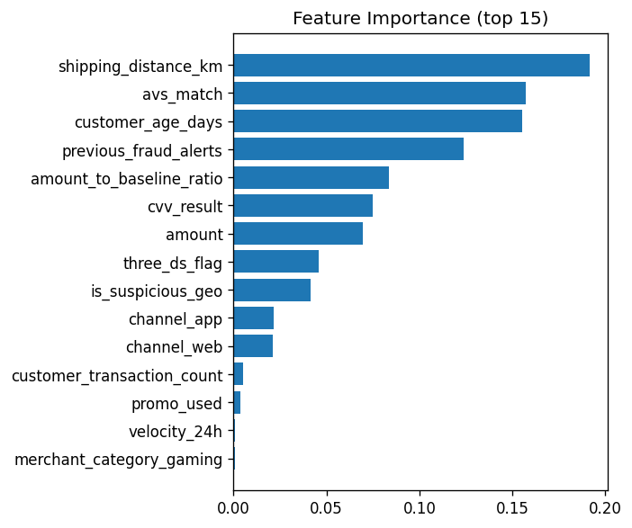
Risk Explanation
Every score ships with why — feature importance, contributing factors, and a recommendation
Risk Score: 61.79/100 Level: HIGH Confidence: 100%
Transaction: txn_real_73041 • Amount: ₹1,238.03
Source: reports/demo_results.json (real prediction, not illustrative)
Key Risk Signals (actual top-5 by feature importance)
Shipping distance (km)
AVS (address) match result
Customer account age
Previous fraud alerts on this customer
Amount-to-baseline ratio
Recommendation: ⚠ Human Review Required
RiskGraph AI | Razorpay AI Builder Internship 2026 — Track 2: AI Risk Manager
10

Slide 11
Business Impact
How this changes the analyst's day-to-day, without overclaiming financial figures
🎯
📉
🕵️
Prioritize manual reviews
Reduce fraud exposure
Surface behavioral patterns
Analysts see the highest-risk 0.4% of traffic first (245 false positives out of 59,939 test transactions), not a flat queue.
72.8% of real fraud in the test set is caught automatically at the selected threshold — a concrete, measured reduction, not a projected savings figure.
Graph-based ring detection exposes coordinated fraud a single-transaction check would miss entirely.
⚙️
🛡️
Improve operational efficiency
Add a defense-in-depth layer
LOW/MEDIUM cases route automatically; only HIGH/CRITICAL reach a human, cutting review volume without cutting oversight.
ML + graph + rules + anomaly detection means no single failure mode compromises the whole system (see Limitations).
RiskGraph AI | Razorpay AI Builder Internship 2026 — Track 2: AI Risk Manager
11

Slide 12
Future Scope
Real-time streaming ingestion (Kafka / webhooks)
Graph-based abuse-ring detection with real device/IP intelligence
1
2
Full SHAP-based per-prediction explainability
Customer relationship graphs across multiple data sources
3
4
Continuous model monitoring and drift detection
Production deployment with authentication & authorization
5
6
From Transaction Data → AI Risk Decision
RiskGraph AI | Razorpay AI Builder Internship 2026 — Track 2: AI Risk Manager
12

