Slide 1
Churn Prediction and Campaign Optimization for SkyPlay DTH Services
Capstone Project by Shreekar. M R, Student ID: 212VBBR01213

Slide 2
Problem Overview
SkyPlay DTH Services faces significant customer churn, which negatively impacts profitability.
The objective is to build a churn prediction model and create segmented offers that increase customer retention while balancing profitability.

Slide 3
Dataset Overview
The dataset includes customer demographics, service usage, and financial information.
Key features: Tenure, Service Score, Revenue Growth, Customer Care Contacts, Churn.

Slide 4
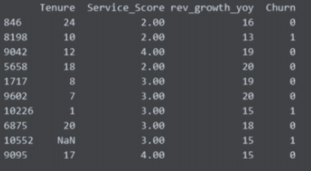
Dataset Overview

Slide 5
Approach & Methodology
Preprocessing: Handled missing values using KNN imputation, capped outliers.
Feature Engineering: Created interaction variables and ratio features.
Algorithms: Tested models like Logistic Regression, Decision Trees, and XGBoost.

Slide 6
Model in Action: XGBoost
XGBoost was chosen as the best-performing model based on evaluation metrics.
Predicts churn probability for customers using features like Tenure and Revenue Growth.

Slide 7
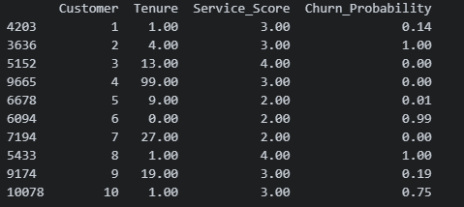
Model in Action: XGBoost

Slide 8
Model Evaluation
XGBoost achieved high recall and ROC-AUC scores, making it the best model for minimizing false negatives.
Confusion matrix shows the distribution of correct and incorrect predictions.

Slide 9
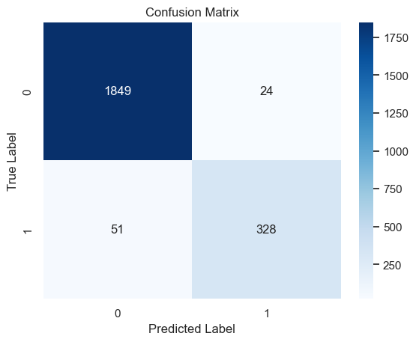
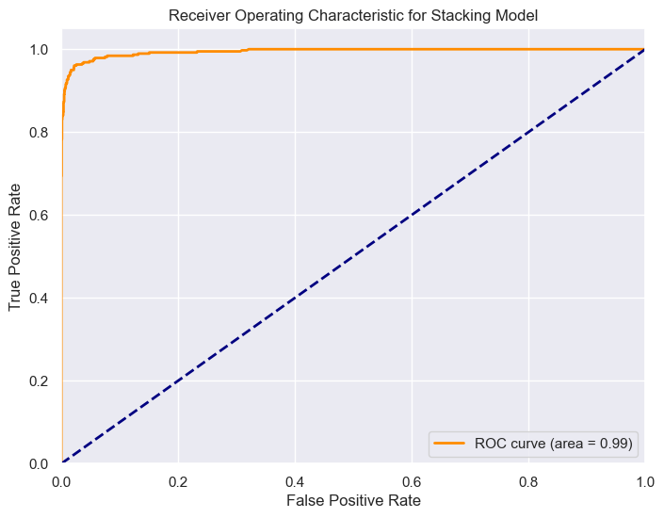
Model Evaluation

Slide 10
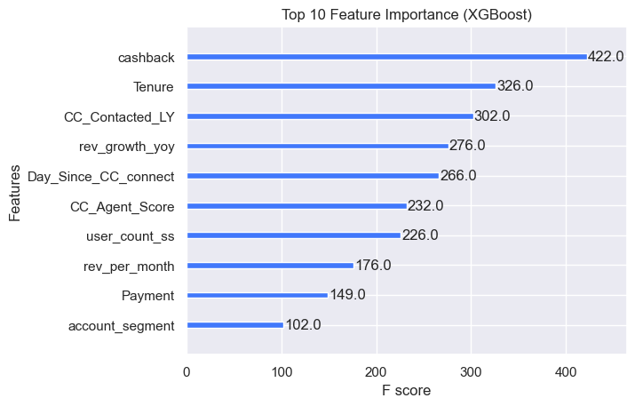
Feature Importance
XGBoost identifies Tenure, Service Score, and Revenue Growth as the most important features for predicting churn.

Slide 11

Customer Segmentation
Customers are segmented into High, Medium, and Low-risk groups based on churn probabilities.

Slide 12
Conclusion and Results
XGBoost was the best model for churn prediction.
Customer segmentation allows for targeted retention strategies that balance effectiveness and cost.

Slide 13
Thank You

