Slide 1
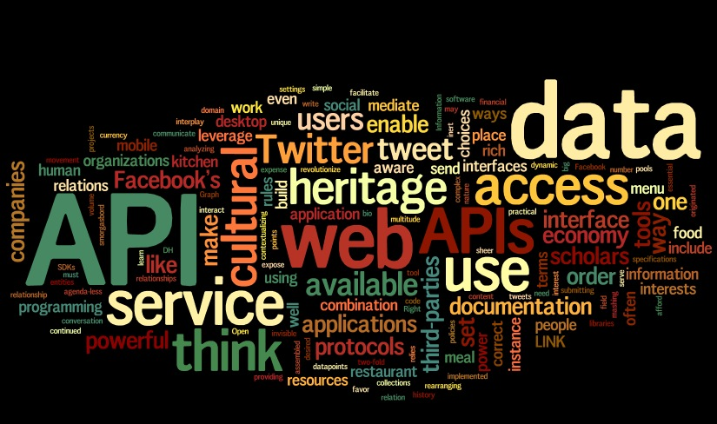
Api & Micro Services Test Automation

Slide 2

Who Am I?

Slide 3
Why am I here?
Love to code and teach.
Working in Product based company.
Having 10+ years of experience as Automation Testing.
Conducting trainings, seminars and webinars for both in-house and out-house from last 2 years.
Having hands on experience on building UI as well as API automation framework.
Designed and Developed frameworks using c#, java, python, Appium selenide etc.
Working for a cloud based product where involved in designing devOps solution using tools like Jenkins, ansible, docker etc.

Slide 4

API
Need?
- Interface for communicating between client and server.
it's a set of clearly defined methods of communication between various software components.

Slide 5

API
APIs provides product or service to communicate with other products and services without having to know how they're implemented.

Slide 6
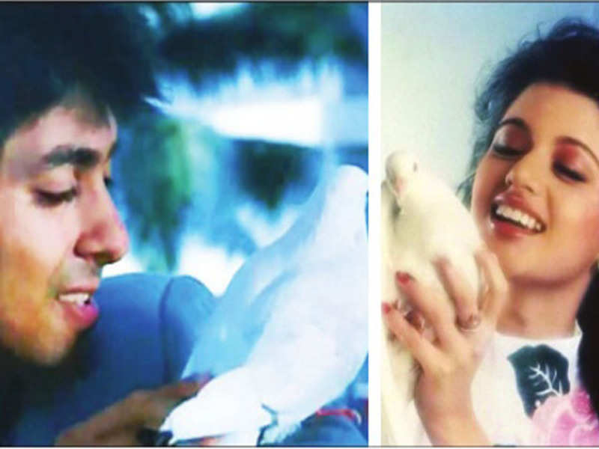
Web-Services
A Web service is a collection of open protocols and standards which are widely used for exchanging data between systems or applications.

Slide 7
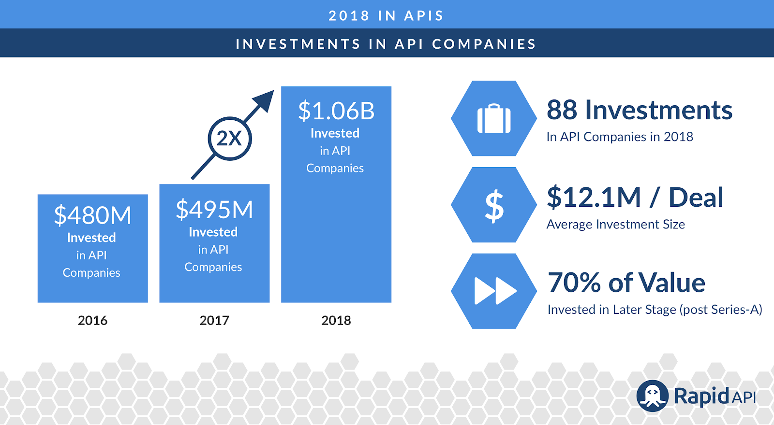
Facts

Slide 8

Real World Usage
Airbnb has already admitted that they work with algorithms to place advertizing based on image quality.
These types of predictive models have increased the site's total number of bookings by 4%.

Slide 9

Real World Usage
Uber uses information to create predictive models to find out, for example, what your destination will be when you use their transport service.
Their data team uses Bayesian statistics to achieve a model that is able to determine the destination 75% of the time.

Slide 10



Uber Business Continues..
How did Uber manage to achieve this high percentage? Thanks to using APIs. The company anonymously accumulated the driving patterns of more than 3000 professionals in the city of San Francisco at the beginning of 2014, which enabled them to collate the success of the model.
An algorithm can also be used to anonymously accumulate information about users' movement patterns, the places they go, what time they go there.The idea of the Uber data team is to find out more about consumers and offer services that adjust to their needs. This wouldn't be viable without APIs.

Slide 11
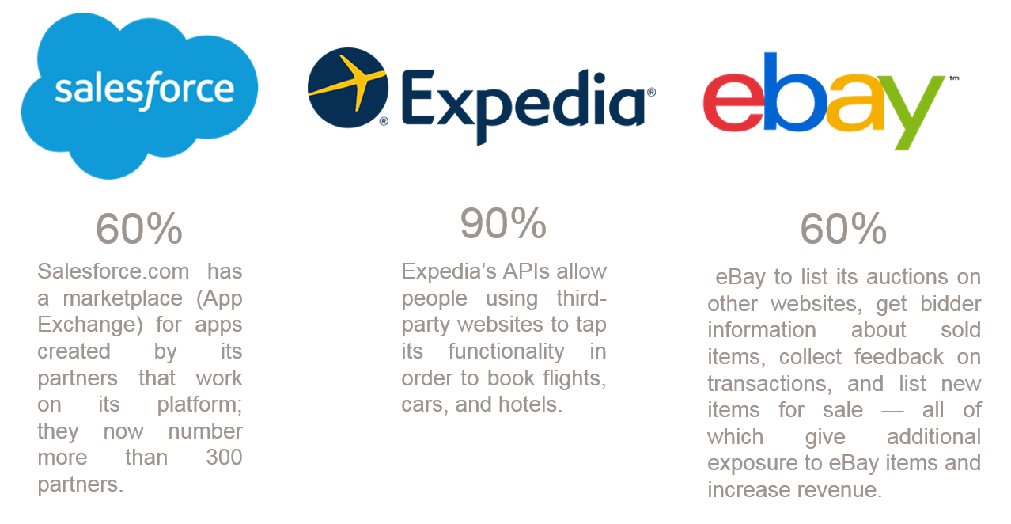
Real world business cases

Slide 12
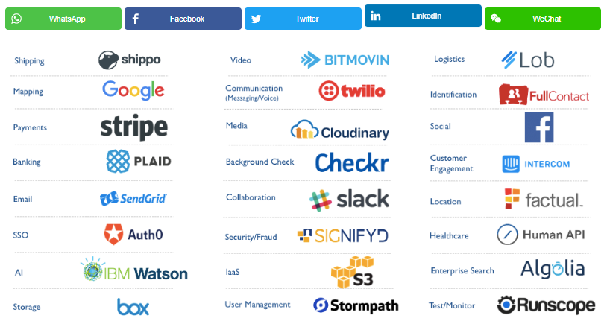
Top Companies Exposing APIs

Slide 13
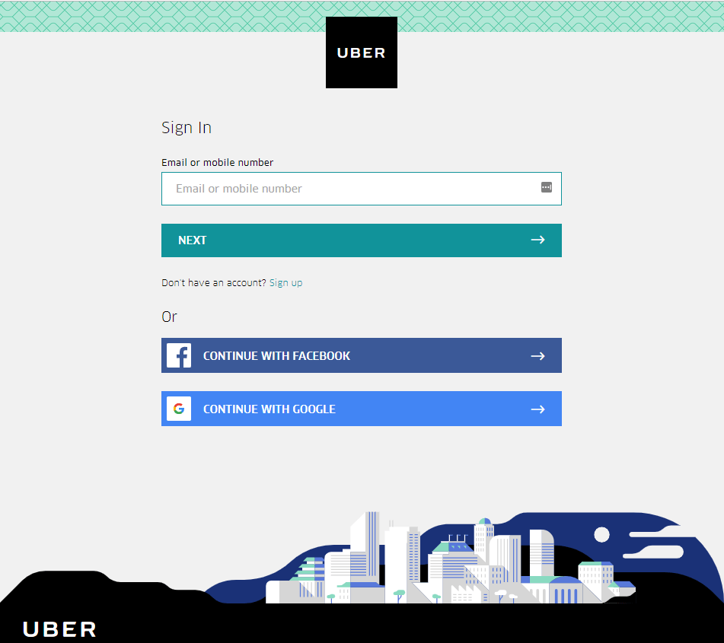
Still confused??

Slide 14
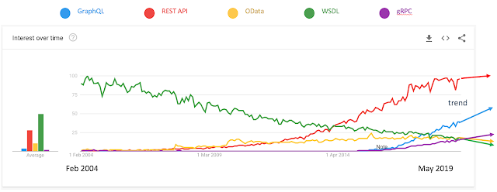
Popularity : Soap & REST

Slide 15
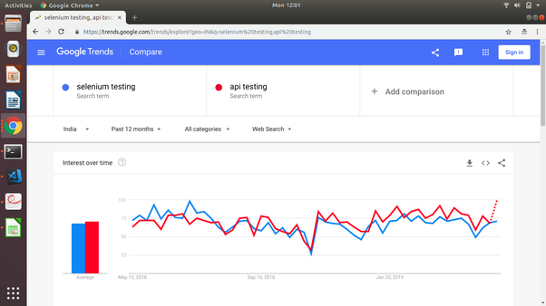
Testing : UI or API ?

Slide 16
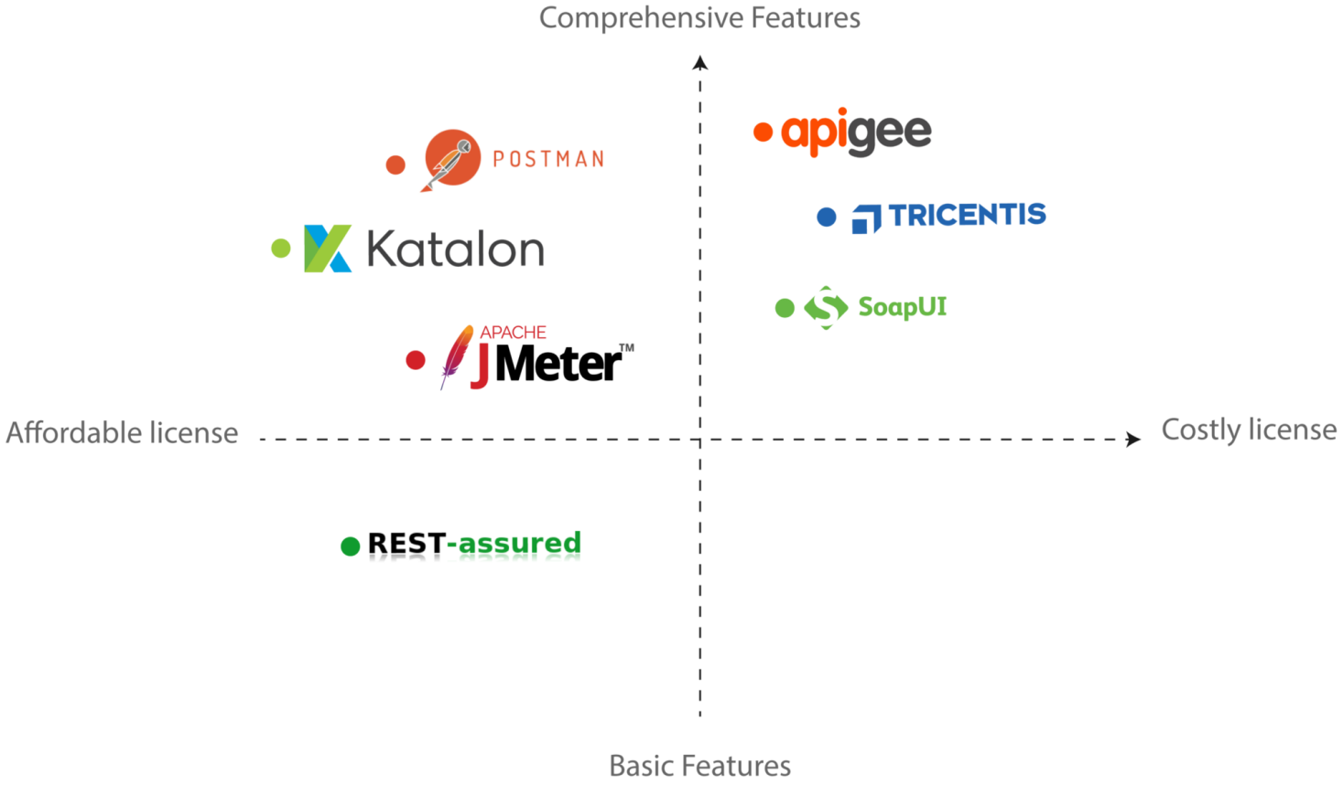
Top API Testing Tools

Slide 17
Job Profiles
https://g.co/kgs/ngMt6N
https://www.naukri.com/job-listings-Automation-Test-Engineer-Oracle-India-Pvt-Ltd-Bengaluru-4-to-6-years-250719000742?src=cluster&sid=15738512521297&xp=32&px=1
https://g.co/kgs/nL6vPe
https://g.co/kgs/9id2Es

Slide 18
Demo

