Slide 1
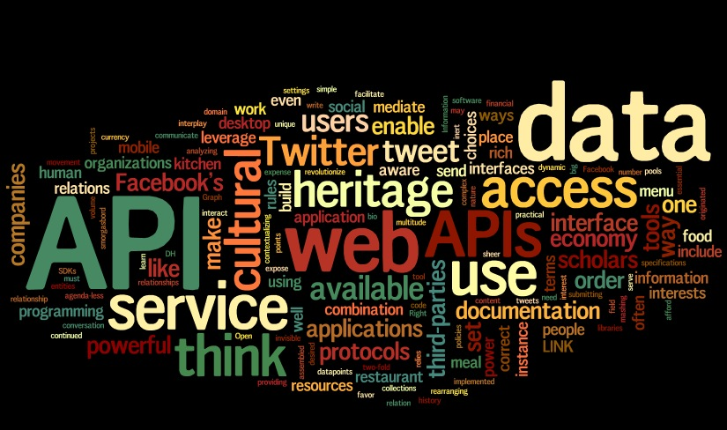
API & Micro Services Test Automation

Slide 2

Who Am I?

Slide 3
Why am I here?
Love to code and teach.
Working in Product based company.
Having 11+ years of experience in Automation Testing.
Conducting trainings, seminars and webinars both in-house and outdoor from last 4 years in the area of automation.
Having hands on experience on building UI as well as API automation framework.
Designed and Developed frameworks using c#, java, python, Appium selenide etc.
Working on cloud based product as principle software developer having responsibilities like writing API based micro services and managing deployment, automation of them end to end.

Slide 4

API
Need?
- Interface for communicating between client and server.
it's a set of clearly defined methods of communication between various software components.

Slide 5

API
APIs provides product or service to communicate with other products and services without having to know how they're implemented.

Slide 6

Web-Services
A Web service is a collection of open protocols and standards which are widely used for exchanging data between systems or applications.

Slide 7
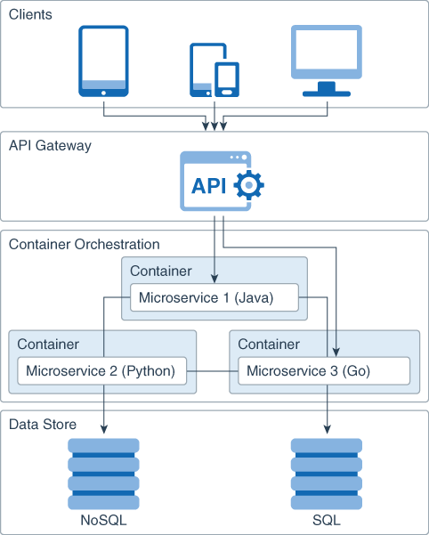
Micro Services

Slide 8
Facts
RapidAPI Developer Survey Highlights
Developer Survey 2020-21 Report

Slide 9

Real World Usage
Uber uses information to create predictive models to find out, for example, what your destination will be when you use their transport service.
Their data team uses Bayesian statistics to achieve a model that is able to determine the destination 75% of the time.

Slide 10



Uber Business Continues..
How did Uber manage to achieve this high percentage? Thanks to using APIs. The company anonymously accumulated the driving patterns of more than 3000 professionals in the city of San Francisco at the beginning of 2014, which enabled them to collate the success of the model.
An algorithm can also be used to anonymously accumulate information about users' movement patterns, the places they go, what time they go there. The idea of the Uber data team is to find out more about consumers and offer services that adjust to their needs. This wouldn't be viable without APIs.

Slide 11

Twitter API
Creating and publishing tweets after the occurrence of X requirements Each time someone names your company in Twitter and includes the words “query”, “question”, please” or “thank you”, you can create a default thank you tweet with your company’s maximum response time. Any bot in Twitter or profiles that publish automatic tweets normally uses the streaming Twitter API, based on an app created in this social network. There are thousands of entertaining cases of bots in Twitter, in fact, according to a recent study, 15% of Twitter users are bots
Case studies
You are an airline and you want to know more about travelers’ experience and the profile of the most frequent travelers. You can use the Twitter API to search for airports where your company flies to that include the word “flight”, thereby obtaining data about how many users have complained on the social network about flight cancellations or delays and, for example, the average number of followers of those users. Thus, even if these users are not your customers, you can find out which airports usually have the most problems and the types of users who use this social network to find this type of information or even as a customer service medium.

Slide 12

Facebook API in your business
Facebook Leads Ads API
Ads on Facebook are one of the best ways of attracting potential customers online. They help all kinds of businesses connect with consumers interested in their products and services.
With Facebook Lead Ads, users can easily register with your business; a button and a form are shown inside every message. The ingenious thing about it is the fact that Facebook pre-populates the requested details: name, phone number, email address, etc. This makes potential customers much less reluctant to send their personal details and find out about your offers and services or register in your platform.
After you post the message with the button to capture “leads,” you can use other Facebook tools to promote your message and reach more people.

Slide 13




Google
Google Maps
7744 companies reportedly use Google Maps in their tech stacks, including Google, Lyft, and Snapchat.
G Pay
Google Pay lets your customers pay with the press of a button — using payment methods saved to their Google Account.
airbnb11x increase in average daily transaction volume facilitated by Google Pay.
Hotel Tonight 65% increase more likely to complete the booking flow with Google Pay.
Google Analytics
Google Analytics APIs for enterprise allows IT teams to programmatically setup and configure Google Analytics accounts, saving time, and allowing you to spend more time analyzing data.

Slide 14
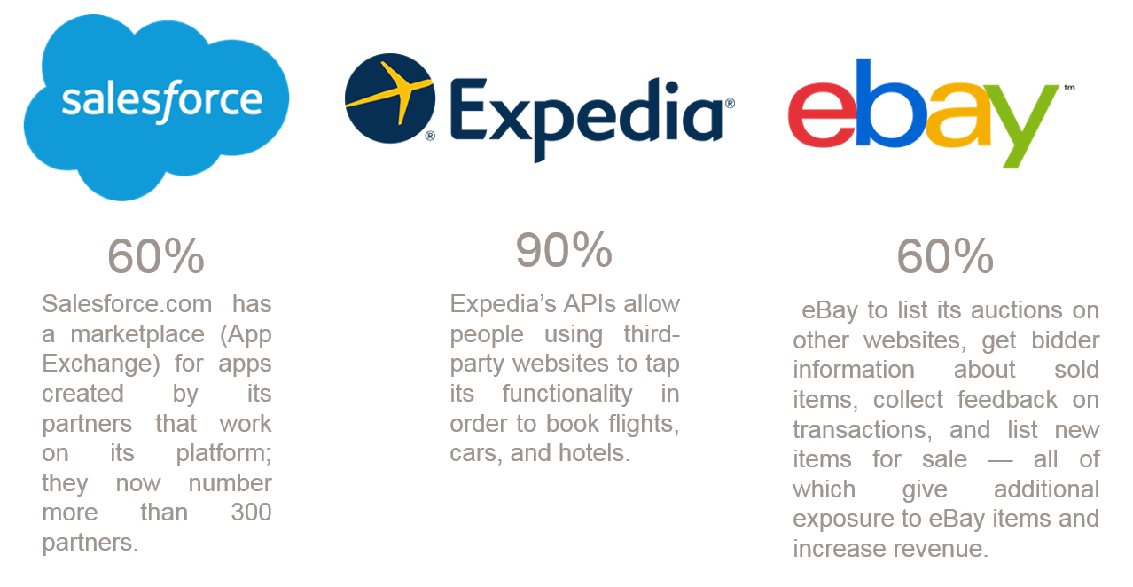
Real world business cases

Slide 15
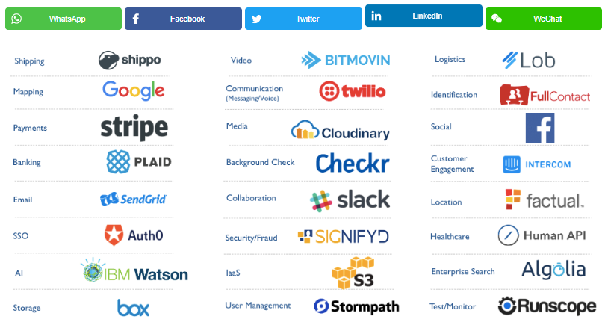
Top Companies Exposing APIs

Slide 16
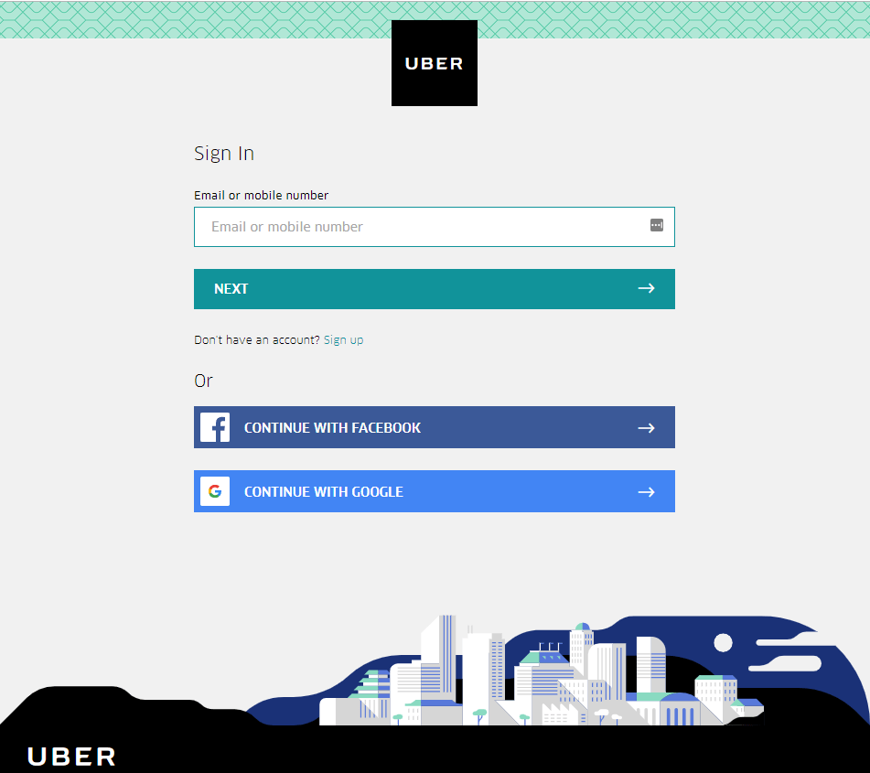
Still confused??

Slide 17
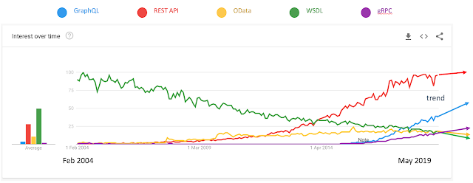
Popularity : Soap & REST

Slide 18
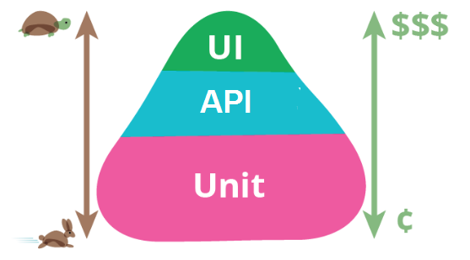
Testing : UI or API ?

Slide 19
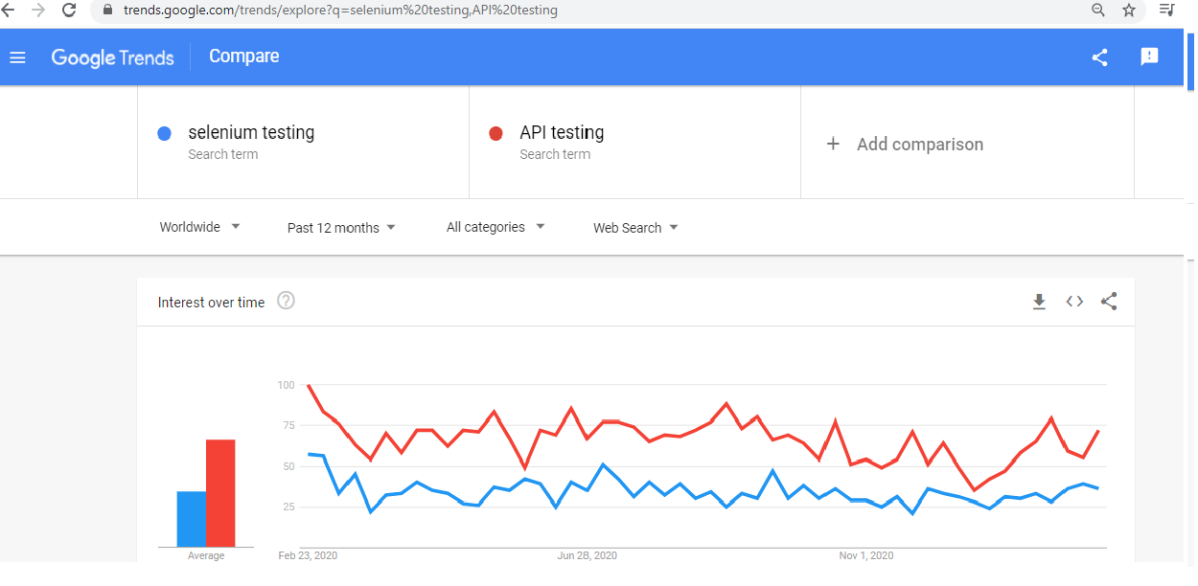
Testing : UI or API ?

Slide 20
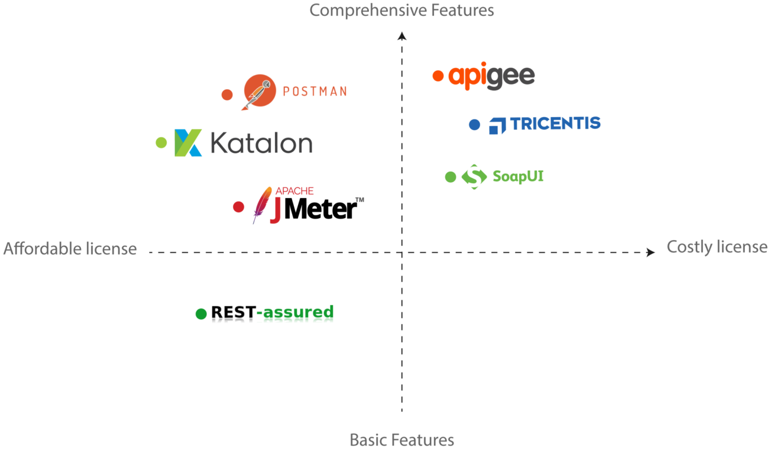
Top API Testing Tools

Slide 21
Job Profiles
https://www.amazon.jobs/en/jobs/1117417/software-development-engineer-in-test
https://www.amazon.jobs/en/search?offset=10&result_limit=10&sort=relevant&distanceType=Mi&radius=24km&latitude=&longitude=&loc_group_id=&loc_query=&base_query=API%20Testing&city=&country=&region=&county=&query_options=&
https://www.amazon.jobs/en/search?base_query=Selenium+Testing&loc_query=&latitude=&longitude=&loc_group_id=&invalid_location=false&country=&city=&region=&county=

Slide 22
Demo

