Slide 2
Shree Kumar
Independent
Consultant

Slide 3


Slide 4


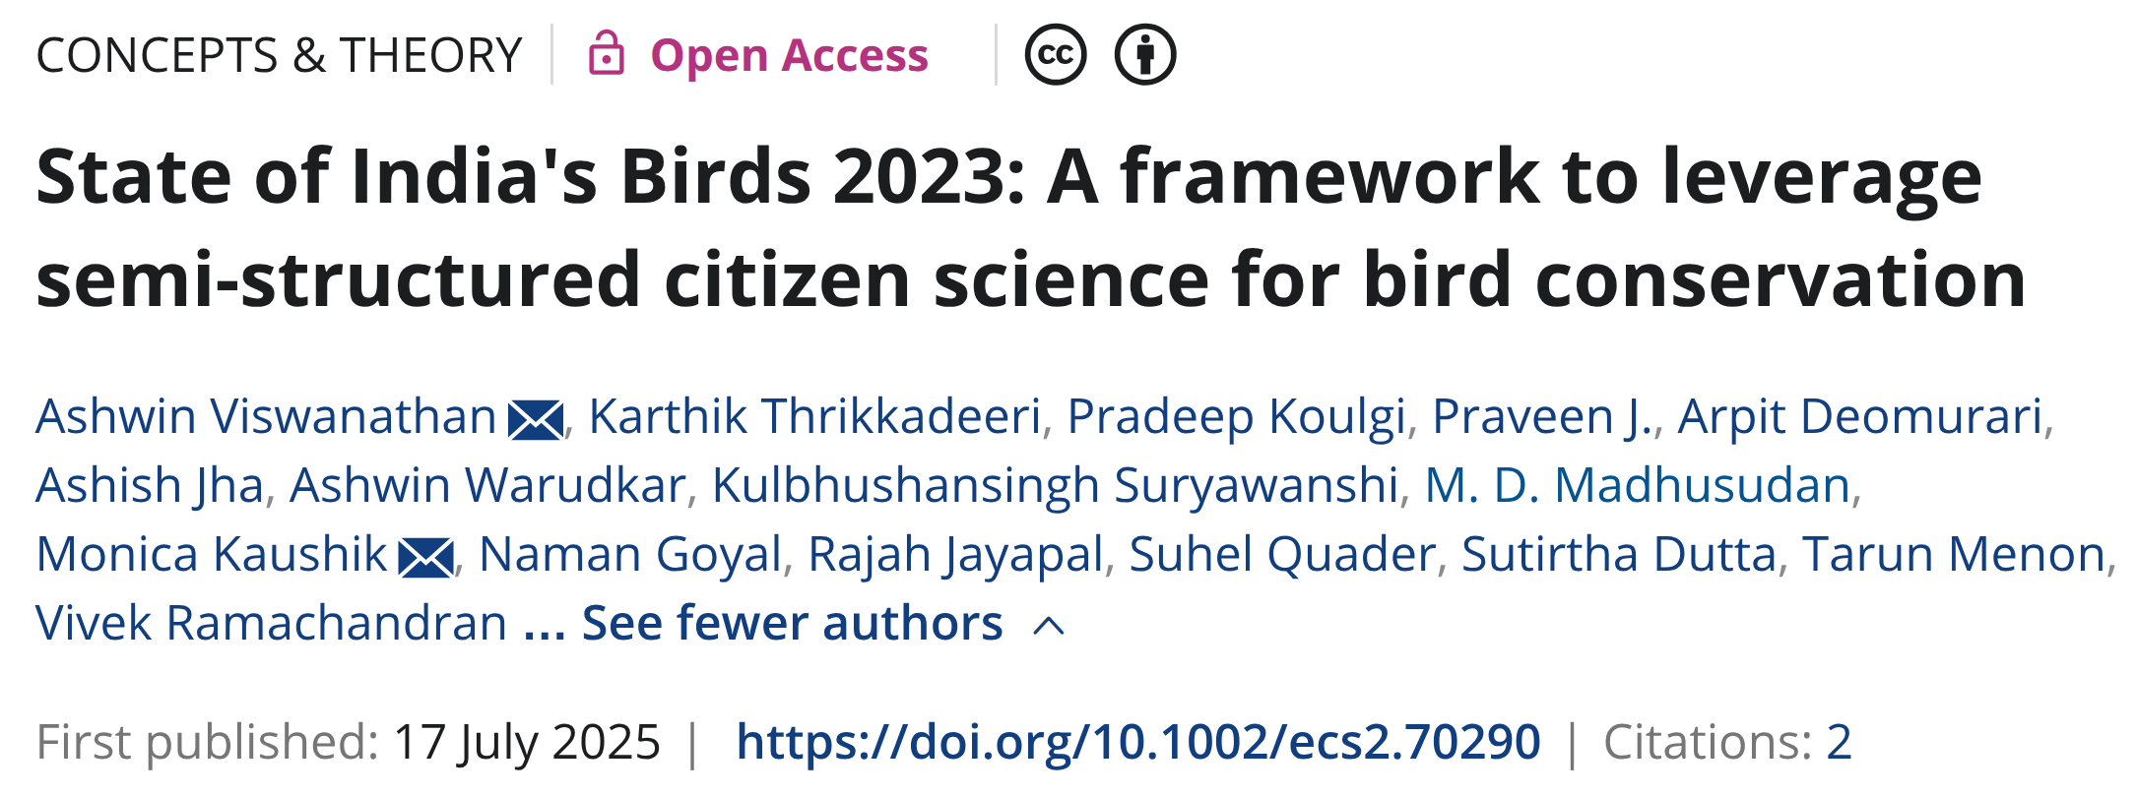
It’s FOSS !

Slide 5

Hidden costs of Memory
Cores | RAM per Core | $ per Hour | RAM Premium
64 | 2 | 3.872
64 | 4 | 4.371 | ~13%
64 | 8 | 5.728 | ~48%
Reference X86 Virtual Machine on Microsoft Azure

Slide 6
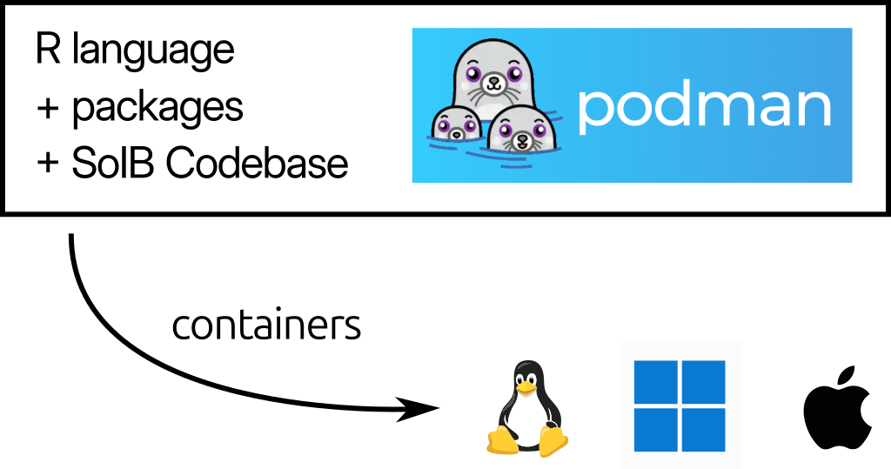
Build once,
Run everywhere...

Slide 7
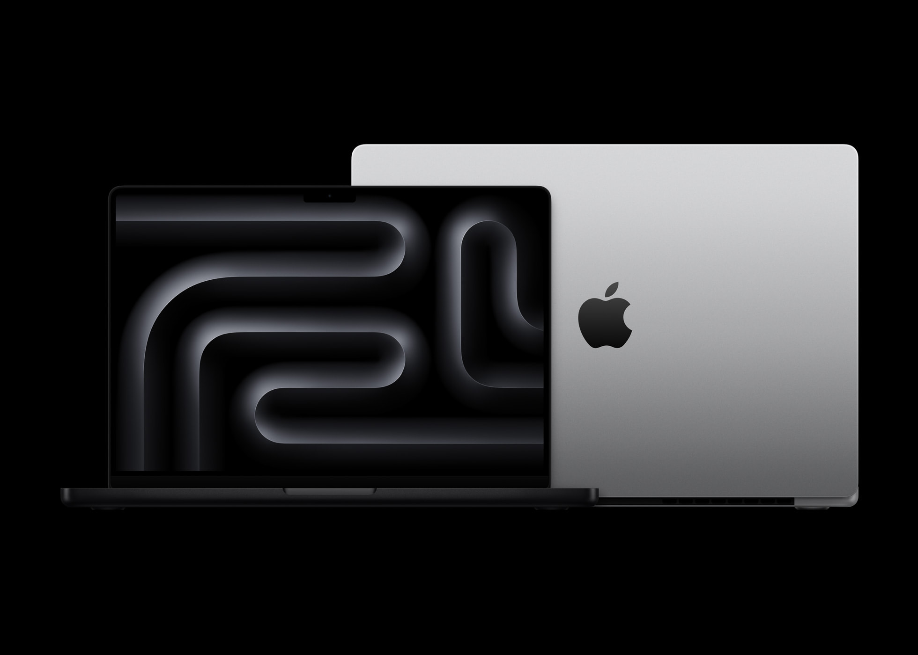
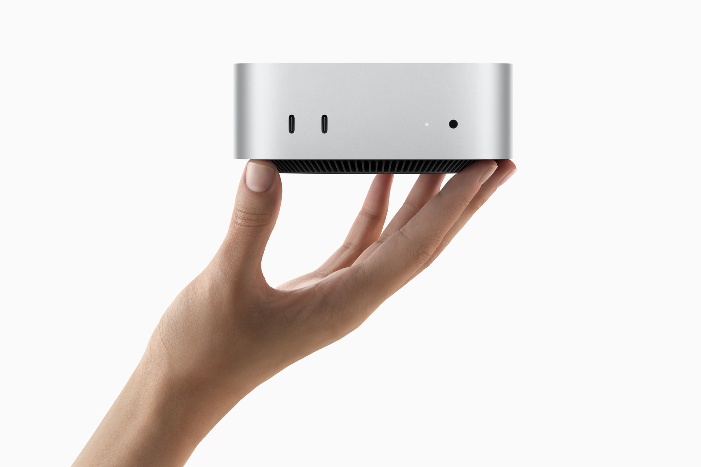
MacBook Pro M4 – 33 minutes
Mac Mini M4 – 61 minutes
AMD Ryzen 9, 16 core
42 minutes !
images: apple.com

Slide 8
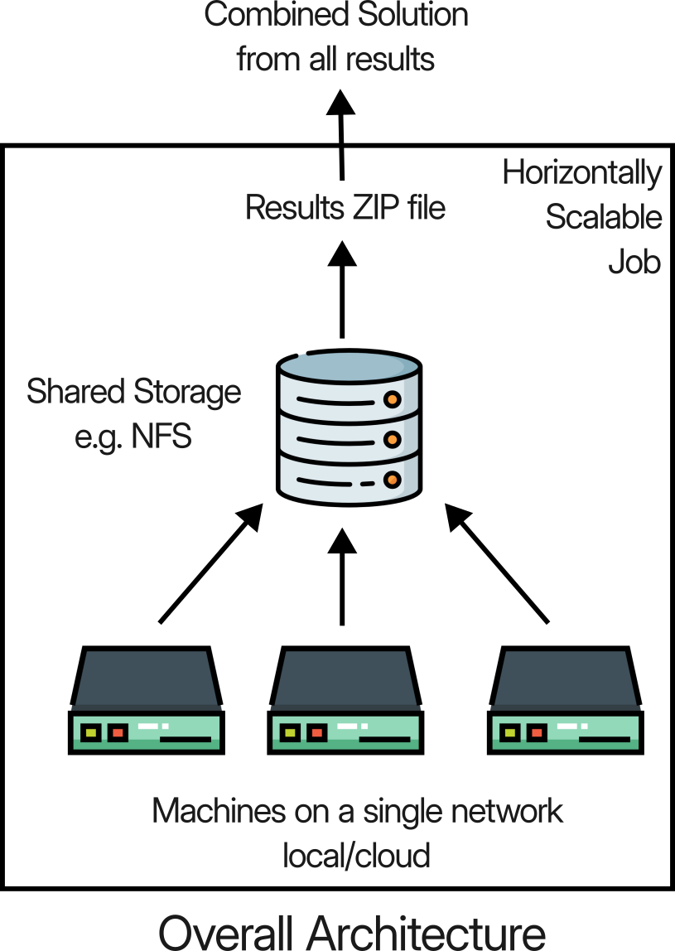

Slide 9
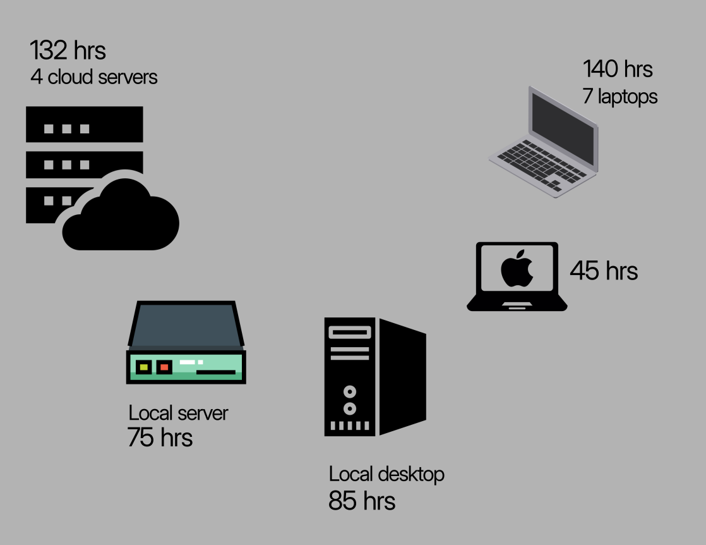
5 days, 17 machines
Rs 25k Cloud Costs
Crowd Computing
images: flaticon.com

Slide 10
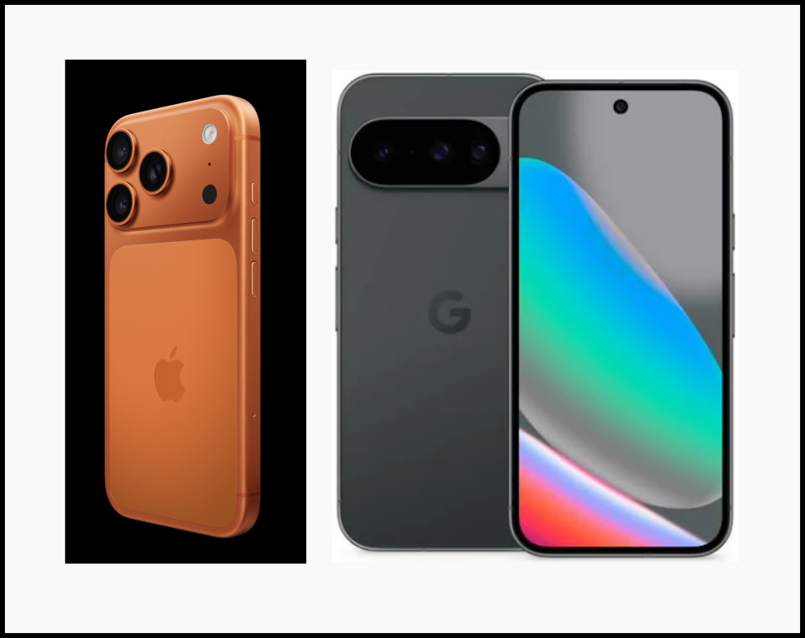

Slide 11
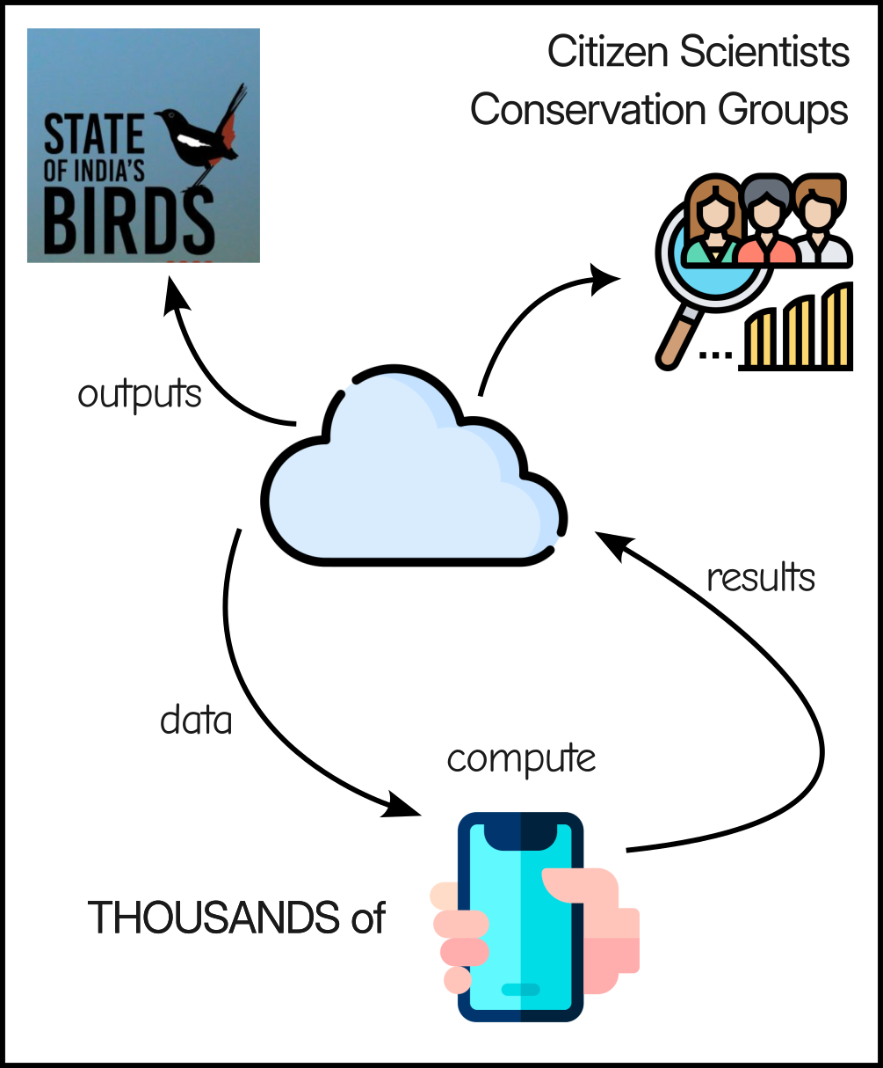
Community
Computing

