Slide 1

Open Source
in and for
Indian Chips
Shree Kumar

Slide 2
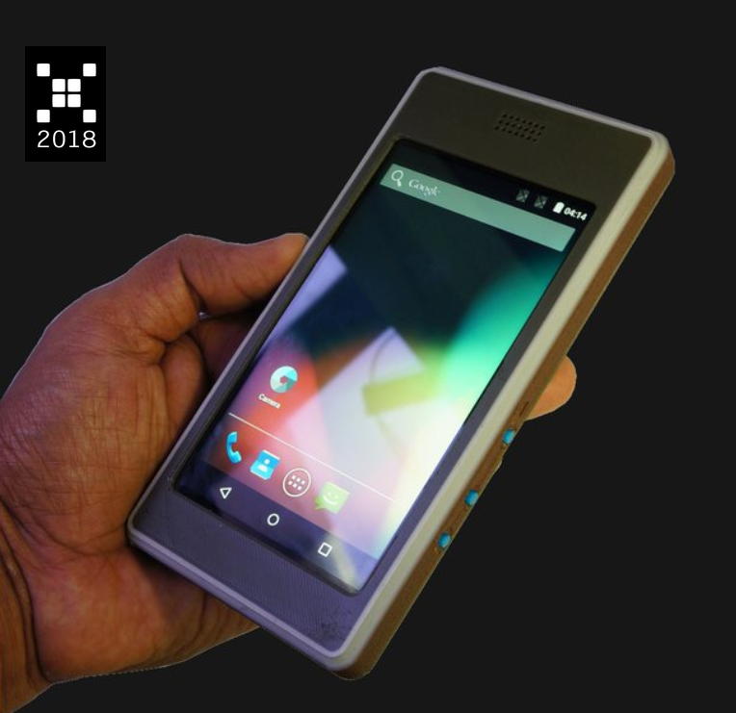
I, me, myself
Software Guy
Hardware “designer”
All things 3D
Cycling & Fooding
Fractional volunteer & policy wonk!
3D
KitePhone at Hackaday

Slide 3
Why Open Source Hardware ?
Disclaimer : Commercial grade hardware mostly has some proprietary angle!
Electronics Hardware is a national priority
Skill development
Ecosystem/community development
Accelerate Development and Innovation
Transparent costs

Slide 4


RISC-V - “Linux” for Chips
Open Standard Instruction Set Architecture (ISA)
Royalty free
Scalable across all levels of compute via profiles, extensions
Many proprietary and open source implementations
Geopolitical neutrality via HQ in Switzerland
A true “Disruptive Technology”, as defined by Prof Clayton Christensen
One ISA to rule them all… ?

Slide 5
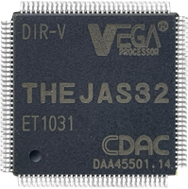
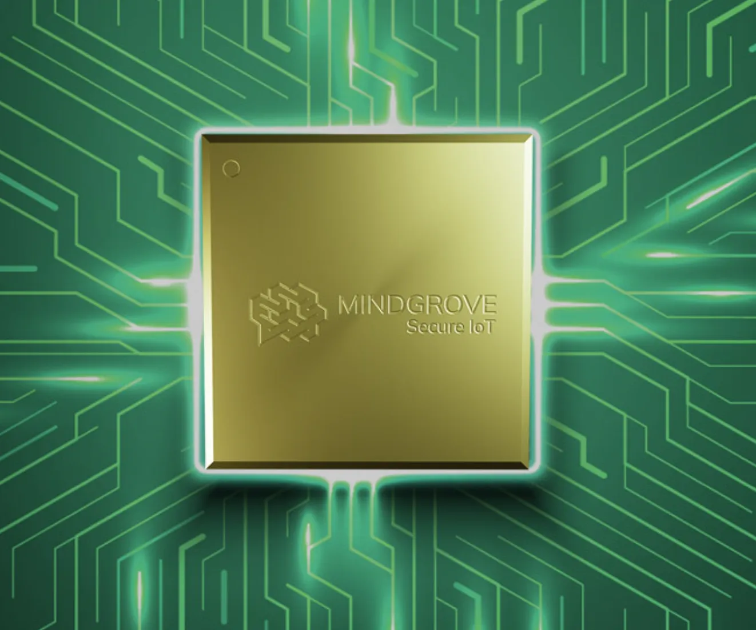
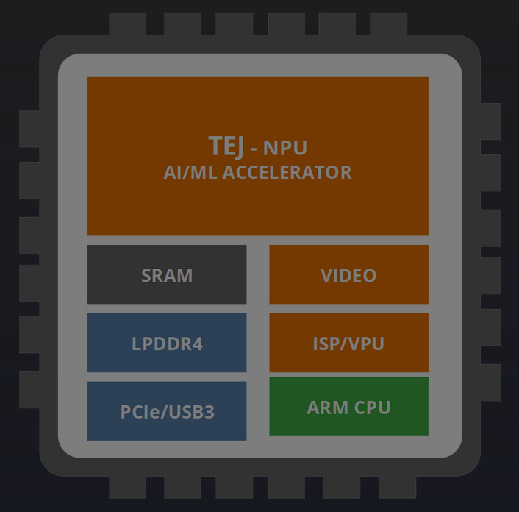
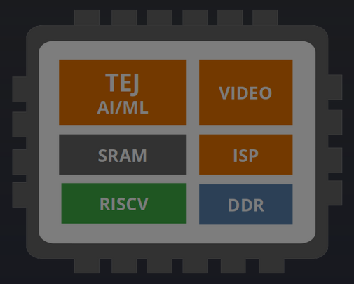
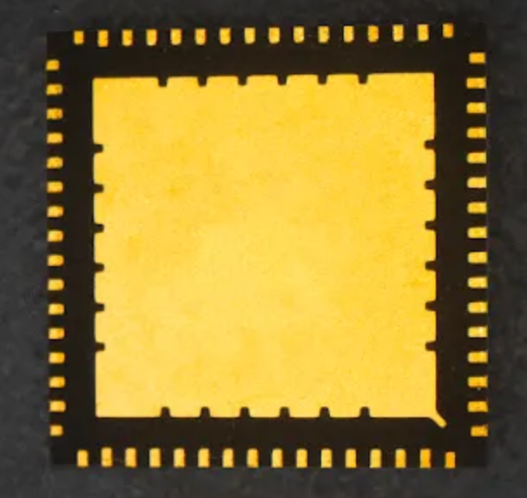
Which Chips ?
Chip
Vendor
Launched
Available to all ?
In Production ?
CPU Core
Public Funding
THEJAS32
CDAC
Yes
Yes
Yes
RISC-V (“ET1031”)
100%
Secure IoT
Mindgrove Tech
Yes
No
No
RISC-V, based on “Shakti”
DLI, C2S
Netra-A2000, R-1000
Netrasemi
Not Yet
NA
NA
ARM, RISC-V
DLI, C2S

Slide 6
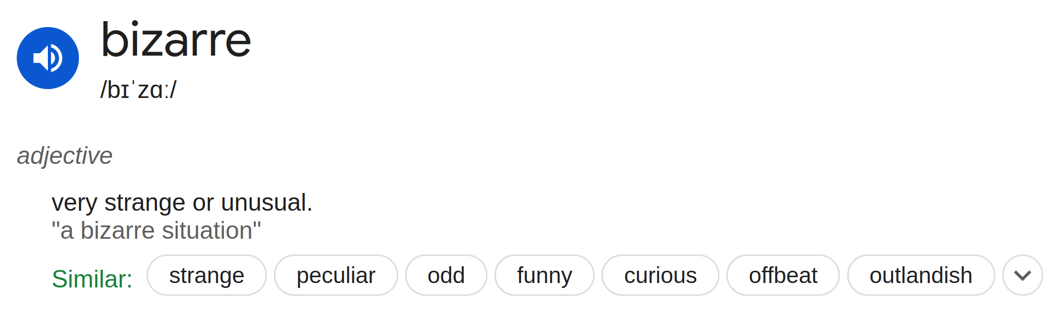
DIY - When Govt gets into Chips...
Sarkaar
Samaaj
Bazaar

Slide 7
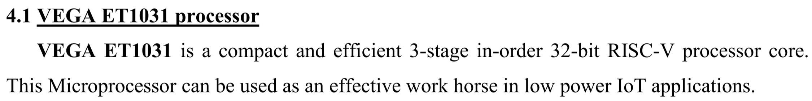
THEJAS32 - the “sarkaari” SoC
Designed by CDAC, Thiruvananthapuram
100 Mhz 32 bit RISC-V chip, “ET1031” core
Underwhelming feature set
High power consumption
  130 nm process
High cost !
High board cost !
Excerpt from Datasheet

Slide 8


ET 1031 ??
Extra Terrestrial, 1982
Koi Mil Gaya, 2003

Slide 9
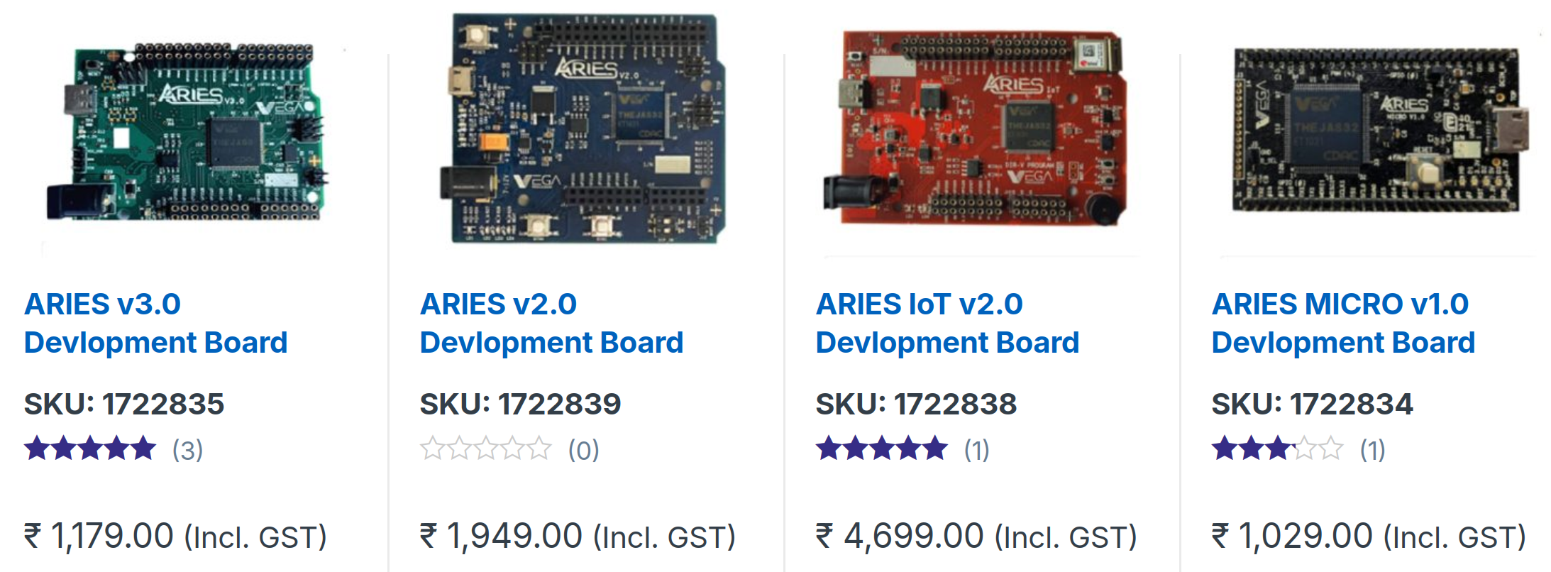
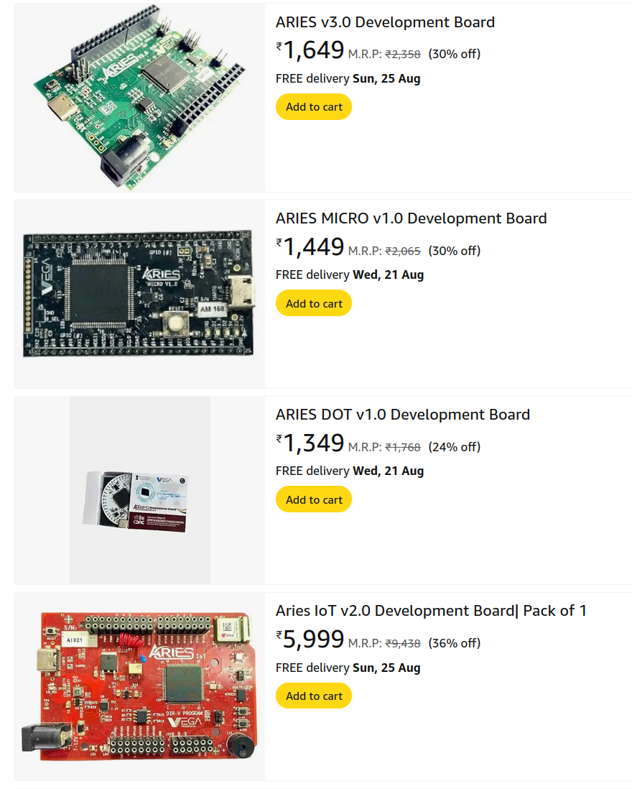


THEJAS32 “ecosystem”
ARIES Developer Boards
More Closed Source than Commercial Solutions !
Documentation !?!
Miniscule community…
Phone call support !

Slide 10
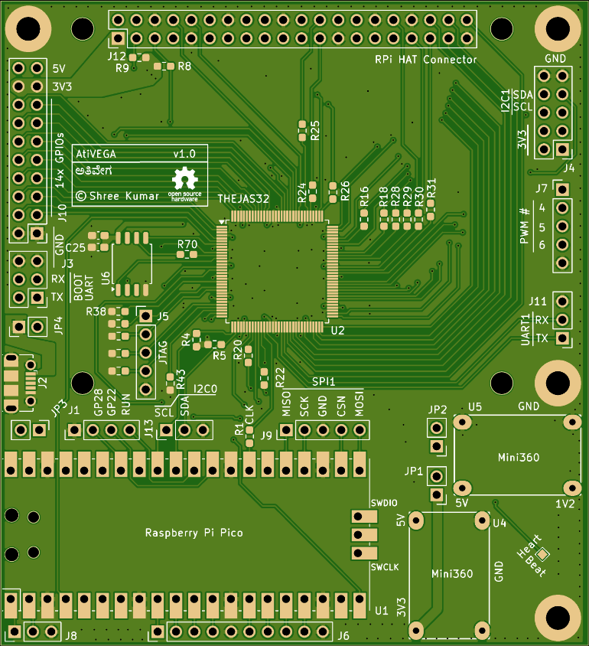
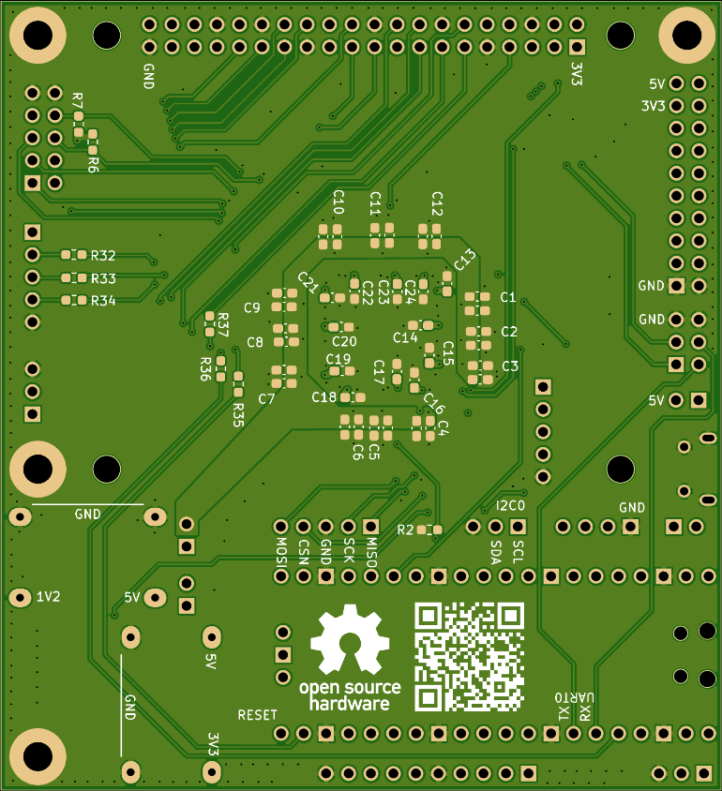

AtiVEGA
ಅತಿವೇಗ
Open Hardware System to Study RISC-V
github.com/shreekumar3d/thejas32-testbed

Slide 11
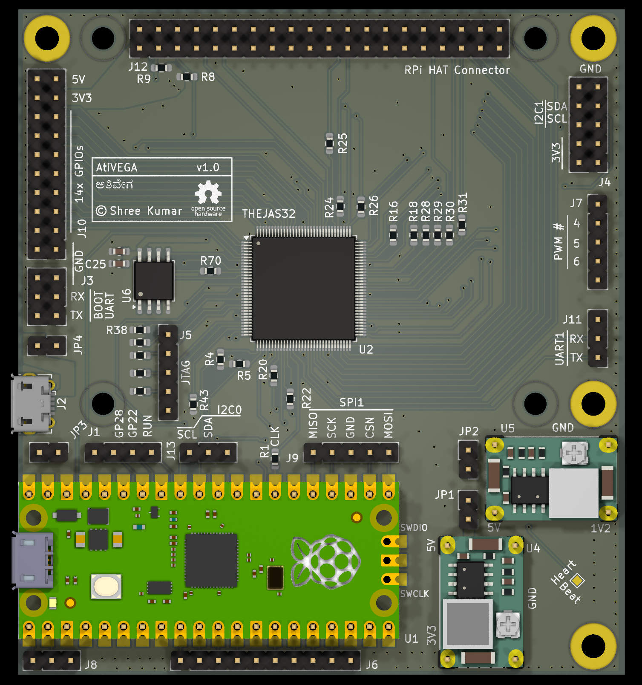
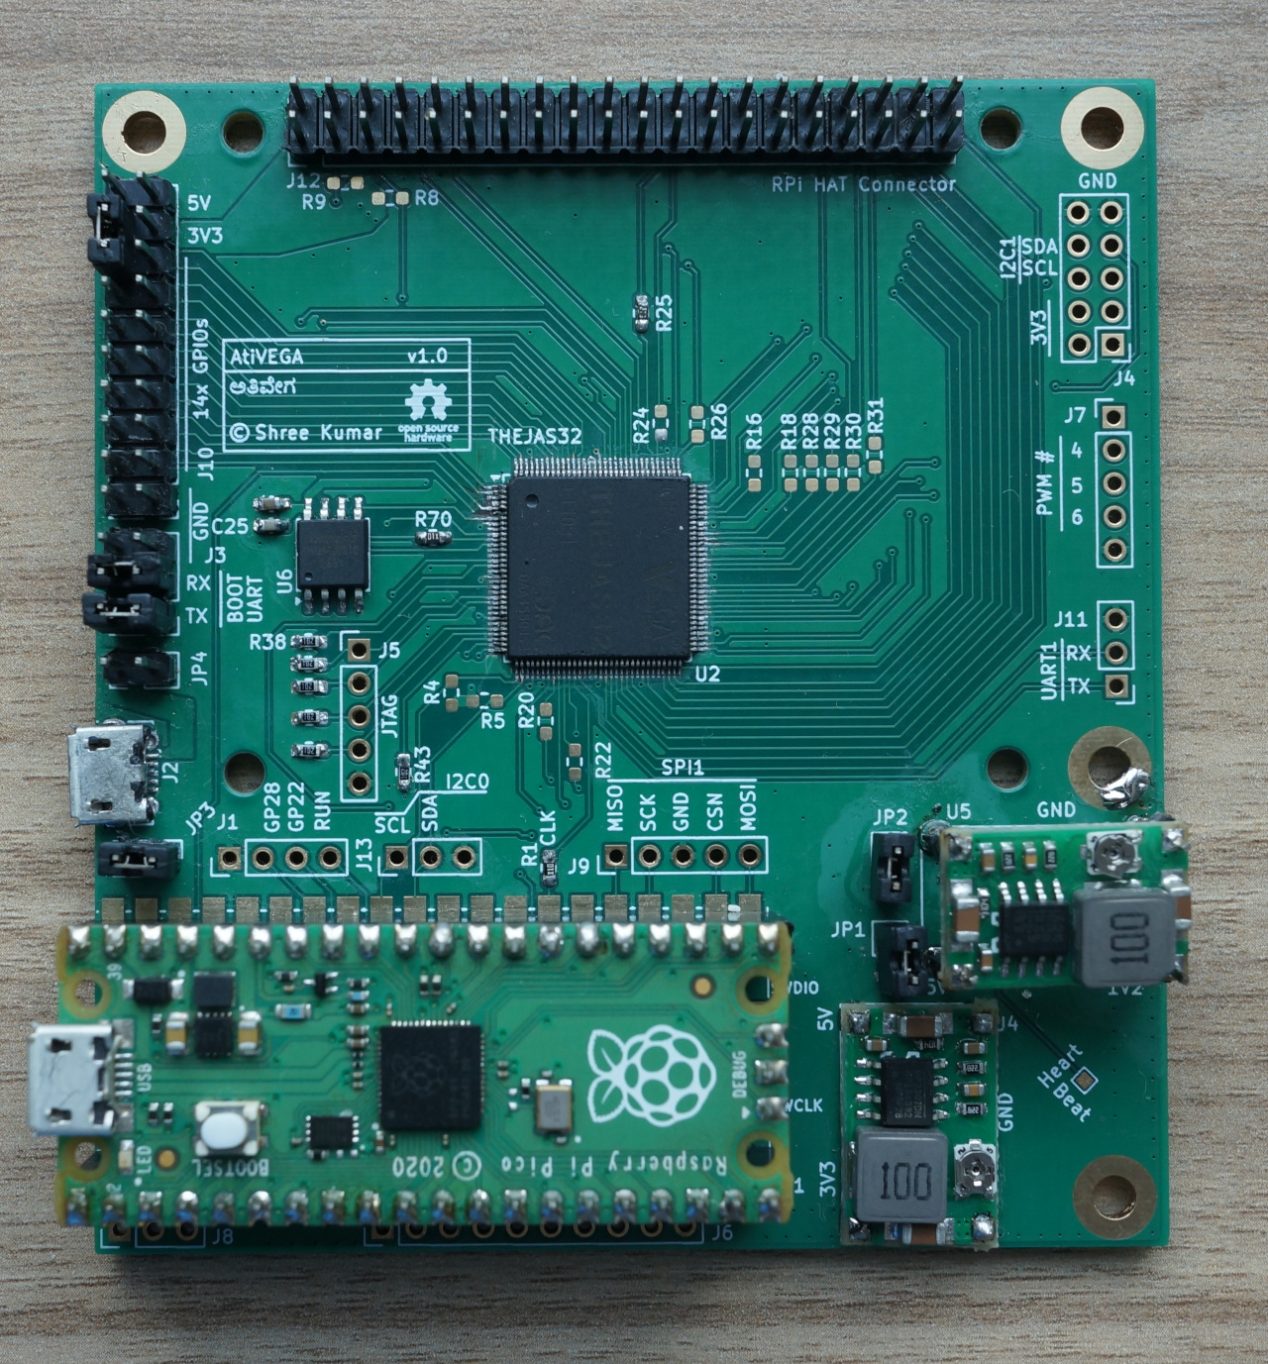
AtiVEGA
ಅತಿವೇಗ
Reel vs Real
github.com/shreekumar3d/thejas32-testbed

Slide 12
AtiVEGA
RPi HAT Compatibility
I2C, SPI
14x GPIO
PWM
Boot UART
UART
USB
+
Power
ಅತಿವೇಗ
github.com/shreekumar3d/thejas32-testbed

Slide 13
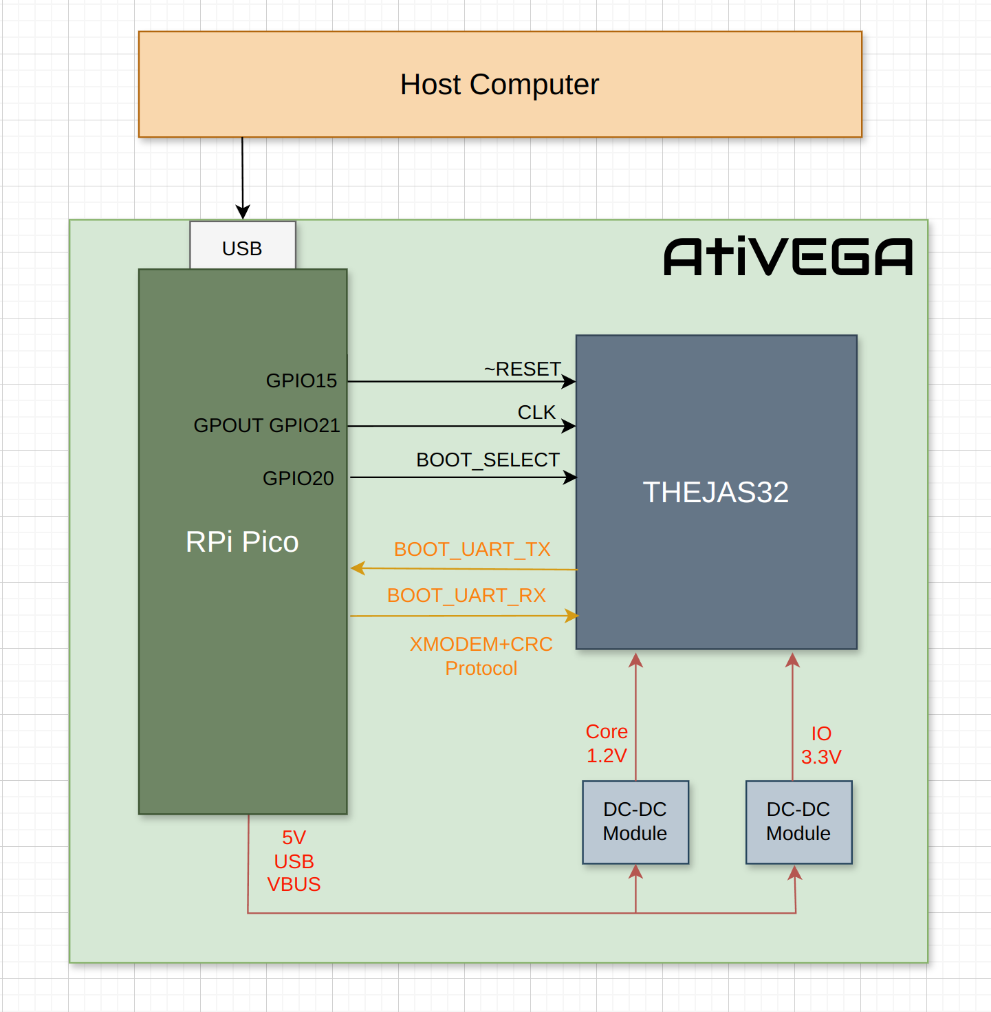
How is this board different ?
~/sw/bringup/poweron

Slide 14
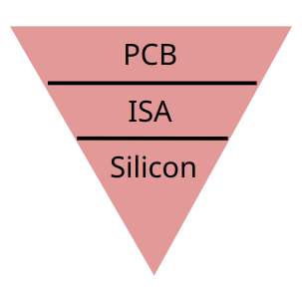
Why this board?
Does the typical “Arduino” and “IoT” things
  Sensors, Displays
  I2C, UART, SPI, GPIO
And much more...
  Deep dive into ISA implementation
  Characterize silicon power consumption
  Reverse engineer THEJAS32 !?
  Assemble from first principles

Slide 15
BOM(b) Cost for Prototype
Component | Quantity | Cost Per Piece | Total (Rs)
THEJAS32 | 1 | 289 | 289
Rpi Pico | 1 | 343 | 343
2 MB Flash | 1 | 65 | 65
DC-DC Converter | 2 | 27 | 54
USB connector | 1 | 19.62 | 19.62
10uF capacitor | 13 | 1.45 | 18.85
100nF capacitor | 25 | 0.9 | 22.5
Resistors | 32 | 0.4 | 12.8
PCB | 1 | 252 | 252
Connectors
Shipping, Customs
Assembly
Sarkaari SoC
Bazaar’s Board !
Grand Total
~ ₹ 1100
All prices inclusive
of GST

Slide 16
Demo Time
Overclock
100 MHz => 150 MHz

Slide 17
A New Way to Understand
Verilog Simulation
Clock as you need
RP2040/Pico
always begin
#5 clock = !clock
end
gpio_put(21, 1);
sleep_ms(500*1000);
gpio_put(21,0);
sleep_ms(1);

Slide 18
Current Status
Version 1.0 Hardware
  4 boards assembled
  Features verified : GPIO, I2C, UART, SPI
Project page on Hackaday()
Github repository is a real-time update with samples!

Slide 19
Next Status
Coming Soon
  Beautiful Documentation
  SDK
Follow the project for updates…
Want to try ? Let me know!

Slide 20
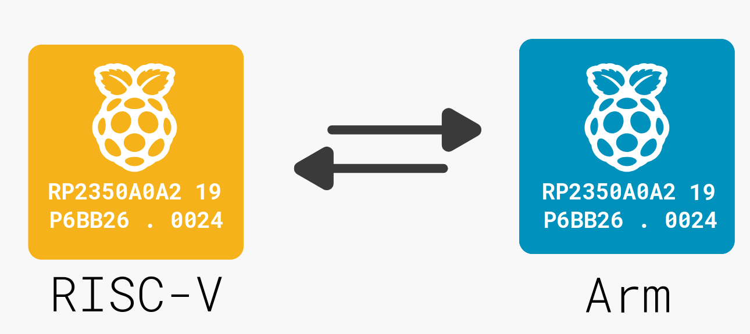
Summary
Open Source Hardware is crucial for
developing the Indian Semiconductor
Ecosystem.
Opinion
RP2350
“Hazard3” RISC-V Open Source Core
Dual core 32 bit RISC-V, 150 MHz
$0.8
Open Source Hardware can
Build deeper capabilities
Enable new use cases
Fact
I would like to see…
CDAC open sourcing “ET1031”
More open hardware from vendors
Hope

Slide 21
Quick Pitch
Free Hardware Library
as in free lunch

Slide 22
Backup Slides

Slide 23

Thank you!
Open Source
in and for
Indian Chips
@ shreekumar3d
AtiVEGA
ಅತಿವೇಗ

Slide 24

Free your mind ?
FREE YOUR MIND
FREE YOUR MIND

Slide 25


Bullet Time Demo
How do you get from here
To here
printf
sleep

Slide 26

Are you the ONE?
NEO
Are you telling me that I can dodge bullets ?
MORPHEUS
No. I am telling you that when you are ready,
you won’t have to !

Slide 27

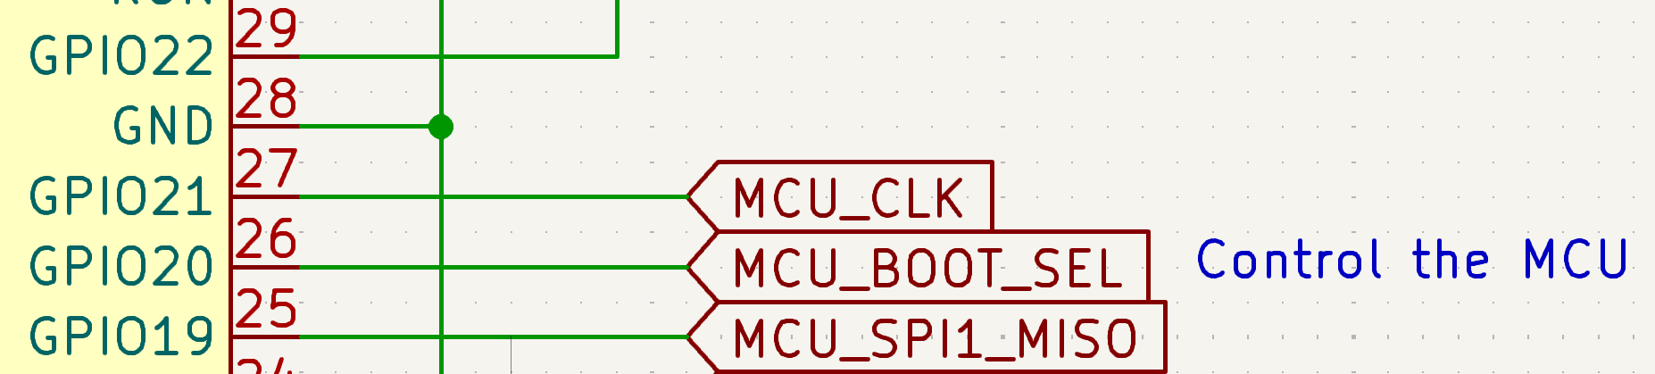
But in the real world, we are?
Use the CLOCK, Luke!
RP2040/Pico
gpio_put(21, 1);
sleep(500*1000);
gpio_put(21,0);
sleep(500*1000);
CLK is a GPIO ! 1 milliHz FTW !

