Slide 1
Connected Environment
1.0
RELEASE · OCTOBER 2026
Danger
Weather Station
All Clear
The home for everything environmental on site.
Lightning
Check
Gas
WakeCap · Internal presentation
Notes:
Welcome. About twelve minutes, plus questions. The overview video (3:21) is optional.
We cover why we built Connected Environment, what is in 1.0 today, what it does not do yet, and where to watch and try it.
The three chips on the right are the three answers a site can get: Danger from Weather Station, All Clear from Lightning, Check from Gas. That is the whole story in one picture.

Slide 2
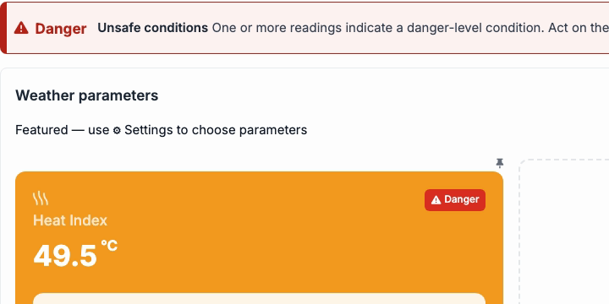
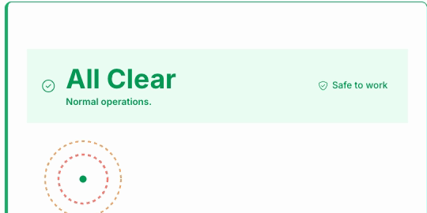
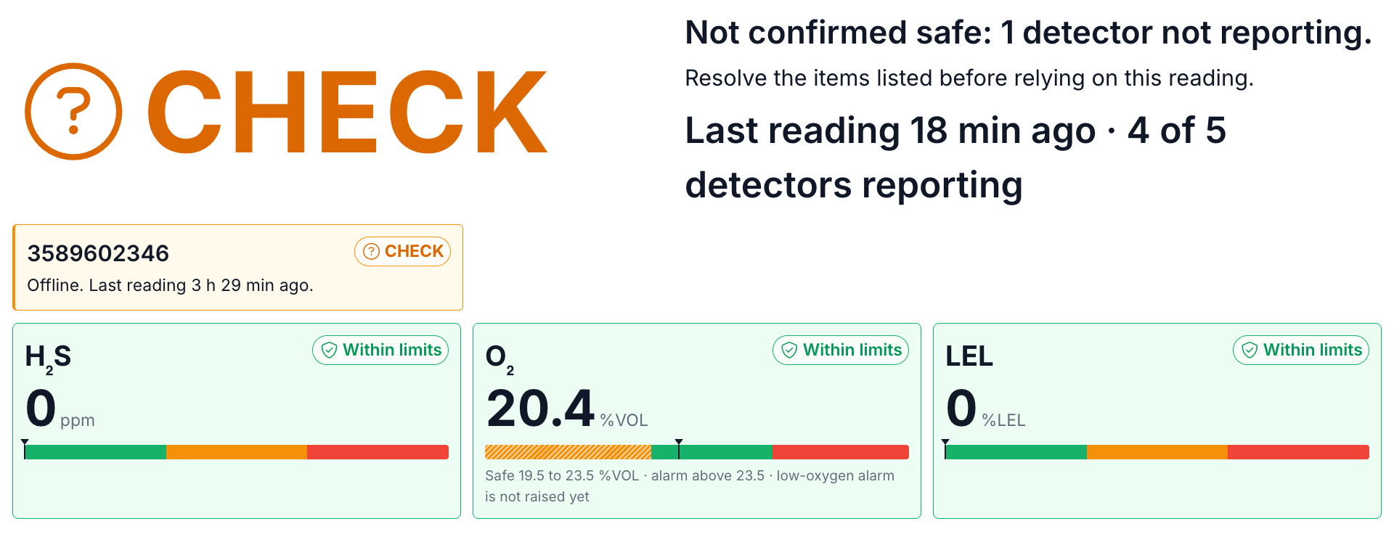
Is it safe to work right now?
WHY ONE PLACE
Heat says one thing. Lightning says another. Gas says a third.
Danger
Weather Station
All Clear
Lightning
Check
Gas
Danger, in words, with the steps to take.
All Clear. Only green counts as safe to work.
Check. Not confirmed safe: one detector is not reporting.
Connected Environment puts them under one roof: one place to look.
Three projects, three screens, one portal. Live production screens, 4 October 2026. Names blurred.
Connected Environment 1.0 · Internal
2
Notes:
On site the question is simple: is it safe to work right now?
Heat says one thing. Lightning says another. Gas says a third. Three screens, three products, three places to look.
Connected Environment puts them under one roof.
These tiles are live production screens from three different projects, captured on 4 October. Weather showed Danger. Lightning showed All Clear. Gas showed Check.
Point out that Check does not mean calm. It means one detector is not reporting, so the screen cannot confirm it is safe.

Slide 3
One product. Three environment products inside.
WHAT SHIPPED
Connected Environment
1.0
One menu and header · one backend · each project switches on only what it uses
Weather Station
Lightning
Gas
A verdict and the steps to take, not just a heat number.
Alert state and alert distances, on a map.
Overview and detectors.
Alerts you can acknowledge and close, and compliance limits.
Reports, and a Site Safety Policy with a 30 day preview.
Alarm history. A backup to the site's own cabinet lights and sounder.
One platform behind them. Readings and status from all three sit in one place.
DIRECTION
Going forward, new environment products go under Connected Environment.
Connected Environment 1.0 · Internal
3
Notes:
Connected Environment is one umbrella in the portal.
Under it sit Weather Station, Lightning and Gas, each with its own screens and devices.
They share one platform: one backend, one menu and header. A project switches on only the products it uses.
The last line, new environment products go under it, is our stated direction. It is not a shipped feature, so say it as direction.

Slide 4
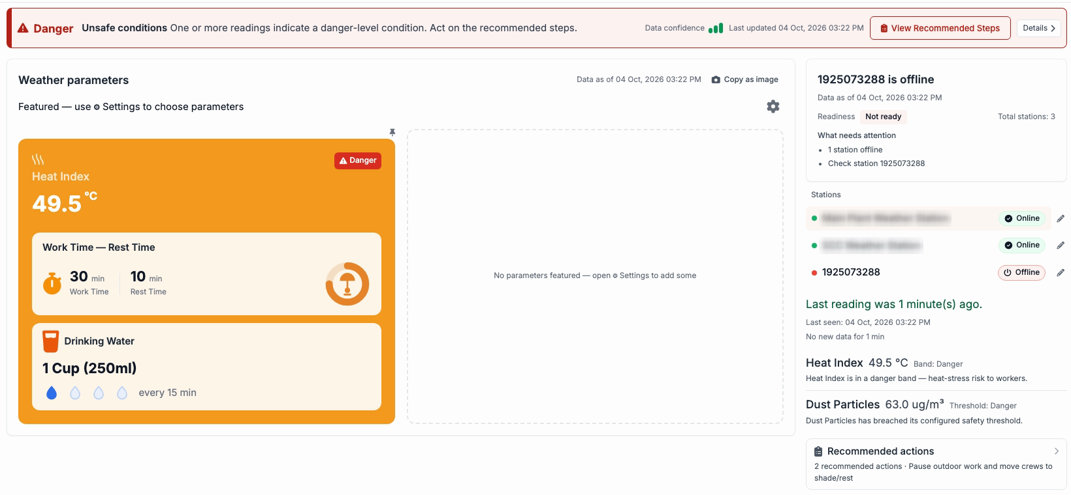
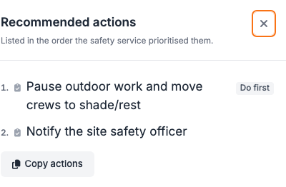
A heat number is not an answer
WEATHER STATION
1
A verdict, in words. The strip says Danger and the steps to take, in priority order.
1
4
2
The cycle in force. The heat card shows work, rest and water for the crew.
2
3
3
Station health. An offline station is named, and readiness reads Not ready.
4
Your readings. The gear, Select parameters, chooses which readings are featured.
Live production screens, 4 October 2026. Station names blurred.
Inset: View Recommended Steps. The first action is marked Do first.
Connected Environment 1.0 · Internal
4
Notes:
A heat number does not tell a supervisor what to do. The strip across the top does: Danger, in words, and an instruction.
One: View Recommended Steps opens the actions in priority order. First, pause outdoor work and move crews to shade or rest. Then notify the site safety officer.
Two: the heat card carries the cycle in force. Work time, rest time, and drinking water.
Three: station health. An offline station is named, and readiness reads Not ready.
Four: the gear opens Select parameters. It chooses which readings are featured. Each station also has a rename pencil.

Slide 5
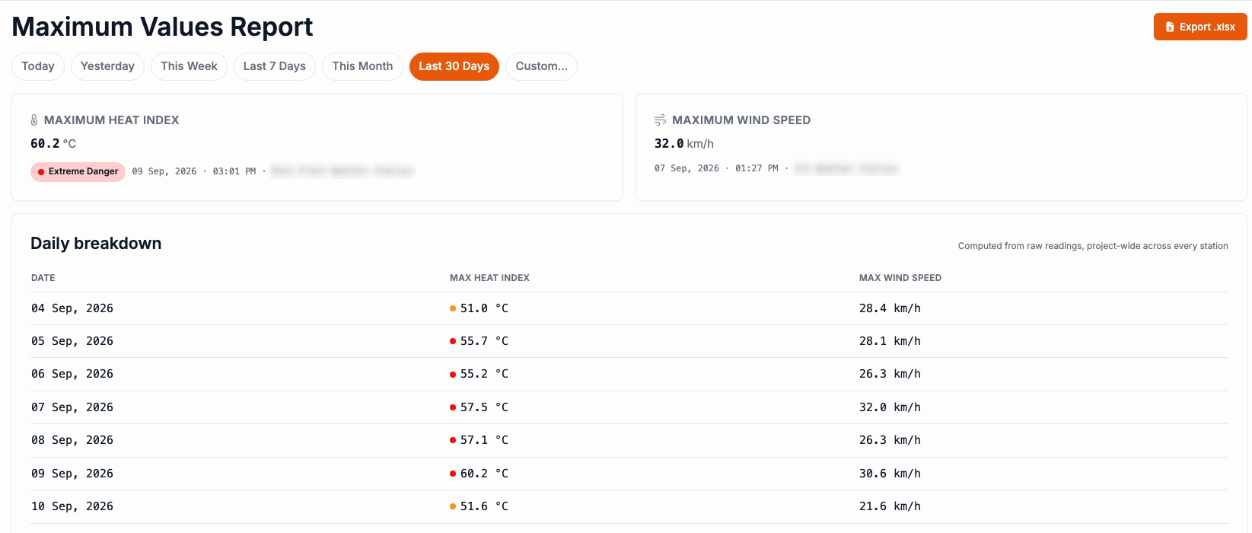
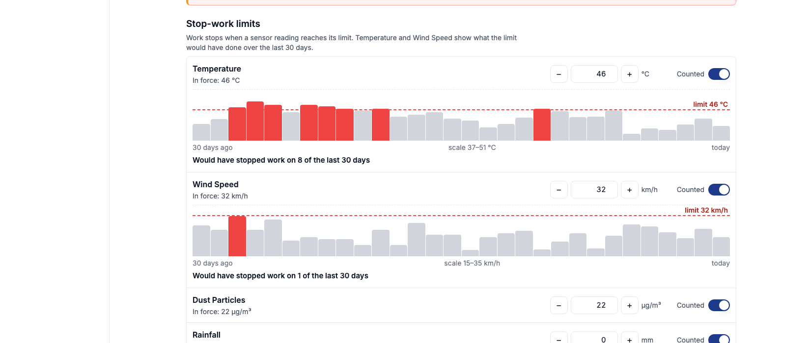
Look back at the heat. Check what stops work.
WEATHER STATION · REPORTS AND SAFETY POLICY
REPORTS
SETTINGS, WEATHER STATION
Maximum Values Report
Site Safety Policy
Pick a period, today to the last 30 days, or a custom range.
Temperature and wind limits show what they would have done in the last 30 days.
Peak heat index and peak wind speed, a daily breakdown, and an Excel export.
Heat index bands, each with its own work, rest and water settings. A Change history tab lists changes.
CAREFUL
The page warns: changing anything here changes when work stops, for everyone on the project.
Connected Environment 1.0 · Internal
5
Notes:
Two more places.
Reports: pick a period and see the peak heat index and peak wind speed across stations, with a daily breakdown and an Excel export.
Settings, Weather Station holds the Site Safety Policy. Stop-work limits. For temperature and wind, a 30 day chart shows what the limit would have done. On the project in this screenshot, temperature would have stopped work on eight of the last 30 days, and wind on one. Those are values at capture time.
Below the limits are the heat index bands, each with work, rest and water settings, and a Change history tab.
Say the warning out loud: the page says changing anything here changes when work stops, for everyone on the project.

Slide 6
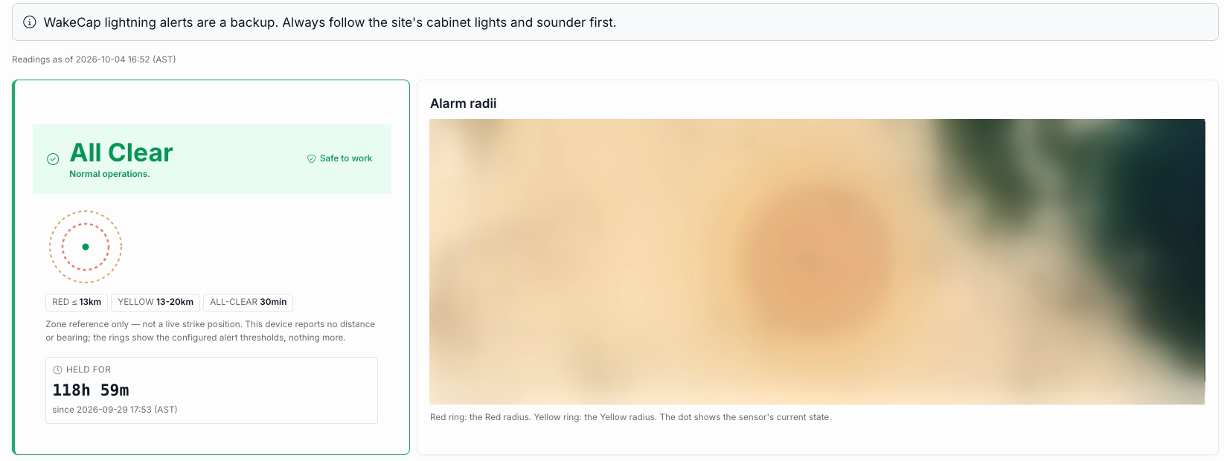
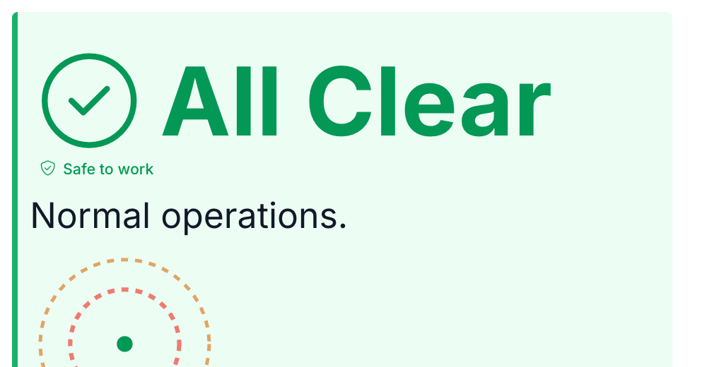
A backup, not the alarm
LIGHTNING
1
Cabinet lights and sounder first. The page's top line says so.
2
Only green is safe to work. The tile reads All Clear, with a held-for timer.
3
Alert distances, on a map. Red and yellow rings and a dot for the sensor. A zone reference, not a live strike position.
4
History you can export. An alarm activity chart, and an alarm history with CSV export.
Live production screens, 4 October 2026. Map blurred.
Inset: the wallboard view. Wallboard and phone views open by web address, not from the menu.
ON THE PAGE
WakeCap lightning alerts are a backup. Always follow the site's cabinet lights and sounder first.
Connected Environment 1.0 · Internal
6
Notes:
Lightning is close. Who tells the crew to stop? The site&#x27;s own cabinet lights and sounder, first. This page is the backup, and its top line says so.
Only the green state counts as safe to work.
The rings are the configured alert distances. They are a zone reference, not a live strike position.
New here: a map of the alert distances, an alarm activity chart, and an alarm history you can export as CSV.
The wallboard and phone views, shown in the inset, open by web address, not from the menu.
Settings, Lightning lets you edit the alert distances and set the location.

Slide 7
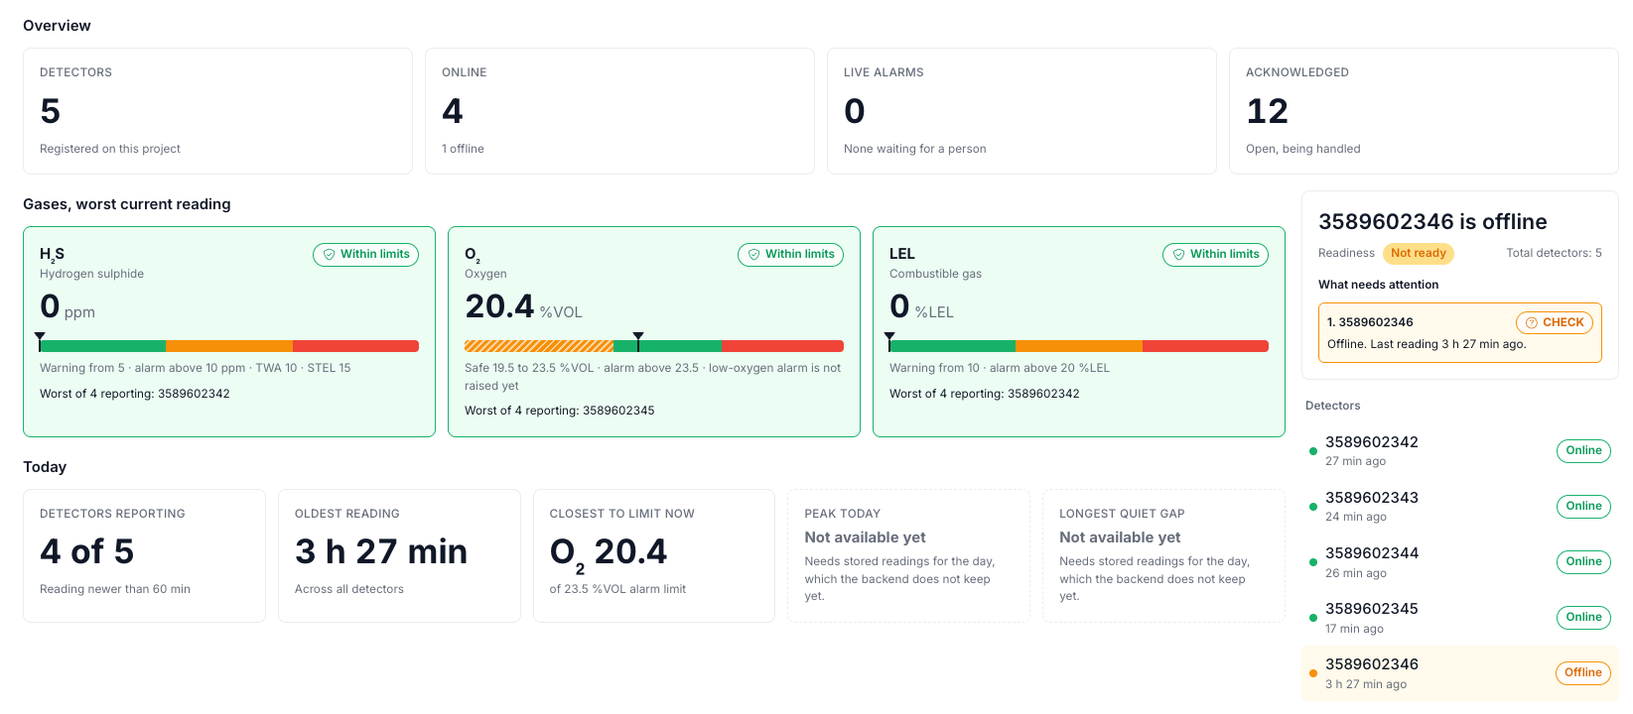
A quiet screen is not a safe screen
GAS
1
Overview. Detectors, how many are online, live alarms, and the worst current reading per gas, each with its limits.
2
Gaps are named. A detector that stops reporting shows as offline. The status reads Check: not confirmed safe.
3
Alerts. Acknowledge and close, with edit access. Recorded in WakeCap only, not sent to the gas vendor.
4
Compliance. Limits in force. Exposure and exceedance figures say Not available yet.
Live production screens, 4 October 2026.
Inset: the wallboard view, by web address.
NOTE
Acknowledge and close are recorded in WakeCap only. They are not sent to the gas vendor.
Connected Environment 1.0 · Internal
7
Notes:
A quiet gas screen is not a safe gas screen.
The Gas dashboard opens on Overview. Five detectors, four online. Live alarms counts alerts nobody has acknowledged. Each gas card shows the worst current reading among the detectors that are reporting, with its limits.
When a detector stops reporting, the page names it, and the status reads Check: not confirmed safe.
Alerts can be acknowledged and closed, with edit access. Be explicit: that is recorded in WakeCap only. It is not sent to the gas vendor, so an alert closed here stays open in the vendor&#x27;s system.
Compliance lists the limits. Exposure and exceedance figures say Not available yet, instead of an empty chart that reads as all clear.

Slide 8
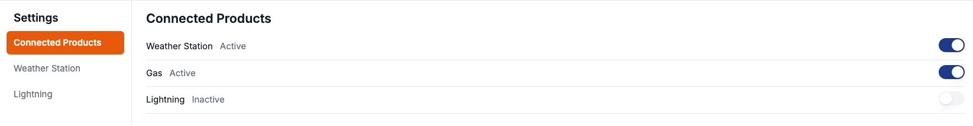
Each project switches on only what it uses
THE PLATFORM
PROJECT
WEATHER STATION
LIGHTNING
GAS
Settings, then Connected Products. One switch per product on a project.
Weather alone
The menu follows. A project's menu shows only what it has switched on.
Lightning alone
One shell. One menu and header across all three products.
Weather with Gas
Active or Inactive, one switch per product. Three real projects.
Live screen: Connected Products on a project with Weather Station and Gas on. Nothing was switched for this deck.
Connected Environment 1.0 · Internal
8
Notes:
Each project switches on only what it uses.
In Settings, Connected Products has one Active or Inactive switch per product. The table is drawn from three real projects: Weather alone, Lightning alone, and Weather with Gas. The strip below is the live screen.
The menu shows what is on.
We did not switch anything on or off for this deck.
If someone asks how to enable a product: Settings, Connected Products. It changes a real project, so do it with the project owner.

Slide 9
Three roads in, one platform behind them
HOW READINGS ARRIVE
Weather
Weather station
→
Site wireless mesh
→
Gateway
→
WakeCap cloud decodes and stores
Lightning
Sensor and input module
Modbus device on the mesh
WakeCap cloud, unreadable data set aside
→
→
Gateway
→
Gas
Gas detectors
→
Vendor's cloud, a black box to us
→
WakeCap asks on a regular timer
→
WakeCap stores readings and alerts
All three reach the same portal: Connected Environment.
Gas has no mesh and no Modbus. Each detector reports on its own schedule, so each reading shows its age. Modbus is an industrial wiring and data standard many sensors speak.
Connected Environment 1.0 · Internal
9
Notes:
Different roads in, one platform behind them.
Weather stations reach WakeCap over the site&#x27;s wireless mesh, through a gateway, into the cloud, which decodes and stores the readings.
Lightning is read through a small input module and shows on the mesh as a Modbus device. Modbus is an industrial wiring and data standard many sensors speak. Anything unreadable is set aside.
Gas takes another road: the vendor&#x27;s cloud. No mesh, no Modbus. WakeCap asks that cloud on a regular timer, and each detector reports on its own schedule, so each reading shows its age.
Do not quote polling or reporting intervals. We have not verified numbers.

Slide 10
What it does not do yet, and where it is going
HONEST EDGES
Good to know
DIRECTION
Gas acknowledge and close are recorded in WakeCap only, not sent to the gas vendor.
Direction, not a commitment
New environment products go under Connected Environment.
Gas exposure and compliance figures say Not available yet. Some gas history is not stored yet.
A future assistant could read weather readings and propose changes. A person approves.
Trends sits in the menu marked Planned.
The AI assistant is direction only. Building blocks exist for Weather Station only. No assistant runs on any site.
The weather safety answer comes from fixed rules. An assistant would only reword it.
No dates are promised.
Connected Environment 1.0 · Internal
10
Notes:
Be plain about the edges.
Gas acknowledge and close are recorded in WakeCap only. Gas exposure and compliance figures say Not available yet, and some gas history is not stored yet. Trends is in the menu marked Planned.
The AI assistant is direction only. Building blocks exist for Weather Station only. No assistant runs on any site.
Direction: new environment products go under Connected Environment. A future assistant could read weather readings and propose changes. A person approves, and the weather safety answer comes from fixed rules. We promise no dates.

Slide 11
Five short videos, and one place to start
WATCH AND TRY
1
Connected Environment overview
3:21
Try it
One umbrella over weather, lightning and gas.
1
Open your project in the portal.
2
Weather Station
2:18
The verdict, steps, Reports and Site Safety Policy.
2
In the left rail, click the sun-and-cloud icon: Connected Environment, if your project has it.
Lightning
2:08
3
Read the top line first. Weather verdict, Lightning banner, Gas status.
3
A backup alert view, alert distances and history.
4
Ask. Questions now, or after.
4
Gas
2:32
Overview, Check, alerts and compliance limits.
CAREFUL
Setup tour
Look, do not switch. Enabling a product or changing a policy changes a real project.
5
4:33
Explore, feature, enable and configure, with voice-over.
All five videos show live production screens, read only.
Connected Environment 1.0 · Internal
11
Notes:
Where to watch: five short videos. Start with the overview. The setup tour shows how to enable and configure each product, read only on production.
To try it: open your project in the portal, then click the sun-and-cloud icon in the left rail. That is Connected Environment, if your project has it.
Read the top line first: the Weather verdict, the Lightning banner, the Gas status.
Then take questions. The next slides are the appendix: setup flows, what we say and do not say, and a glossary.

Slide 12
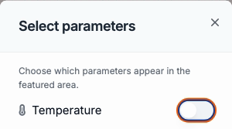
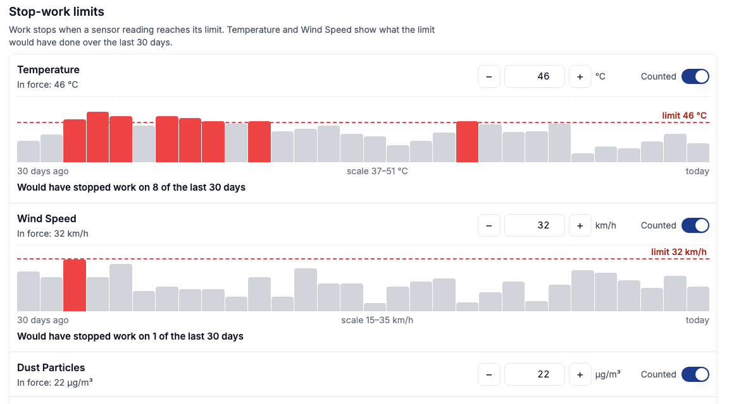
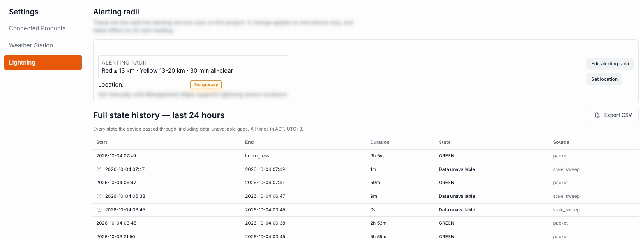
How products are enabled and configured
APPENDIX · SETUP
1
Choose what to feature
2
Enable products
3
Configure Weather Station
4
Configure Lightning
WEATHER STATION PAGE, GEAR
SETTINGS, CONNECTED PRODUCTS
SETTINGS, WEATHER STATION
SETTINGS, LIGHTNING
Weather Station
Gas
Lightning
Select parameters: one switch per reading.
One Active or Inactive switch per product.
Site Safety Policy: limits, heat index bands, method, change history.
Edit alerting radii: red, yellow, all-clear delay.
Each card can also move or leave the area.
Changes a real project.
Set location: click the map or type coordinates.
Changes when work stops, for the whole project.
Gas has no settings page. Its limits are shown, read only, on the Compliance page. The setup tour video (4:33) walks through all of this.
Connected Environment 1.0 · Internal
12
Notes:
Appendix: the setup flow, in order.
Choose what to feature: the gear on the Weather Station page opens Select parameters.
Enable: Settings, Connected Products, one switch per product.
Configure Weather Station: Settings, Weather Station, the Site Safety Policy.
Configure Lightning: Settings, Lightning. Edit alerting radii and Set location.
Gas has no settings page. Its limits are read only on the Compliance page.
The setup tour video walks through all of it. Remind the audience that enabling a product and changing a policy both affect a real project.

Slide 13
What we say, and what we do not say
APPENDIX · CAREFUL WORDING
Say
Do not say
Connected Environment 1.0 is live. Weather Station, Lightning and Gas are in it today.
That a site is safe.
One rule set, or one audit trail.
Lightning is a backup. The site's cabinet lights and sounder come first.
A go-live date, or any expansion plan.
Gas acknowledge and close are recorded in WakeCap only.
That the assistant approves or runs anything.
That gas exposure or compliance figures exist today.
The AI assistant is direction only.
New environment products go under it. (Direction, no dates.)
Connected Environment 1.0 · Internal
13
Notes:
Cheat sheet for questions.
Say: it is live; Lightning is a backup; gas close is recorded in WakeCap only; the assistant is direction only; new products go under it, as direction.
Do not say: that a site is safe; one rule set or one audit trail; a go-live date or expansion plan; that the assistant approves anything; that gas exposure or compliance figures exist today.

Slide 14
Terms used in the videos and on the screens
APPENDIX · GLOSSARY
Verdict strip
Heat index
The bar across the top of Weather Station: the state in words, and the steps to take.
The heat number the policy uses, with a band such as Danger.
Readiness
Alert distances
Whether the stations or detectors can be relied on. Not ready lists what needs attention, such as an offline station.
Lightning reference rings, red and yellow. A zone, not a live strike position.
Held for
Wallboard view
How long the current Lightning state has lasted.
A large-type page for a site screen. Opens by web address.
Live alarms / Acknowledged
Modbus
Gas: alerts nobody has acknowledged, and open alerts that are being handled.
An industrial wiring and data standard many sensors speak.
Connected Environment 1.0 · Internal
14
Notes:
Glossary, for reference. Nothing here needs to be read out.

