Slide 1
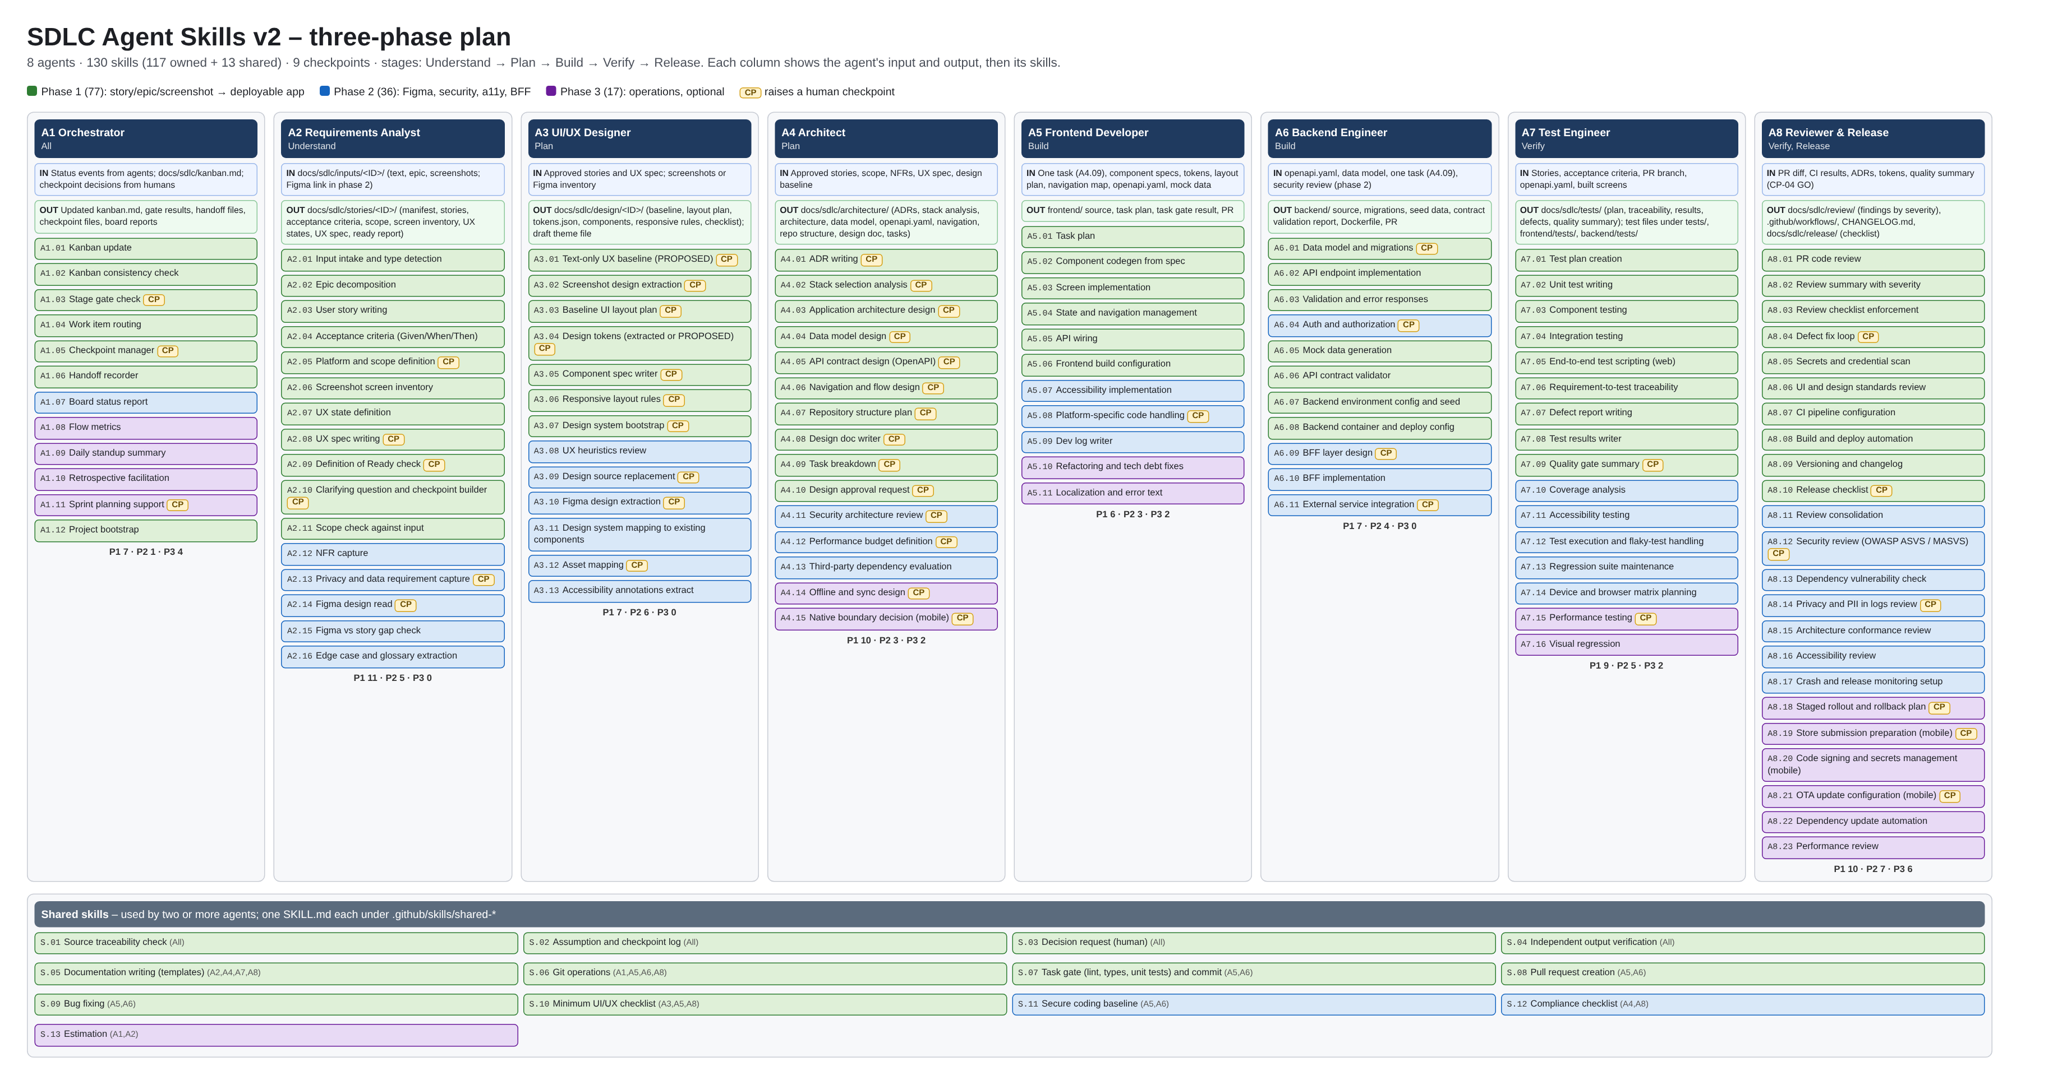
SDLC Agent System v2: agents and skills by phase (green = phase 1, blue = 2, purple = 3)

Slide 2
What to build and how it runs
Goal
Flow (reads > writes)
Rules and checkpoints
Build a .github/ folder for VS Code (Copilot customization files): 8 agents, 130 skills (77 in phase 1), prompts, instructions, config, templates.
Input: story, epic or screenshots (Figma in phase 2). Output: tested, reviewed, release-ready full-stack project plus a docs/sdlc/ trail.
Build files only. Do not build any application.
Stages: Understand > Plan > Build > Verify > Release.
Skills: .github/skills/<folder>/SKILL.md, flat. Folder name = agent ID + slug (shared-* for shared).
0 Intake (A1): kanban.md Backlog row; route to A2
1 Understand (A2): docs/sdlc/stories/<ID>/: manifest.md, features.md (epic), stories.md, acceptance-criteria.md, scope.md, scr... [CP-01 Ready]
2 Plan: design (A3): docs/sdlc/design/<ID>/: ui-baseline.md or extracted-design.md, layout-plan.md, tokens.json, components.md, ... [CP-02 Design approval]
2 Plan: architecture (A4): docs/sdlc/architecture/: adr/ADR-*.md, stack-analysis.md, architecture.md, data-model.md, api/openapi.yaml,... [CP-03 Architecture approval]
3 Build: backend (A6): backend/ (migrations, api, validation, seed/synthetic, config, Dockerfile); docs/sdlc/build/plans, task-gat...
3 Build: frontend (A5): frontend/ (components, screens, state, routes, api, theme); docs/sdlc/build/plans, task-gate, pr files
4 Verify: tests (A7): tests/, frontend/tests/, backend/tests/; docs/sdlc/tests/: test-plan, traceability, results, defects, quali... [CP-04 Quality GO]
4 Verify: review (A8): docs/sdlc/review/<PR>-*.md (review, summary, checklist, secrets, design, loops) [CP-06 if loop limit]
5 Release (A8): CHANGELOG.md, .github/workflows/ci.yml and deploy.yml, deploy/, docs/sdlc/release/checklist-<version>.md [CP-05 Release approval]
R1 trace to source. R2 no invented values: TBD + CP-07. R3 humans decide. R4 fresh-context verify (S.04). R5 checkpoints are human; agents write OPEN only. R6 fix-loop max 3. R7 tool output over opinion. R8 end every file with Checkpoints raised. R9 separation of duties. R10 label PROPOSED. R11 token-optimized: read named inputs only, SKILL.md max 60 lines.
Checkpoints: CP-01 Ready, CP-02 Design, CP-03 Architecture, CP-04 Quality GO, CP-05 Release, CP-06 loop limit, CP-07 TBD, CP-08 Figma, CP-09 security.
Only A1 writes docs/sdlc/kanban.md.
Claude Code reads: .github/sdlc/plan/ (skills.csv, agents.md, checkpoints.md, stage_flow.md, rules.md, folder_tree.md, config.yml, board.png) and PHASE1_BUILD_PROMPT.md.

