Slide 1

hiver
UBER SUPPORT AI AGENT
An AI customer-support agent for “Uber_Support”, built from the Kaggle "Customer Support on
Twitter" dataset. Classifies each message, drafts a reply grounded in Uber's historical replies
and help-centre articles, and decides auto-handle vs escalate with a stated reason.
THE PROBLEM
THE SOLUTION
Real, noisy Twitter support conversations. Build an agent that classifies each message, drafts a reply grounded in how the brand historically resolved similar issues, and decides auto-handle vs. escalate - with a stated reason.
A fixed 7-step pipeline — enrich → rules → retrieve → draft → check → persist → respond. The LLM reads the message; deterministic rules decide where it goes. Not an agent loop: there are no side-effect tools to choose between.
Key finding - Uber’s Twitter team is a triage desk, not a resolution channel. Only 13.6% of replies are informative; the rest deflect (“send us a DM”). This shaped every downstream design choice.
150
7
100
<15 min
hand-labelled golden rows
fixed pipeline steps
tests, ~2s, zero network
reproduce, no API keys

Slide 2
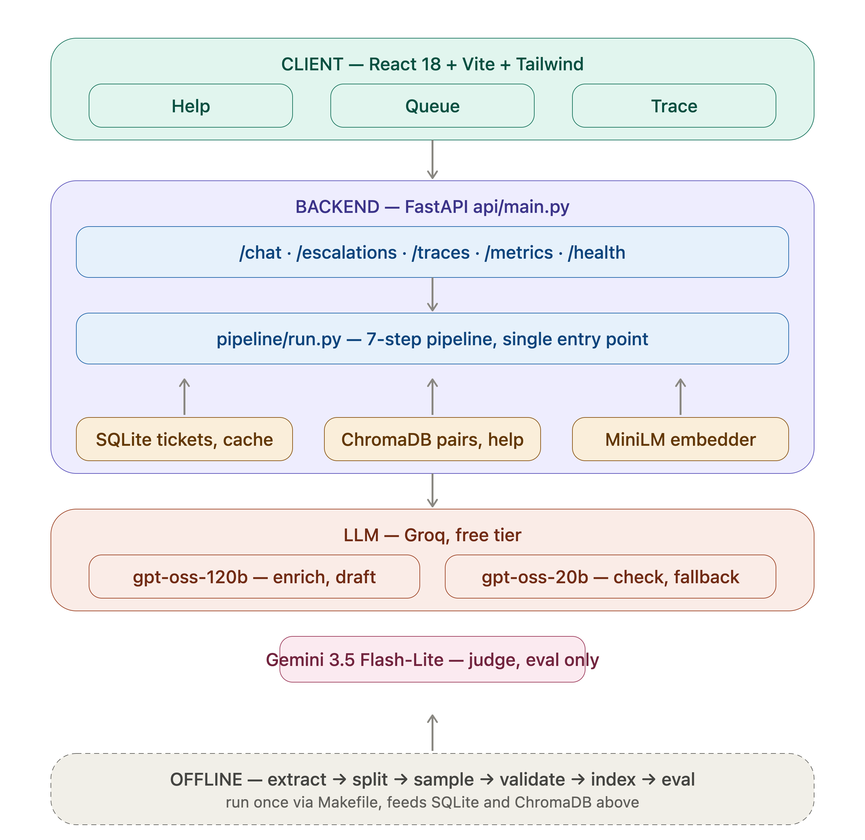
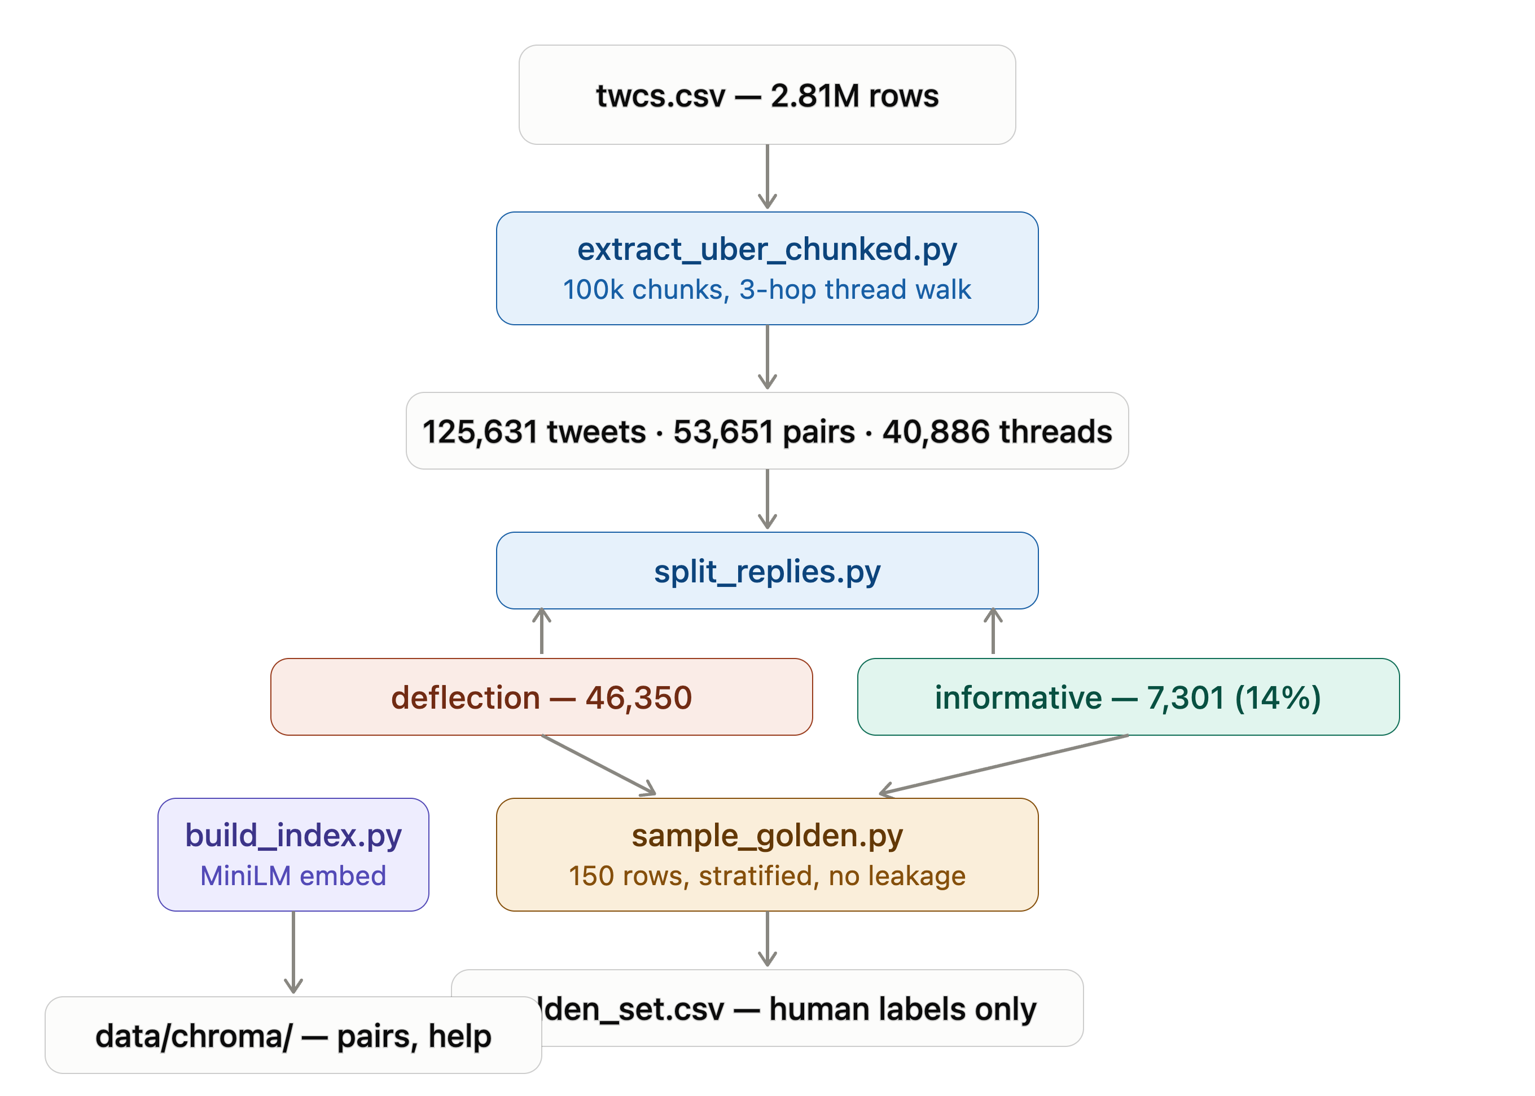
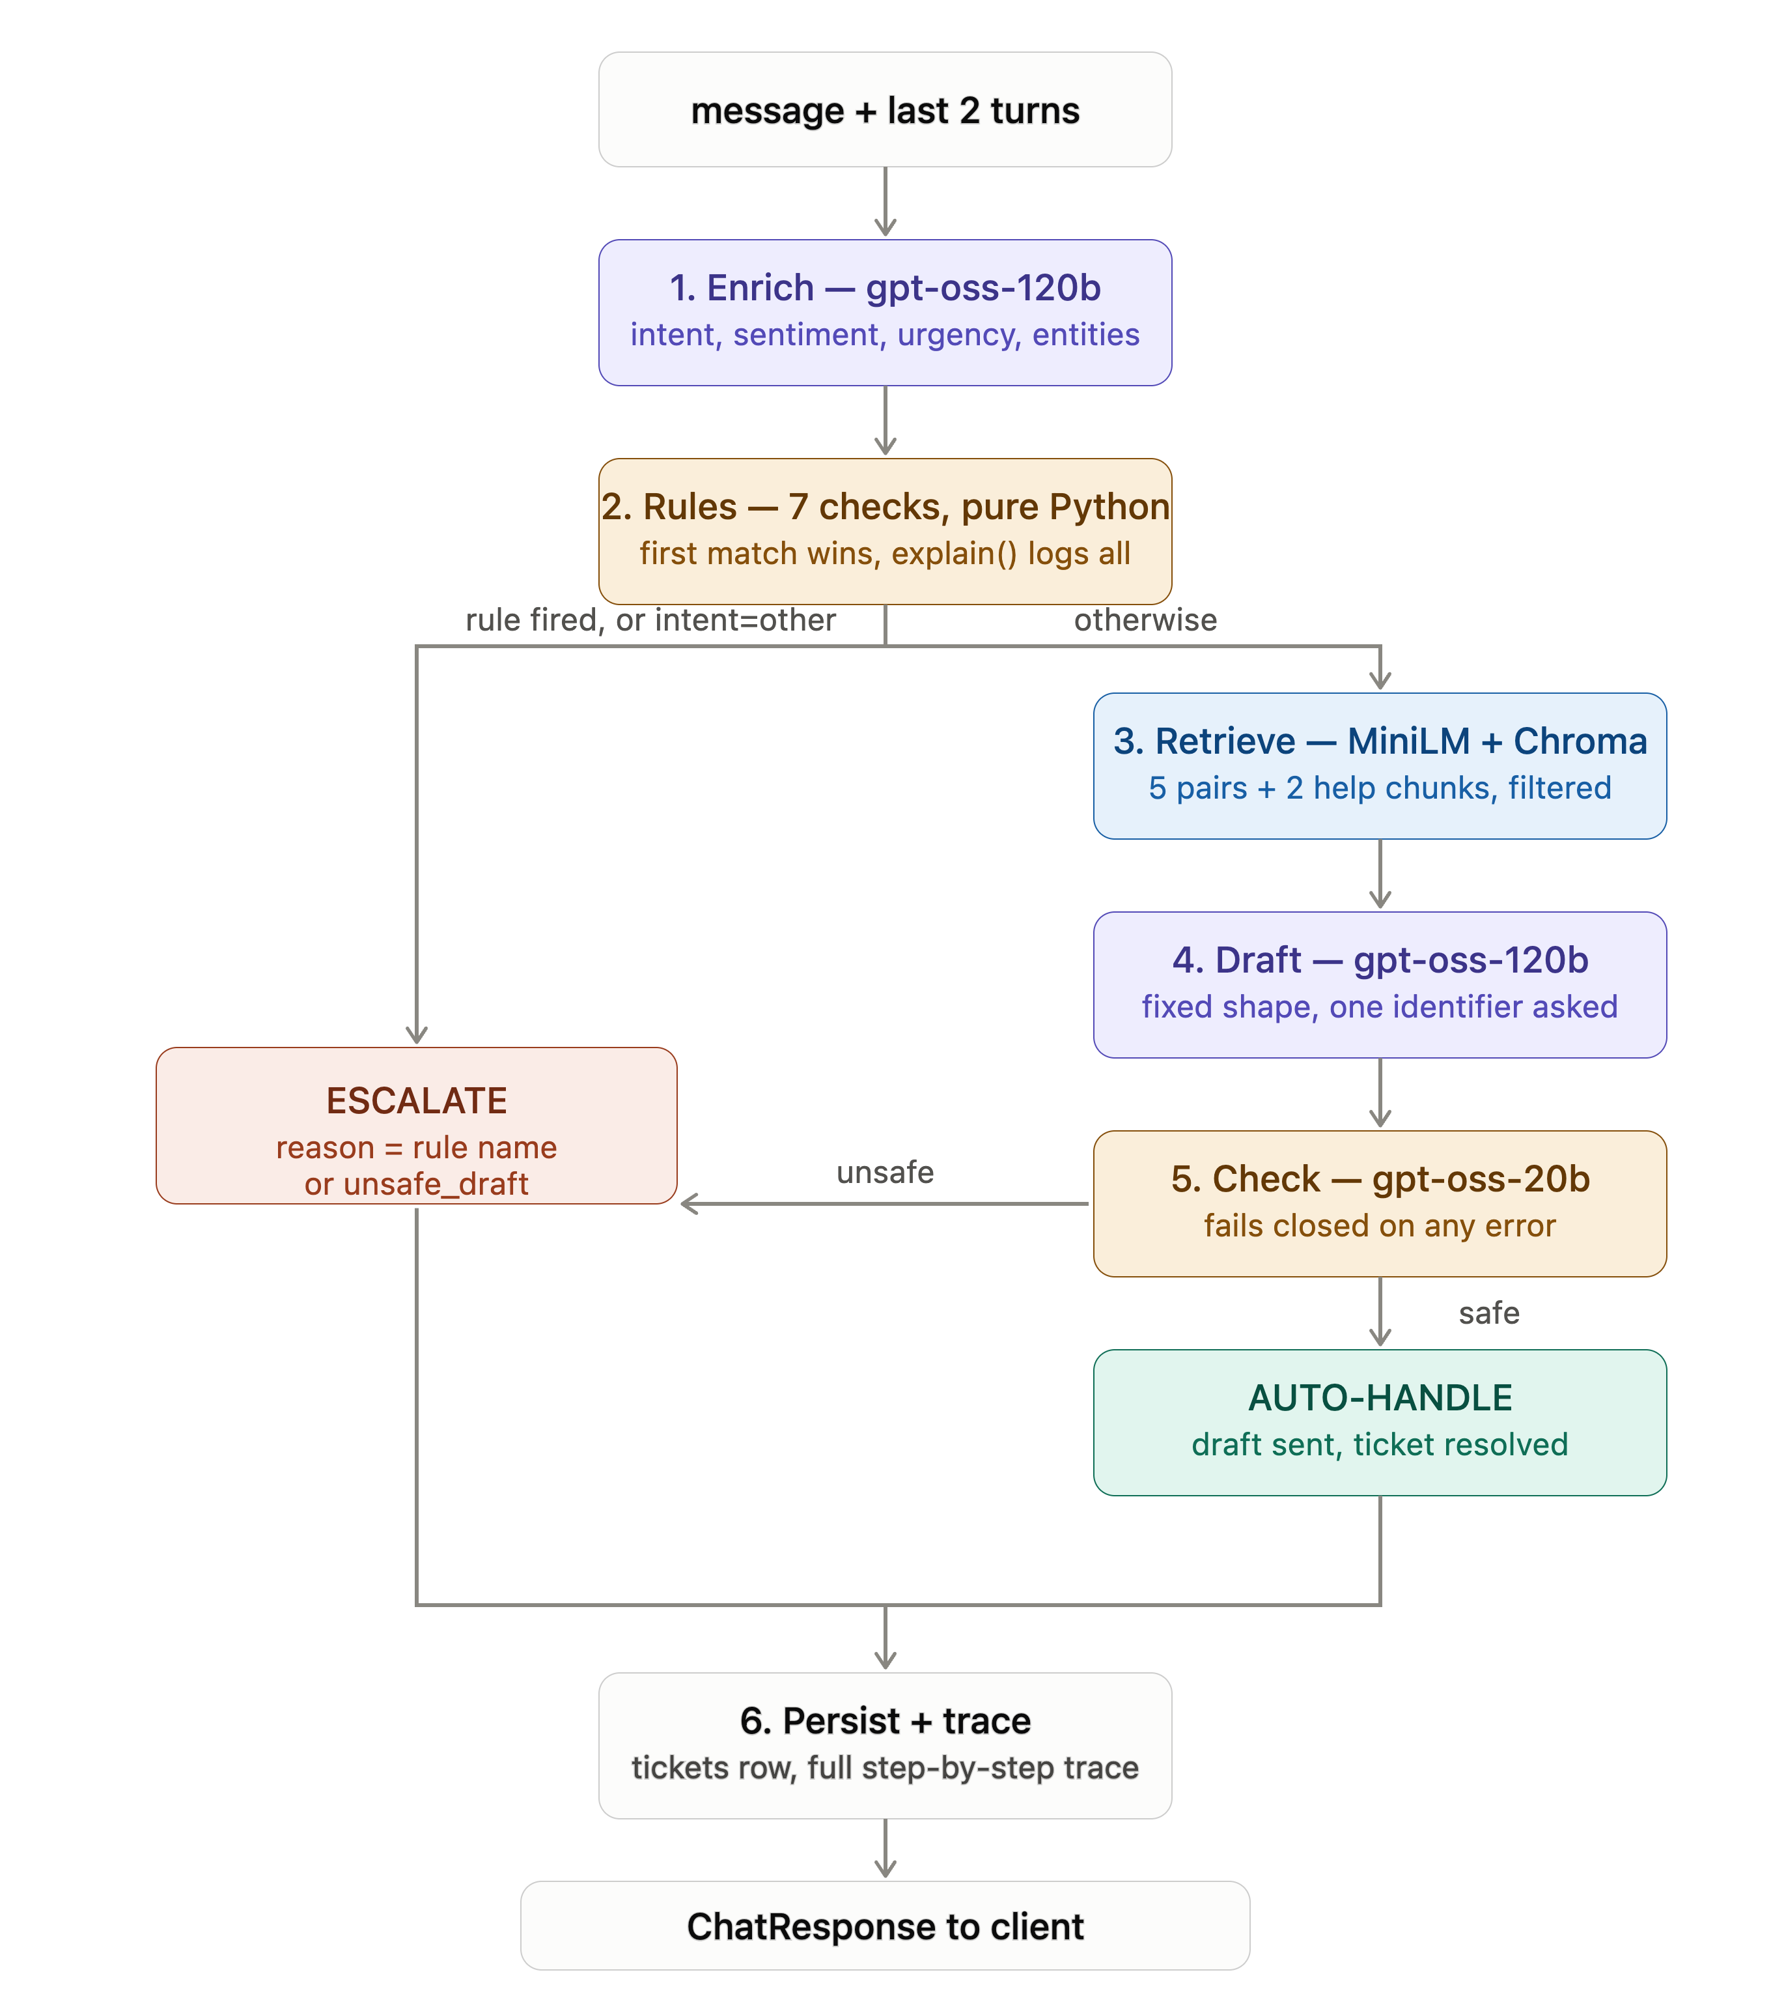
Architecture, request flow & stack
hiver
TECH STACK
Layer | Choice
LLM | Groq gpt-oss-120b / 20b — free tier
Judge | Gemini 3.5 Flash-Lite — eval only
Embeddings | MiniLM-L6-v2, local CPU
Storage | SQLite + ChromaDB, local
API / UI | FastAPI, React + Vite + Tailwind

Slide 3
The rules decide; the model reads
ESCALATION RULE TABLE - first match wins, reason = rule name
DESIGN PRINCIPLES
Fixed pipeline, not an agent loop
# | Rule | Fires when
1 | safety | mentions_safety
2 | legal | mentions_legal
3 | amount_over | amount > $10
4 | urgent | urgency = high
5 | repeat_contact | is_repeat_contact
6 | low_confidence | confidence < 0.7
7 | not_allowed | intent not on allow-list
No side-effect tools to choose between.
Rules run before retrieval
An escalated message costs one LLM call, not three.
One enrich call
Intent + sentiment + urgency + entities, same read of the message.
Everything local & cached
Deterministic, 15-minute reproduction, zero API keys.
HANDLED MID-PROJECT
WORKED EXAMPLE — SAFETY ESCALATION
Groq deprecated the Llama models mid-build — migrated to GPT-OSS 120B/20B in two lines because model IDs are env-driven.
An early draft config returned empty replies that a checker wrongly passed as safe — fixed by rejecting empty drafts before any LLM call and never caching them.
“My driver was drunk and swerving”
Enrich sets mentions_safety = true → rule 1 fires immediately → escalated with reason “safety”. The draft step never runs — the trace shows the pipeline stopping before it, not a policy the model chose to follow.

Slide 4
hiver
Evaluation & key insights
HEADLINE METRICS
REPO MAP
Metric | Value
Intent macro-F1 (ours vs. baselines) | 90%
Escalation recall | 90%
Judge vs. human kappa (40 rows) | 89%
Labeller A vs. B kappa (50 rows) | 90%
pipeline/ 11 modules — models, taxonomy, enrich, rules, retrieve, draft, check, run
eval/ run_eval.py, metrics.py, judge.py, kappa.py
tests/ 100 pytest tests, fake LLM, no network, ~2s
docs/ PROJECT_PLAN, DECISIONS (47 entries), TRACE_SPEC
TOP FAILURE MODES — found, understood, next fix identified
WHAT'S MISLEADING ABOUT THE HEADLINE NUMBER
Small, self-labelled golden set (150 rows).
Escalation recall measured only on enumerated conditions.
Judge is an LLM too.
Uber's replies are mostly deflections, so similarity-to-Uber rewards the wrong thing.
• Misdirected payouts & hacked accounts currently auto-handle when they should escalate — next fix: a mentions_account_compromise rule.
• Confidence is uncalibrated (clusters 0.93–0.99) — the 0.7 floor may rarely fire; per-reason breakdown decides if it stays.

Slide 5
Small, typed, explainable live
100 tests, offline
pipeline/rules.py
• Fake Groq client, no network
• Every rule tested in order
• run() tested on escalate, auto, unsafe-draft, empty-draft, other
• Trace shape asserted (8 keys, 1 row per rule)
• ~2 seconds, full suite
RULES = [
("safety", lambda e: e.entities.mentions_safety),
("legal", lambda e: e.entities.mentions_legal),
("amount_over", lambda e: (e.entities.amount or 0)
> AMOUNT_LIMIT),
("urgent", lambda e: e.urgency == "high"),
("repeat_contact", lambda e:
e.entities.is_repeat_contact),
("low_confidence", lambda e: e.confidence < 0.7),
("not_allowed", lambda e: e.intent not in AUTO_ALLOW),
]
REPRODUCE IN UNDER 15 MINUTES — NO API KEYS
git clone → docker compose run --rm -e CACHE_ONLY=1 api python eval/run_eval.py

