Slide 1
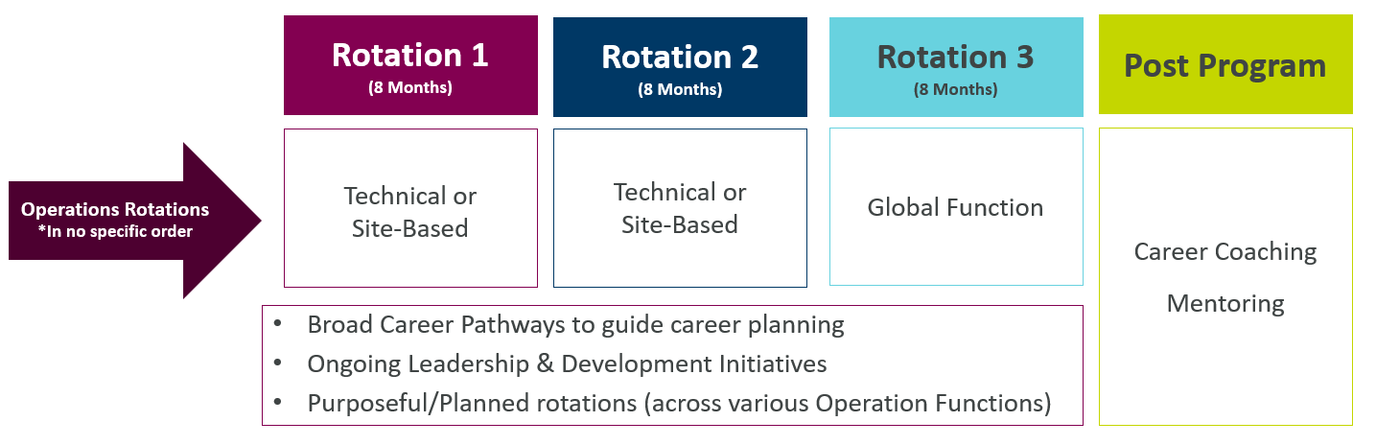
Global Operations Graduate Program
What Can Graduates Expect
The Program Provides
Diverse Placement Opportunities & Meaningful Impact: Gain exposure to varied projects across Supply Chain, Global Engineering, Logistics, Quality, Manufacturing & Procurement.
Mentorship & Career Development: Tailored support, mentorship, training and development opportunities across Operations to help you channel your skills to grow. Leadership skills training focused on influencing decisions across Operation areas.
Global Impact: Contribute to projects with a global impact and collaborate with leaders across the world.
Community: Thrive in a supportive and collaborative environment, where every voice is valued and heard.
Skills & experience to support an exciting career in Operations
Leadership, project and change management
Good understanding across a variety of Operations Functions during the 2-year program (3 rotations)
Real accountability given from Day One
A foundation for leadership

