Slide 1
Hybrid Multi-Frequency Image Illusion
Group - 10

Slide 2
SHREENA PATEL | AU2340240
DHYEY PATEL | AU2340245
HETVI RAVAL | AU2340015
DHVANI HIRAPARA | AU2340238

Slide 3
Introduction: Before Mid-Sem
Concept development of Hybrid Multi-Frequency Image Illusion.
Experimented spatial frequencies low frequency (far view), high frequency (near view).
Literary review: Oxford Compendium, Gonzalez and Woods (1992).
Collected information: Einstein, Marilyn Monroe and pictures of the actual existence.
Methodology: Preprocessing, Alignment, Frequency Separation, Hybrid.

Slide 4
Conclusion: Before Midsem
Showed perception depending on distance.
Near view: High frequency image prevails.
Far view: picture of low frequency is revealed.
Mastered good use of spatial filters.
The following steps have been identified: Adaptive filtering, application study, quantitative analysis.

Slide 5
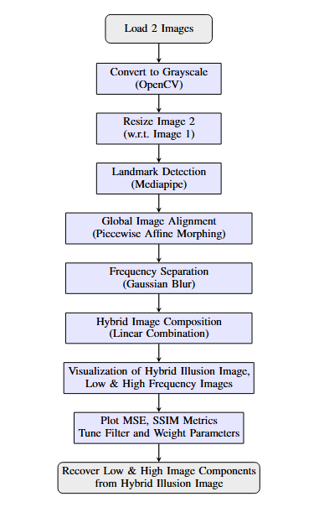
Updated Methodology
Preprocessing
Alignment
Frequency Separation
Composition
Visualisation
Quantitative Analysis
Restoration(demorphing)

Slide 6
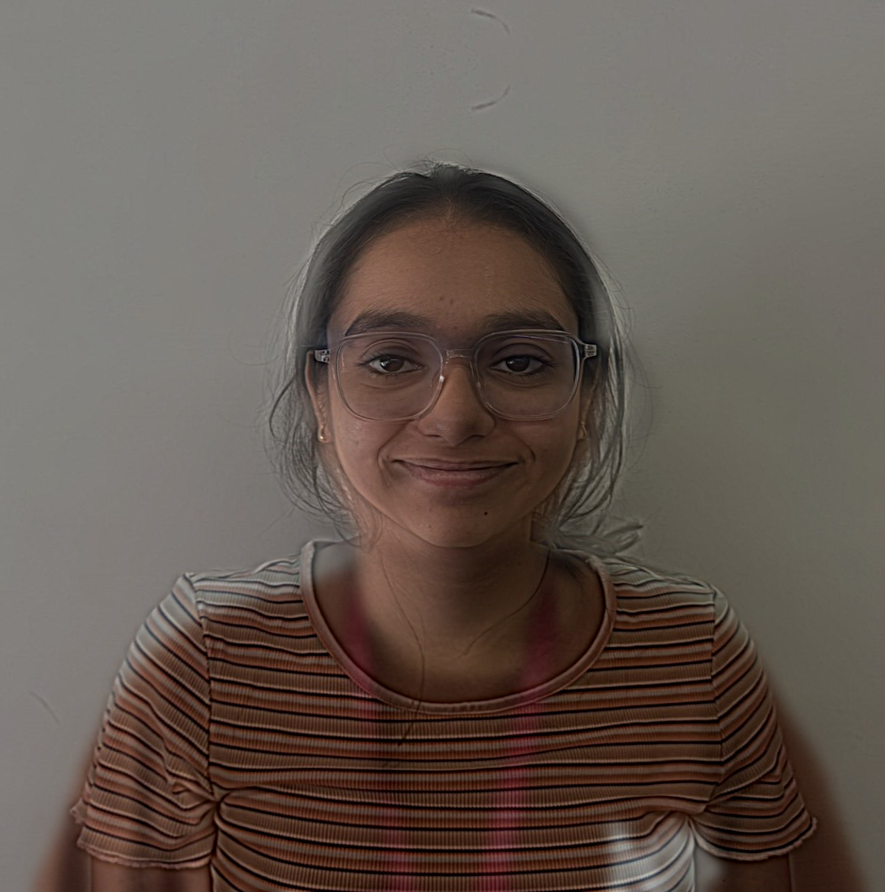
Results: Coloured Hybrid Image

Slide 7
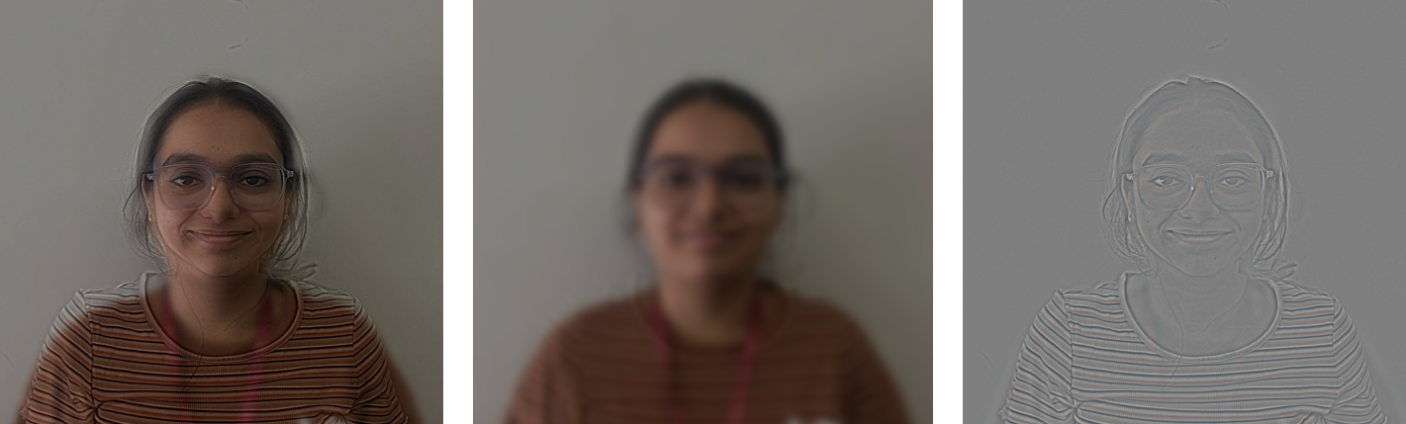
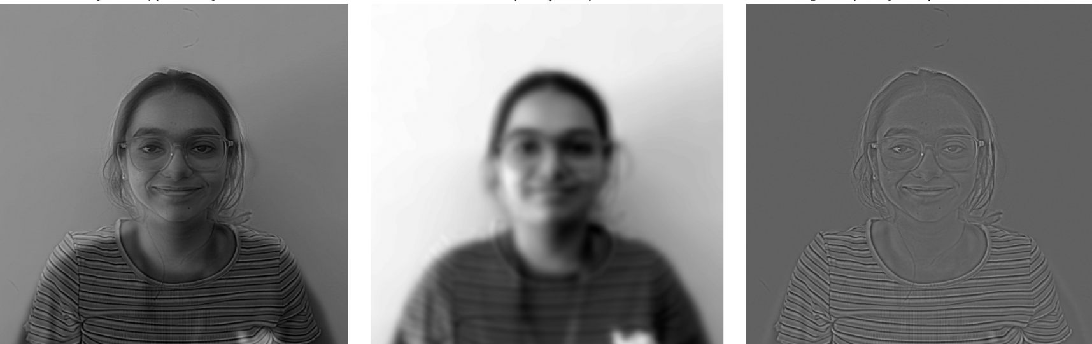
Results: De-Morphing

Slide 8
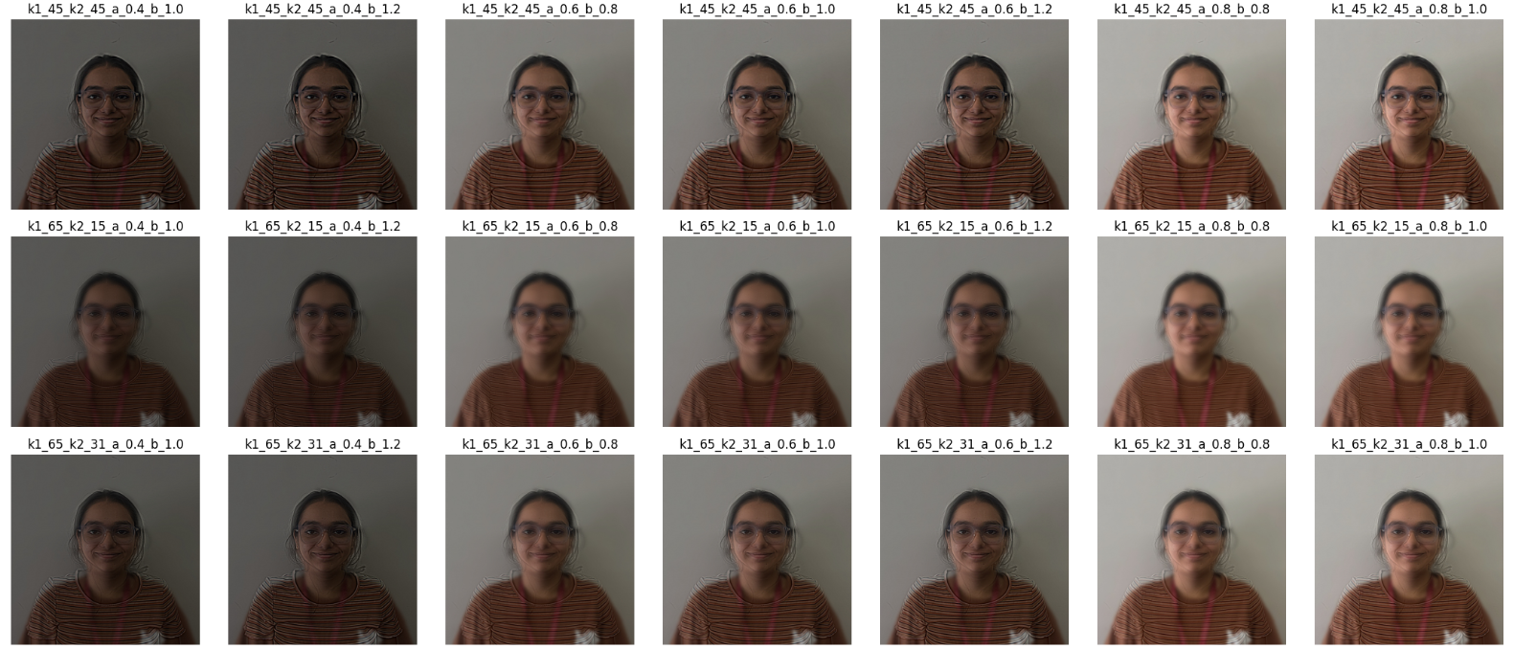
Parametric Analysis

Slide 9
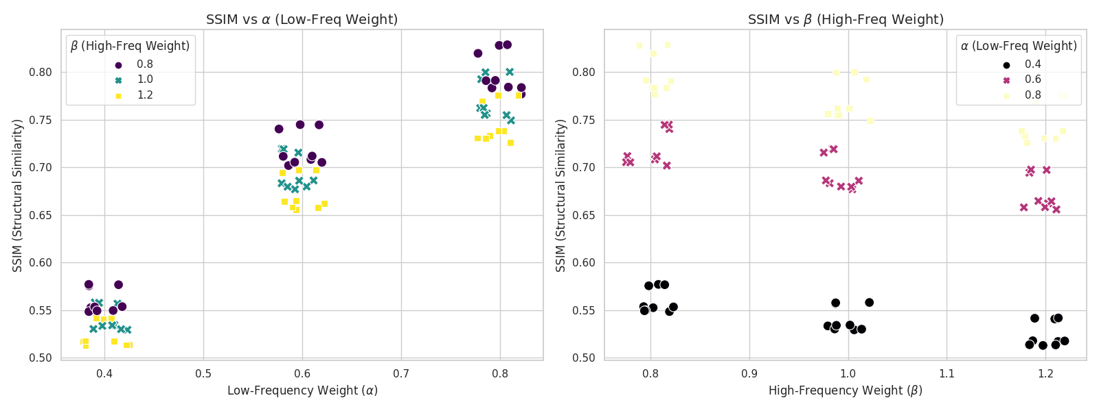
Quantitative Analysis
Parameter Increase | MSE | PSNR
Increase α | ↓ Strong decrease | ↓ Strong increase
Increase β | ↓ Moderate decrease | ↓ Moderate decrease
Low α + High β | ↑ High error | ↓ Low PSNR
High α + High β | ↓ Lowest MSE | ↓ Lowest MSE

Slide 10
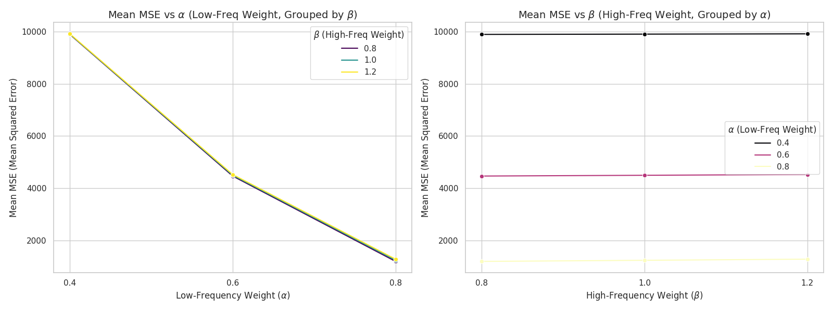
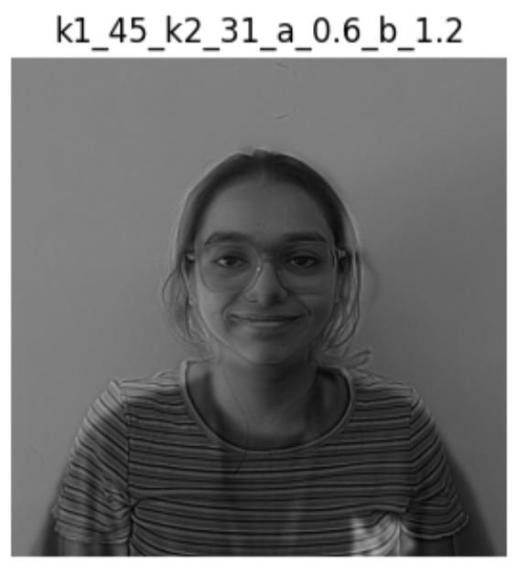
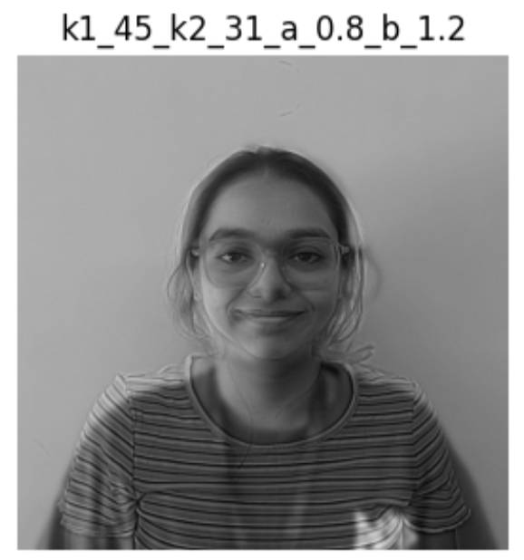
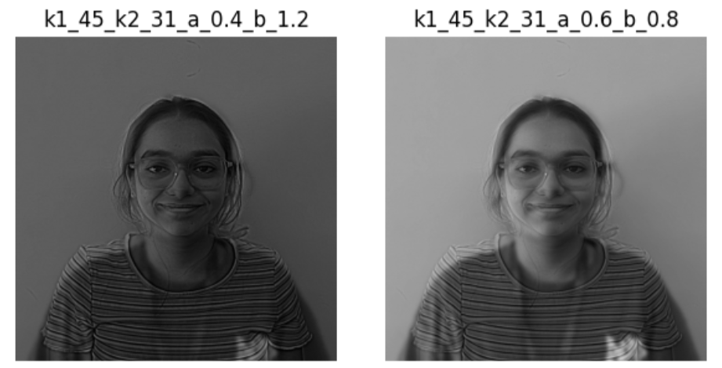
Quantitative Analysis

Slide 11
Conclusion
Successfully created hybrid illusions using only classical image processing.
Grayscale and color hybrids showed clear distance-based perceptual shifts.
Demorphing validated correct frequency encoding (with minor information loss).
Illusion quality depended on manual tuning of filter parameters.
Accurate spatial alignment of source images was essential for success.

Slide 12
References
Gonzalez, R. C., Woods, R. C., & Woods, R. E. (1992). Digital image processing. Addison-Wesley.
Shapiro, A. G., & Todorovic, D. (2017). Hybrid Image Illusion. Computational Perception & Cognition. Retrieved October 02, 2025, from http://olivalab.mit.edu/Papers/Oliva-Schyns_Hybrid-Image-Illusion-Chapter.pdf
Sripian, P., & Yamaguchi, Y. (2020, February 10). Hybrid image of three contents. Springer Open. https://doi.org/10.1186/s42492-019-0036-3
Yang, J., Zheng, H., & Oh, K. (2015, October 09). Proceedings of the 2024 CHI Conference on Human Factors in Computing Systems | ACM Conferences. ACM Digital Library. Retrieved October 12, 2025, from https://dl.acm.org/doi/10.1145/2811411.2811547
Shukla, N., Ross, A. (2024). Facial demorphing via identity preserving image decomposition. IEEE International Joint Conference on Biometrics (IJCB) (pp. 1–10). IEEE. https://doi.org/10.1109/IJCB62174.2024.10744431
Banerjee, S., Jaiswal, P., Ross, A. (2022). Facial de-morphing: Extracting component faces from a single morph. IEEE International Joint Conference on Biometrics (IJCB) (pp. 1–10). IEEE. https://doi.org/10.1109/IJCB54206.2022.10007977
Isenberg, P., Dragicevic, P., Willett, W., Bezerianos, A., Fekete, J.D. (2013). Hybrid-image visualization for large viewing environments. IEEE Transactions on Visualization and Computer Graphics, 19(12), 2346–2355. https://doi.org/10.1109/TVCG.2013.163
Sripian, P., Yamaguchi, Y. (2017). Synthesis and assessment methods for an edge-alignment-free hybrid image. Journal of Electronic Imaging, 26(4), 043016. https://doi.org/10.1117/1.JEI.26.4.043016
Sripian, P. (2019). Computational visual illusion and its application. In L. Cocchiarella (Ed.), ICGG 2018 – Proceedings of the 18th International Conference on Geometry and Graphics (pp. 106–113). Springer. https://doi.org/10.1007/978-3-319-95588-9_8

Slide 13
Thank you

