Slide 1
Hybrid Multi-Frequency Image Illusion
Group - 10

Slide 2
SHREENA PATEL | AU2340240
DHYEY PATEL | AU2340245
HETVI RAVAL | AU2340015
DHVANI HIRAPARA | AU2340238

Slide 3
Introduction
A hybrid multi-frequency image illusion is an optical illusion that uses multiple images that can be combined at different spatial frequencies, resulting in the perception of different images based on different viewing distances.
When we take a closer view, the fine-detail image dominates;while we observe from afar, the smoother image appears to come forward.
In simple words we create a combination of 2 images in such a way that objects in both images tend to overlap but we can clearly distinguish one at some distance and other at far away distance.

Slide 4
Literature Review
Chapter-111, from Oxford Compendium of Visual Illusions introduced hybrid images, showing that visual interpretation depends on spatial frequency.
Gonzalez & Woods (1992) discussed Gaussian filters for separating image frequencies.

Slide 5

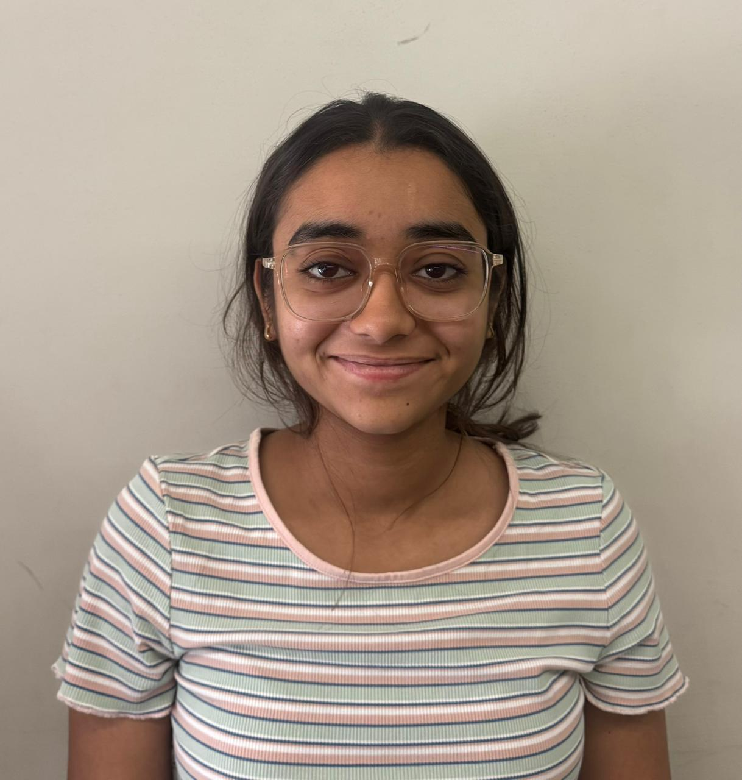
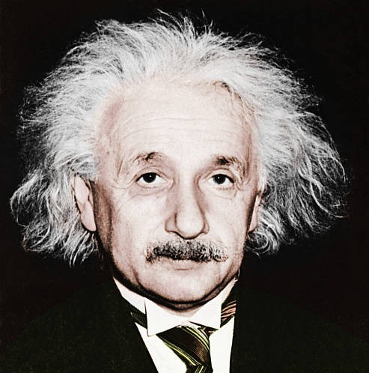
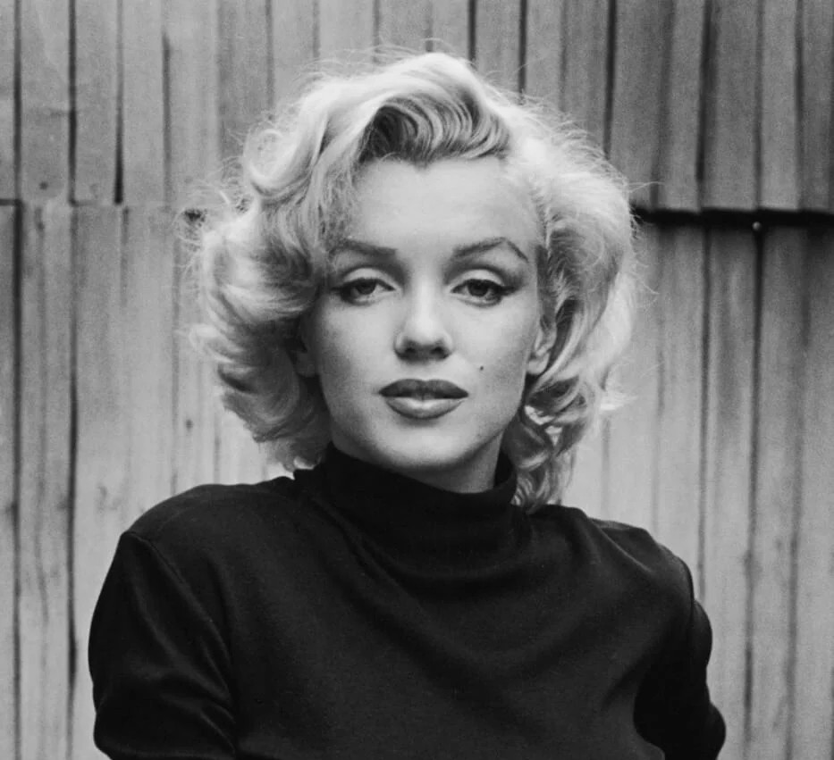
Dataset
The image at bottom left is Einstein and at bottom right is Marilyn Monroe, this images are collected from Google images inspired by Oxford Compendium of Visual Illusions chapter 111
The images at top left and top right are our group members - Shreena and Dhvani respectively, this images are captured as real life examples.

Slide 6
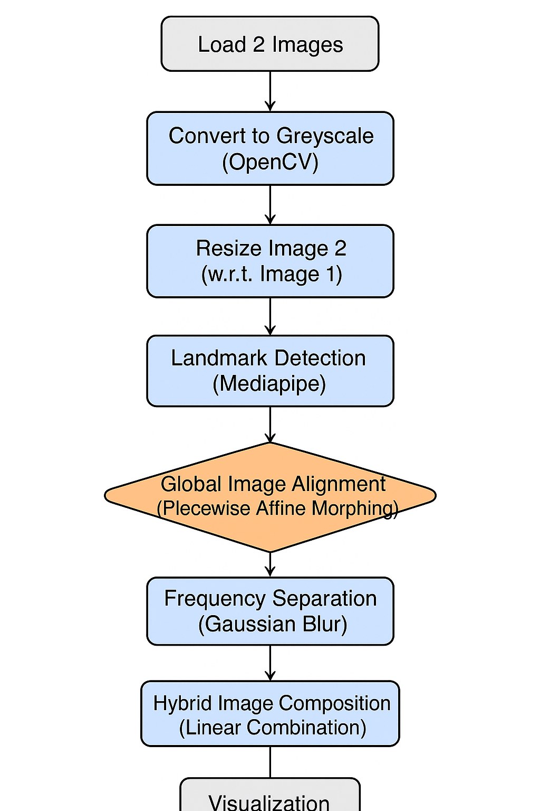
Methodology
Preprocessing
Alignment
Frequency Separation
Hybrid Formation
Visualization

Slide 7
Results
Created hybrid images that shifts perception with distance:
Near view: Sharp, detailed image(high frequency) dominates
Far view: Soft, blended image(low frequency) appears.
As human eye naturally perceives high frequency better from a shorter range and low frequencies better from a longer range, producing an illusion.

Slide 8
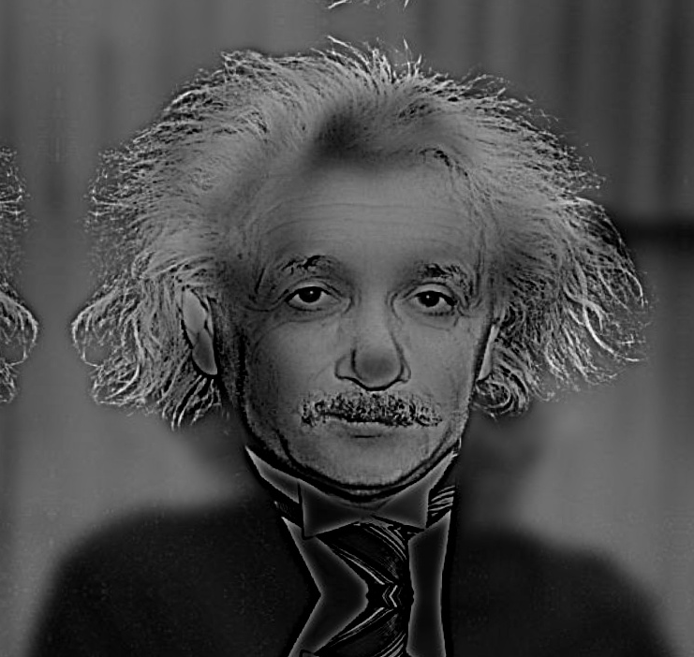
Results

Slide 9
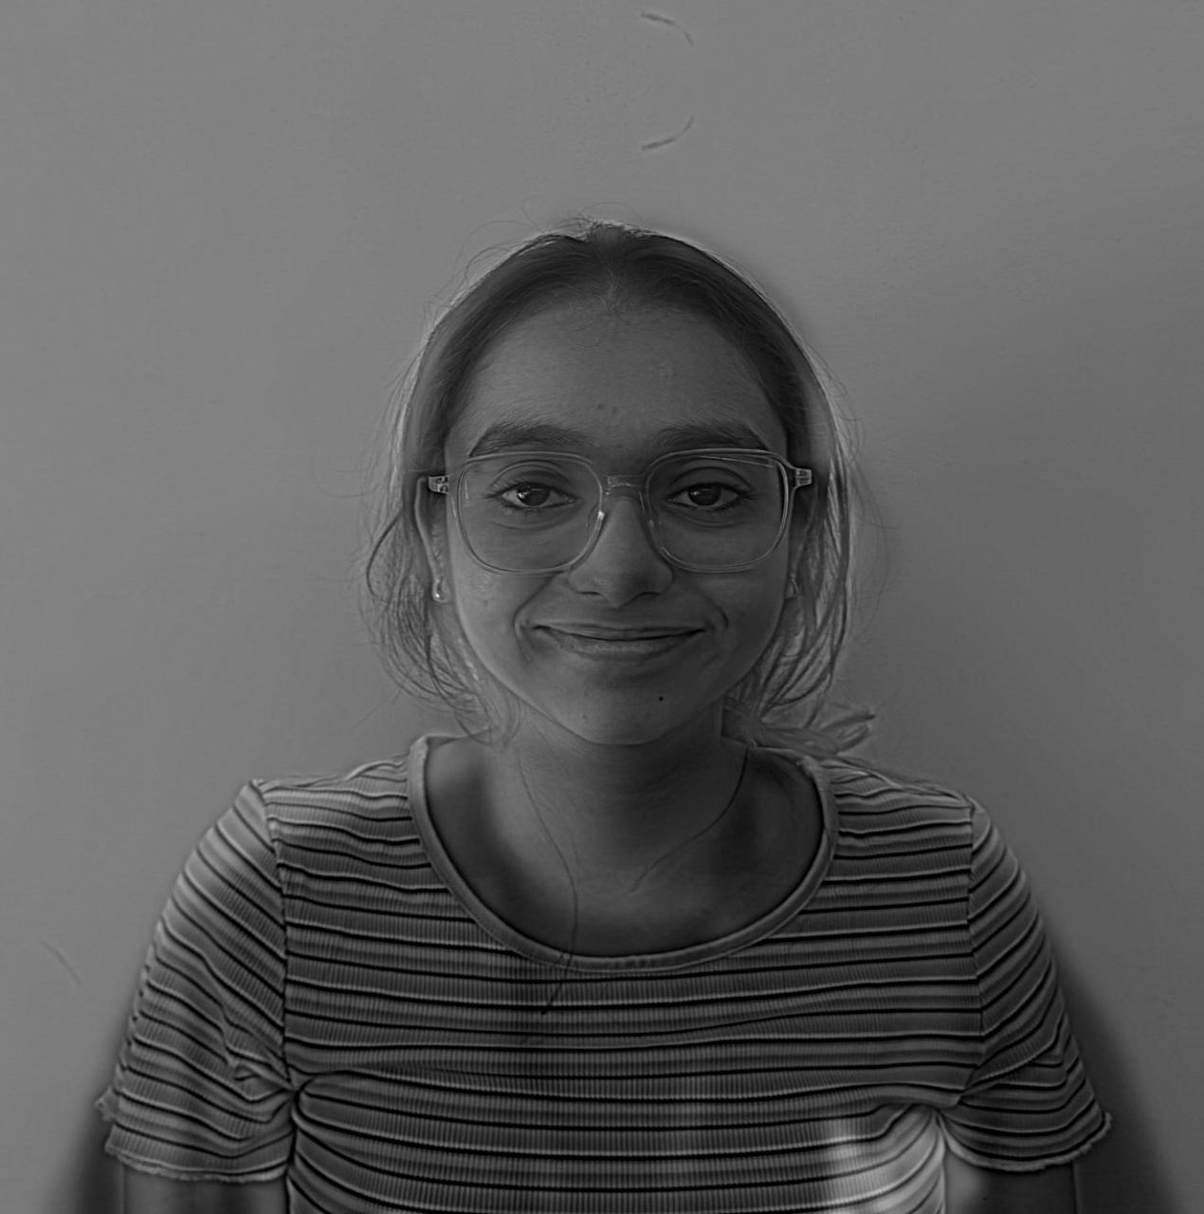
Results

Slide 10
Conclusion
The project validated the concept of multi-frequency image blending through practical implementation.
It also confirmed that distance dependent perception can be effectively illustrated through the concept of hybrid images.
It suggest how different type of spatial filtering to different image and effective combination results in perfect example of image illusion

Slide 11
Next set of work
Introduce adaptive filtering for wide range of dataset, such that we take different images and illusion methodology falls for dataset majorly.
Explore applications of hybrid image illusion and collect images with criteria to application, so we can implement illusion and get better results to help its application.
Quantitative measure for analysis of resultant hybrid image generated.

Slide 12
References
Gonzalez, R. C., Woods, R. C., & Woods, R. E. (1992). Digital image processing. Addison-Wesley.
Shapiro, A. G., & Todorovic, D. (2017). Hybrid Image Illusion. Computational Perception & Cognition. Retrieved October 02, 2025, from http://olivalab.mit.edu/Papers/Oliva-Schyns_Hybrid-Image-Illusion-Chapter.pdf
Sripian, P., & Yamaguchi, Y. (2020, February 10). Hybrid image of three contents. Springer Open. https://doi.org/10.1186/s42492-019-0036-3
Yang, J., Zheng, H., & Oh, K. (2015, October 09). Proceedings of the 2024 CHI Conference on Human Factors in Computing Systems | ACM Conferences. ACM Digital Library. Retrieved October 12, 2025, from https://dl.acm.org/doi/10.1145/2811411.2811547

Slide 13
Thank you

