Slide 1
CONFEXX CONSULTING
Knowledge Assessment Test
Shreenath Mohan

Slide 2
Useful resources available
Talend
ETL
SQL server ( MySQL & MS SQL)
Python
R

Slide 3
USE Case

Slide 4
Intro
The business has large number of customer database
Customer database Maintained in HTML format ( 20 years old )
Credit Card database in another JSON format
Need to set up backend database with any relational database
Merging two databases into JSON format & exported company-wide

Slide 5
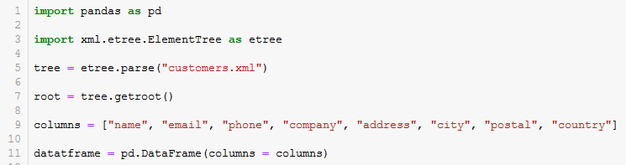
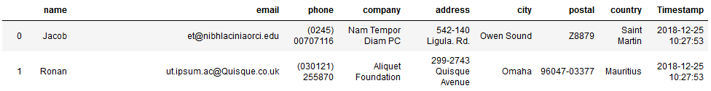
Technical description of the Process
Reading the data from XML
Output

Slide 6
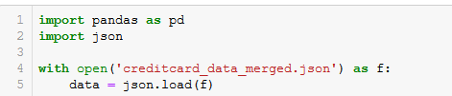
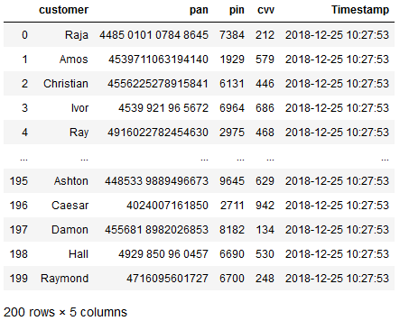
Technical description of the Process
Output
Reading the data from JSON format

Slide 7
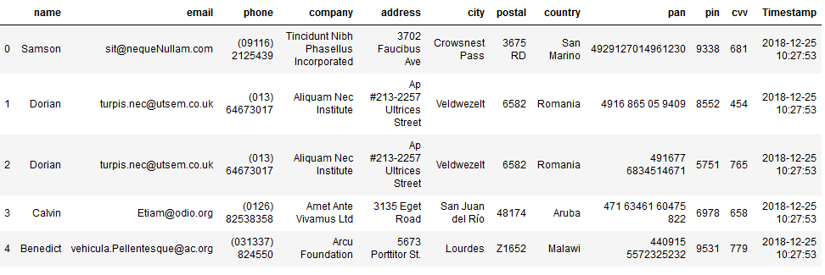
Technical description of the Process
Merged JSON data frame ( the credit card data are assigned to the respective customers )

Slide 8
Setting up the database MS SQL Server

Slide 9
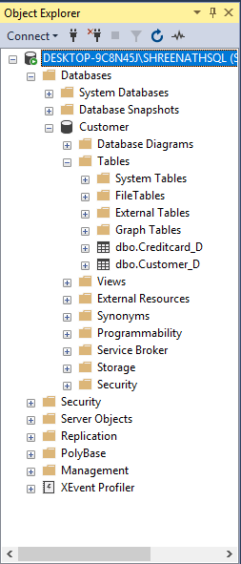
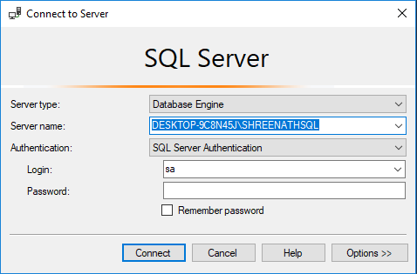
User Credentials to the Server
Database
Tables

Slide 10
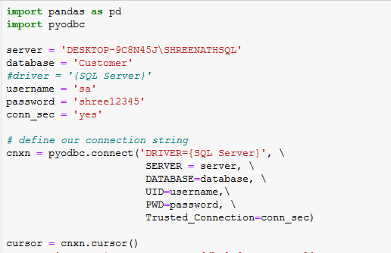
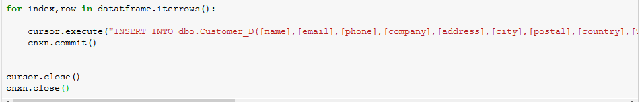
Setting up the engine in Python to MS SQL Server
Database connectivity Process

Slide 11
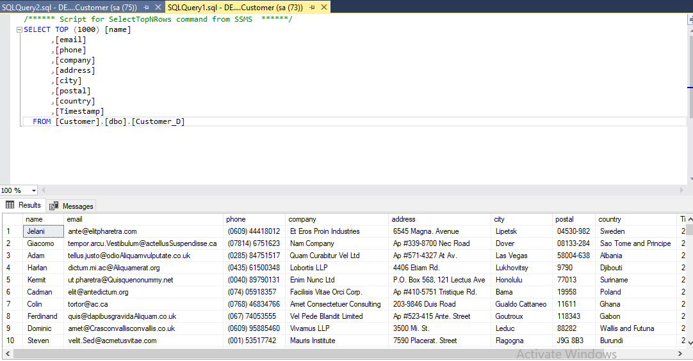
Database record for customers data

Slide 12
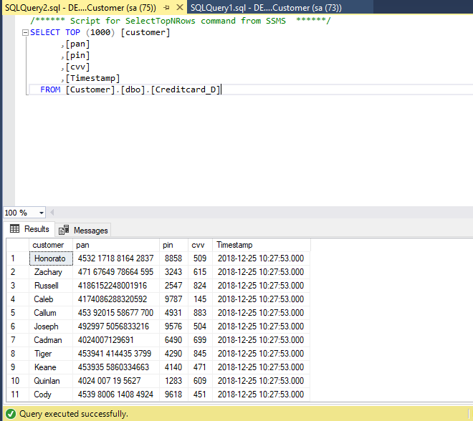
Database record for Credit card data

Slide 13
Business issues need to be considered
1. Are they any issue with the data quality ?
Yes – Format of the file. Primary key need to be added for the customer and credit card details. Now its merged on the name, name can be reduntant
email column type as “nvarchar(50)“- met error for this datatype.
reason : some email string has some bugs(string format or length or encoding type )
The issue was fixed after changing set datatype as varchar(max)
2. Are they any credit card datasets that could not be connected to customers
Yes –. Not all customers have credit card with them. Some customers have more than 2 credit cards.

Slide 14
Business issues need to be considered
3. How to improve business to improve the existing model ?
Has key encryption need to be added for pin, cvv for file being transferred and in the db
Alternative approach
Using SqlAlchemy by creating the process we can automate the entire process.

Slide 15
End

