Slide 1
Artificial method of predicting the weather conditions using API keys
Abstract
The system is proposed for predicting, monitoring the weather conditions of a particular place or city using API keys which is received from openweather.com. This system exactly shows the maximum temperature, minimum temperature, wind degree, humidity, wind speed, sunrise timing, sunset timing, longitude and latitude of the given particular place. This weather detection proposed work uses “openweather.com” weather call applications “appid” i.e. API keys to detect weather conditions of cities. Appropriate output of ‘json’ data received from “openweather.com” is received.
Keywords: weather, temperature, API Keys.
Introduction
This is a first article of a using multipart series on using python basic concepts to build a module to detect weather conditions using API keys. API full form is Application Programming Interface Key. The API key often act as both a unique identifier and a secret token for authentication , and will generally have a set of access rights on API associated with it. It has no expiration so it may be used indefinitely, unless the project owner revokes or regenerates the key. Similarly in this article also we have created an API key to detect the accurate weather conditions of a place using openweather.com. Using this openweather.com will get the exact data which is required for us.
Literature Survey
Google Earth Engine (GEE) is a cloud-based geospatial processing platform for large-scale environmental monitoring and analysis [1].
Application Programming Interfaces (APIs) with development environments that support popular coding languages, such as JavaScript and Python [2].
The system has successfully show real-time monitoring [3] of weather through weather monitoring system we can collect the information about humidity and temperature using API(s)
Proposed Work
This article fully describes the entire process of the weather analysis project using API keys. First, requests module is been imported which is used to requests from the open source website. Second, date and time module is been imported to collect the current date and time information automatically [4].
Third, os module is been imported and which is mainly used for executing shell commands, managing files and directories, spawning process etc. Then we gather API keys (Fig.1) from the open source “openweather.com”, which is used to collect the information regarding the weather of particular specified city at the current date and time .The request module then searches for the JSON data for the users input.

Slide 2
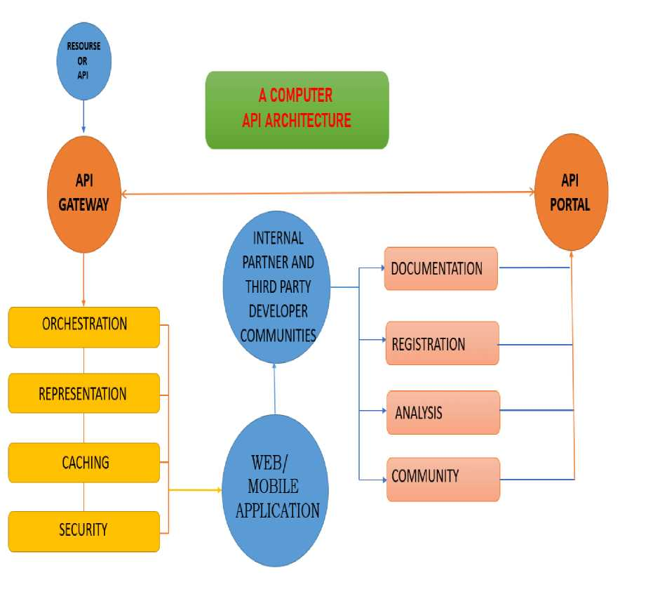
Fig 1. A Computer API Architecture
JSON (JavaScript Object Notation) is an open standard file format that uses human -readable text to store and transit data objects consisting of attribute-value pairs and arrays. It is a very

Slide 3
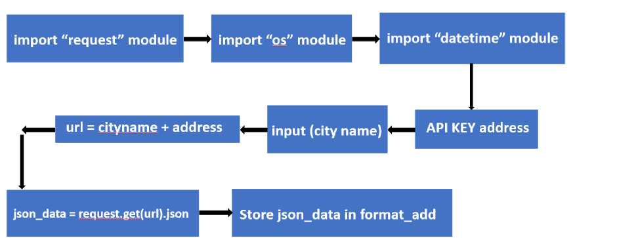
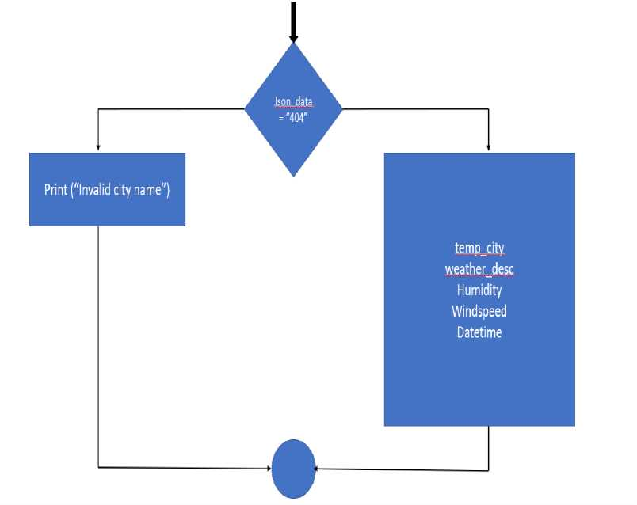
common data format, with diverse range of applications, one example being web applications that communicate with a server.
In this program we use some of the JSON datas such as coord, weather, main, visibility, wind, sys, and name. If the input city name given by user is invalid it gives the prompt string as INVALID INPUT or else the program gives the required output.
Fig 2. Flowchart for the Weather Detecting Program Using Python
The required program output are the maximum temperature , minimum temperature , wind degree , humidity , wind speed , sunrise timing , sunset timing , longitude and latitude of the given particular place . Finally the program ends.

Slide 4
Conclusion
At last we came to the conclusion of the interesting project of finding weather conditions of various cities around the world by using an API keys of www.openweather.com and some of the in-built modules in python. Even though this is conclusion but this is not an end. We can use this weather conditions information in many fields. This type of model can be used for agricultural purposes, industrial and domestic purposes etc. Using the major topic of ARTIFICIAL INTELLIGENCE and MACHINE LEARNING. Planning to create a message box such that automatically the weather information reaches the user message box future scope.
Reference
[1] . "Google Earth Engine for geo-big data applications: A meta-analysis and systematic review".By Haifa Tamiminiaa , Bahram Salehia,Masoud Mahdianparib,Lindi Quackenbusha, Sarina Adelia, Brian Brisco.
[2] ."Design of Real-time Weather Monitoring System Based on Mobile Application using Automatic Weather Station".By Aris Munandar*, Hanif Fakhrurroja, Muhammad Ilham Rizqyawan, Rian Putra Pratama, Jony Winaryo Wibowo, Irfan Asfy Fakhry Anto.
[3] . “Arduino Based Weather Monitoring System”. By Karthik Krishnamurthi, Suraj Thapa, Lokesh Kothari, Arun Prakash.
[4] . “Weather monitoring system using IOT” by R.Kavin , K.Lakshmi , S.Sheeba Rani , K.Ramesh Kumar , Sri Krishna , College of Technology , Coimbatore ,Tamil Nadu ,India.

