Slide 1
ragcap: a multi-agent RAG system, built and measured
A colleague's capstone design (LangGraph router, document RAG with grade and rewrite, SQL agent, general agent, Postgres + pgvector) reproduced on local models, then evaluated the way it should be: frozen test sets, repeated runs, and a version-aware filter with an OFF/ON proof.
Apple M5 Pro · local models · no API key · no admin rights · October 2026
https://github.com/shreenathacc22/ragcap · https://shreenathacc22.github.io/ragcap/
Notes:
Open with the one-line summary, then the two links. Everything on these slides is reproducible from the repository.

Slide 2
The design to reproduce, and what was added
The design (from the capstone PDF)
Added here
Router → documents / database / general
Retrieve top-6 → Grade → one Rewrite → Generate with citations
SQL agent: one SELECT, read-only, time-limited, one retry
General agent never states facts
Postgres + pgvector, LangGraph, FastAPI, streaming chat, UI
Reported: latency and cost per flow (110 answers)
A quality column: frozen golden set (27), unseen set (25), router / retrieval / answer accuracy
Repeated runs: means and ranges, failing ids listed
Version-aware retrieval: superseded versions excluded before ranking, proven OFF vs ON
Model choice measured: a second-opinion grader lifts unseen answers 80% → 96%
A P&ID branch on synthetic drawings with a 3B vision model
Four documents (SOP, runbook, recreate, install); rebuild and clean-start checks
Notes:
The left column is what the PDF described; the right is what this project added. The key gap in the original was that nothing measured correctness.

Slide 3
The graph: one router, three paths, one trace
documents: top-6 chunks from pgvector, WHERE superseded = false before ranking
retrieve
grade
generate
rewrite ×1
question
router
database: one read-only SELECT, 5 s timeout, one retry
answer
sql_agent
generate_sql
general
general: greetings only; forbidden from stating facts
Every node appends its milliseconds and tokens to the trace; the API streams one event per node.
Notes:
Walk the three paths. Point out that the version filter is a WHERE clause in code, before the vector ranking, not a prompt instruction.

Slide 4
The stack, all local
Postgres 16 + pgvector
Ollama
Native via pgctl.sh, 127.0.0.1:5433. Tables documents (name, version, superseded, effective_date), chunks (vector(768), HNSW), uploaded_tables.
llama3.2:3b for all LLM calls; qwen3:8b as optional grader; nomic-embed-text for embeddings; qwen2.5vl:3b for drawings.
LangGraph 1.2
Ingestion
StateGraph with conditional edges; nodes are plain functions with a timing decorator.
Markdown and PDF to paragraph-packed chunks; front-matter becomes version metadata and is stripped before embedding; CSV/Excel become SQL tables.
FastAPI + web/
Evaluation and operations
/upload, /chat (server-sent events), /eval, /health; a static page renders the node stream. Gradio as a second UI.
eval.py, b1_eval.py (filter OFF/ON), b1_check.py, scenarios.py, pid_eval.py, recreate.sh, services.sh check.
Notes:
No hosted service anywhere. That is what made the honest measurement cheap to repeat.

Slide 5
From pre-work to troubleshooting
1
2
3
4
5
6
Pre-work
Prepare
Implement
Test
Operate
Troubleshoot
requirements, design decisions, rules that keep results honest (SOP 3)
uv, Python 3.12, Ollama, two required models; no admin rights (SOP 4)
native Postgres, schema, ingestion, graph, interfaces, P&ID, Docling (SOP 5)
clean start, fingerprints, filter OFF/ON, 18 scenarios, 3 runs per set (SOP 6)
services.sh, backups, model profiles, change control (runbook)
symptom, cause and fix for every problem met (SOP 8, runbook 5)
Every step in the SOP has its commands, the expected output and the result measured on the M5 Pro.
Notes:
These six stages are the sections of the SOP; each one can be done and checked on its own.

Slide 6
How the numbers are kept honest
1
Freeze first
2
Never tune on the test
The golden set was committed before the pipeline existed; the unseen set before its first run. Git order is the evidence.
A first router draft copied golden questions as examples; it was replaced before any run. Scorer fixes go in an amendments file, never in the frozen set.
3
Commit before measuring
4
Repeat and compare
One prompt change at a time, full run, compared by failing case ids, not just the percentage.
Three runs on each set (identical on this machine); the tuned (92.6%) and unseen (80%) sets are reported side by side.
5
Fair latency
6
Score as frozen
OFF and ON interleaved in one run after a warm-up; quoted as a range (12–13 ms) because runs differ by a millisecond.
llama3.1:8b refused one question in other words; it stays scored as a failure instead of changing the scorer.
Notes:
These six rules are what make the next two slides trustworthy.

Slide 7
Results: tuned set vs unseen set
80 → 96%
unseen answers with a qwen3:8b second-opinion grader that loads only for hard questions
5 cases
documented weaknesses in the scenario catalogue: grader, multi-hop, SQL, two P&ID relations
100%
unanswerable questions refused, every run; general questions never answered with facts
Notes:
Routing and retrieval generalise to unseen questions; four of the five unseen failures are the small grader, which the second-opinion grader fixes.

Slide 8
Version-aware retrieval: the trap and the fix
Retrieval only, 32 frozen cases | OFF | ON
Version-trap cases passing (facts present, no stale value from an old chunk) | 2/12 | 12/12
Control cases passing (must stay flat) | 20/20 | 20/20
Median retrieve, interleaved ×3, 96 calls each | 12–13 ms | 12–13 ms
Pair similarity old vs current (nomic-embed-text) | 0.963 – 0.990
How: each document version carries version, effective_date and superseded; retrieve() adds WHERE d.superseded = false before ORDER BY, so an old runbook that is 0.99-similar to the question is never a candidate. One line of SQL, behind a switch, default ON since the ablation was recorded.
At answer level the filter raised the 27-question score from 88.9% to 92.6% (multi-hop 0/2 → 1/2); version questions were 8/8 both ways because each current runbook names its former value.
Notes:
The headline is the left chart. The right table shows the control cases did not move and the cost is at most one millisecond.

Slide 9
Decisions taken on evidence
Second-opinion grader: recommended
Next.js: descoped
qwen3:8b reads the six passages only when the 3B grader keeps none: unseen answers 80% → 96%, about 3 s for a hard question, unloaded after 5 minutes idle.
Node 24 is installed, so it was possible; it adds a toolchain and hosting without changing anything measured. A static page proves the streaming contract instead.
Bigger models: tested, not kept
No Docker, no admin rights
llama3.1:8b for every step scored 92% unseen and stays 5.2 GB resident; qwen2.5vl:7b gave +2 P&ID answers for +2.7 GB. Both were removed.
Postgres + pgvector run natively from a pip wheel through pgctl.sh; Ollama is a standalone binary; services.sh check proves a clean start.
Notes:
Each of these is written up with its evidence in the SOP; none is a guess.

Slide 10
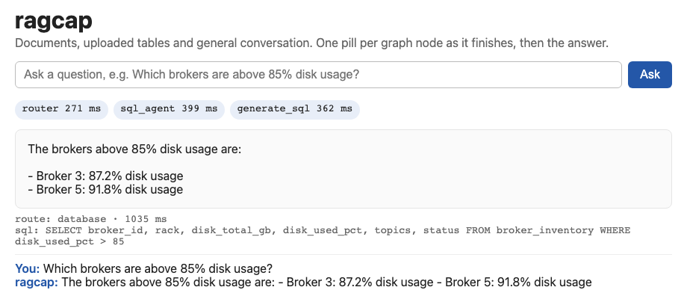
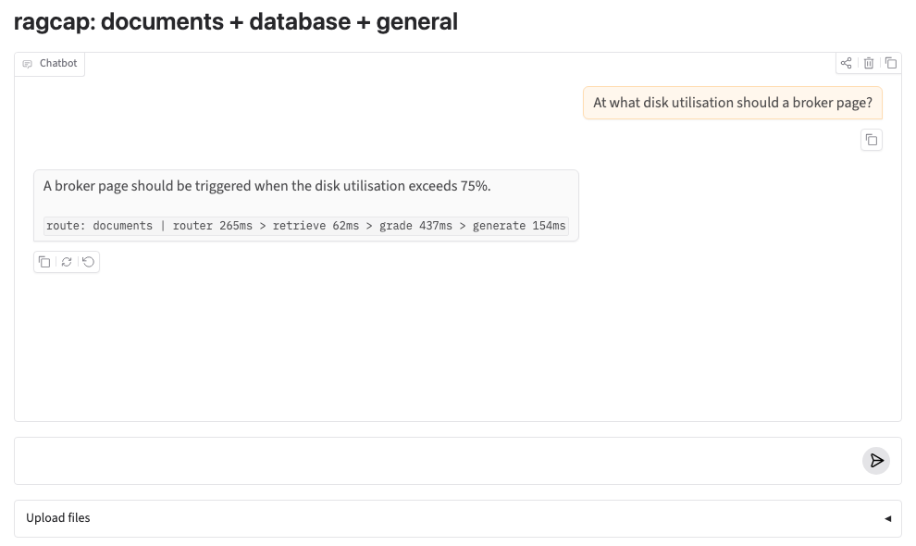
Two interfaces on one streaming API
web/index.html: one pill per graph node as it finishes, then the answer, route, SQL and citations. No build step; served by FastAPI at /.
Gradio: chat with the trace line under each answer; upload documents and tables. Both were exercised in headless Chromium with live questions.
Notes:
Both screenshots are from real runs on the M5 Pro; the latencies in the pills are real.

Slide 11
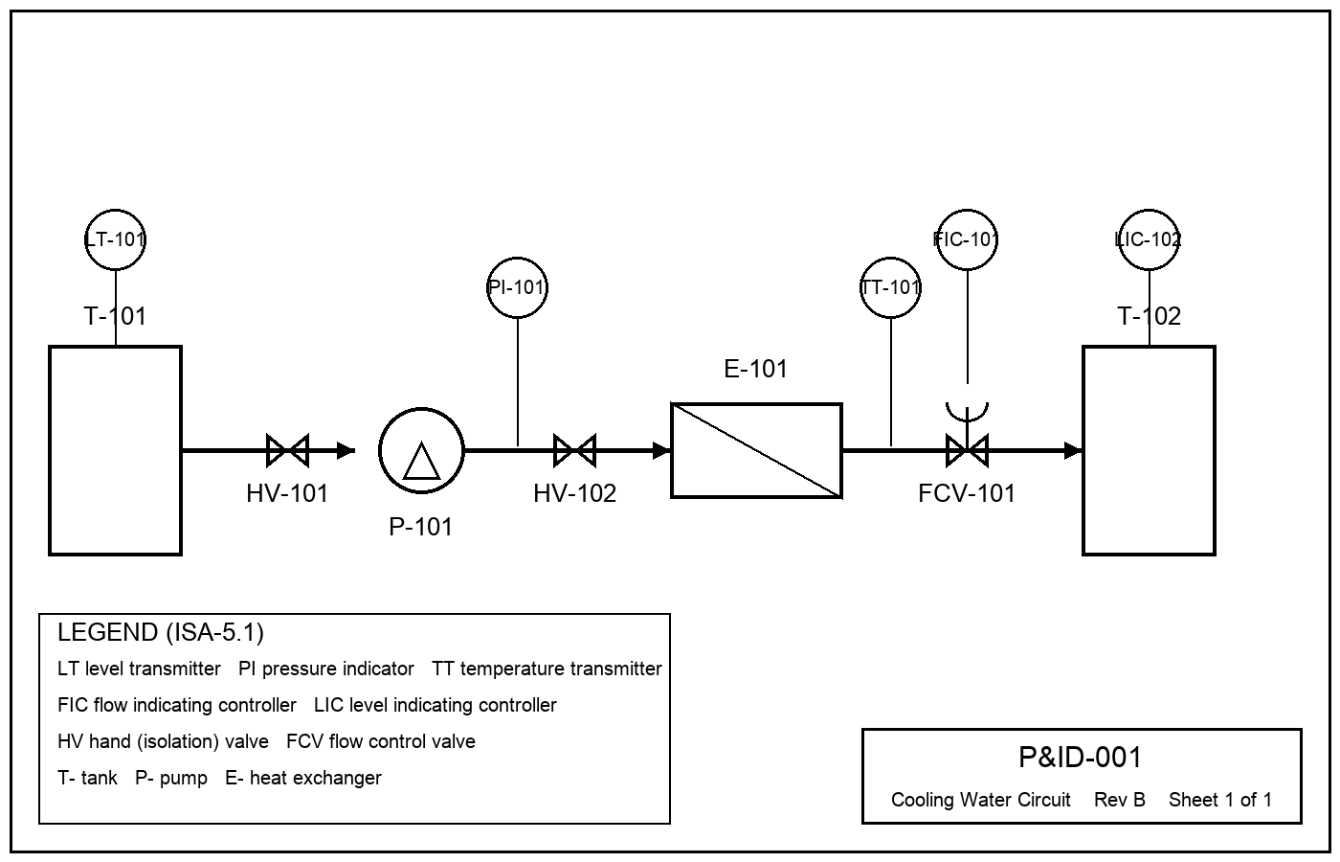
P&ID branch: drawings into the same index
qwen2.5vl:3b (5–12 s per drawing)
Tags read correctly (3 drawings) | 38/39, none invented
Right drawing retrieved | 12/12
Answers correct, 12 frozen questions | 4/12
what an instrument measures, on what | 3/3
valve isolating a pump | 1/3
controller + control valve | 0/3
which drawing / unit | 0/3
Synthetic drawings from one template with every tag in a ground-truth file (real P&IDs are confidential). The right drawing is always retrieved and a 7b vision model reads all 39 tags, but questions about connections (which valve is on the suction side) fail even with bigger models: the next step is storing connections as table rows.
Notes:
This was the colleague's proposed direction. The scaffold and the measurement method transfer; model size is not the next lever.

Slide 12
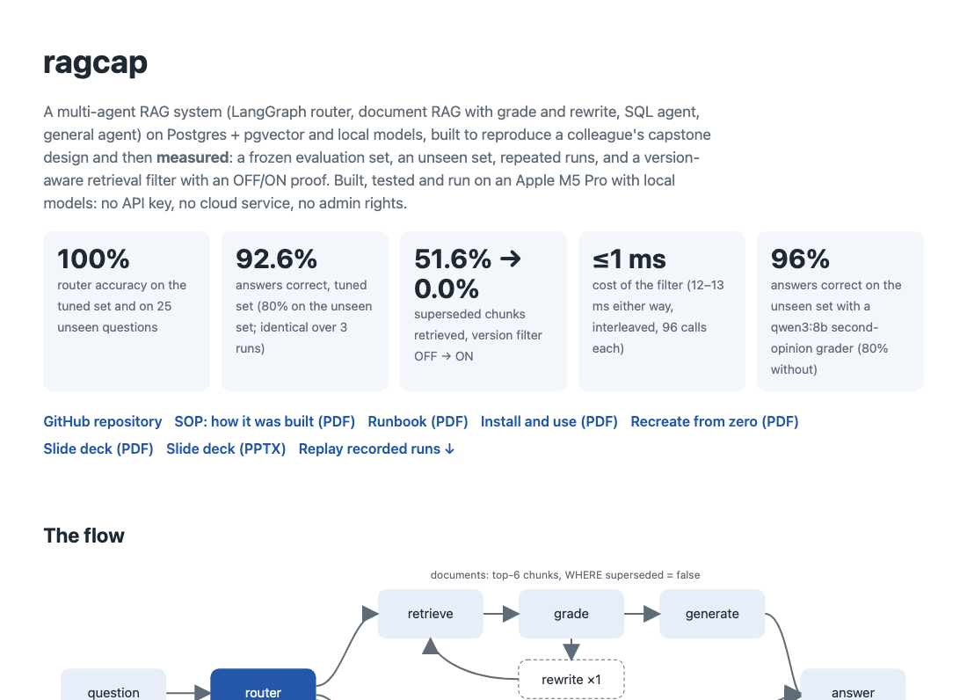
See it, test it
Live showcase (GitHub Pages, static): https://shreenathacc22.github.io/ragcap/
Results, the flow, screenshots, the documents, and a replay of 64 recorded runs: pick a question, see its route, node timings, answer, and for version cases the documents retrieved OFF vs ON.
Test it live (Ollama + Python 3.12; a few minutes):
git clone https://github.com/shreenathacc22/ragcap
cd ragcap && ./recreate.sh
Then try the scenario catalogue in docs/RECREATE.pdf, for example:
python scenarios.py → 12 pass, 5 known weaknesses, 0 unexpected
python b1_eval.py → old versions retrieved 51.6% OFF, 0% ON
"Which brokers are above 85% disk usage?" → SQL agent, brokers 3 and 5
Documents: SOP · Runbook · Recreate guide · Install guide
Notes:
The site is static: the replay is recorded. recreate.sh exits 1 if any fingerprint differs from the recorded ones.

Slide 13
Deploying the site to Vercel, step by step
1
Sign in
2
Import
vercel.com → Continue with GitHub (the account that owns shreenathacc22/ragcap).
Add New → Project → Import Git Repository → shreenathacc22/ragcap. Authorise the Vercel GitHub app for this repo if asked.
3
Settings
4
Deploy
Framework Preset: Other. Root Directory: leave as the repo root. Build Command: empty. Output Directory: site (vercel.json already says so).
Click Deploy; the first URL looks like ragcap-<hash>.vercel.app and opens the same site as GitHub Pages.
5
Domain
6
Keep it current
Settings → Domains → add ragcap.vercel.app (or any free name); paste the URL into README.md and the site, run publish_site.sh.
Every git push to main redeploys; the Deployments tab shows each build. CLI alternative: npm i -g vercel && vercel login && vercel --prod.
Why only the site: the pipeline needs Postgres + pgvector and Ollama, which neither Vercel nor Pages run. GitHub Pages is already live from the gh-pages branch (publish_site.sh); Vercel serves the identical site/ folder once imported.
Notes:
Three minutes in the Vercel dashboard. The CLI path needs an interactive login, which is why it was not done from the build machine.

Slide 14
Recreating it anywhere
git clone https://github.com/shreenathacc22/ragcap && cd ragcap
ollama pull llama3.2:3b; ollama pull nomic-embed-text # no Docker needed
./recreate.sh # DB, ingest, checks, fingerprints, OFF/ON ablation, smoke questions
.venv/bin/uvicorn api:app --port 8000 # http://127.0.0.1:8000/
./services.sh start && ./services.sh check # after a reboot: CLEAN START OK
.venv/bin/python pid_eval.py --ingest # P&ID branch (ollama pull qwen2.5vl:3b first)
Fingerprint | Value a correct rebuild must match
Database after ingest | 16 docs, 16 chunks, 8 superseded, 1 table
Data checks | PASS; pair similarity 0.963–0.990; three negative tests reported
Retrieval ablation | OFF 99/192 (51.6%) → ON 0/192 (0.0%); trap 2/12 → 12/12; control 20/20
Golden sets (sha1 prefixes) | golden 68ec09bd…, held-out 02ddcfd6…, P&ID 10fe1aa6…
Notes:
recreate.sh checks every row of this table and stops on the first mismatch.

Slide 15
What this shows
A design can be reproduced on a laptop with no API key. What makes it credible is not the architecture but the measurement: a frozen test set, an unseen set, ranges over repeated runs, a filter proven OFF against ON, and negatives written down with their evidence.
On an Apple M5 Pro: lean models (~2.7 GB) answer 92.6% / 80%; a second-opinion grader lifts unseen questions to 96%. Next: P&ID connections as data, multi-hop, then deployment.
https://github.com/shreenathacc22/ragcap · https://shreenathacc22.github.io/ragcap/
Notes:
Close on the two links. Offer the method before the numbers.

