Slide 1
ragcap: a multi-agent RAG system, built and measured
A colleague's capstone design (LangGraph router, document RAG with grade and rewrite, SQL agent, general agent, Postgres + pgvector) reproduced on local models, then evaluated the way it should be: frozen test sets, repeated runs, and a version-aware filter with an OFF/ON proof.
2019 Intel MacBook Pro · no API key · no GPU · October 2026
https://github.com/shreenathacc22/ragcap · https://shreenathacc22.github.io/ragcap/
Notes:
Open with the one-line summary, then the two links. Everything on these slides is reproducible from the repository.

Slide 2
The design to reproduce, and what was added
The design (from the capstone PDF)
Added here
Router → documents / database / general
Retrieve top-6 → Grade → one Rewrite → Generate with citations
SQL agent: one SELECT, read-only, time-limited, one retry
General agent never states facts
Postgres + pgvector, LangGraph, FastAPI, streaming chat, UI
Reported: latency and cost per flow (110 answers)
A quality column: frozen golden set (27), unseen set (25), router / retrieval / answer accuracy
Repeated runs: means and ranges, failing ids listed
Version-aware retrieval: superseded versions excluded before ranking, proven OFF vs ON
Honest negatives: 8B grader on CPU, Docling on Intel macOS
A P&ID branch on synthetic drawings with a 3B vision model
Three documents: SOP, runbook, recreate guide; a one-command rebuild
Notes:
The left column is what the PDF described; the right is what this project added. The key gap in the original was that nothing measured correctness.

Slide 3
The graph: one router, three paths, one trace
documents: top-6 chunks from pgvector, WHERE superseded = false before ranking
retrieve
grade
generate
rewrite ×1
question
router
answer
sql_agent
generate_sql
database: one read-only SELECT, 5 s timeout, one retry
general
general: greetings only; forbidden from stating facts
Every node appends its milliseconds and tokens to the trace; the API streams one event per node.
Notes:
Walk the three paths. Point out that the version filter is a WHERE clause in code, before the vector ranking, not a prompt instruction.

Slide 4
The stack, all local
Postgres 16 + pgvector 0.8
Ollama
In Docker on 127.0.0.1:5433. Tables documents (name, version, superseded, effective_date), chunks (vector(768), HNSW), uploaded_tables.
llama3.2:3b for every LLM call; nomic-embed-text (768 d) for embeddings; qwen2.5vl:3b for drawings. OpenAI-compatible endpoint, so the openai SDK is the only client.
LangGraph 1.2
Ingestion
StateGraph with conditional edges; nodes are plain functions with a timing decorator.
Markdown and PDF to paragraph-packed chunks; front-matter becomes version metadata and is stripped before embedding; CSV/Excel become SQL tables.
FastAPI + web/
Evaluation scripts
/upload, /chat (server-sent events), /eval, /health; a static page renders the node stream. Gradio as a second UI.
eval.py (answer level), b1_eval.py (retrieval OFF/ON), b1_check.py (data checks + negative tests), pid_eval.py, summarize_series.py, recreate.sh.
Notes:
No hosted service anywhere. That is what made the honest measurement cheap to repeat.

Slide 5
Twenty-five steps in six phases
1
2
3
4
5
6
Build
Improve
Measure
Negative
Versions
Close out
DB, ingest, graph, golden set frozen before any code, eval, API + UI (steps 1–8)
router, SQL rules, per-passage grader; one change at a time, committed before measuring (9–14)
25 unseen questions, 3+4 repeated runs, mean and range, the gap stated (15–18)
8B grader on this CPU: recorded with evidence, switch kept for a GPU (19)
16 runbooks old/current, data checks, OFF/ON ablation, default ON (20)
browser checks, LangSmith opt-in, static front end, P&ID branch, site (21–25)
Every step in the SOP has the problem found, the change, how it was verified, and the commands used.
Notes:
Phase 4 is red on purpose: a recorded negative result is part of the method, not a failure of it.

Slide 6
How the numbers were kept honest
1
Freeze first
2
Never tune on the test
The golden set was committed before the pipeline existed; the unseen set before its first run. Git order is the evidence.
A first router draft copied golden questions as examples; it was replaced before any run. Scorer fixes go in an amendments file, never in the frozen set.
3
Commit before measuring
4
Report ranges
One prompt change at a time, full run, compared by failing case ids, not just the percentage.
Three held-out runs and four tuned-set runs; the 7.6-point gap between them is stated as the over-fitting measure.
5
Fair latency
6
Record negatives
OFF and ON interleaved in one process after a warm-up; a single cold run once showed a false 3× difference.
qwen3:8b could not grade six passages in usable time on this CPU; the switch stays, the evidence is in the SOP.
Notes:
These six rules are what make the next two slides trustworthy.

Slide 7
Results: tuned set vs unseen set
7.6 pts
the gap between tuned and unseen answer accuracy: the honest measure of over-fitting
4 cases
fail in every held-out run: three are the 3B grader rejecting a differently phrased passage, one is a router ambiguity
100%
unanswerable questions refused, every run; general questions never answered with facts
Notes:
Routing and retrieval generalise; answer accuracy drops 7.6 points on unseen questions, and the failing ids are the same every run, so they are model limits, not noise.

Slide 8
Version-aware retrieval: the trap and the fix
Retrieval only, 32 frozen cases | OFF | ON
Version-trap cases passing (facts present, no stale value from an old chunk) | 2/12 | 12/12
Control cases passing (must stay flat) | 20/20 | 20/20
Median retrieve, interleaved ×3, 96 calls each | 56 ms | 57 ms
Pair similarity old vs current (nomic-embed-text) | 0.962 – 0.990
How: each document version carries version, effective_date and superseded; retrieve() adds WHERE d.superseded = false before ORDER BY, so an old runbook that is 0.99-similar to the question is never a candidate. One line of SQL, behind a switch, default ON since the ablation was recorded.
At answer level both settings scored 88.9% on this corpus (its current runbooks name their former values); multi-hop improved 0/2 → 1/2 with the filter on.
Notes:
The headline is the left chart. The right table shows the control cases did not move and the cost is one millisecond.

Slide 9
Decisions taken on evidence
Stronger grader: tested, not possible here
Next.js: descoped
qwen3:8b grades one passage in 33–52 s but never returned six passages in 20 minutes on this CPU; the runner sat at 578% CPU. The escalate design and switch are in place for a GPU or hosted model.
Node 24 is installed, so it was possible; it adds a toolchain and hosting without changing anything measured. A static page proves the streaming contract instead.
Docling: blocked on Intel macOS
The 'outages' were sleep
Last torch wheel is 2.2.2; the layout model needs newer transformers and numpy 2. PDFs use pypdf text; run Docling elsewhere and ingest the Markdown.
Three service failures traced in the system log to the Mac sleeping; every long script now re-execs under caffeinate, and the runbook has the checklist.
Notes:
Each of these is written up with its evidence in the SOP; none is a guess.

Slide 10
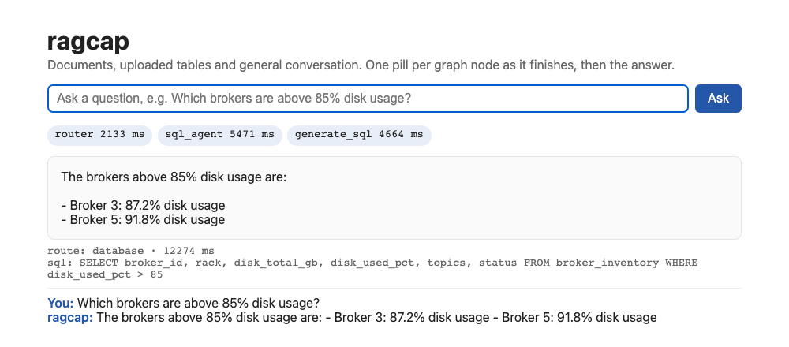
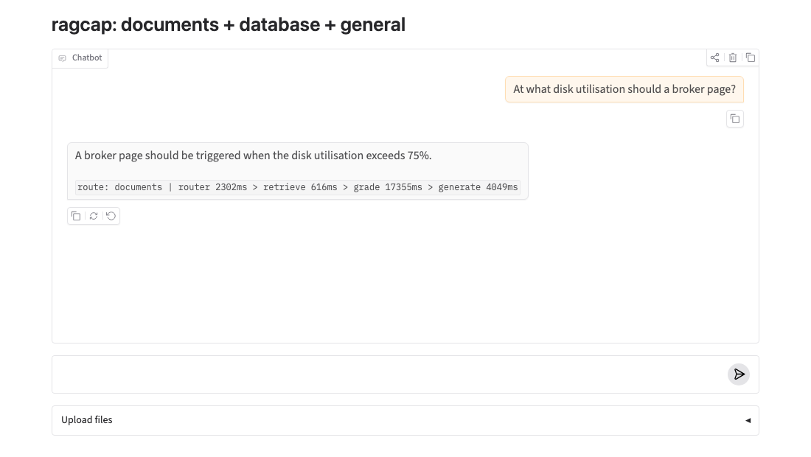
Two interfaces on one streaming API
web/index.html: one pill per graph node as it finishes, then the answer, route, SQL and citations. No build step; served by FastAPI at /.
Gradio: chat with the trace line under each answer; upload documents and tables. Both were exercised in headless Chromium with live questions.
Notes:
Both screenshots are from real runs on the Mac; the latencies in the pills are real.

Slide 11
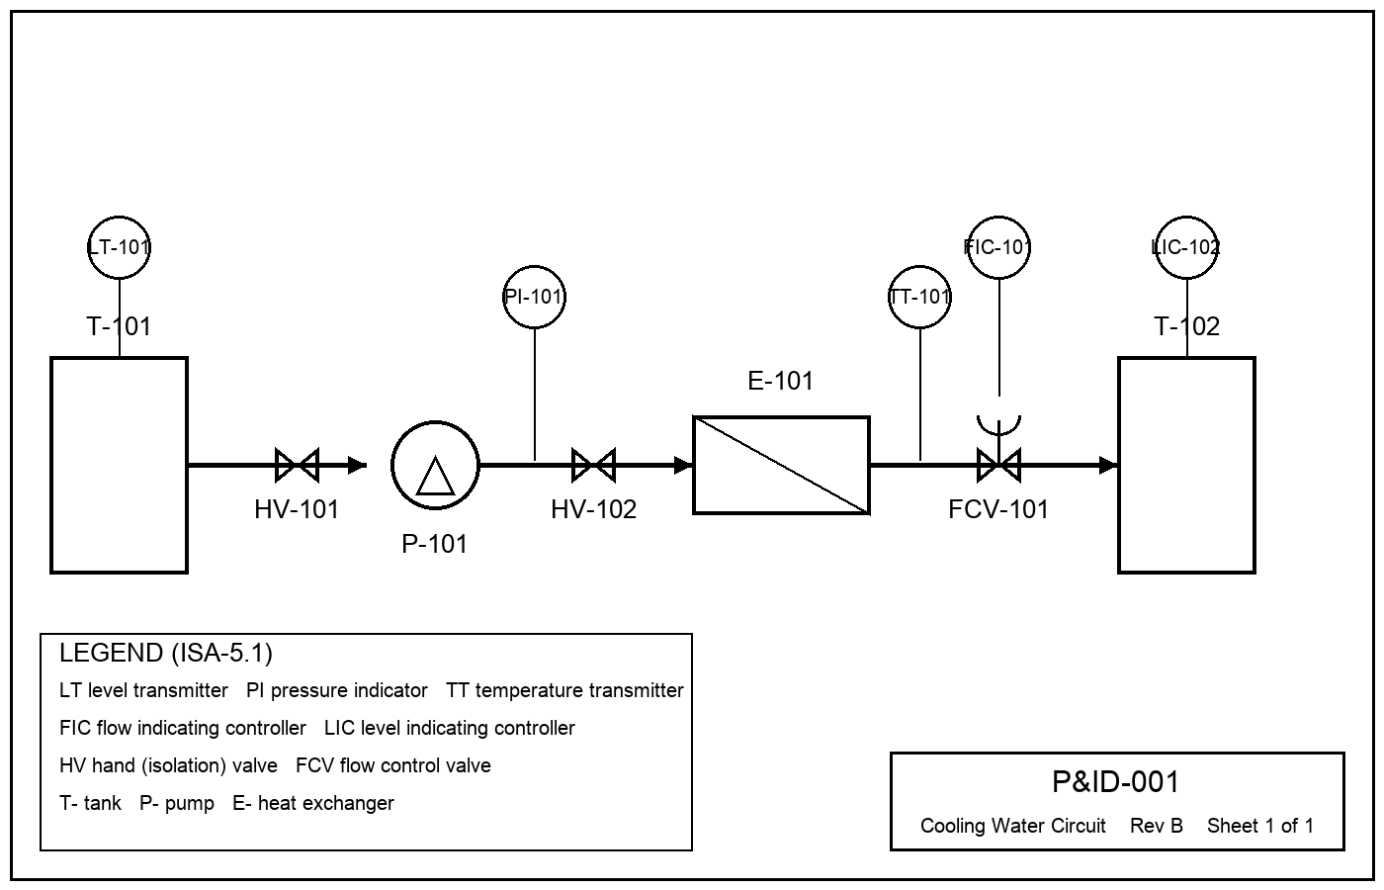
P&ID branch: drawings into the same index
Run 2 (qwen2.5vl:3b, ~100 s per drawing)
Tags read correctly (3 drawings) | 36/39, none invented
Right drawing retrieved | 12/12
Answers correct, 12 frozen questions | 5/12
what an instrument measures, on what | 3/3
valve isolating a pump | 1/3
controller + control valve | 1/3
which drawing / unit | 0/3
Synthetic drawings from one template with every tag in a ground-truth file (real P&IDs are confidential). What fails is the same 3B grader that limits the text pipeline, plus the title-block subtitle and small text near symbol edges: exactly what a real set will exercise first. Start a real project from a golden set like this one, on a GPU-class vision model.
Notes:
This was the colleague's proposed direction. The scaffold and the measurement method transfer; the model needs to be bigger.

Slide 12
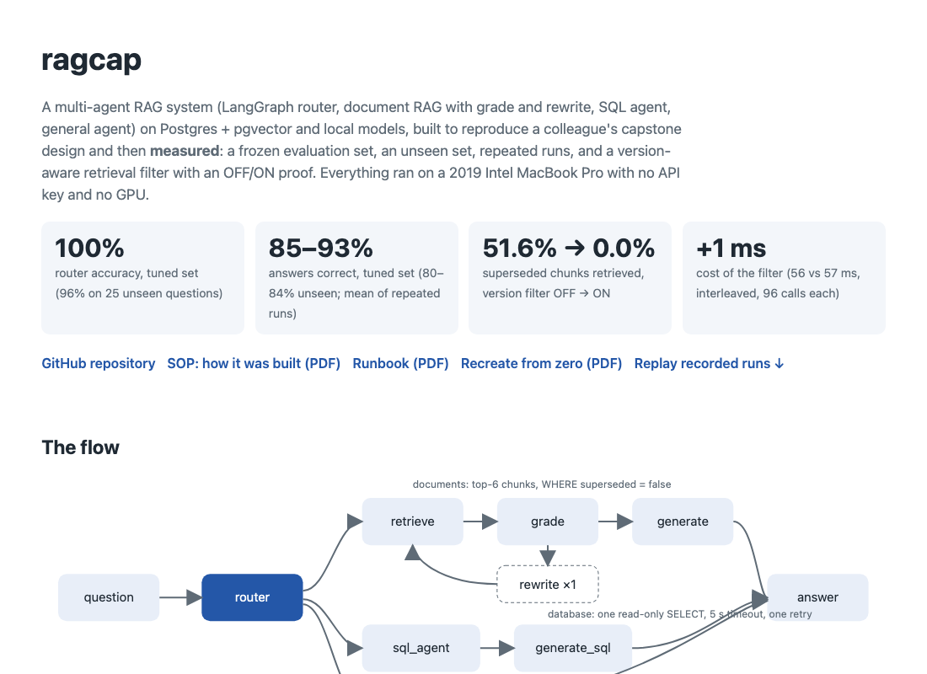
See it, test it
Live showcase (GitHub Pages, static): https://shreenathacc22.github.io/ragcap/
Results, the flow, screenshots, the documents, and a replay of 64 recorded runs: pick a question, see its route, node timings, answer, and for version cases the documents retrieved OFF vs ON.
Test it live (45 min, Docker + Ollama + Python 3.12):
git clone https://github.com/shreenathacc22/ragcap
cd ragcap && ./recreate.sh
Then try the scenario catalogue in docs/RECREATE.pdf, for example:
VERSION_AWARE=0 … "At what disk utilisation should a broker page?" → often 85% (the trap)
VERSION_AWARE=1 … the same question → 75% (the fix)
"Which brokers are above 85% disk usage?" → SQL agent, brokers 3 and 5
Documents: SOP · Runbook · Recreate guide
Notes:
The site is static: the replay is recorded. recreate.sh exits 1 if any fingerprint differs from the recorded ones.

Slide 13
Deploying the site to Vercel, step by step
1
Sign in
2
Import
vercel.com → Continue with GitHub (the account that owns shreenathacc22/ragcap).
Add New → Project → Import Git Repository → shreenathacc22/ragcap. Authorise the Vercel GitHub app for this repo if asked.
3
Settings
4
Deploy
Framework Preset: Other. Root Directory: leave as the repo root. Build Command: empty. Output Directory: site (vercel.json already says so).
Click Deploy; the first URL looks like ragcap-<hash>.vercel.app and opens the same site as GitHub Pages.
5
Domain
6
Keep it current
Settings → Domains → add ragcap.vercel.app (or any free name); paste the URL into README.md and the site, run publish_site.sh.
Every git push to main redeploys; the Deployments tab shows each build. CLI alternative: npm i -g vercel && vercel login && vercel --prod.
Why only the site: the pipeline needs Postgres + pgvector and Ollama, which neither Vercel nor Pages run. GitHub Pages is already live from the gh-pages branch (publish_site.sh); Vercel serves the identical site/ folder once imported.
Notes:
Three minutes in the Vercel dashboard. The CLI path needs an interactive login, which is why it was not done from the build machine.

Slide 14
Recreating it anywhere
git clone https://github.com/shreenathacc22/ragcap && cd ragcap
open -a Docker; ollama pull llama3.2:3b; ollama pull nomic-embed-text
./recreate.sh # DB, ingest, checks, fingerprints, OFF/ON ablation, smoke questions
.venv/bin/uvicorn api:app --port 8000 # http://127.0.0.1:8000/
./run_series.sh mylabel llama3.2:3b # repeated runs; summarize_series.py mylabel
.venv/bin/python pid_eval.py --ingest # P&ID branch (ollama pull qwen2.5vl:3b first)
Fingerprint | Value a correct rebuild must match
Database after ingest | 16 docs, 16 chunks, 8 superseded, 1 table
Data checks | PASS; pair similarity 0.962–0.990; three negative tests reported
Retrieval ablation | OFF 99/192 (51.6%) → ON 0/192 (0.0%); trap 2/12 → 12/12; control 20/20
Golden sets (sha1 prefixes) | golden 68ec09bd…, held-out 02ddcfd6…, P&ID 10fe1aa6…
Notes:
recreate.sh checks every row of this table and stops on the first mismatch.

Slide 15
What this shows
A design can be reproduced on a laptop with no API key. What makes it credible is not the architecture but the measurement: a frozen test set, an unseen set, ranges over repeated runs, a filter proven OFF against ON, and negatives written down with their evidence.
Next, on a GPU or hosted model: the escalate grader, a real P&ID set with its own golden questions, and LangSmith with a real key.
https://github.com/shreenathacc22/ragcap · https://shreenathacc22.github.io/ragcap/
Notes:
Close on the two links. Offer the method before the numbers.

