Slide 1
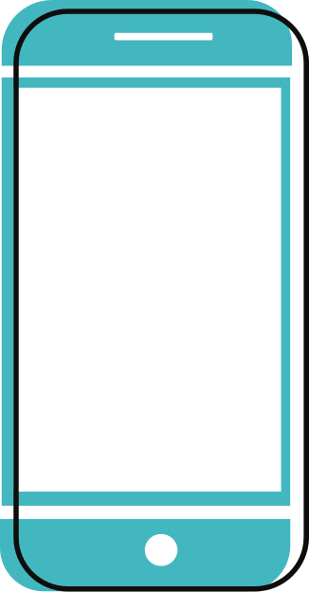



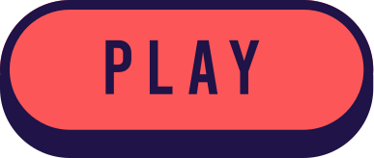

GAME-BASED LEARNING APP
Presented by:
Priyadharshini G
Sai Krishna C
Shreenidhi G L

Slide 2
AGENDA:
01 | PROBLEM STATEMENT
02 | OBJECTIVES
03 | LITERATURE SURVEY
04 | PROPOSED SYSTEM
05 | FUNCTIONAL DESCRIPTION
06 | IMPLEMENTATION
07 | CONCLUSION

Slide 3
ABSTRACT:
Quizmaster revolutionizes education for students with disabilities by offering a tailored learning experience.
The app's accessibility features, such as customizable controls and text-to-speech, ensure inclusivity.
Adaptive learning paths, engaging content, and immediate feedback enhance the learning journey.
This innovative app provides users with the opportunity to answer questions across various modules, while simultaneously maintaining a real-time leaderboard to foster healthy competition.

Slide 4

PROBLEM STATEMENT:
The problem statement entails addressing the challenges faced in traditional educational methods by developing a Game-Based Learning App.
This app aims to enhance student engagement and comprehension by integrating educational content with interactive gaming elements.

Slide 5

OBJECTIVES:
Enhanced Engagement
Assessment and Feedback
Enhancing Accessibility with Text-to-Speech Integration
Curriculum Alignment
User friendly Interface
Continuous Improvement

Slide 6

EXSISTING SYSTEM:
Quiz Maker typically involve a combination of educational content and gaming elements to engage users and facilitate learning. These apps are act as an online quiz maker and game-based learning platform.
Trivia is one of the top game-based learning platforms. Through gamified quizzes and a competitive leaderboard, it motivates employees to actively participate and retain knowledge.
.Gamelearn is one of the top game-based learning platforms. With a focus on engaging and immersive learning experiences.

Slide 7
PROPOSED SYSTEM:
Quiz Module:
The quiz module will provide interactive assessments to reinforce learning and comprehension.
Upon completing a quiz, users will receive instant feedback on their performance, including correct answers and explanations.
READING MODULE:
Integrated text-to-speech functionality will convert written text into spoken words, facilitating accessibility for visually impaired users.
This module will allow users to access educational content in a text format.

Slide 8
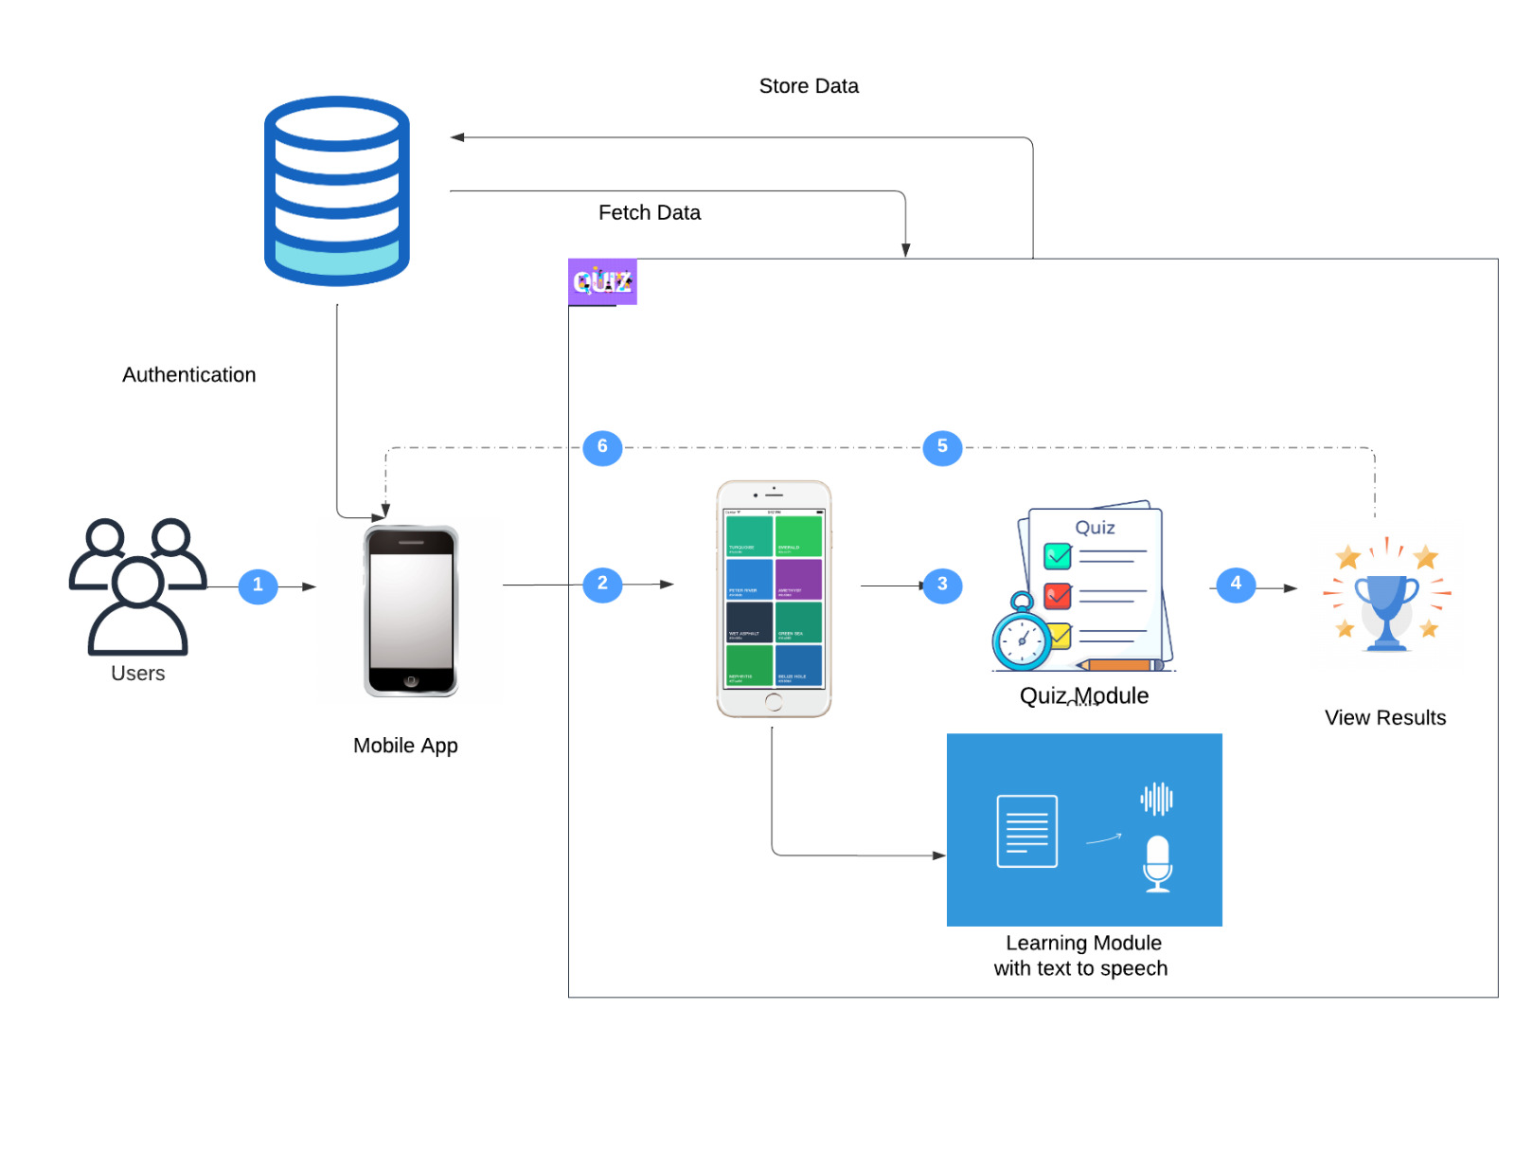
FUNCTIONAL DESCRIPTION:

Slide 9
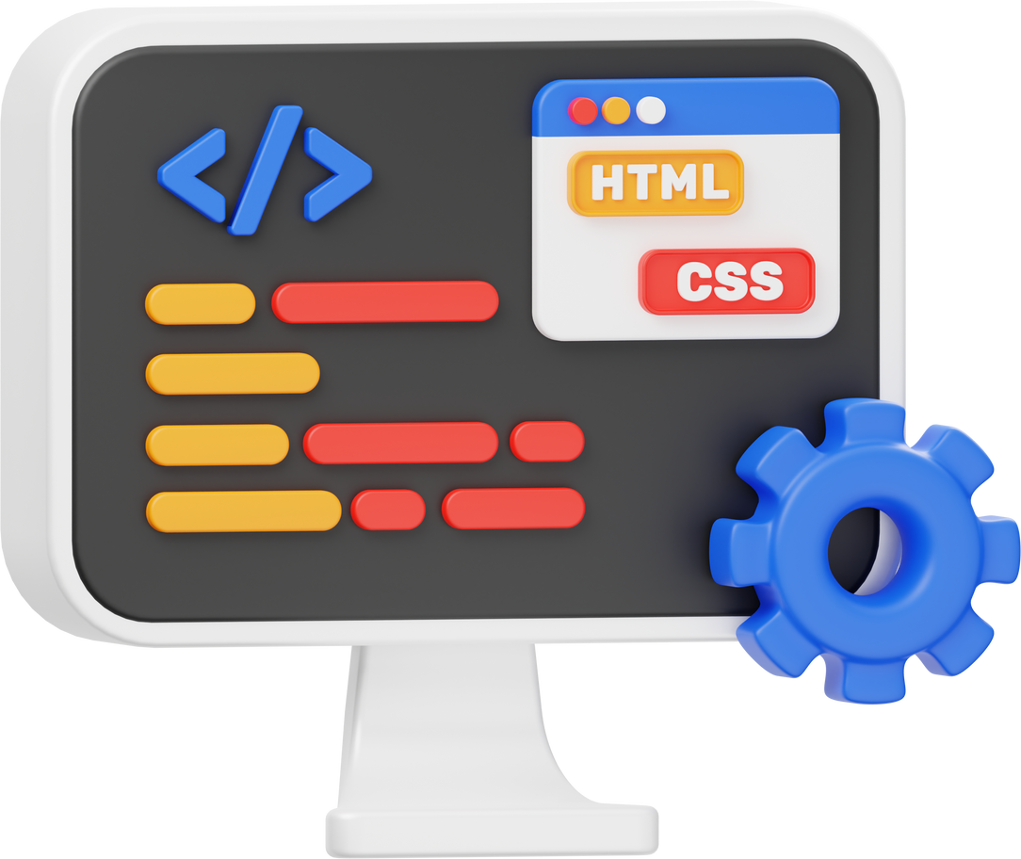
TECHNOLOGY USED:
FRONTEND: KOTLIN
BACKEND: KOTLIN
DATABASE: FIREBASE

Slide 10
MODULES USED:
.
USER
AUTHENTICATION
LEARNING MODULE
ASSESMENT
MODULE
FEEDBACK
MODULE

Slide 11

IMPLEMENTATION

Slide 12

01 | In conclusion, our Game-Based Learning App presents a transformative approach to education, fostering engagement, accessibility, and learning outcomes for all users.
02 | By integrating a reading module with speech functionality and a quiz module, we have created a comprehensive learning platform that caters to diverse learning needs and preferences.
03 | Through innovative features and user-centric design, our app empowers learners to engage with educational content in meaningful ways, ultimately enhancing their academic achievement and fostering a love for lifelong learning.
CONCLUSION:

Slide 13



THANK YOU

