Slide 1
Review - 1

Slide 2
SEMANTIC-AWARE ARCHIVAL OF LOW-IMPACT SOCIAL MEDIA POSTS USING TIERED COMPRESSION AND COLD STORAGE
Team Members:
R S Shreenidhi-22MID0306
Keerthana G – 22MID0144
R Sivani – 22MID0005
Alyssa Mariam - 22MID0076

Slide 3
Preserving Social Media
(Paper Methodology)
Define Designated Community & requirements
Re-selection, risk assessment, and policy definition
Rich metadata & documentation practices
Bit-preservation & standard packaging (e.g., WARC)
Support for emulation/replay & authenticity
Ethics, legal & privacy controls
Advocacy & sustainability for long-term preservation

Slide 4
Semantic-Aware Archival
(Proposed Methodology )
Semantic-aware impact scoring of posts
Tiering strategy: Hot, Warm, Cold classification
Adaptive compression per tier for efficiency
Migration of low-impact data to cold storage
Lightweight metadata for fast retrieval
Selective decompression on demand
Integration of automated privacy/PII checks

Slide 5
Comparison of Methodologies
Aspect | Existing Methodology | Proposed Methodology
Selection | Re-selection & policy-driven decisions | Semantic scoring & tier assignment
Metadata | Rich metadata & provenance | Lightweight metadata + minimal provenance
Compression | Focus on bit-preservation | Tiered adaptive compression
Access | Authenticity & emulation/replay | Selective decompression for efficiency
Risk/Ethics | Ethical/legal frameworks emphasized | Automated PII detection & access policies
Preservation | WARC & fixity checks | Cold storage migration with retrieval metadata

Slide 6
Suggested Integration of Both Approaches
Adopt paper's rich metadata & provenance capture in cold tier
Combine semantic impact scoring with preservation re-selection policies
Maintain WARC/raw copies for authenticity where critical
Use policy-driven thresholds for lossy vs. lossless compression
Embed risk assessment and privacy checks into archival workflow
Provide dual metadata layers: lightweight (retrieval) + preservation (authenticity)

Slide 7
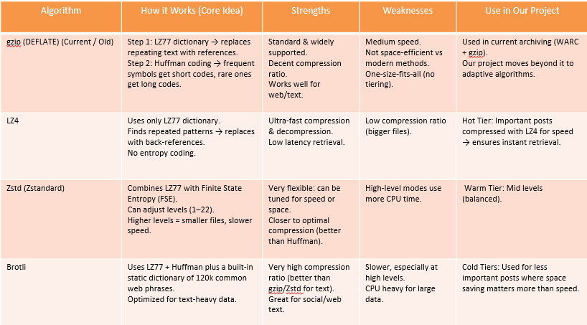
Compression Algorithms in Our Project

Slide 8
Conclusion
Old Approach:
Used gzip (LZ77 + Huffman) for all posts.
Decent, but not efficient (one-size-fits-all).
Our Approach (Adaptive by Semantic Impact Score):
LZ4 → Speed for high-value posts.
Zstd → Flexible across all tiers used for the warm tier.
Brotli → Maximum space saving for low-value posts or cold tier.

