Slide 1

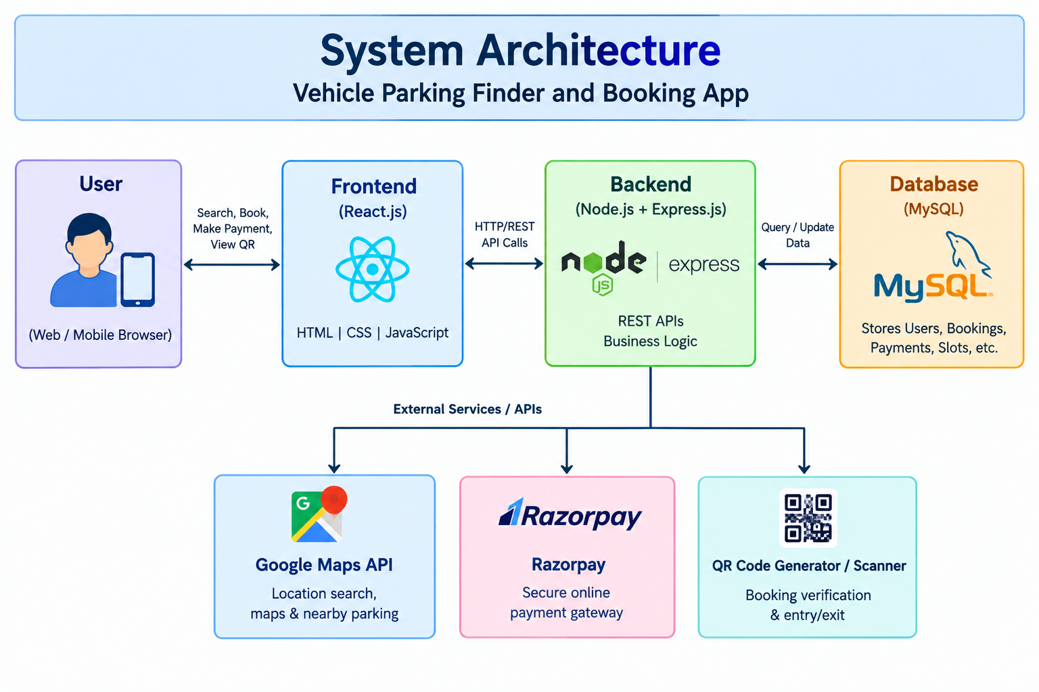
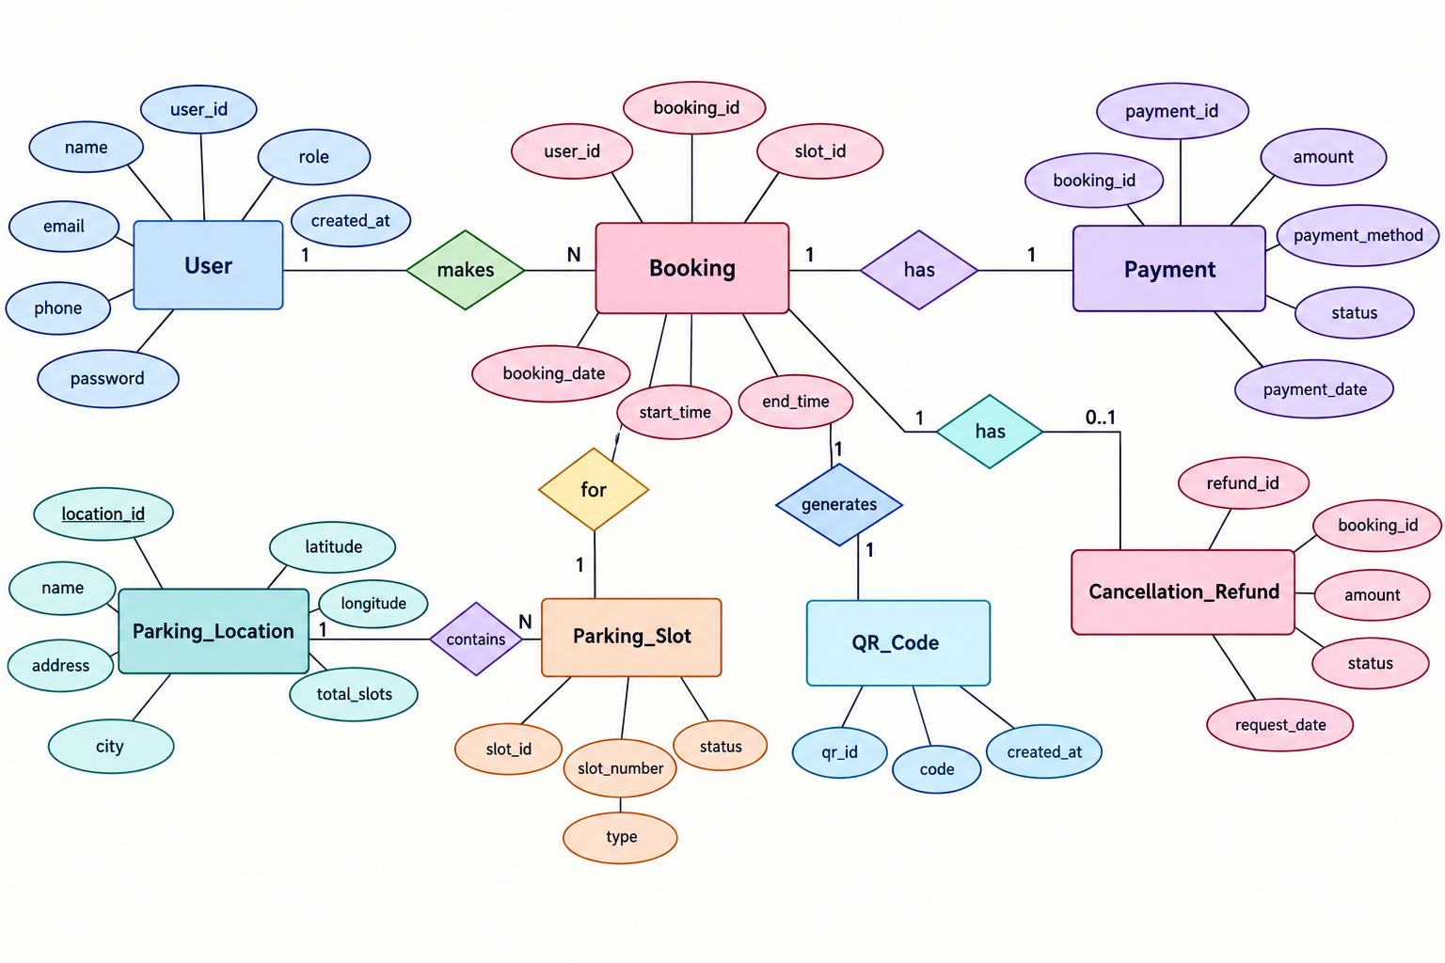
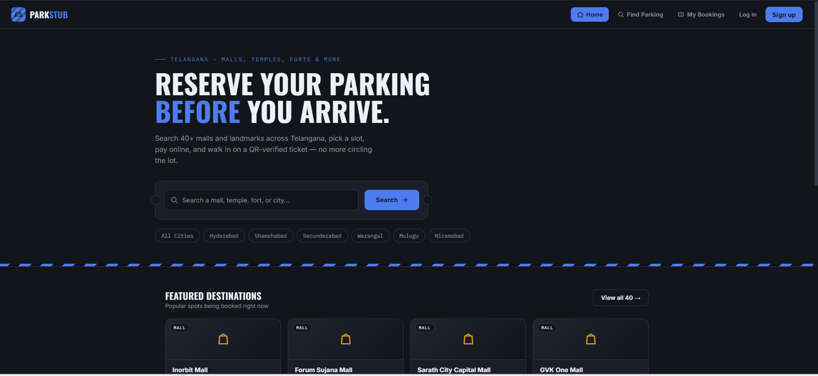
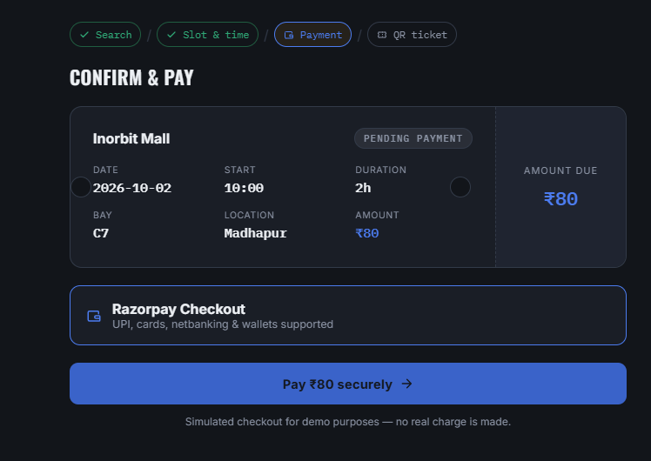

KLH Logo
Vehicle Parking Finder & Booking App
Team ID: [19] | Section: [S-3] | Members: [D. Shreenitha– 2520030504.], [A. Srihitha – 2520030566.] | Guide: [Dr. S.Spanadana ]
Database Systems Engineering and Distributed Backend Development (25CS1302E) | KLH Bachupally Campus, CSE | PBL 2026-27
Abstract
Tools & Technologies
Vehicle Parking Finder and Booking App helps users find nearby parking, check slot availability, and make bookings easily. Built using React.js, Node.js, Express.js, MySQL, Google Maps API, Razorpay, and QR technology.
Front-End: React.js, HTML, CSS, JavaScript
Back-End: Node.js, Express.js, REST APIs
Database: MySQL
APIs & Services: Google Maps API, Razorpay
Tools: VS Code, Git & GitHub, Postman
Additional: QR Code Generator & Scanner
Problem Statement & Objectives
Problem: Finding available parking spaces is time-consuming and inconvenient, especially in busy areas.
Objective 1: Find nearby parking spaces and view slot availability.
Objective 2: Allow users to select time slots and book parking online.
System Architecture
[Insert architecture diagram: Front-End – REST API – Database]
Existing vs Proposed System
Feature | Existing System | Proposed System
Parking Search | Manual search | Location-based search
Slot Availability | Difficult to search | Check available slots
Booking | Mostly Offline | Online booking
Payment | Manual Payment | Online Razorpay payment
Verification | Manual Checking | QR-based verification
ER Diagram & Database Design
[Insert ER diagram with entities, keys and relationships]
Feasibility Study
Technical: Uses React.js, Node.js, Express.js, MySQL and available APIs.
Economic: Uses open-source technologies with low development cost.
Operational: Simple interface for users and parking management.
Schedule: Can be developed and tested within the academic project timeline.
Implementation Screenshots
[Screenshot 1]
[Screenshot 2]
Results & Testing
Conclusion
Future Scope
Successfully implemented parking search, slot selection, booking, payment and QR verification.
Developed a centralized application for finding and booking parking spaces. Meets the core objectives of convenient parking search and digital booking.
Real-time parking availability using IoT/sensor integration.
AI-based parking recommendations based on user location and availability.
References: [1] React.js Documentation — Frontend development
QR: GitHub

