Slide 1
SMARTLOAN: LOAN APPROVAL PREDICTION USING MACHINE LEARNING
Team Members :
Nithya Shree M
Sridharshan S
Course:
Data Science (21CSS303T)

Slide 2
Abstract
- Loan approval decision-making is a critical task for financial institutions
- This project uses machine learning to predict whether a loan will be approved or rejected
- Applicant data, such as income, credit history, and loan amount, is analyzed
- Data preprocessing and visualization are performed to understand patterns
- A Logistic Regression model is built for classification
- The model achieved an accuracy of around 79%
- The results show that credit history is a key factor in loan approval

Slide 3
Objectives
The objectives are:
To analyze loan applicant data to identify key factors influencing loan approval decisions.
To perform data preprocessing and visualization to ensure data quality and extract meaningful insights.
To build a machine learning model for prediction.
To predict loan approval status based on applicant characteristics and financial information.

Slide 4
Dataset Description
- Dataset: Loan Prediction Dataset (Kaggle)
- Number of records: ~614
- Features include:
- Applicant Income
- Loan Amount
- Credit History
- Education, Gender, etc.
- Target variable: Loan_Status (Y/N)

Slide 5
Methodology
1. Data Collection
2. Data Preprocessing
3. Exploratory Data Analysis
4. Data Visualization
5. Model Building (Logistic Regression)
6. Evaluation

Slide 6
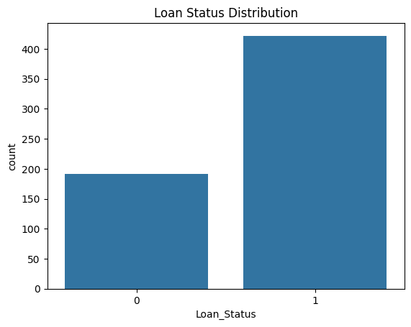
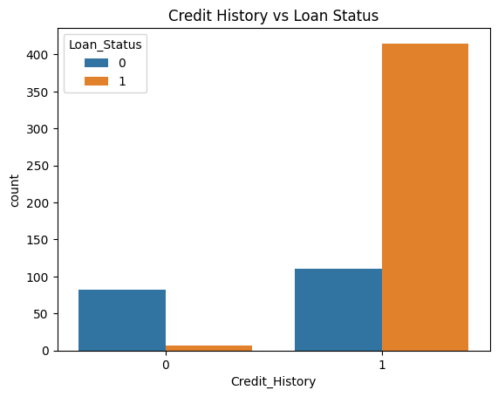
Data Visualization
Loan Status Distribution
Credit History vs Loan Status Distribution

Slide 7
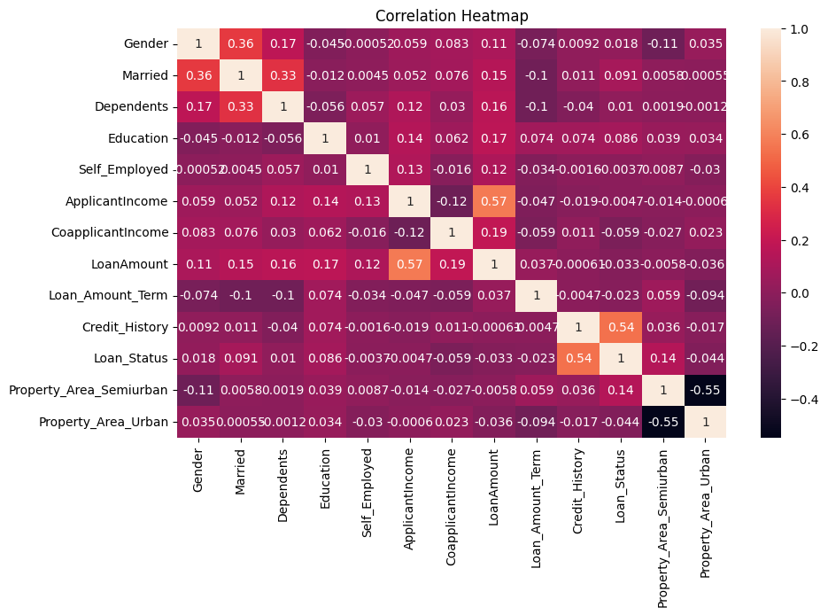
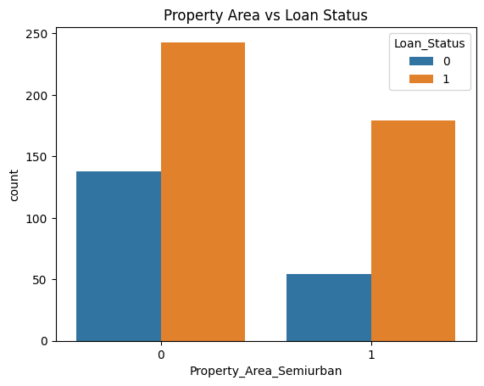
Data Visualization
Property Area vs Loan Status
Correlation Heatmap

Slide 8
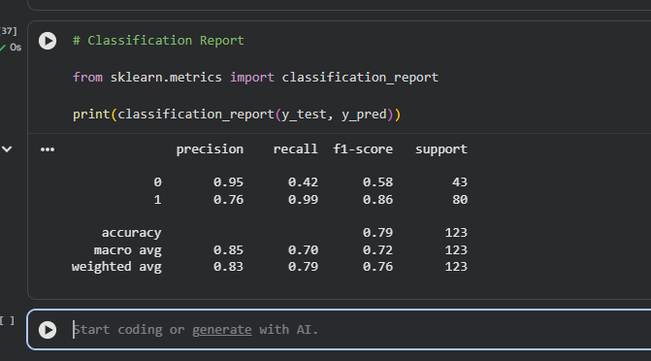
Model Building
Results
- Algorithm used: Logistic Regression
- Data split: 80% training, 20% testing
-Feature scaling applied using StandardScaler
- Accuracy: ~79%
- Confusion Matrix used for evaluation
- Classification Report analyzed

Slide 9
Key Insights
- Credit history is the most important factor influencing loan approval decisions
- Applicants with a positive credit history are more likely to get approval
- Higher applicant income generally increases the chances of loan approval
- The dataset is imbalanced, with more approved loans than rejected ones
- The model performs better for approved loans compared to rejected loans
- Some features like gender and education have less impact on prediction

Slide 10
Conclusion
- The machine learning model successfully predicts loan approval with good accuracy (~79%)
- Data preprocessing and feature selection played a key role in improving performance
- The model helps automate loan decision-making, reducing manual effort
- It enables faster, consistent, and data-driven loan approval processes
- Limitation: lower performance in predicting rejected loans due to class imbalance
- Future work can include balancing the dataset and using advanced models for better accuracy

