Slide 1
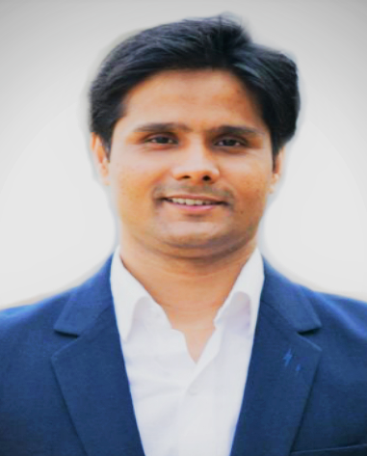
Ashutosh Mani Tripathi – Assistant Manager
Business Unit: FRL (Digital Team) | Emp Code: 441824
Talent History |  |  |  |  |  | Educational Qualification
9 Box Rating |  |  | Performance Rating |  |  | PGDM – BLS institute of Management, 2009 L.L.B – Veer Kunwar Singh University , 2015 B.A ( Hons) – Patna University , 2006
 |  |  | 2012-13 | 2013-14 | 2014-15
Internal Work History |  |  |  |  |  | External Work History
FRL– Assistant Manager – Since Apr’18 |  |  |  |  |  | Grofers – Area Manager (Nov’15- Apr ‘18) HSA lipid System- Partner – (Aug’13- Oct’15) IUP Jindal Metals & Alloys – Executive – (Sept’11-Oct’12) Gujarat Ambuja Exports Limited – Executive –(Nov’10-Sept’11) Veecon Media & Broadcasting – Executive – (Jul’09-Oct’10)
Key deliverables in current role |  |  |  |  |  | Family Information
Handling Home Delivery Operation centrally. Amazon Now – Co-ordinating with Zones for Amazon Sales & operation. HypercityFresh.com – Handling entire operation for Hypercityfresh.com Setting up operational infrastructure for upcoming online platform. |  |  |  |  |  | Married Spouse Working with Glenmark Pharma Parents details – Mother – 58 Years (Patna) Father – 64 Years (Patna)
Keep this blank
Supervisor: | Sanjeev Jaiswal
Band: | 3A
Dept: | Product Management
Location: | FRHO
Age: | 32
Total Exp:
DOJ:
AGC:
PB:
CTC:

Slide 2
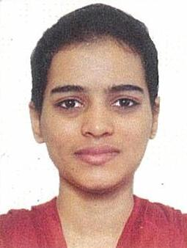
Aksaa Azmuddin Temrekar– Online Merchandiser
Business Unit: FRL (Digital Team) | Emp Code: 442732
Talent History |  |  |  |  |  | Educational Qualification
9 Box Rating |  |  | Performance Rating
 |  |  | 2015-16 | 2016-17 | 2017-18
Internal Work History |  |  |  |  |  | External Work History
 |  |  |  |  |  | Hindustan Unilever - Ecommerce Content Management (Feb 2017- April 2018) Matrix Global - Catalog Manager (Feb 2016- Feb 2017) Lumina Datamatics Ltd - Ecommerce Executive (Oct 2013- Feb 2016)
Key deliverables in current role |  |  |  |  |  | Family Information
Planning of banner on the basis of file acquired from the offer team and Execution Liaison with the category teams to get product offers. Evaluating and enhancing the online customer experience. Improve site layout and quality of content for better user experience
B.Sc.IT from Raheja College, Santacruz, Mumbai University (Nov 2013)
Keep this blank
FRL - Online Merchandiser since April 2018
Supervisor: | Sanjeev Jaiswal
Band: | 2D
Dept: | FRL
Location: | HO
Age: | 27 Years
Total Exp: | 5.4 Years
DOJ: | 17-Apr-18
AGC:
PB:
CTC:
Single
Parents Details:
Mother – 51 Years (Mumbai)
Father – 59 Years (Mumbai)

Slide 3
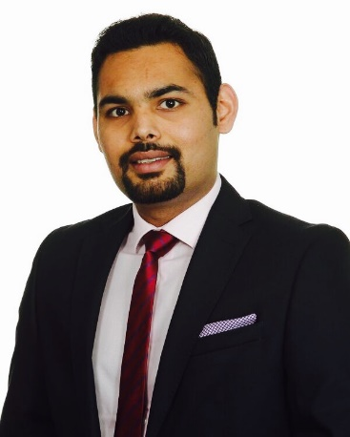
PRATEEK BIYANI – Assistant Manager
Business Unit: FRL (Digital Team) | Emp Code: 434059
Talent History |  |  |  |  |  | Educational Qualification
9 Box Rating |  |  | Performance Rating |  |  | MBA - Durham University, United Kingdom in 2017 B. Com - Pune University in 2012
 |  |  | 2012-13 | 2013-14 | 2014-15
Internal Work History |  |  |  |  |  | External Work History
FRL– Assistant Manager Marketing – Since Feb’18 |  |  |  |  |  | Videocon – Deputy Manager Marketing (July’14 – Sep’16) Videocon – Assistant Manager Marketing (July’13 – June’14) Videocon – eCommerce – Category Management & B2B Sales (Sep’11 – June’13)
Key deliverables in current role |  |  |  |  |  | Family Information
Developing and Implementing Digital and Offline Marketing Campaigns for Hypercityfresh.com Creating promotional offers to drive new customers and retain old customers. Day to day campaign analysis and taking corrective measures. Working closely with Creative Agency |  |  |  |  |  | Single Parents details – Mother – 45 Years (Gurgaon) Sister – 22 Years (Gurgaon)
Keep this blank
Supervisor: | Sanjeev Jaiswal
Band: | 3A
Dept: | Digital Team
Location: | FRHO
Age: | 27
Total Exp:
DOJ:
AGC:
PB:
CTC:

