Slide 1

EFFICIENT ALLOCATION OF RESOURCES IN CLOUD ENVIRONMENT USING GREEN COMPUTING
Under the guidance of,
C. S. JAYASHEELA
ASSISTANT PROFESSOR
INFORMATION SCIENCE AND ENGINEERING
BANGALORE INSTITUTE OF TECHNOLOGY
SUBMITTED BY,
ASHOK PAI[1BI12IS007]
SHREEPRASAD BHAT[1BI2IS042]
THARUN G[1BI12IS056]
VIJITHATHMA[1BI12IS069]

Slide 2
Abstract
Efficient Allocation of resources in cloud environment using Green Computing
Cloud computing, also known as on-the-line computing, is a kind of Internet-based computing that provides shared processing resources and data to computers and other devices on demand.
It is a model for enabling on-demand access to a shared pool of configurable computing resources (e.g., networks, servers, storage, applications and services) which can be rapidly provisioned and released with minimal management effort.
Cloud computing and storage solutions provide users and enterprises with various capabilities to store and process their data in third-party data centers.
Cloud computing has become a highly demanded service or utility due to the advantages of high computing power, cheap cost of services, high performance, scalability, accessibility as well as availability.

Slide 3
Introduction
Efficient Allocation of resources in cloud environment using Green Computing
CLOUD computing is a new service model for sharing a pool of computing resources that can be rapidly accessed based on a converged infrastructure.
In the past, an individual user or company can only use their own servers to manage application programs or store data.
Nowadays, resources provided by cloud allow users to get on demand access with minimal management effort based on their needs.
Infrastructure as a Service (IaaS), Platform as a Service (PaaS) and Software as a Service (SaaS) are all existing service models.
For example, Amazon web services is a well-known IaaS that lets users perform computations on the Elastic Compute Cloud (EC2). Google’s App Engine and Salesforce are public clouds for providing PaaS and SaaS, respectively.

Slide 4
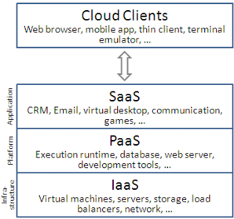
Efficient Allocation of resources in cloud environment using Green Computing
In the most basic cloud-service model—and according to the IETF (Internet Engineering Task Force)—providers of IaaS offer computers—physical or (more often) virtual machines—and other resources.
In the PaaS models, cloud providers deliver a computing platform,
typically including operating system, programming-language
execution environment, database, and web server.
Application developers can develop and run their software solutions
on a cloud platform without the cost and complexity of buying and
managing the underlying hardware and software layers.
In the SaaS model, cloud providers install and operate application
software in the cloud and cloud users access the software from cloud clients.

Slide 5
Objective
Efficient Allocation of resources in cloud environment using Green Computing
To satisfy uncertain workloads and to be highly available for users anywhere at any time, resource over-provisioning is a common situation in a cloud system.
However, most electricity-dependent facilities will inevitably suffer from idle times or low utilization for some days or months since there usually have off-seasons caused by the nature of random arrivals. In fact, servers are only busy 10-30 percent of the time on average.
Our objectives are to find the optimal service rate and mode-switching restriction, so as to minimize cost within a response time guarantee under varying arrival rates.

Slide 6
Problem Statement
Efficient Allocation of resources in cloud environment using Green Computing
As cloud computing is predicted to grow, substantial power consumption will result in not only huge operational cost but also tremendous amount of carbon dioxide (CO2) emissions.
An energy efficient control, especially in mitigating server idle power has become a critical concern in designing a modern green cloud system.
Ideally, shutting down servers when they are left idle during low-load periods is one of the most direct ways to reduce power consumption. Unfortunately, some negative effects are caused under improper system controls.

Slide 7
Literature Survey
Efficient Allocation of resources in cloud environment using Green Computing
In [11], Huang et al. studied the virtual machine placement problem with a goal of minimizing the total energy consumption. A multi-dimensional space partition model and a virtual machine placement algorithm were presented. When a new VM placement task arrived, their algorithm checked the posterior resource usage state for each feasible PM, and then chose the most suitable PM according to their proposed model to reduce the number of running PMs.
In [14], the energy efficiency from the performance perspective was studied Ye et al. presented a virtual machine based energy efficient data center architecture for cloud computing. Then they investigated the potential performance overheads caused by server consolidation and lived migration of virtual machine technology.

Slide 8
Existing System
Efficient Allocation of resources in cloud environment using Green Computing
Energy Efficient Hardware One of the approaches to reduce the power consumption at data centre and virtual machine level is usage of energy efficient hardwares at host side.
No specific algorithms are used to mitigate load among the VMs, the load is mitigated based on predefined threshold values and once the load of a particular VM reaches the threshold value, the Hypervisor creates a new VM or transfers the extra load to a VM with minimal load.
This kind of approach is very crude and if not configured properly, can actually increase the resource consumption of the server and can result in inefficient and wasteful use of resources.

Slide 9
Disadvantages of Existing System
Efficient Allocation of resources in cloud environment using Green Computing
Load balancing based on inefficient methodologies.
Tools like Hypervisors are complicated and difficult to maintain.
Miscalculation of actual load on server.
No specific and efficient algorithm in place to govern the load/resource balancing.

Slide 10
Proposed System
Efficient Allocation of resources in cloud environment using Green Computing
The proposed system uses a specifically designed algorithm called Efficient Green computing to monitor and balance the load of a cloud server.
The EGC takes into account all the aspects such as total resource, power consumption, tasks in the pipeline, current load and system overhead to efficiently predict and balance the load.
The unique aspect of the EGC is that it also takes into account the cost context to minimize the cost as far as possible during resource allocation.
The EGC optimizes the cloud server such that cloud users get smooth services while keeping the cost at a bare minimum.

Slide 11
Advantages of Proposed System
Efficient Allocation of resources in cloud environment using Green Computing
Cost is an important aspect during resource allocation.
EGC is specifically designed for cloud servers.
Accurate prediction of load thus efficient management of resources.
Dynamic operating modes to adapt to different load situations.

Slide 12
Modules Description
Efficient Allocation of resources in cloud environment using Green Computing
Overload avoidance
The capacity of a PM should be sufficient to satisfy the resource needs of all VMs running on it. Otherwise, the PM is overloaded and can lead to degraded performance of its VMs. We introduce the concept of “skewness” to measure the uneven utilization of a server. By minimizing skewness, we can improve the overall utilization of servers in the face of multi-dimensional resource constraints. To perform skewness algorithm we should need server status spot. Types of server status spot:
Hot spot-: We define a server as a hot spot if the utilization of any of its resources is above a hot threshold. This indicates that the server is overloaded and hence some VMs running on it should be migrated away.
Cold spot-: We define a server as a cold spot if the utilizations of all its resources are below a cold threshold. This indicates that the server is mostly idle and a potential candidate to turn off to save energy.
Warm spot-: We define a server as a warm spot if the utilizations of all its resources are below a hot threshold and above cold threshold. This indicates that the server is ready to run VMs.

Slide 13
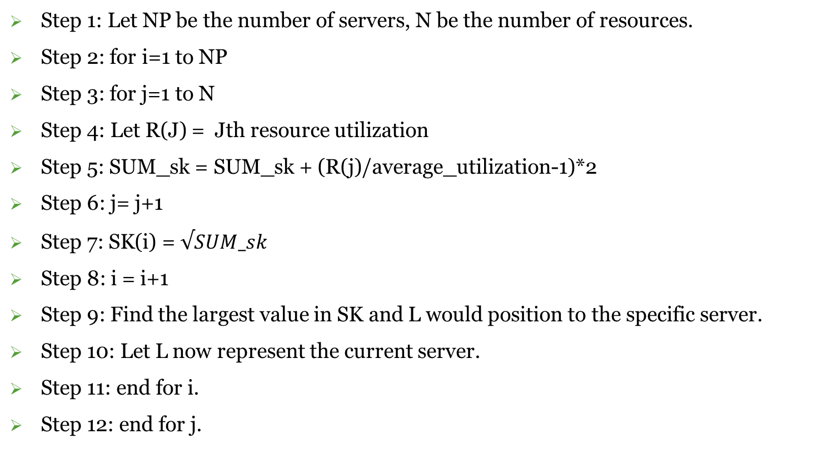
Skewness Algorithm(S)
Efficient Allocation of resources in cloud environment using Green Computing
Step 1: Let NP be the number of servers, N be the number of resources.
Step 2: for i=1 to NP
Step 3: for j=1 to N
Step 4: Let R(J) = Jth resource utilization
Step 5: SUM_sk = SUM_sk + (R(j)/average_utilization-1)*2
Step 6: j= j+1
Step 7: SK(i) = $√SUM_sk$
Step 8: i = i+1
Step 9: Find the largest value in SK and L would position to the specific server.
Step 10: Let L now represent the current server.
Step 11: end for i.
Step 12: end for j.

Slide 14
Overload Avoidance
Efficient Allocation of resources in cloud environment using Green Computing
Step 1: Input: Let C represent the computer usage and M be the memory usage, threshold denoted by Ω.
Step 2: The threshold values is calculated using the skewness algorithm S.
Step 3: Server accepts the input from the client C,M.
Step 4: Server checks the Total load T(C,M).
Step 5: if T>Ω then migrate request to the next server
else
Step 6: The request is handled by the current server.

Slide 15
Load Prediction Management
Efficient Allocation of resources in cloud environment using Green Computing
We need to predict the future resource needs of applications. As said earlier, our focus is on Internet applications. One solution is to look inside a server for application level statistics, e.g., by parsing logs of pending requests. Doing so requires modification of the server which may not always be possible. Instead, we make our prediction based on the past external behaviors of server. In this project, the exponentially weighted moving average prediction algorithm plays an important role in improving the stability and performance of our resource allocation decisions. Based on Physical machines (PMs) Usage we will select server using algorithm.

Slide 16
Prediction Algorithm
Efficient Allocation of resources in cloud environment using Green Computing
Step 1: Let N denotes the No of virtual machines.
Step 2: Let E(N) in a array containing estimated value of a VM in Time T.
Step 3: Let O(t) in a array containing observed load if all VM in Time(T).
Step 4: Let NE(t) in a array reserved for estimated values of all VM in time T+1
Step 5: So by taking a=0.7
Step 6: for i=1 to N
Step 7: NE(i) = a*E(i) + (1-a) * O(i)
Step 8: i = i+1
Step 9: end for i.

Slide 17
Green computing
Efficient Allocation of resources in cloud environment using Green Computing
The number of PMs used should be minimized as long as they can still satisfy the needs of all VMs. Idle PMs can be turned off to save energy. When the server becomes cold spot, we there are no further more connections to that server and we will turn off the server. This will be done by using Green computing.

Slide 18
Algorithm for Server shutdown
Efficient Allocation of resources in cloud environment using Green Computing
Step 1: Green computing algorithm calculates the Total Load T.
Step 2: When the total load reaches the min(Ω),here Ω denotes the threshold.
Step 3: The server would migrate back in return switching the mode to idle.
Step 4: If the load on the current server drops way below the threshold Ω.
Step 5: Switch to sleep mode.

Slide 19
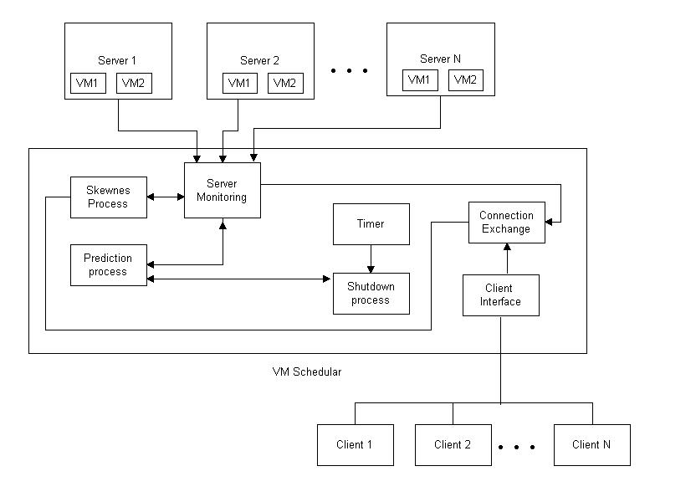
System Architecture
Efficient Allocation of resources in cloud environment using Green Computing

Slide 20
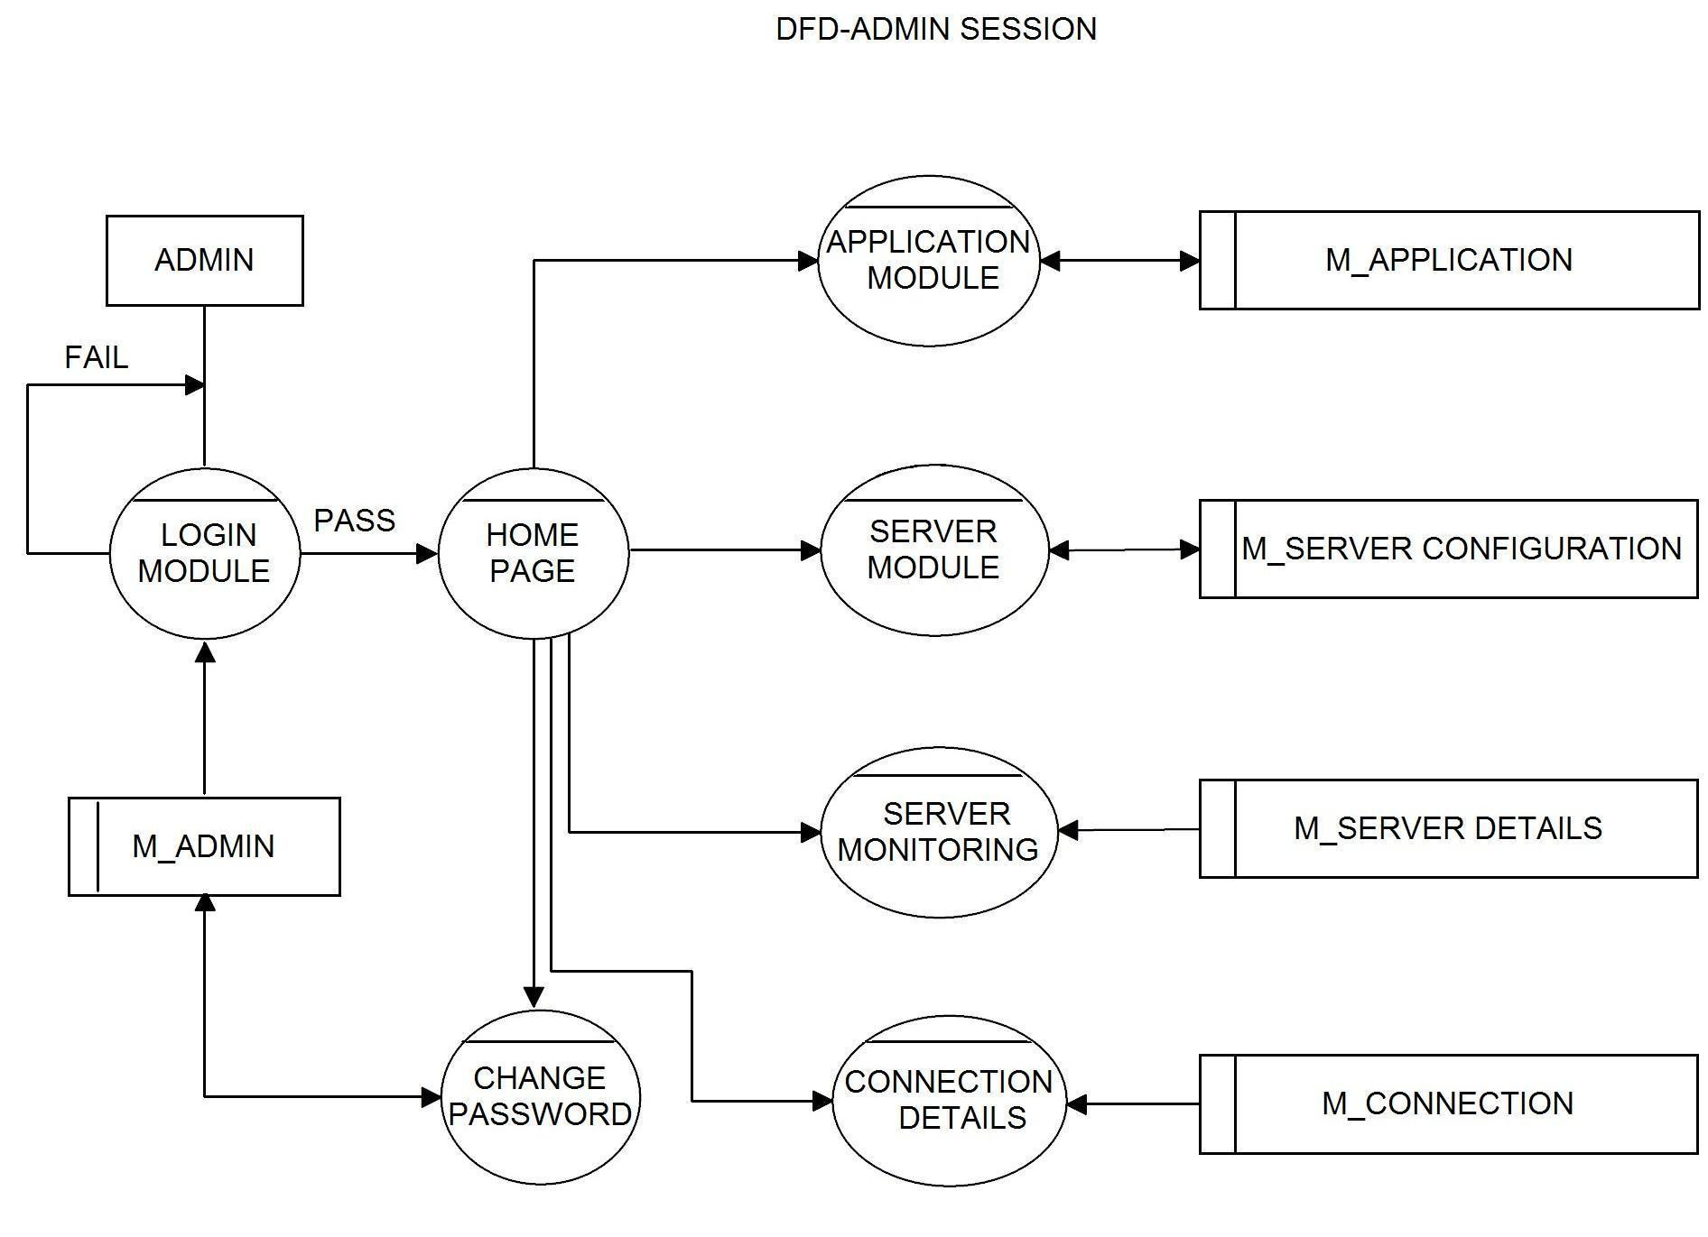
Dataflow diagram
Efficient Allocation of resources in cloud environment using Green Computing

Slide 21
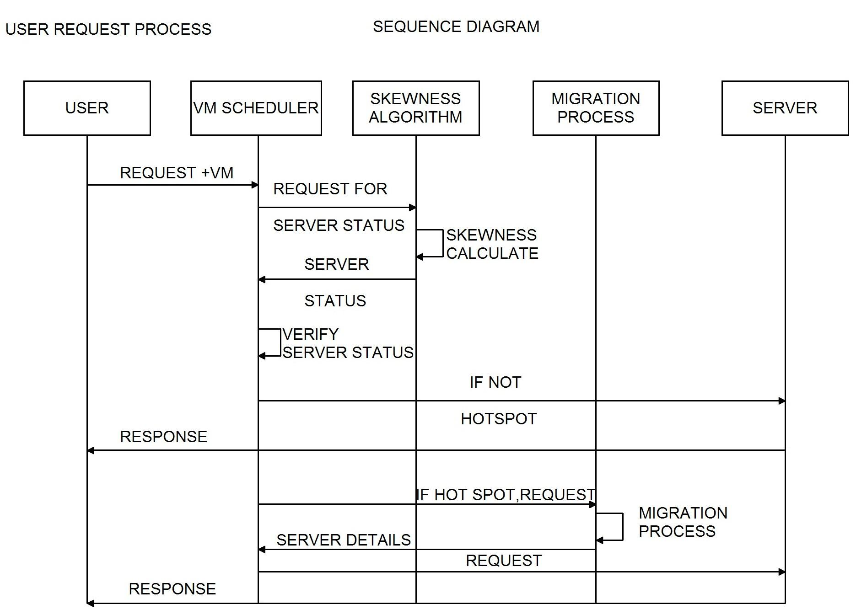
Sequence diagram
Efficient Allocation of resources in cloud environment using Green Computing

Slide 22
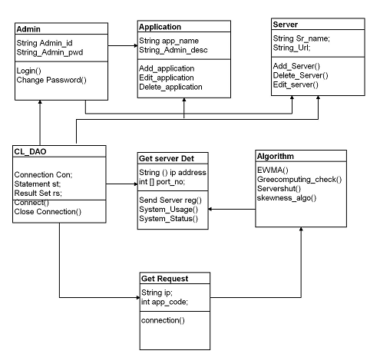
Class Diagram
Efficient Allocation of resources in cloud environment using Green Computing

Slide 23
TEST CASES
Efficient Allocation of resources in cloud environment using Green Computing
Test Case | Expected Result | Actual Result | Final Result | Status
Job Input | The system must be able to ingest the processes. | The system is able to evaluate the incoming tasks. | The system is behaving as expected. | Success
Job Scheduling | The system must evaluate the incoming tasks and prioritize them depending on the load | The System is evaluating the tasks and is prioritizing them according to the load | The system is behaving as expected | Success
Resource Evaluation | The system must evaluate the tasks from the queue and must determine the resources required to carry out the tasks | The system is able to evaluate the resources required by the tasks from the queue by keeping in sync with response time and load. | The system is behaving as expected | Success

Slide 24
Overload avoidance | The capacity of a PM should be sufficient to satisfy the resource needs of all VMs running on it. Otherwise, the PM is overloaded and can lead to degraded performance | There is no overload. | The system is behaving as expected | Success
Migration | This algorithm must be able to allocate the tasks to servers such that the cost, efficiency and performance parameters of the system must be maintained at optimum level | The algorithm is able to successfully assign the tasks to appropriate servers by minimizing the costs and increasing the efficiency of the overall system | The system is behaving as expected | Success
Green computing | The system must successfully change the server state based on the current resource consumption and the required computing of tasks | The system is successfully switching the server state between Sleep/Idle/Busy (cold/warm/hot) depending on the load of the current tasks | The system is behaving as expected | Success

Slide 25
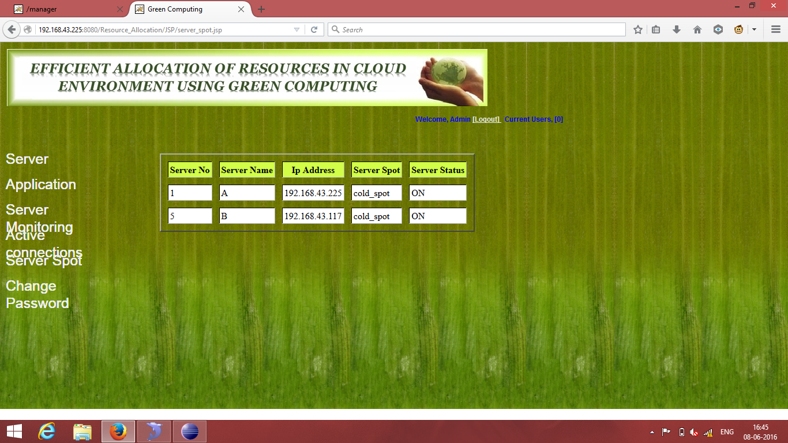
Results
Efficient Allocation of resources in cloud environment using Green Computing
Shows The active servers

Slide 26
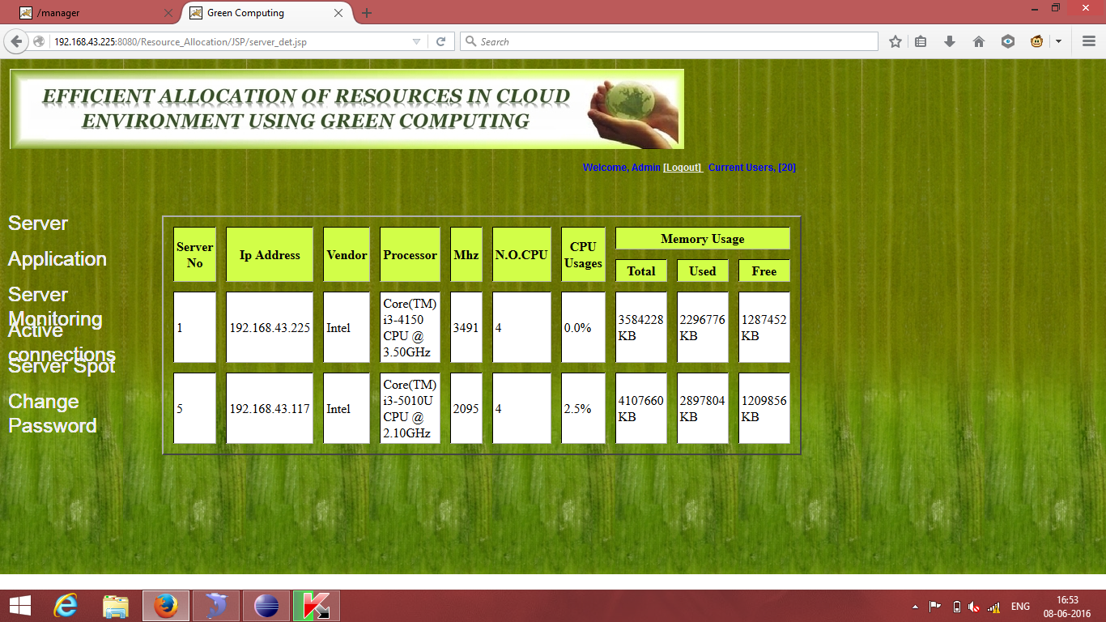
Efficient Allocation of resources in cloud environment using Green Computing
Applications that run on servers

Slide 27
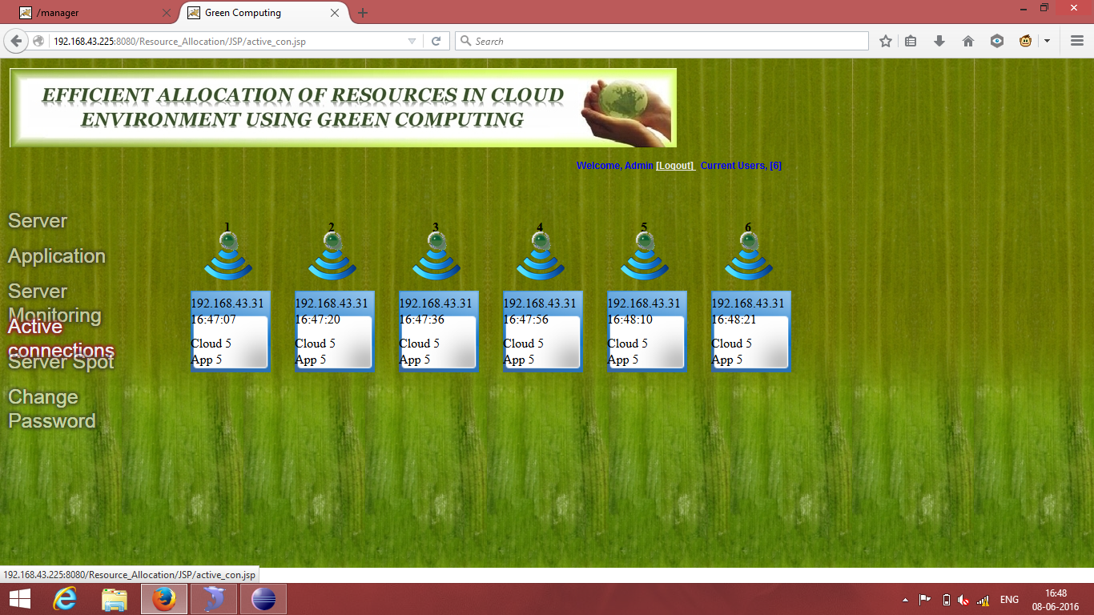
Efficient Allocation of resources in cloud environment using Green Computing
Number of connections to each server

Slide 28

Efficient Allocation of resources in cloud environment using Green Computing
Server migration from Cold spot to Hot spot

Slide 29
Efficient Allocation of resources in cloud environment using Green Computing
Server monitoring

Slide 30

Efficient Allocation of resources in cloud environment using Green Computing
Server sleeps when there is no load

Slide 31
CONCLUSION
Efficient Allocation of resources in cloud environment using Green Computing
Over the past decade, green computing has proven itself to be the most concerning issue for the businesses and governments around the globe as computing becomes increasingly pervasive.
A Green Cloud System responds to peak utilization periods and adjusts availability of resources based on them expanding or shrinking the cloud as needed. The aim of this project is to study the challenges and various issues in field of Green Computing and discusses the future scope of Green Clouds.
We have presented the design, implementation, and evaluation of a resource management system for cloud computing services. Our system multiplexes virtual to physical resources adaptively based on the changing demand. We use the skewness metric to combine VMs with different resource characteristics appropriately so that the capacities of servers are well utilized. Our algorithm achieves both overload avoidance and green computing for systems with multi-resource constraints.

Slide 32
FUTURE ENHANCEMENTS
Efficient Allocation of resources in cloud environment using Green Computing
the prevalence of Cloud computing continues to rise, the need for power saving mechanisms within the Cloud also increases
Future opportunities could explore a scheduling system that is both power-aware and thermal-aware to maximize energy savings both from physical servers and the cooling systems used.
Such a scheduler would also drive the need for better data center designs, both in server placements within racks and closed-loop cooling systems integrated into each rack.

Slide 33
REFERENCES
Efficient Allocation of resources in cloud environment using Green Computing
Cloud Computing: Concepts, Technology & Architecture (The Prentice Hall Service Technology Series from Thomas Erl) Hardcover – Import, 10 May 2013
Y. C. Lee and A. Y. Zomaya, “Energy efficient utilization of resources in cloud computing systems,” J. Supercomputers., vol. 60, no. 2, pp. 268–280, 2012.
R. N. Calheiros, R. Ranjan, and R. Buyya, “Virtual machine provisioning based on analytical performance and QoS in cloud computing environments,” in Proc. Int. Conf. Parallel Process., 2011, pp. 295–304.
Architecting the Cloud: Design Decisions for Cloud Computing Service Models (SaaS, PaaS, and IaaS) 1st Edition by Michael J Kavis (Author)

Slide 34
THANK YOU.

