Slide 1

Online course Recommendation Model Analysis
Subtitle: k-Nearest Neighbors (k-NN) Classification Model Analysis
Presented by: Bindhushree Ragula

Slide 2
Project Overview
Dataset Features:
University
Course Name
Difficulty Level
Rating
Course URL
Course Description
Skills
Goal
Predict course difficulty into categories: Excellent, Good, Below Average, Average.

Slide 3

Model Workflow (Pipeline)
1
Data Retrieval: Fetch Coursera and complete dataset
2
Data Preprocessing:
Generate unique IDs.
Handle missing values.
Select relevant features.
Convert categorical data into numerical form
3
Data Storage: Store processed data.

Slide 4
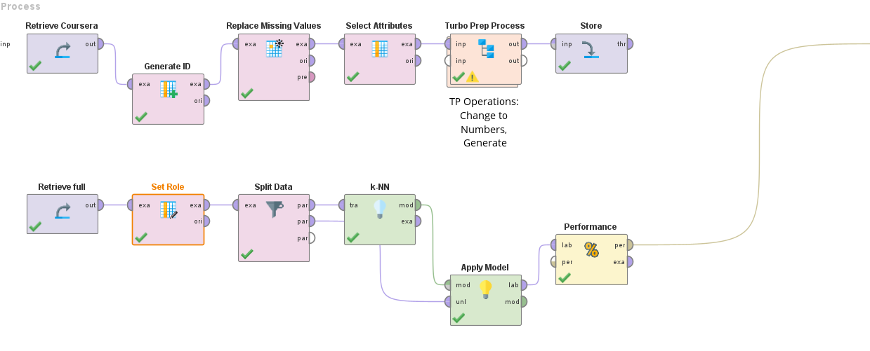
4
Data Splitting: Divide into training and testing sets.
5
Model Training: Apply k-Nearest Neighbors (k-NN).
6
Performance Evaluation: Measure accuracy, precision, and recall.

Slide 5
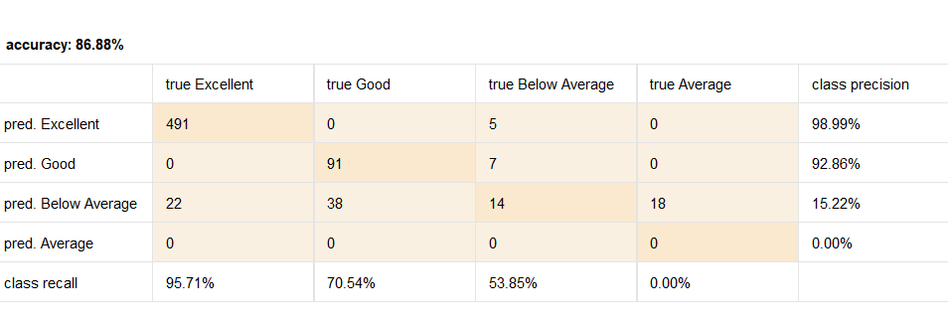
Model Performance Metrics
Overall Accuracy: 🌟 86.88%
Class-wise Results:
Excellent: Precision: 98.99% | Recall: 95.71%
Good: Precision: 92.86% | Recall: 70.54%
Below Average: Precision: 15.22% | Recall: 53.85%
Average: Precision & Recall: 0%

Slide 6
Key Observations
✅ High accuracy for "Excellent" and "Good" predictions.
⚠️ Poor performance for "Below Average" and "Average" categories.
🚩Possible class imbalance in the dataset.
Need for better distinction among mid-tier classes.
1
2
3

Slide 7




Recommendations for Improvement
🔄 Handle Class Imbalance: Use techniques like SMOTE or undersampling.
🎛️ Hyperparameter Tuning: Experiment with different k values in k-NN.
🏗️ Feature Engineering: Create additional relevant features.

Slide 8

Conclusion
The k-NN model achieved 86.88% accuracy, performing best for top-rated courses.
Next Steps: Improve predictions for lower-tier difficulty levels by addressing class imbalance and exploring advanced algorithms.
Outcome: A robust recommendation system aiding learners in selecting suitable online courses.

