Slide 1
Breast Cancer Risk Prediction

Slide 2
Agenda
This project focuses on understanding how long breast cancer patients survive and predicting their chances of living over the next 10 years
Analyze Survival Trends:
Apply advanced statistical techniques and machine learning to understand breast cancer survival rates and predict 10-year mortality risk.
Enhance Patient Care:
Use insights from the analysis to optimize treatment plans and provide precise prognosis information, leading to more personalized patient care.

Slide 3
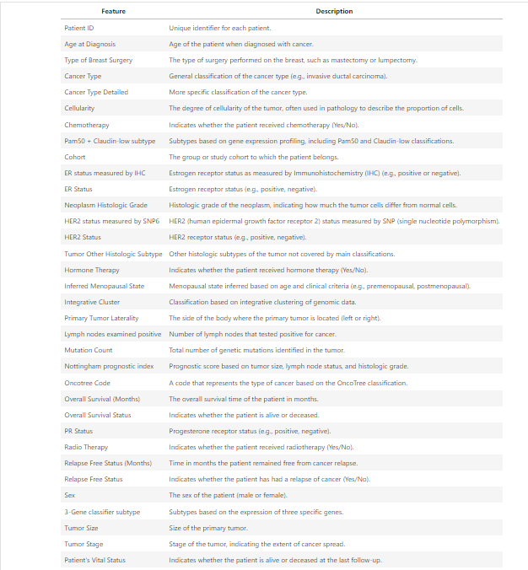
Data Cleaning & Pre-processing
Dataset dimension: Number of Records: 2,012 (rows)
Number of Features: 34 (columns)
1. Drop irrelevant columns:
Patient ID and Sex columns were removed.
2. Removed duplicates:
One identified duplicates were removed, keeping only the first occurrence of each record.

Slide 4


3. Handling the Missing Data:
Dropping Rows :
Imputation :
Rows with missing values in critical columns (Relapse Free Status, ER status measured by IHC, ER Status, Age at Diagnosis, Cohort) were dropped since these accounted for less than 4% of the dataset.
This ensures that we maintain data integrity while losing only a small fraction of the dataset.
Numerical Features:
For columns with more than 4% missing values, I used median imputation. The median is robust to outliers and provides a reasonable central value for replacement.
Categorical Features:
For categorical features, I filled missing values with the mode (most frequent value) to retain the most common category, which helps in preserving the distribution of the data.

Slide 5
4. Handling Outliers:
Outlier handling is crucial for enhancing model performance.
By comparing the logarithmic transformation and capping, I was able to identify the most effective approach for this dataset, leading to more accurate and reliable predictions.
Exploratory Data Analysis (EDA)
Understand the data through visualizations and summary statistics to gain insights and identify patterns.​
Change the Data-type:
Converting relevant variables to categorical types is a critical step to ensure the accuracy and efficiency of the EDA process, leading to better insights and model performance.
Here we changed : Tumor Stage & Neoplasm Histologic Grade

Slide 6
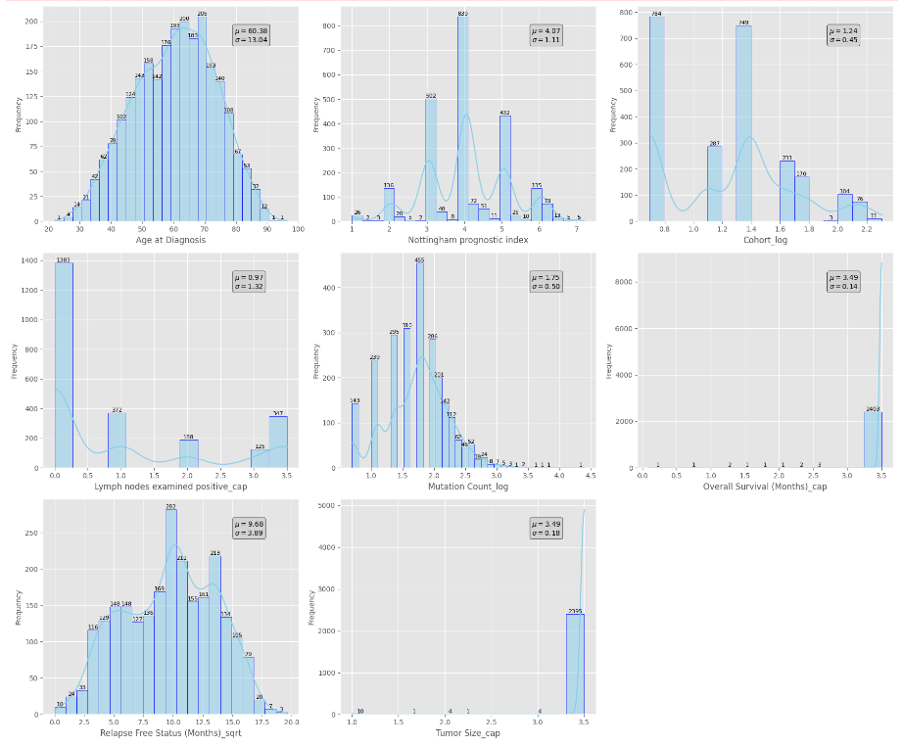
Univariate Analysis(numerical) :
Age at Diagnosis: Most diagnoses occur between 50-70 years, typical for middle-aged and older women.
Nottingham Prognostic Index (NPI): Shows variability with values around the mean, indicating diverse prognosis.
Overall Survival (Months): Peaks at shorter times, reflecting a wide range of survival outcomes.
Relapse Free Status (Months): Right-skewed with some patients relapse-free for extended periods.
Cohort: Concentrated around the mean, indicating data from a specific patient group.
Lymph Nodes Examined Positive: Mostly few or no positive nodes, suggesting limited spread.
Mutation Count (log): Right-skewed with moderate to high counts indicating potential aggressiveness.
Tumor Size (log): Mostly normal distribution, reflecting typical tumor size variation.

Slide 7
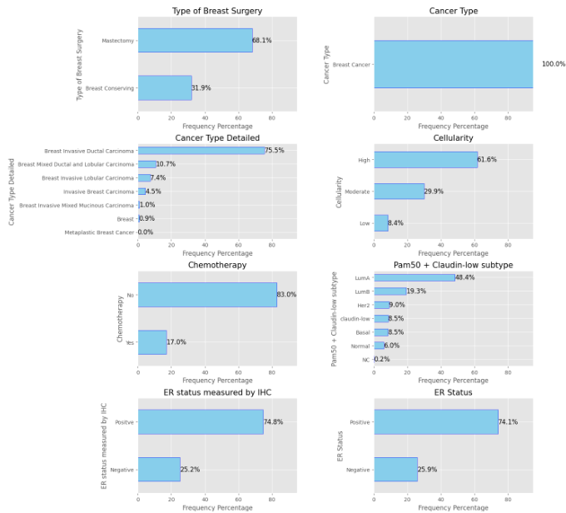
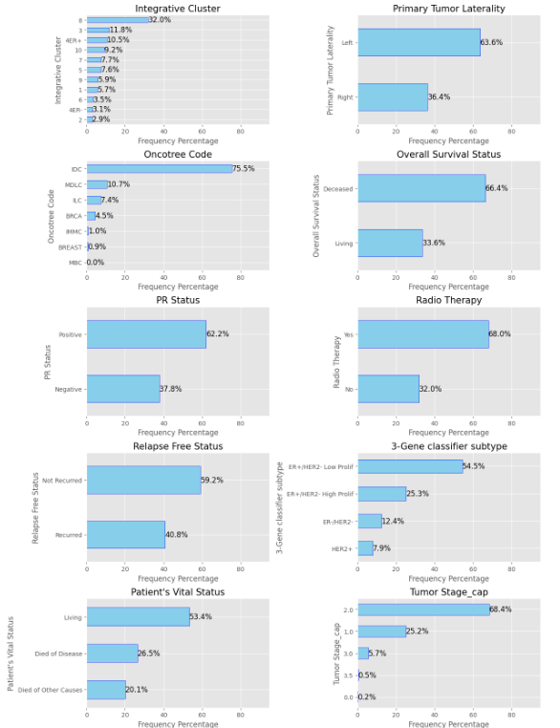
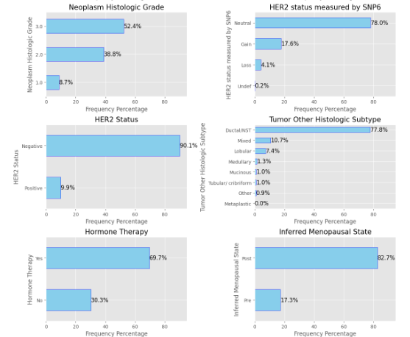
Univariate Analysis(categorical) :
The charts provide insights into various factors affecting breast cancer patients: types of breast surgery, cancer types, and molecular subtypes (integrative clusters, 3-gene classifiers).
They reveal the distribution of tumor laterality, treatment patterns (chemotherapy, radiotherapy), and biomarker statuses (ER, PR, HER2).
Information on histologic grade, tumor stage, survival status, and relapse rates offers a comprehensive view of disease progression and treatment outcomes.
The oncotype code distribution may help assess recurrence risk and inform treatment strategies.

Slide 8
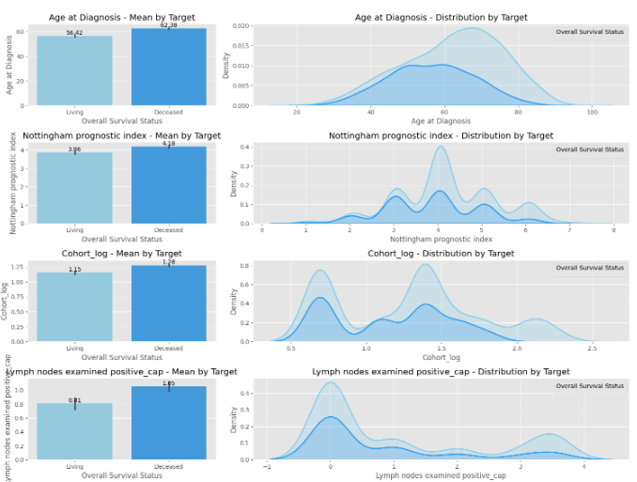
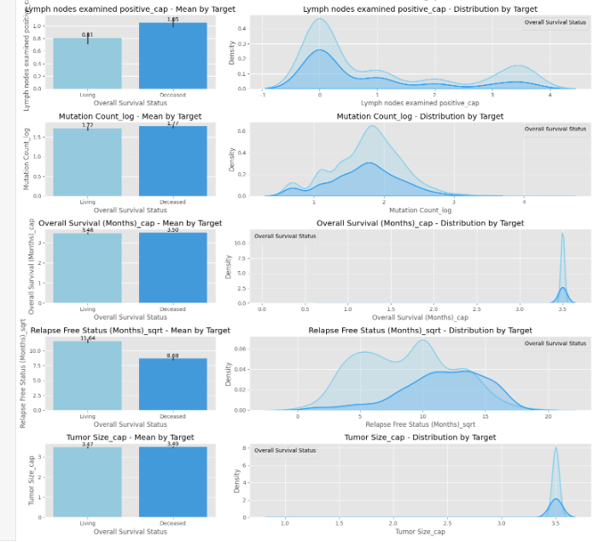
Bivariate Analysis (Numerical vs Target):
Age at Diagnosis:
Younger patients (around 50) have a higher survival rate, with living patients generally diagnosed at a younger age than deceased patients.
Nottingham Prognostic Index (NPI):
Deceased patients tend to have a slightly higher NPI, indicating worse prognostic factors and survival outcomes.
Cohort (log scale):
Lower cohort scores are associated with better survival, while deceased patients show higher cohort log scores, suggesting worse outcomes.
Lymph Nodes Examined Positive (cap):
A higher number of positive lymph nodes is linked to poorer survival, with deceased patients showing more positive lymph nodes.
Mutation Count (log scale):
No significant difference in mutation counts between living and deceased patients, indicating it may not strongly impact survival.
Overall Survival (Months):
Living patients tend to have slightly higher overall survival times, with deceased patients showing a broader range of survival months.
Relapse-Free Status (Months) (sqrt scale):
Longer relapse-free periods are associated with survival, with living patients showing a slight skew towards higher relapse-free months.
Tumor Size (cap):
Larger tumor sizes are correlated with poorer survival, with deceased patients having larger tumors on average.

Slide 9
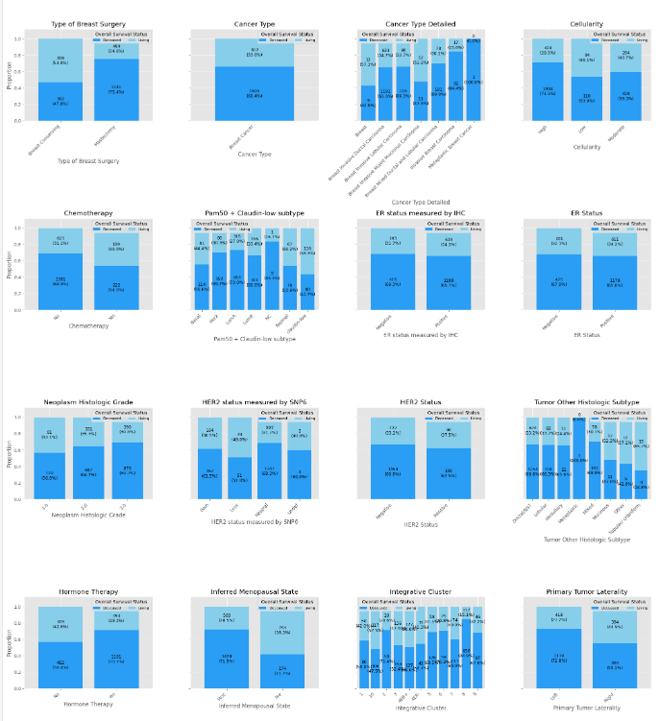
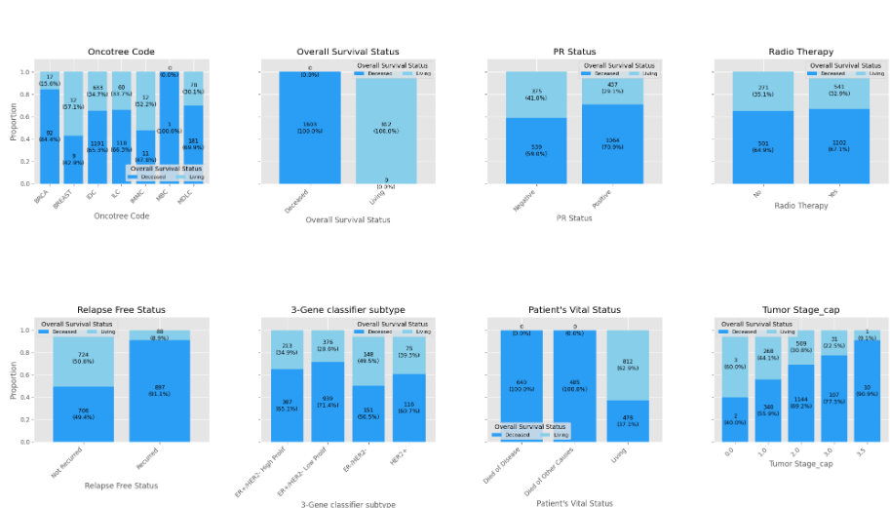
Bivariate Analysis(Categorical Vs Target) :
Breast Surgery, Cancer Type & Subtypes, Cellularity:
Survival status shows no significant variation based on the type of breast surgery, general cancer type, or cellularity. While detailed cancer subtypes show some differences, they are not substantial enough to be decisive survival predictors.
Treatment Factors (Chemotherapy, Hormone Therapy, Radiotherapy):
Deceased patients had a higher incidence of undergoing chemotherapy and radiotherapy, suggesting these treatments are more common in advanced or aggressive cancers. Hormone therapy usage was consistent across groups, indicating its widespread use regardless of survival status.
Molecular Subtypes (PAM50 + Claudin-low, ER Status, HER2 Status, PR Status):
ER-positive and PR-positive statuses are linked to better survival outcomes, while HER2-positive status is more common among deceased patients. Molecular subtypes, such as those in PAM50, reveal varied survival outcomes, highlighting the importance of genetic profiling.
Tumor Characteristics (Neoplasm Histologic Grade, Tumor Stage):
Higher histologic grades and advanced tumor stages are strongly associated with poorer survival outcomes, suggesting that these factors are critical in prognosis.
Other Clinical Factors (Inferred Menopausal Status, Tumor Laterality, Integrative Cluster, Oncotree Code):
Menopausal status and tumor laterality do not significantly affect survival outcomes. However, certain integrative clusters and Oncotree codes show variability in survival, indicating the relevance of genetic and molecular profiling in prognosis.
Overall Survival & Relapse-Free Status:
Longer relapse-free periods and early tumor stages correlate with better survival outcomes. The overall survival status aligns with these findings, reinforcing the identified trends.

Slide 10
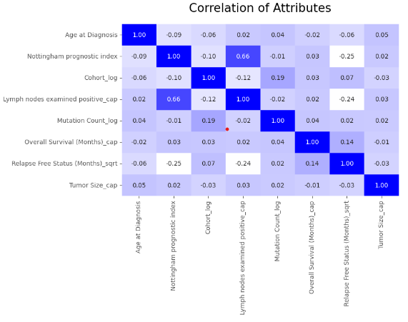
Heatmap of Correlations :
Nottingham Prognostic Index and Lymph Nodes Examined Positive have the highest correlation, indicating their combined significance in prognosis.
Overall Survival is moderately correlated with Relapse-Free Status, suggesting these are related but not directly proportional.
Tumor Size show weak correlations with other attributes, implying these may act independently in determining patient outcomes.

Slide 11
Split the dependent and independent variable:
The target variable would be Patient’s Vital Status.
We will be dropping the ‘Overall Survival Status’ as to remove the data leakage.
Dummy Encode & Scale the data:
Make dummy data frame for categorical columns. Scale the numerical features.
Train-Test Split:
We divided the data into training (80%) and testing (20%) sets.
We divided the dataset into two parts: X and y.
"X" typically represents the independent Variables, and "y" represents the Dependent (target variable) that we want to predict or understand.

Slide 12
Machine Learning Models
Created a ‘Classic Model function to train, evaluate and visualize the performance of a machine learning model using stratified 5-fold cross-validation to ensure robust performance metrics.
It starts by scaling the feature data and encoding the target variable to ensure consistent model performance. The model is then trained on the scaled training data and predictions are made on the test data.
Cross-validation scores are computed to assess the model's performance across different data folds, and the ROC-AUC score measures the model’s ability to distinguish between classes.
Additionally, a confusion matrix and ROC curve are plotted to visualize the model's performance.
Finally, a classification report provides detailed metrics such as precision, recall, and f1-score for each class.
Models Applied:
SVM, Logistic Regression, Random Forest, DecisionTree, XGBOOST

Slide 13
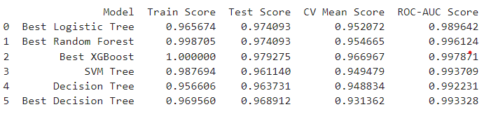
Model Performance Comparison
Best XGBoost achieved the highest Test Score (0.979) and ROC-AUC Score (0.998), indicating excellent performance in both accuracy and class separation.
Best Random Forest and Best XGBoost show the highest Train Scores, suggesting strong model fit on training data.
Conclusion:
XGBoost stands out with the best balance of high accuracy and ROC-AUC Score, making it the most effective model for predicting breast cancer survival in this analysis.

Slide 14
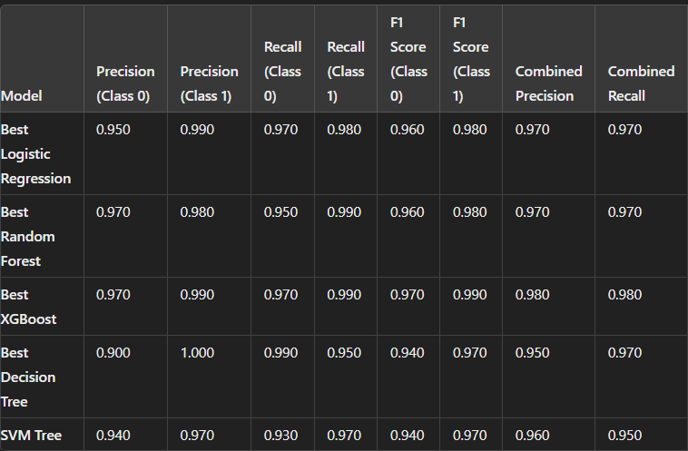
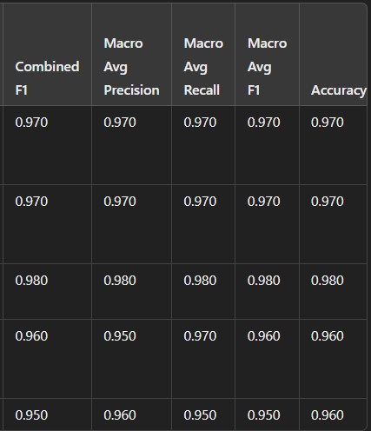
Results and Insights:

Slide 15
Best XGBoost:
Overall Best Performance with the highest Combined Precision (0.980), Combined Recall (0.980), and Accuracy (0.980).
Balanced Performance across all metrics, including high precision, recall, and F1 score for both classes.
Best Random Forest:
Strong Performance with high scores across all metrics, similar to XGBoost but slightly lower in macro averages.
Best Logistic Regression:
Consistently High Metrics with slightly lower combined F1 score compared to XGBoost and Random Forest.
Conclusion:
Best XGBoost is recommended due to its superior overall performance, with the highest accuracy, combined F1 score, and balanced precision and recall across both classes. It provides the best trade-off between sensitivity and specificity, making it the most robust choice for this dataset.

Slide 16
Limitation:
Data Quality and Size: The project relies on a single dataset, which may limit generalizability and may not account for diverse patient populations or rare cases.
Feature Limitations: The analysis is constrained by the available features, potentially missing critical factors such as genetic or environmental influences.
Model Interpretability: Complex models like XGBoost may offer high performance but can be challenging to interpret, making it difficult to understand the underlying decision-making process.
Future Work:
Model Enhancement: Further refine models by optimizing hyperparameters and exploring ensemble methods to improve prediction accuracy and robustness.
Feature Expansion: Incorporate additional features and perform advanced feature selection to enhance model performance and insights.
Clinical Integration: Validate model predictions in real-world clinical settings and collaborate with healthcare professionals for practical feedback and integration.

Slide 17

Questions ?

Slide 18
Thank You!

