Slide 1

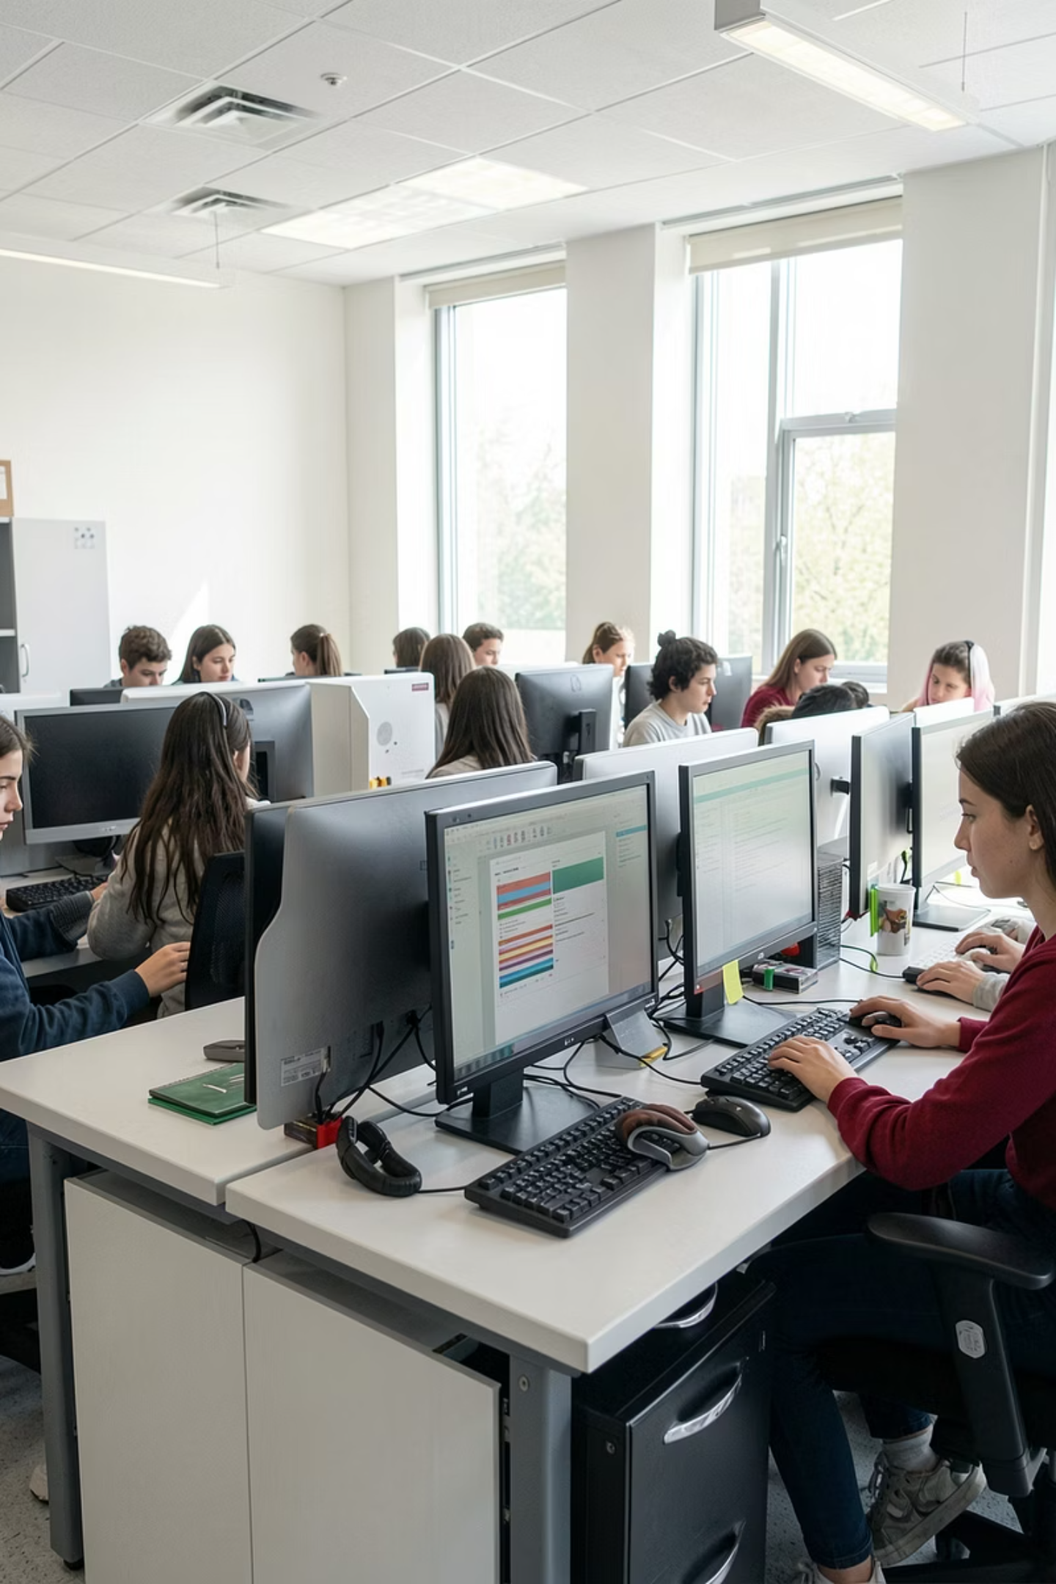
Kolhapur Institute of Technology, Kolhapur
Department of Computer Science & Engineering (AIML)
The Ghost Of Lab
A modular hybrid suite for LAN-based classroom management and monitoring
Team : Shubham Patil A48,
Shreeraj Gudade A73,
Anjali Wale A74,
Shreya Thorat A77
UNDER GUIDANCE OF:
Mrs. Sapna Buwa.
Date: 19th May 2026

Slide 2
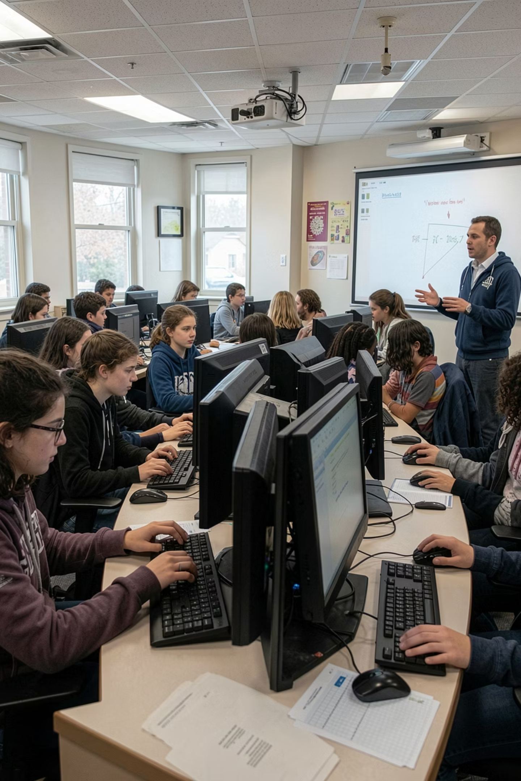
Introduction & Problem Statement
The Vision
Dual-state application providing instant instructor control and broadcasting over LAN without external internet
Current Challenges
High latency in screen broadcasting
Complex setup with Maven dependencies
No silent OS-level command execution
Key Challenges
Maintaining low-latency screen broadcasting, preventing software bypass, managing persistent student data

Slide 3

Core Objectives
1
2
3
Dual-State Launcher
Persistent User System
Real-Time Broadcasting
Instant Admin/Student role assignment with modular architecture.
Student registration and attendance tracking with local data persistence.
High frame-rate screen transmission over standard LAN.
4
5
High-Fidelity GUI
Global Command Console
JavaFX-powered interface with customisable themes and responsive design.
Execute remote Python scripts across all student machines simultaneously.

Slide 4

Literature Review
Existing tools fall short in key areas — Ghost of Lab fills all these gaps.
Tool
Strengths
Limitations
NetSupport School
Rich classroom management, real-time screen viewing
Heavy and costly for single-lab deployment
LANSchool
View all student computers, lock screens
No stealthy agents or custom Python integration
General SaaS Tools
Wide scope monitoring
No SQLite, UDP discovery, or OS-level control
Ghost of Lab addresses all gaps: portable, offline, Python-powered, and LAN-native.

Slide 5
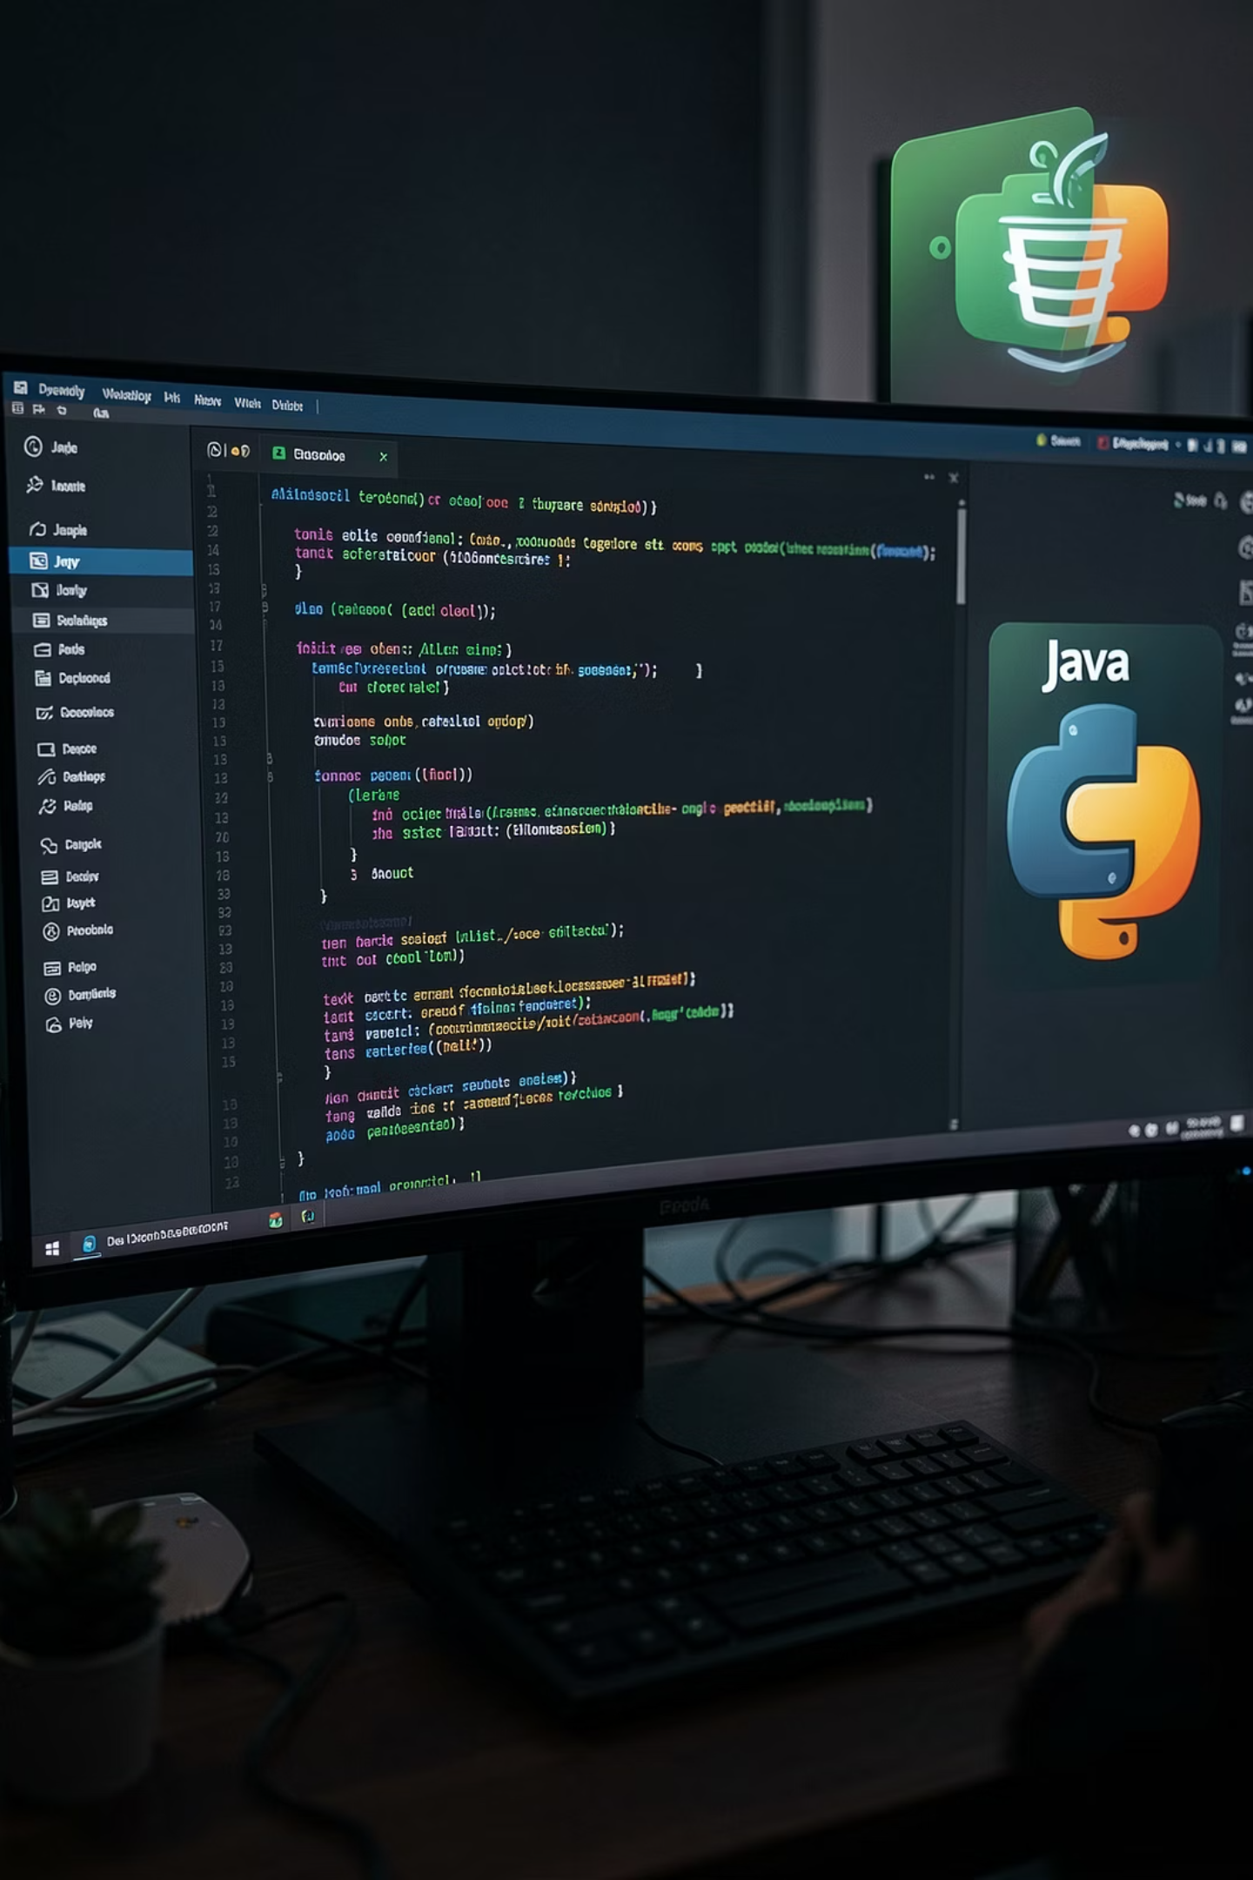
Technology Stack
Core Technologies
Infrastructure
Java 17+ — Core logic and socket programming
Python 3.x — System-level automation
JavaFX — Rich GUI framework
TCP/IP Sockets — Data transmission
UDP — Network discovery
SQLite — Lightweight local database
CSS — Custom theming

Slide 6
System Architecture
ADMIN DASHBOARD
STUDENT AGENTS (×N)
• JavaFX GUI + thumbnail grid
• TCP server socket
• SQLite (users, sessions, logs)
• File distribution, command console
• Background Java client
• Screen capture via java.awt.Robot
• Python ghost-task scripts
• Receives files and commands
▼
▼
LAN COMMUNICATION LAYER
TCP sockets — screen data, commands, file transfer · UDP broadcast — student discovery & registration
SQLite DB lives on Admin side — no external server needed
Notes:
Let me walk you through the system architecture. At the top-left, we have the Admin Dashboard — this is what the teacher sees. It is a JavaFX application that opens a TCP server socket to accept incoming connections from student PCs. It displays a live thumbnail grid, handles file distribution, runs the command console, and persists all data in a local SQLite database on the admin machine. On the right, we have the Student Agents — a Java client running on each lab PC. When a student logs in or connects, the agent captures the screen using java.awt.Robot, compresses it, and streams it over TCP to the Admin. The agent also receives commands and files from the server, and can execute Python ghost-task scripts for safe local operations like logging and file handling. In the middle, the LAN Communication Layer connects everything. TCP sockets carry reliable streams for screen data, commands, and file transfer. UDP broadcasts allow the admin to discover which student PCs are online, without any manual IP entry. Importantly, the SQLite database lives entirely on the admin machine. There is no external server, no cloud, no internet.

Slide 7
Feature Comparison
Feature
Existing Systems
Ghost Of Lab
Deployment
Complex installers required
Portable modular Java files
Customisation
Static, hard-to-change UIs
Dynamic JavaFX themes
Control
Standard remote desktop
Python-powered Ghost commands
Offline Usage
Often needs cloud/internet
100% offline LAN operation

Slide 8
Limitations & Challenges
Network Dependency
OS Constraints
Hardware Requirements
Operates exclusively on LAN; performance degrades on highly congested Wi-Fi environments.
Python ghost commands may require administrative privileges on student machines for full functionality.
Real-time broadcasting and thumbnail generation demand moderate CPU usage on both Admin and Student PCs.

Slide 9
Implementation Details
Java-Python Bridge
1
Java handles UI and network stability; Python action.py scripts execute ghost tasks like file creation and system monitoring.
Broadcasting Logic
2
java.awt.Robot captures screens, compresses into byte arrays for rapid LAN transmission.
UI/UX Implementation
3
Smooth transitions and custom toggle buttons in JavaFX with responsive design.
UserData Persistence
4
Registration module stores student details locally for persistent login across lab sessions.

Slide 10


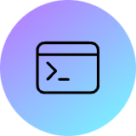
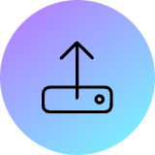


Key Features
Modular Engine
Admin Dashboard
Decoupled networking and UI for easy scaling.
Live thumbnail grid of all connected student screens.
Global Console
File Distribution
Broadcast commands to all or specific machines.
Instant file pushing from Admin PC to student desktops.
LAN Social Hub
AI Integration
Secure peer-to-peer and group chat for collaboration.
Students access AI with an admin-controlled system prompt.

Slide 11
Conclusion
"The Ghost Of Lab" successfully integrates Java's stability with Python's flexibility, delivering a robust classroom management solution.
We built Ghost Of Lab because we are the students who sit in those labs. We saw the problem from the inside. And we decided that if nobody else was going to solve it — we would.
Modular Design
High-Impact Features
Educational Value
Scalable architecture enables future enhancements
Thumbnail dashboard and live stream viewer
Comprehensive solution for modern teaching environments

