Slide 1
PROBLEM STATEMENT :
Design and Implementation of 4×4 Vedic Multiplier

Slide 2
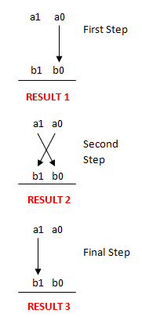
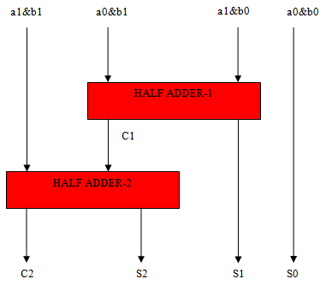
2 x 2 vedic multiplier
2x2 Multiplication Flow
Logic Diagram of 2x2 Vedic Multiplier

Slide 3
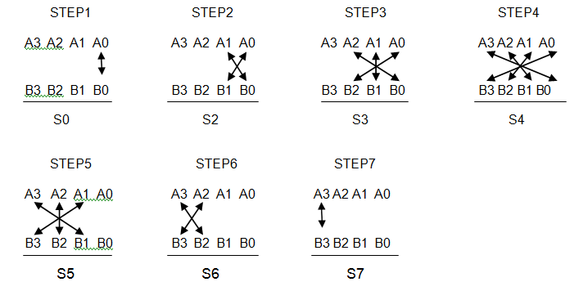
ALGORITHM
Step1: S0 = A0*B0
Step2: S1 = A1*B0+A0*B1
Step3: S2 = A2*B0+A0*B2+A1*B1
Step4: S3 = A3*B0+A0*B3+A2*B1+A1*B2
Step5: S4 = A3*B1+A1*B3+A2*B2
Step6: S5 = A3*B2+A2*B3
Step7: S6 = A3*B
Step8: S7= S0S1S2S3S4S5S6

Slide 4
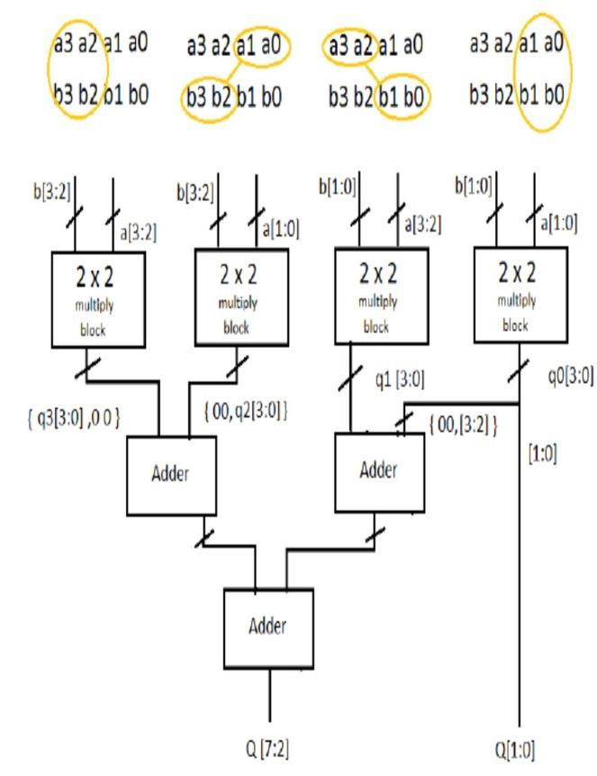
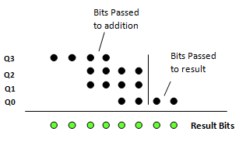
ARCHITECTURE

Slide 5
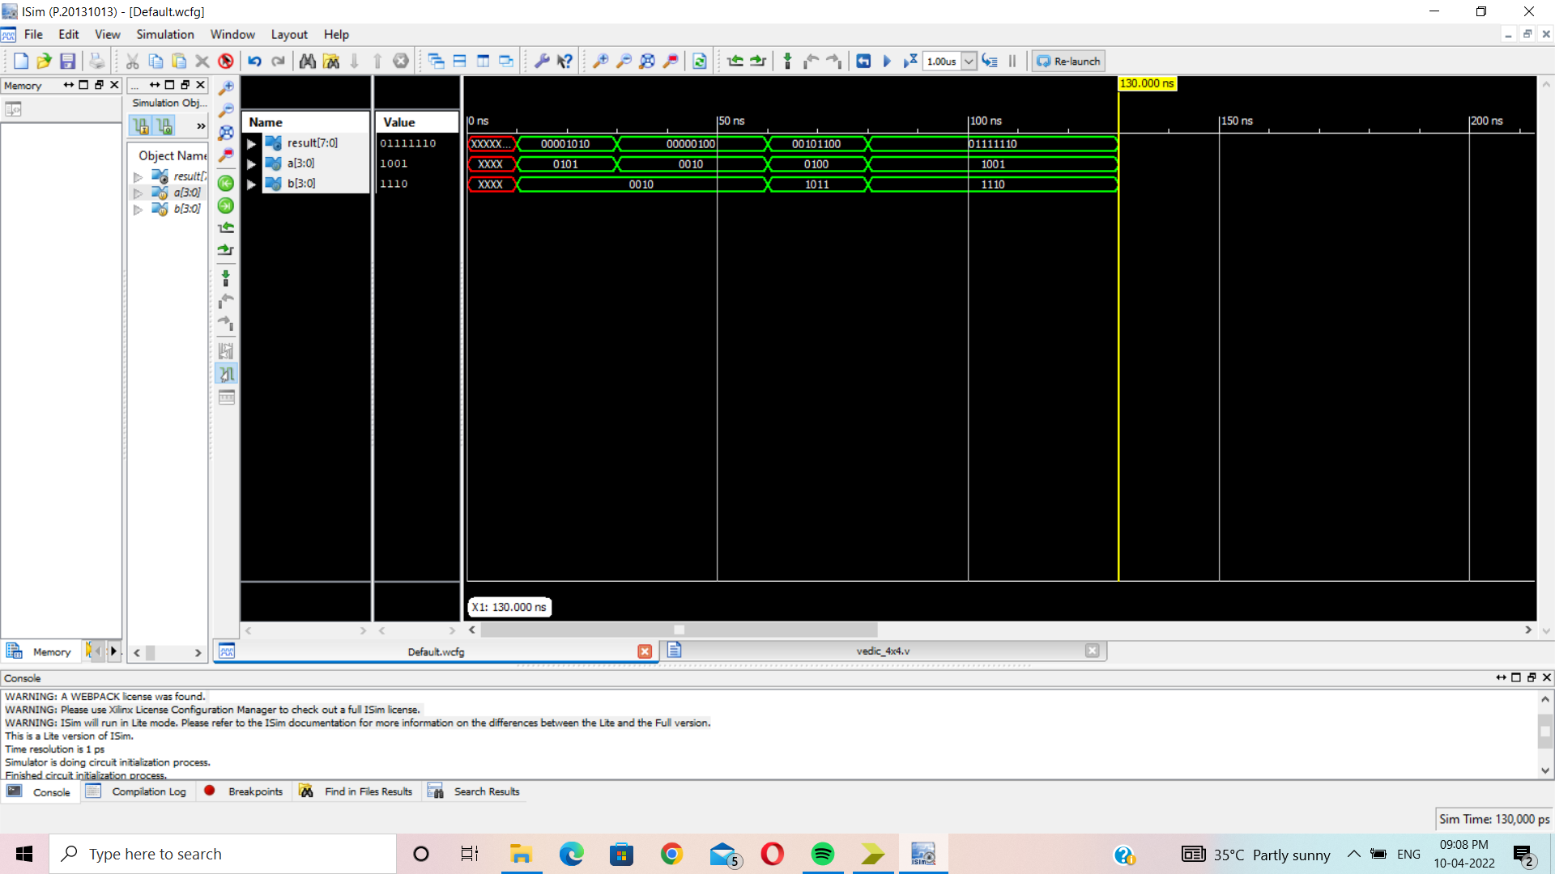
SIMULATION:

Slide 6
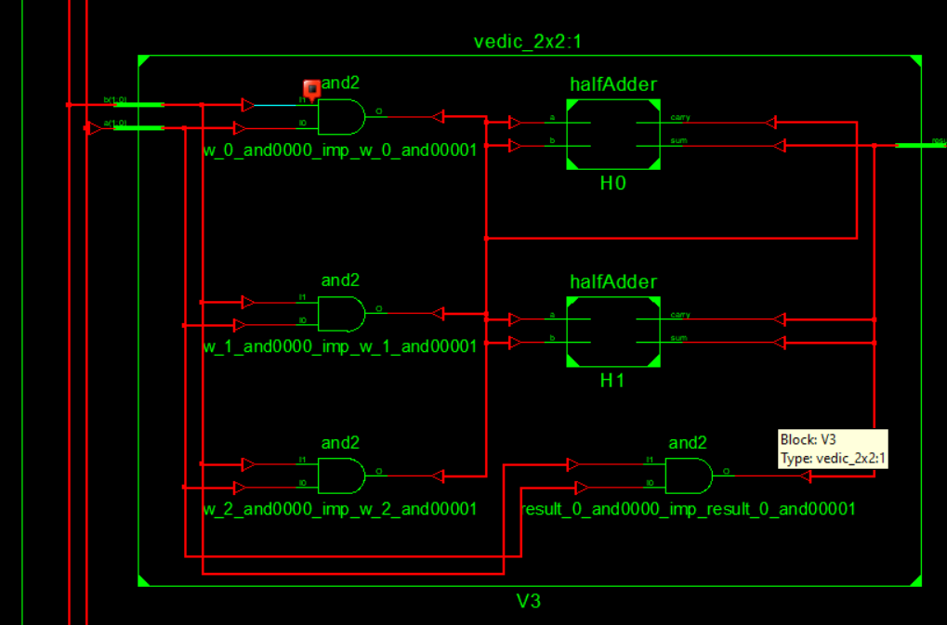
SYNTHESIS :

Slide 7
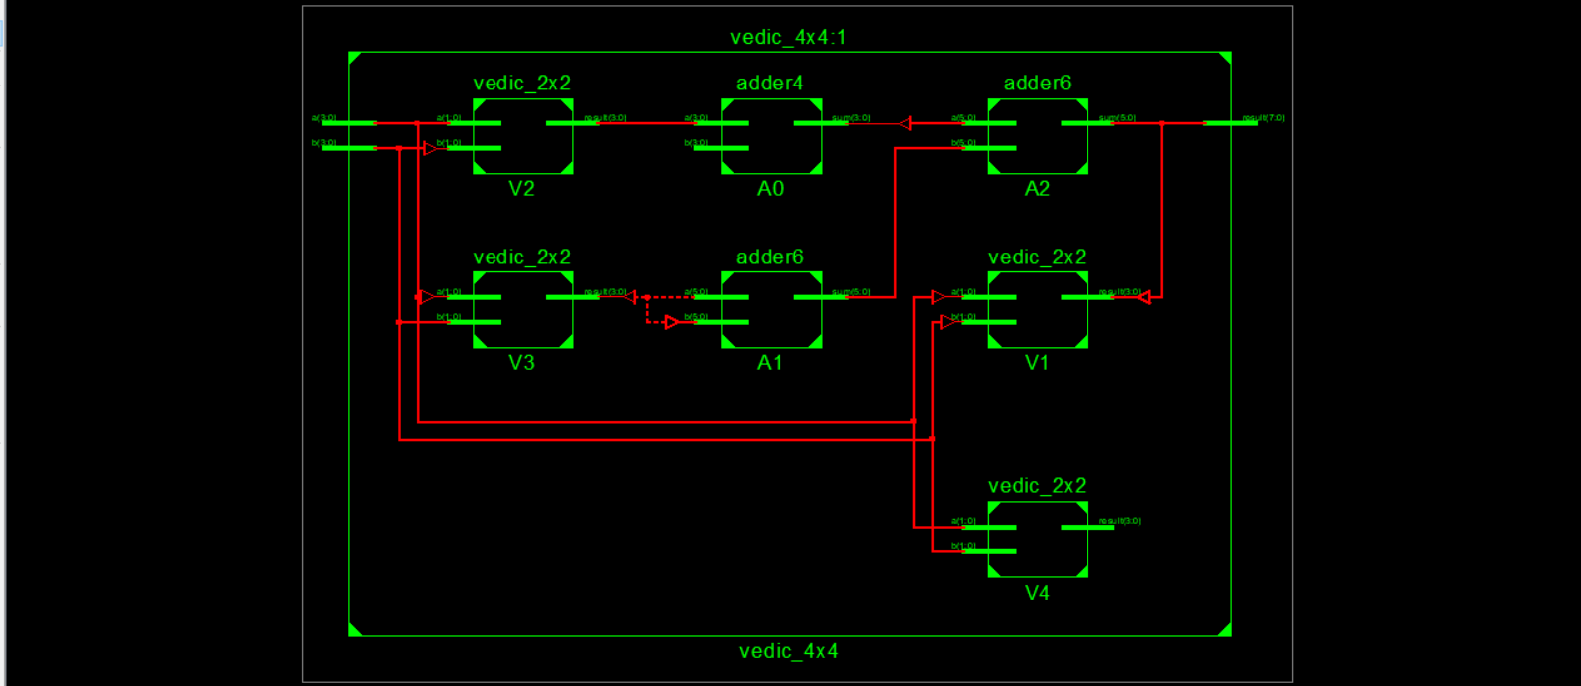
SYNTHESIS:

