Slide 1

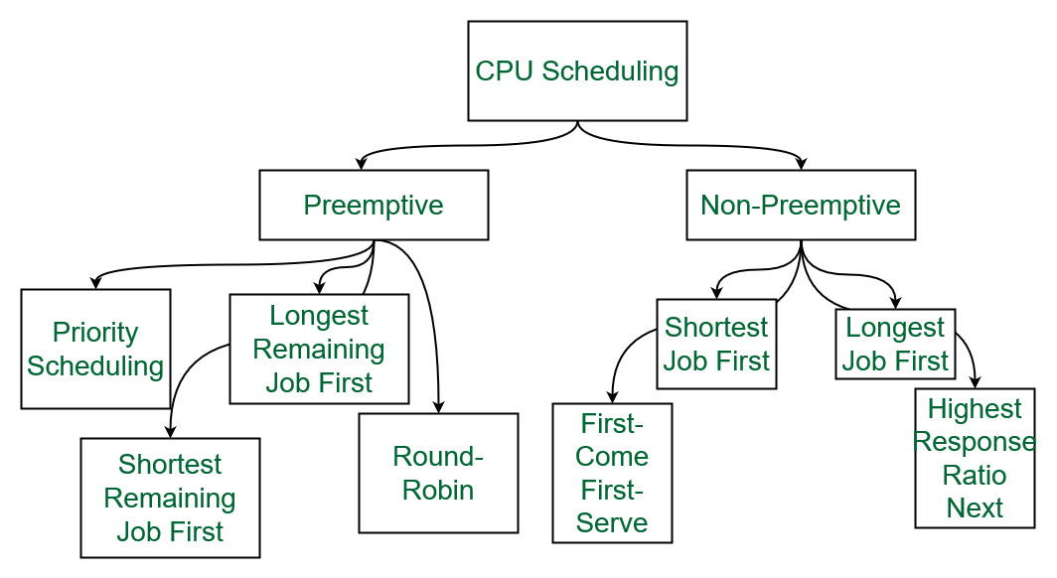


OPERATING SYSTEM.
CPU SCHEDULING.
R V College of Engineering
INTRODUCTION
CPU Scheduling :
Shortest Job First Scheduling :
Priority Scheduling.
Conclusion :
CPU scheduling orchestrates process execution in multitasking environments, aiming to maximize CPU utilization. The scheduler selects processes based on algorithms like FCFS, SJN, RR, Priority, and Multilevel Queue, with each algorithm offering unique trade-offs. By efficiently managing CPU time, scheduling algorithms strive to achieve high system throughput, minimize response time, and ensure fairness among competing processes, crucial for optimal system performance.
CPU scheduling involves managing the execution of processes in a multitasking environment. Various algorithms, including FCFS, SJN, RR, Priority, and Multilevel Queue, optimize CPU utilization, response time, and fairness. Preemptive algorithms allow process interruption, while non-preemptive ones let processes run till completion. Understanding these algorithms is crucial for efficient system resource management.
In the Shortest Remaining Job First (SRJF) scheduling algorithm, the process with the smallest amount of time remaining until completion is selected to execute.
Since the currently executing process is the one with the shortest amount of time remaining by definition, and since that time should only reduce as execution progresses, processes will always run until they complete or a new process is added that requires a smaller amount of time.
Characteristics :
Short processes are handled very quickly.
The system also requires very little overhead since it only makes a decision when a process completes or a new process is added.
When a new process is added the algorithm only needs to compare the currently executing process with the new process, ignoring all other processes currently waiting to execute.
Priority scheduling is one of the most common scheduling algorithms in batch systems. Each process is assigned a priority.
The process with the highest priority is to be executed first and so on.
Processes with the same priority are executed on a first-come first served basis. Priority can be decided based on memory requirements, time requirements or any other resource requirement.
Also priority can be decided on the ratio of average I/O to average CPU burst time.
Advantages:
Priority-based scheduling ensures that high-priority processes are executed first, which can lead to faster completion of critical tasks.
Priority scheduling is useful for real-time systems that require processes to meet strict timing constraints.
Priority scheduling can reduce the average waiting time for processes that require a significant amount of CPU time.
In conclusion, CPU scheduling is indispensable in operating system design, pivotal for optimizing CPU resource usage and process execution efficiency. With a spectrum of algorithms from FCFS to more advanced ones like SRJF, Round Robin, and Priority scheduling, each tailored to specific system requirements, the choice depends on factors like workload, response time, and fairness considerations. Preemptive techniques enhance resource utilization by allowing dynamic process interruption. As technology advances, continual innovation in scheduling algorithms remains crucial for enhancing system performance and meeting the demands of modern computing environments, emphasizing the critical role of efficient CPU scheduling in ensuring seamless operation and user satisfaction across diverse applications.
OBJECTIVE
Round Robin Scheduling :
The objective of this project is to analyze CPU scheduling algorithms (FCFS, SJN, RR, Priority, Multilevel Queue) to understand their impact on system performance, focusing on CPU utilization, response time minimization, and fairness among processes.
First Come First Serve Algorithm :
Round Robin is a CPU scheduling algorithm where each process is cyclically assigned a fixed time slot. It is the preemptive version of the First come First Serve CPU Scheduling algorithm.
Round Robin CPU Algorithm generally focuses on Time Sharing technique.
The period of time for which a process or job is allowed to run in a pre-emptive method is called time quantum.
Each process or job present in the ready queue is assigned the CPU for that time quantum, if the execution of the process is completed during that time then the process will end else the process will go back to the waiting table and wait for its next turn to complete the execution.
Characteristics :
It is simple, easy to implement, and starvation-free as all processes get a fair share of CPU.
One of the most commonly used techniques in CPU scheduling is a core.
It is preemptive as processes are assigned CPU only for a fixed slice of time at most.
Simplest CPU scheduling algorithm that schedules according to arrival times of processes.
The first come first serve scheduling algorithm states that the process that requests the CPU first is allocated the CPU first. It is implemented by using the FIFO queue.
When a process enters the ready queue, its PCB is linked to the tail of the queue. When the CPU is free, it is allocated to the process at the head of the queue.
The running process is then removed from the queue. FCFS is a non-preemptive scheduling algorithm.
Characteristics :
FCFS supports non-preemptive and preemptive CPU scheduling algorithms.
Tasks are always executed on a First-come, First-serve concept.
FCFS is easy to implement and use.
This algorithm is not very efficient in performance, and the wait time is quite high.
References :
Simulation of Priority Round-Robin Scheduling Algorithm
Tri Dharma Putra, Rakhmat Purnomo Universitas Bhayangkara Jakarta Raya rakhmat.purnomo@dsn.ubharajaya.ac.id
Submitted : Aug 9, 2022 | Accepted : Aug 18, 2022 | Published : Oct 3, 2022
link : https://jurnal.polgan.ac.id/index.php/sinkron/article/download/11665/1135.
Performance analysis of FCFS and improved FCFS scheduling algorithms for dynamic real-time computer systems (IEEE).
An Improved SJF Scheduling Algorithm in Cloud Computing Environment By Mokhtar A. Alworafi,DoS in CS,Mysore University, India
TEAM MEMBERS
Shivakumar (1RV22CS184).
Sudhanshu Suman(1RV22CS206).
Shreeram S B(1RV22CS188).

