Slide 1
Project title : document verification system
COMPANY : PYGENICARC
ROLE : Python Backend Developer
TEAM NO. : 10
Presented By :
Chandan S Bhat
Shreeram
Sanjeevini Rama Ankolekar

Slide 2
agenda
Problem Statement
End-to-end Workflow
DVS Comparative Analysis
Features In-detail

Slide 3
problem statement
Current document verification systems are primarily designed for identity verification or basic text extraction and are not suitable for university admission workflows. They do not validate academic correctness, enforce eligibility rules, or provide explainable rejection reasons. This results in manual effort, delays, and lack of transparency in admission decisions, highlighting the need for an admission-specific document verification system.

Slide 4
document verification system
END-TO-END WORKFLOW
STAGE 1: Document Upload & Intake – Validates file format, clarity, completeness, and document type.
STAGE 2: OCR & Information Extraction – Extracts academic details with confidence scoring.
STAGE 3: Structural Authenticity Validation – Verifies layout, fonts, seals, and templates.
STAGE 4: Academic Semantic Validation – Checks subject-stream compatibility, grading schemes, and calculations.
STAGE 5: Cross-Document Consistency – Ensures identity and academic timeline consistency.
STAGE 6: University Eligibility Rule Enforcement – Applies program-specific eligibility criteria.
STAGE 7: Risk Aggregation & Decision – Produces Valid / Invalid / Manual Review decision.
STAGE 8: Explanation & Guidance – Explains decision and guides corrective actions.

Slide 5
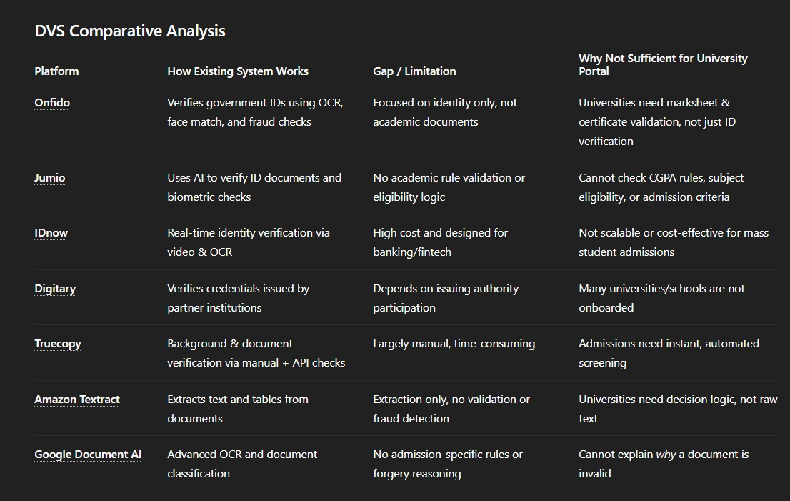
DVS Comparative Analysis
Enhancing your presentation

Slide 6
Features In-detail
DOCUMENT UPLOAD & DATA EXTRACTION ISSUES (STAGES 1–2)
Common Problems :
Blurry / cropped documents
Wrong file format (ZIP/DOCX)
Missing mandatory documents
OCR errors (Name, DOB, Marks not read properly)
System Message :
“We’re unable to read some documents clearly or extract details confidently.”
What Students Should Do :
Upload PDF or JPG only
Ensure:
Full page visible
Clear scan, good lighting
Use Preview before submitting
Manually verify extracted Name, DOB & Marks

Slide 7
AUTHENTICITY & ACADEMIC VALIDATION (STAGES 3–5)
Common Problems :
Document format doesn’t match official template
Missing seal / signature / watermark
Subject mismatch with selected stream
CGPA ↔ Percentage confusion
System Message :
“Document structure or academic details do not fully match official records.”
What Students Should Do :
Original digital or scanned originals
Ensure:
Correct stream & grading system
Same name format in all documents
CGPA conversion certificate
Name correction
Gap certificate (if applicable)

Slide 8
ELIGIBILITY, FINAL DECISION & GUIDANCE (STAGES 6–8)
Common Problems :
Marks below cutoff
Mandatory subject missing
Eligibility criteria not met
High-risk authenticity issues
System Message :
“We’re unable to read some documents clearly or extract details confidently.”
What Students Should Do :
Check :
Eligible alternative programs
Relaxation rules (if applicable)

Slide 9
Thank YOU

