Slide 1
Final Year project Topic: Chest X-Ray reading using image classification and neural networks
Project Work -2
(1st presentation)

Slide 2
INTRODUCTION
This application uses artificial neural network as a filter to classify the image. The output of the neural network is scaled so as to get the proper sizes of the images that are classified and can be used by radiologists to predict the abnormality up to a great extent.

Slide 3
TOOLS
Software Used:
Programmng Language: Python
Libraries :
Pandas : for data manipulation and arrays.
opencv: Used for reading image, resizing,etc.
keras: To use neural network CNN(VGG net)
scikit-learm: for algorithms such as linear-regression, kNN, Random forest classifier.

Slide 4
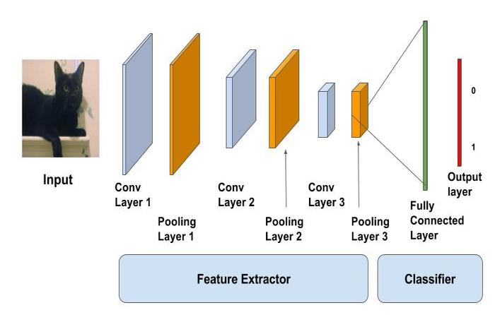
CNN MODEL(Binary neural network)

Slide 5
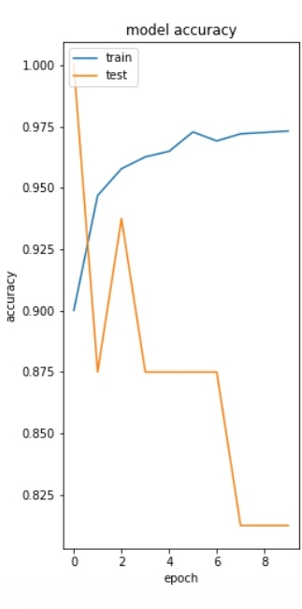
MODEL ACCURACY

Slide 6
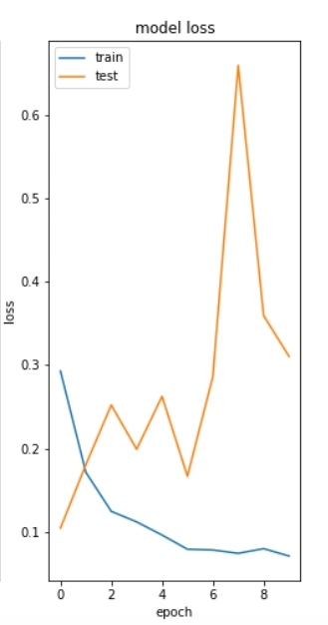
MODEL LOSS

Slide 7
CONCLUSION
As we can see from the MODEL LOSS plot that upto 7 epochs the difference between train loss and test loss is increasing which may be due to high bias(less images) but after 7 epochs it starts decreasing, and also from the MODEL ACCURACY plot after 7 epochs, the graph is constant and has acquired a constant accuracy.

Slide 8
FURTHER ADDITIONS
As the model has acquired good efficiency we can use it to predict if a person is having pneumonia.
This can be added to predict number of diseases using multiclass neural networks.

