Slide 1

Library Management System
Welcome to the Library Management System, a comprehensive tool designed to streamline operations and enhance the efficiency of library management.

Slide 2
Introduction
Book Management
Member Management
Track inventory, add new titles, manage catalog, and update information for each book.
Enroll members, maintain contact information, track borrowing history, and generate reports.
Reporting
Borrowing & Returning
Generate customized reports on various aspects of library operations, such as loan statistics, member activity, and inventory details.
Process loan requests, monitor due dates, manage overdue notices, and handle returns.

Slide 3
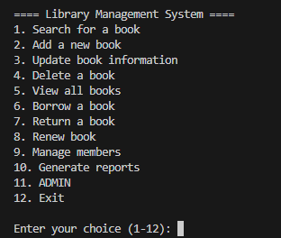
USER FRIENDLY INTERFACE
"Easy access to all data at your fingertips,
with hands-on experience."

Slide 4
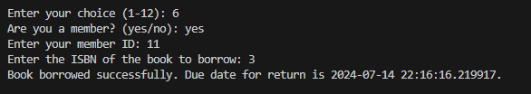
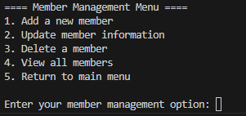

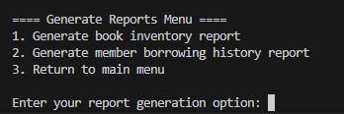
Main Menu
Member Management
Borrowing & Returning
Reports
Generate reports on library activities, including loan statistics, overdue books, and member activity.
Enroll new members, manage member details, and track membership status.
Process book loans, manage due dates, and handle returns.

Slide 5
Data Handling
1
Data Integrity
2
Data Security
Ensures accuracy and consistency of data within the system. This includes implementing data validation rules, enforcing unique identifiers, and performing regular data audits.
Protects sensitive information, such as member data and book inventory, from unauthorized access and modification.
3
Data Backup & Recovery
4
Data Archiving
Regularly backs up all system data to prevent data loss in case of hardware failure or accidental deletion.
Stores historical data for future reference and analysis. This ensures that all past records are preserved and readily accessible.

Slide 6
Benefits
Increased Efficiency
Improved Accuracy
Enhanced Customer Service
Automates tasks, reducing manual effort and saving time for library staff.
Minimizes errors and ensures data accuracy, leading to more reliable information.
Provides quick and easy access to information, improving the experience for library patrons.

Slide 7




User Interface
Intuitive Navigation
Clear and Concise Information
User-Friendly Features
Accessibility
Designed to be accessible to all users, regardless of their technical expertise or physical abilities.
The system's interface is designed for easy navigation, allowing users to quickly access desired features and functionalities.
Includes features such as search bars, filters, and sorting options to enhance user experience.
Displays data in a clear and organized manner, providing users with the necessary information at a glance.

Slide 8
Future Enhancements
Integration with Digital Library Platforms
Expand access to digital resources and e-books.
Mobile App Development
Offer convenient access to library services through mobile devices.
Advanced Reporting Features
Enable more sophisticated data analysis and insights.
Artificial Intelligence Integration
Improve search functionality, provide personalized recommendations, and automate tasks.

Slide 9
1.Search a book - tiltle,authour ==> authour/title + num of pages,edition
2.Add a book - name,authour,pages,edition
3.Update a book - availability, edition replace ==> y/n
4.Delete a book - name ==> book is removed from libraray
5.View all books - ==> all books with title
6.Borrow a book - check availability and take student details(name & roll num).update availaiity. If student not in history enter into mmbership(8).===>Display condition
7.Return a book - check condition and add remarks if any, upadate members rerport . update availabilty
8.Manage students - display all students, borrowing history, new memberships
9.Exit

Slide 10

Conclusion
This presentation provided an overview of the Library Management System, a powerful tool designed to simplify library operations and enhance user experience. By integrating advanced features, the system aims to optimize resource management, streamline processes, and ensure a seamless experience for library staff and patrons.

