Slide 1
Prepackage Content (Discover)
Bangalore, Raj & Binod

Slide 2
Table of Contents
WebUI
1
Discover
2
Components of Pre-package
3
Pre-package Content Configuration
4
Demo
5

Slide 3
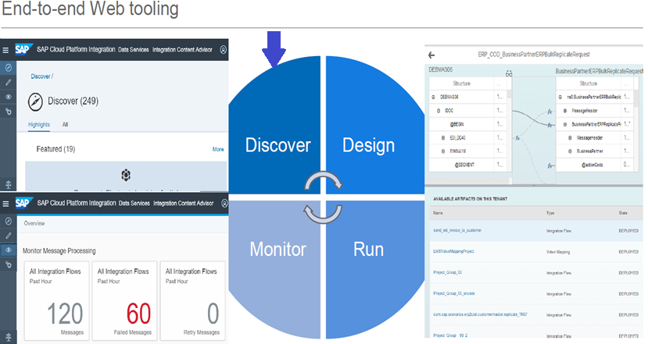
1.WEBUI
SAP CPI WebUI tools allows the developers to Copy/Create a integration content, Deploy and monitor it.
Discover contains Standard Integration Content Catalog.
Design helps to create/edit a content using Modelling area
Operation’s view/ Monitoring is used to monitor deployed content and the message processed.
Message Processing Logs and Traces are stored in Operations view.

Slide 4
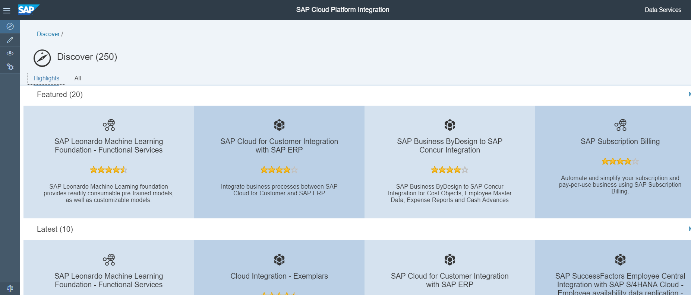
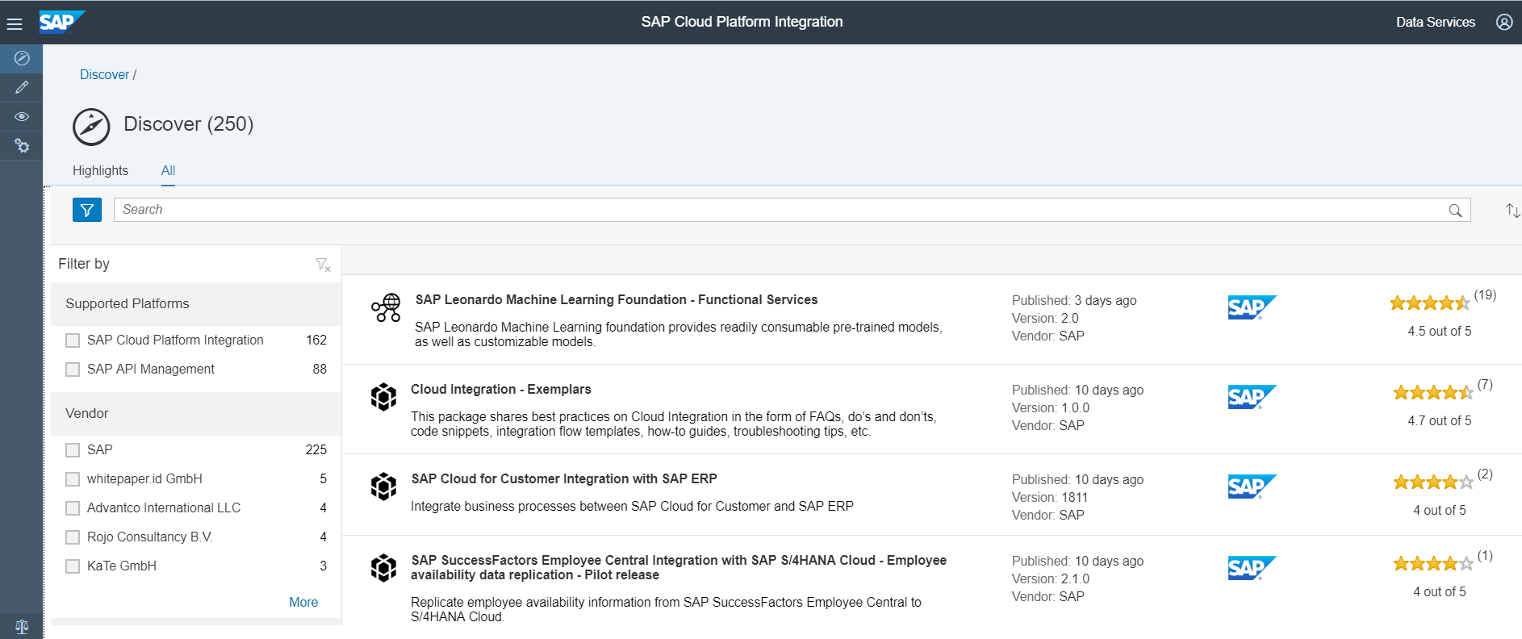
2.Discover
Discover contains Standard Integration Content Catalog.
Packages are tested and published by SAP.
These packages are well documented and released with Configure only mode for most of the package.
Standard packages have to copied to Own workspace and deployed by providing connectivity details
Streams
Vendor
Supported Platforms
Line of Business
Industries
Products
Countries

Slide 5
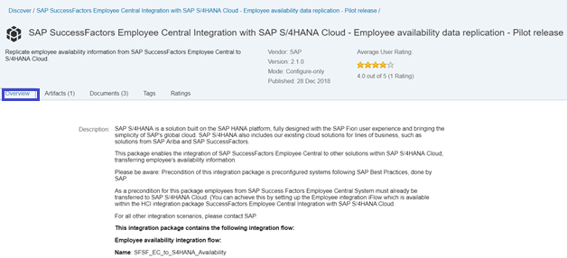
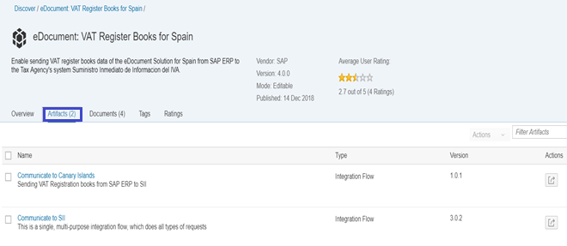
3.Components of Pre-package
Overview:
This contains the description of Systems and the Integration between them.
Artifacts:
Integration flows for various business process are added within Artifacts.
Other information's are available within overview are Integration flow, Package ID, Category and Created date.
Other components available under artifacts are OData Service, Value Mapping and Data integration.
We can view the steps within the Integration flow from Artifacts

Slide 6
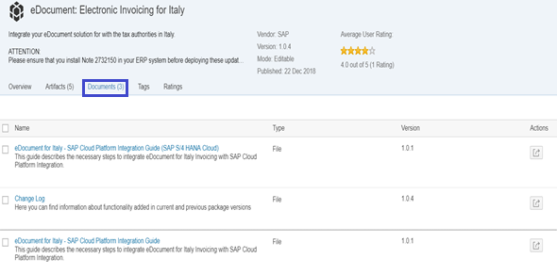
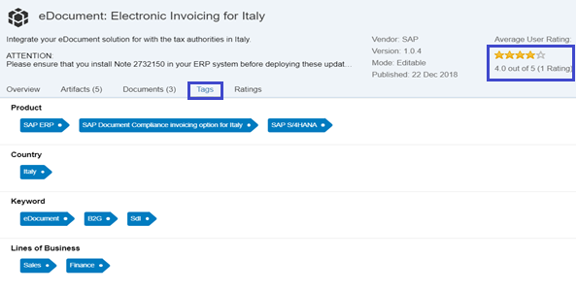
3.Components of Prepackage
Documents:
Integration Guide is provided for some package with step by step process under Documentation section.
PDF Document can be downloaded. Changes for the package is maintained in Change Log and added in Documents Tab.
Tags:
Packages are tagged with the Key words like Product, Country, Line of Business.
Ratings:
Consumer Ratings and Comments for the are Standard content are added in Ratings

Slide 7
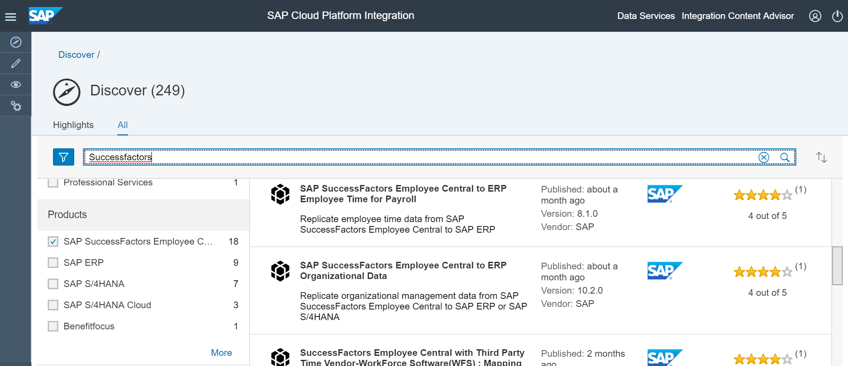
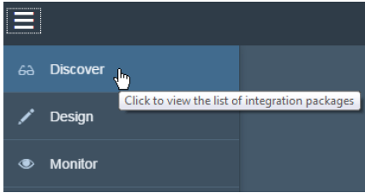
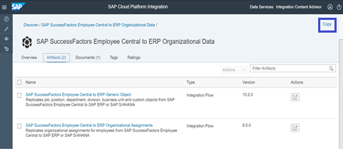
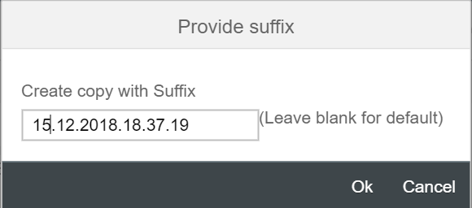
4.Prepackage Content Configuration
Apply Filters
Select the Package
Copy to Own Workspace
Provide Suffix

Slide 8
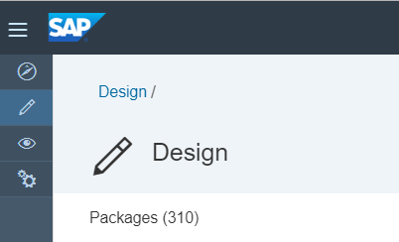
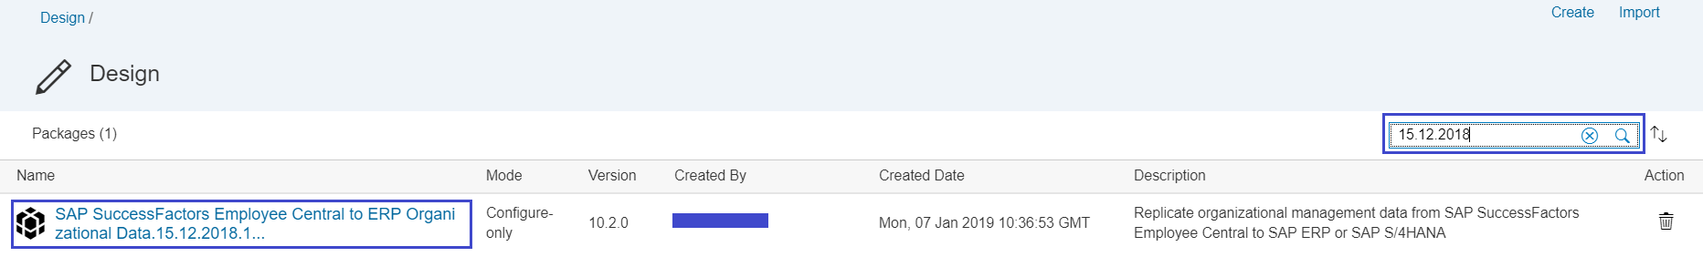
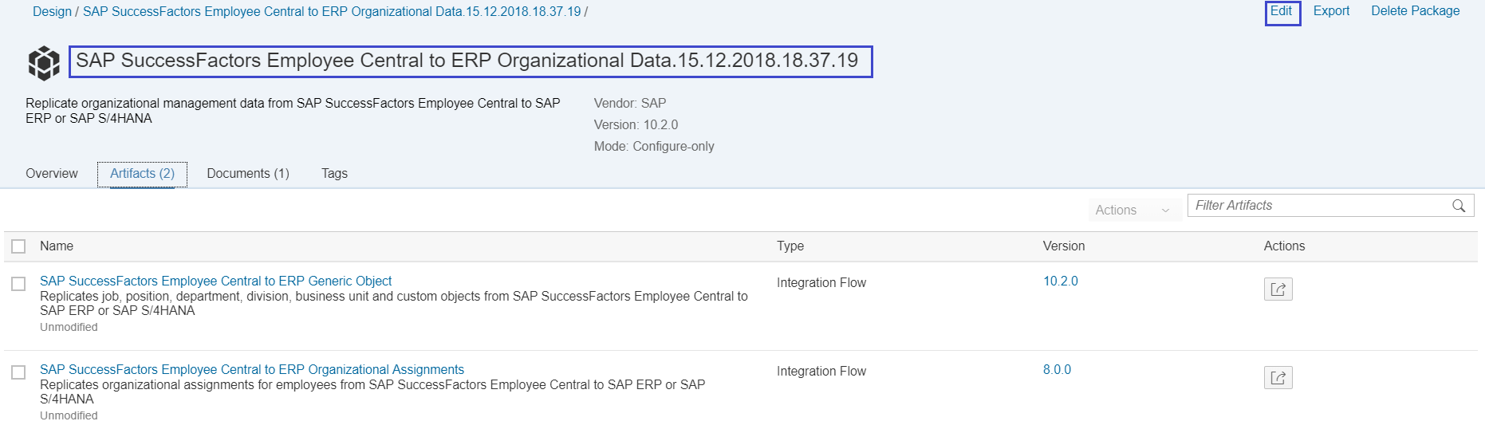
4.Prepackage Content Configuration
Package is added to Own workspace with Prefix and Editable

Slide 9
5.DEMO
Package:
SAP SuccessFactors Employee Central to ERP Employee and Organizational Data

Slide 10


