Slide 1
Road Accident Analysis & Recommendations
Data-Driven Insights for Safer Roads
By Shreeram

Slide 2
Key Findings
🚗 Total Accidents: 301K
🚑 Total Casualties: 409K
⚡ Peak Accident Hours: 4 PM - 8 PM
📍 High-Risk Cities: Birmingham, Leeds, Bradford
🛣️ Most Dangerous Roads: Single Carriageways (78%)

Slide 3
Casualties by Time
🔸 Morning Peak: 87K (8 AM - 12 PM)
🔸 Afternoon Peak: 108K (12 PM - 4 PM)
🔸 Evening Peak: 117K (4 PM - 8 PM) - Highest!
👉 Recommendation: Increase traffic monitoring & dynamic speed control

Slide 4

Accidents by Junction Type
🔹 Not at a Junction: 120K
🔹 T-Junction: 95K
🔹 Crossroad: 29K
👉 Recommendation: Improve lane discipline & traffic signs

Slide 5

Accidents by Light & Weather
💡 Daylight Accidents: 222K
🌙 Night (Lights On): 59K
🌧️ Rainy Weather: 35K
👉 Recommendation: Enforce speed control in clear weather to prevent over-speeding

Slide 6

City-Wise Accident Trends
🏙️ Birmingham: 5.9K
🏙️ Leeds: 4.1K
🏙️ Bradford: 3K
🏙️ Manchester: 2.9K
👉 Recommendation: Implement city-specific traffic safety campaigns

Slide 7
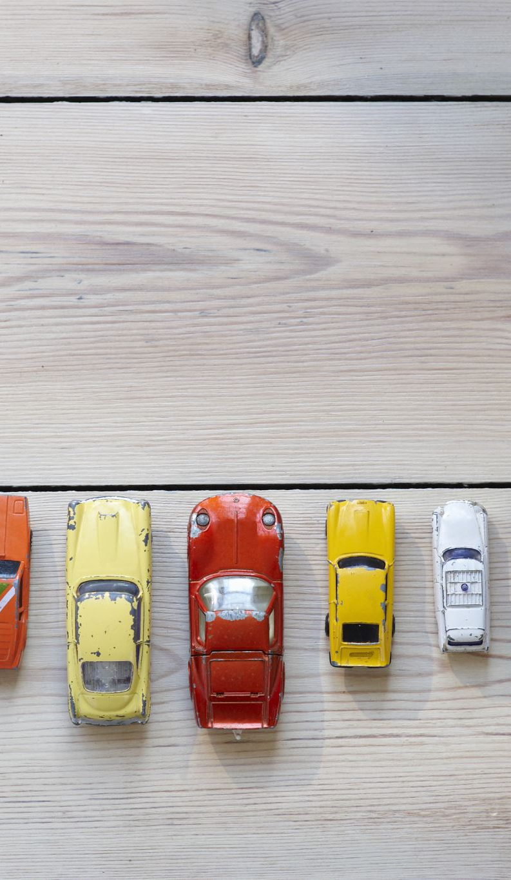
Road & Vehicle Type Accidents
🛣️ Single Carriageway: 78% of accidents
🚗 Cars: 87% of accidents
🚚 Vans/Goods Vehicles: 5.7%
👉 Recommendation: Better road markings & stricter lane discipline

Slide 8
Final Recommendations for Safer Roads
✅ Smart Traffic Lights & AI Monitoring
✅ Stricter Speed Limit Enforcement
✅ Improved Road Infrastructure (Dividers, Pedestrian Crossings)
✅ Public Awareness & Driver Education Campaigns
🚀 Let's work together to reduce accidents!

