Slide 1

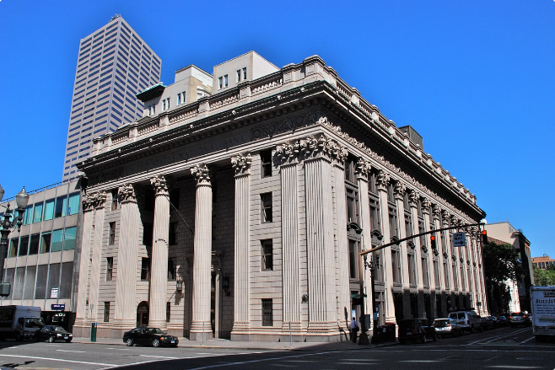

Comprehensive Bank Loan Portfolio Analysis and Strategic Recommendations
This presentation provides a comprehensive analysis of the bank's loan portfolio, highlighting key performance metrics, risk factors, and strategic recommendations for optimization. The analysis covers a total of 38.6K loans with a funded amount of $435.8M, revealing a healthy overall portfolio with an ROI of 8.6%. However, the analysis also identifies areas for improvement, particularly in mitigating the -27.1% ROI on bad loans.
by shreeram kulkarni

Slide 2
Understand problem statement and source data.
Data cleaning and DAX queries.
Create Pivote tables.
Identifying KPI’s and Creating .
Creating adding various charts and slicers.
Generating insights and recommendations.
Steps:

Slide 3
Features in data
Loan ID: Unique identifier for each loan
Address State: Borrower's location
Employee Length: Duration of employment
Employee Title: Borrower's job title
Grade: Risk classification of loan
Sub Grade: Refined risk assessment
Home Ownership: Borrower's housing status
Issue Date: Loan origination date
Last Credit Pull Date: Most recent credit check
Last Payment Date: Most recent payment received
Loan Status: Current state of the loan
Next Payment Date: Estimated next payment
Purpose: Reason for the loan
Term: Duration of the loan in months
Verification Status: Confirmation of financial info
Annual Income: Borrower's yearly earnings
DTI: Debt-to-Income Ratio
Instalment: Fixed monthly payment amount
Interest Rate: Annual cost of borrowing
Loan Amount: Total borrowed sum

Slide 4

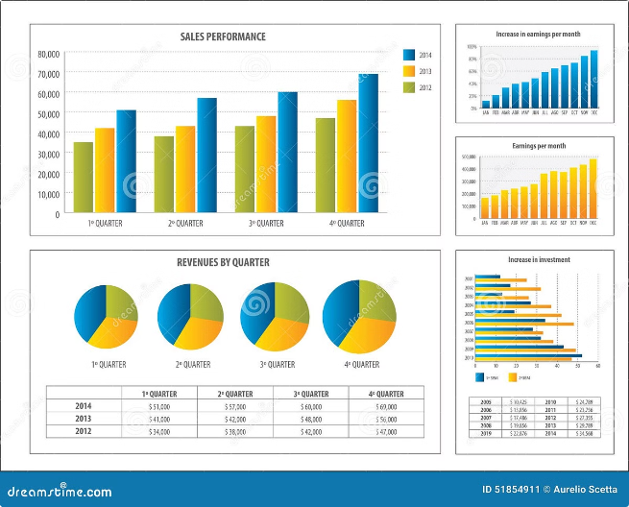
Executive Summary
1
Portfolio Overview
The bank's loan portfolio consists of 38.6K loans with a total funded amount of $435.8M. Of these loans, 83.3% are considered "good" with a positive ROI, while 16.7% are classified as "bad" with a negative ROI.
2
Overall Performance
The overall portfolio exhibits an ROI of 8.6%, with $473.1M received against $435.8M funded. However, the negative ROI on bad loans (-27.1%) presents a significant challenge that requires strategic mitigation.
3
Key Challenge
The primary challenge lies in addressing the negative ROI on bad loans, which constitutes a substantial portion of the portfolio. This requires a focused approach to identify and mitigate risk factors associated with these loans.

Slide 5
Loan Portfolio Overview
Metric
Total
Applications
38.6K
Funded Amount
$435.8M
Amount Received
$473.1M
Interest Rate
12.05%
DTI Ratio
13.33%

Slide 6
Loan Portfolio Overview (Continued)
Loan Status
Key Metrics
The loan portfolio exhibits a healthy distribution of loan statuses, with 83.2% of loans fully paid, 13.7% charged off, and 2.8% currently active.
Applications: 38.6K
Funded Amount: $435.8M
Amount Received: $473.1M

Slide 7
Good vs Bad Loan Analysis
Good Loans (83.3%)
Bad Loans (16.7%)
Good loans represent 83.3% of the portfolio, with 32.1K loans funded for $351.4M. These loans have generated $411.6M in received funds, resulting in a positive ROI of 17.1%.
Bad loans constitute 16.7% of the portfolio, with 6.4K loans funded for $84.4M. These loans have generated only $61.5M in received funds, resulting in a negative ROI of -27.1%.

Slide 8

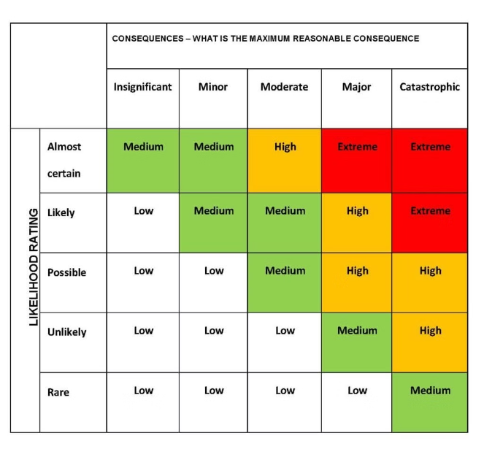
Key Risk Indicators
1
Loan Grade
The analysis reveals that the highest concentration of bad loans falls within loan grades C and D, indicating a potential correlation between loan grade and risk.
2
Interest Rate
A positive correlation exists between loan grade and interest rate, suggesting that higher interest rates may be associated with higher risk loans.
3
Employment Length
Applicants with 2 years of employment exhibit the highest concentration of bad loans, highlighting the importance of employment stability in loan risk assessment.
4
Geography
California demonstrates the highest concentration of bad loans, indicating a potential need for region-specific risk assessment strategies.

Slide 9

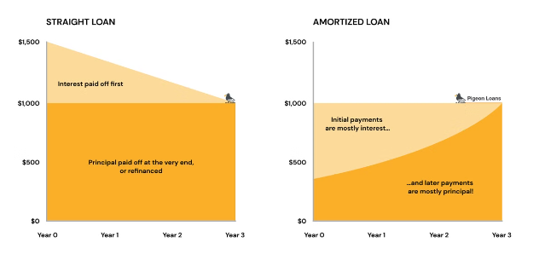
Key Risk Indicators (Continued)
1
Loan Term
The analysis reveals a significant number of bad loans associated with both 60-month and 36-month loan terms, suggesting that loan term alone may not be a primary risk indicator.
2
Loan Term Breakdown
Specifically, 3,408 bad loans are associated with 60-month terms, while 3,023 bad loans are linked to 36-month terms.

Slide 10

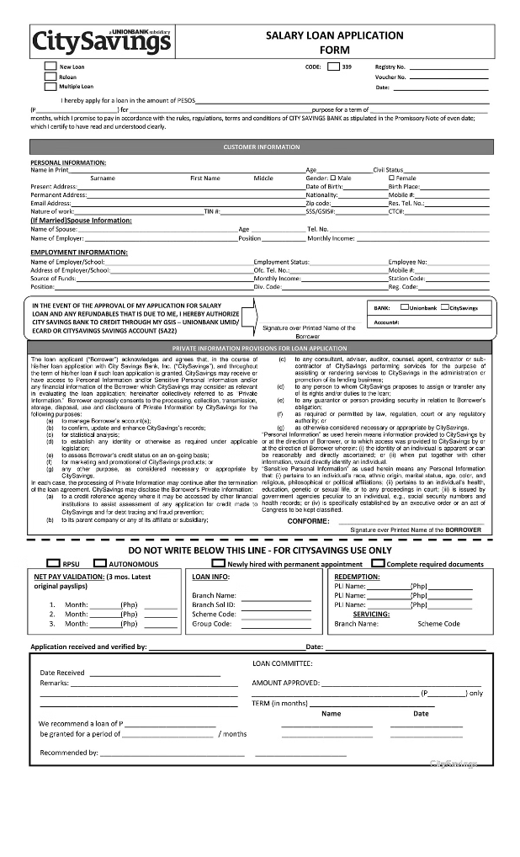
Loan Characteristics Analysis
1
Verification Status
The loan portfolio exhibits a diverse range of verification statuses, with 53% of loans fully verified, 24% not verified, and 23% source verified.
2
Home Ownership
The analysis reveals a balanced distribution of home ownership statuses, with 45% of borrowers holding mortgages, 48% renting, and 7% owning their homes outright.
3
Good vs Bad Loan Ratio Trend
The good vs bad loan ratio trend demonstrates a positive improvement over recent quarters, with Q4 showing a significant increase in good loans (25.55%) compared to bad loans (5.53%).

Slide 11
Month-to-Date (MTD) Performance
MTD Funded Amount
MTD Received Amount
The MTD funded amount stands at $54.0M, with 76.5% fully paid, 16.1% charged off, and 7.2% currently active.
The MTD received amount is $58.1M, with 82.3% fully paid, 9.1% charged off, and 8.4% currently active.

Slide 12
Key Insights
1
Portfolio Health
2
Risk Factors
3
Verification Impact
The overall portfolio health is generally positive, but there is room for improvement in mitigating risk factors and enhancing performance.
Loan grade, employment length, and geography emerge as critical risk factors requiring targeted mitigation strategies.
Higher verification rates could potentially reduce risk by providing more robust borrower information and mitigating fraud.
4
Loan Terms
5
MTD Performance
Shorter loan terms (36 months) may be less risky than longer terms, suggesting a potential shift in loan structure.
The MTD charge-off rate is higher than the overall portfolio average, indicating a need for closer monitoring and potential adjustments to risk assessment.

Slide 13
Recommendations - Risk Assessment
Enhance criteria for Grade C and D loans to more accurately assess risk and pricing for these tiers.
Adjust interest rates for high-risk grades (E, F, G) to better reflect the elevated default probability and provide appropriate risk-adjusted returns.
Implement additional screening for 2-year employment applicants to ensure stability and mitigate the higher risk associated with shorter job tenure.
Develop specific risk assessment for California applicants to account for regional economic and demographic factors that may impact loan performance.
Increase loan verification rate (target >80%) to strengthen underwriting and reduce the risk of fraud or inaccurate borrower information.

Slide 14
Recommendations - Loan Structure
Encourage shorter-term loans (36 months) to reduce overall risk exposure and improve portfolio performance.
Set stricter debt-to-income (DTI) thresholds, especially for higher-risk loan grades, to ensure borrowers have sufficient capacity to repay.
Develop robust assessment for renters and mortgage holders to better understand the unique financial profiles and risks associated with each housing status.
Optimize loan terms for categories with higher charge-off rates, such as adjusting interest rates or reducing maximum loan amounts, to align with the elevated risk.

Slide 15
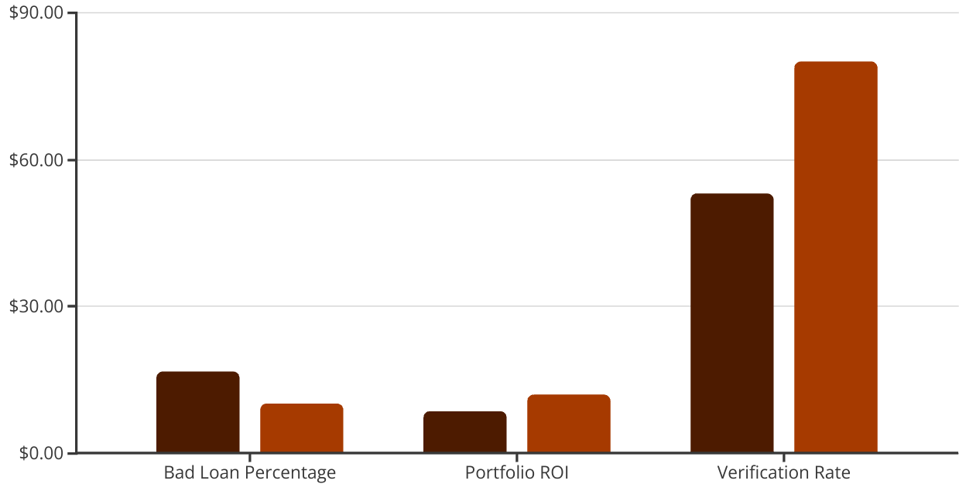
Expected Outcomes
Current
Target
The key expected outcomes for the loan portfolio include reducing the bad loan percentage from 16.7% to under 10%, improving the overall portfolio return on investment (ROI) from 8.6% to over 12%, and increasing the loan verification rate from 53% to more than 80%. These targets aim to strengthen the portfolio's overall health and performance.
Additionally, the analysis seeks to achieve a more balanced geographical distribution of loans and enhance the early warning system for potential defaults, allowing the bank to proactively manage risk and optimize the portfolio.

Slide 16
Conclusion
In summary, this comprehensive strategy outlines a detailed plan to optimize the bank's loan portfolio and reduce overall risk. The key next steps involve prioritizing the recommended short-term actions and immediately beginning the implementation process. This will help the bank achieve its goals of reducing the bad loan percentage, improving portfolio ROI, and increasing the loan verification rate.

