Slide 1
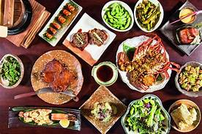
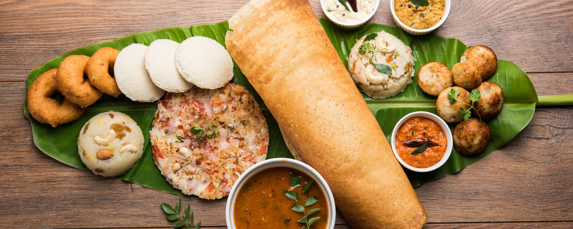
ZOMATO – BANGALORE
200 SELECTED RESTAURANTS FOR ZOMATO COUPONS

Slide 2
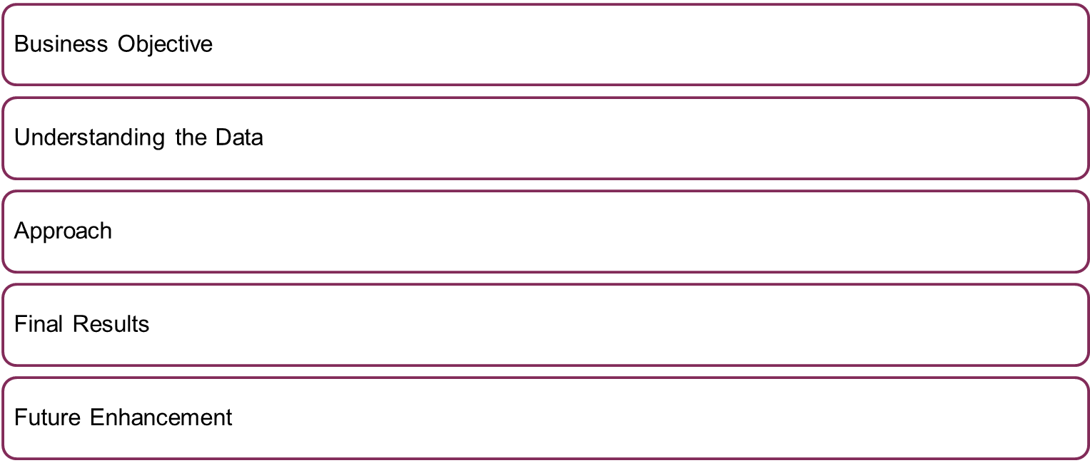
WHAT ARE WE GOING TO DISCUSS TODAY?

Slide 3
WHAT IS THE REQUIREMENT ?
Business objective
  Zomato wants to distribute 200 coupons to Bangalore Restaurants with the following objectives
    Coupons are utilized with in the validity
    Zomato customer base increases
Assumption
  Both Dine-in and Delivery Restaurants are in scope
  All the restaurants in datasets are open and functioning
  Future covid restrictions are not accounted
  All the restaurants category are equally preferred/User preference data is out of scope from this exercise

Slide 4
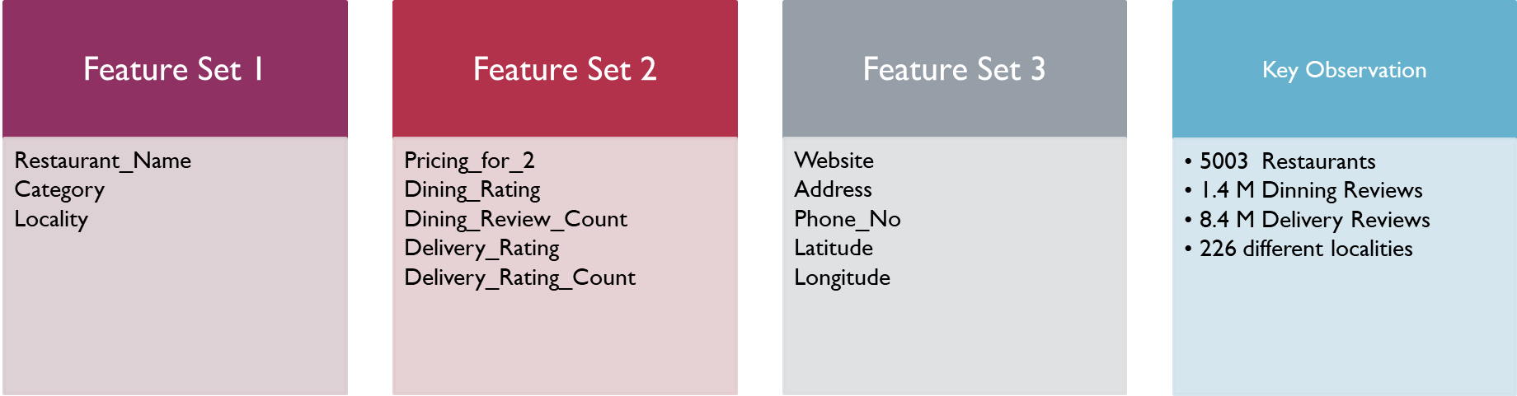
LETS SEE OUR DATA
Comprehensive Data visualization has been done on these features, to find top 10 restaurants in Dinning and Delivery, to understand their relation with each other,(pricing vs rating) ( Catergory vs rating) and to various insights are noted.

Slide 5
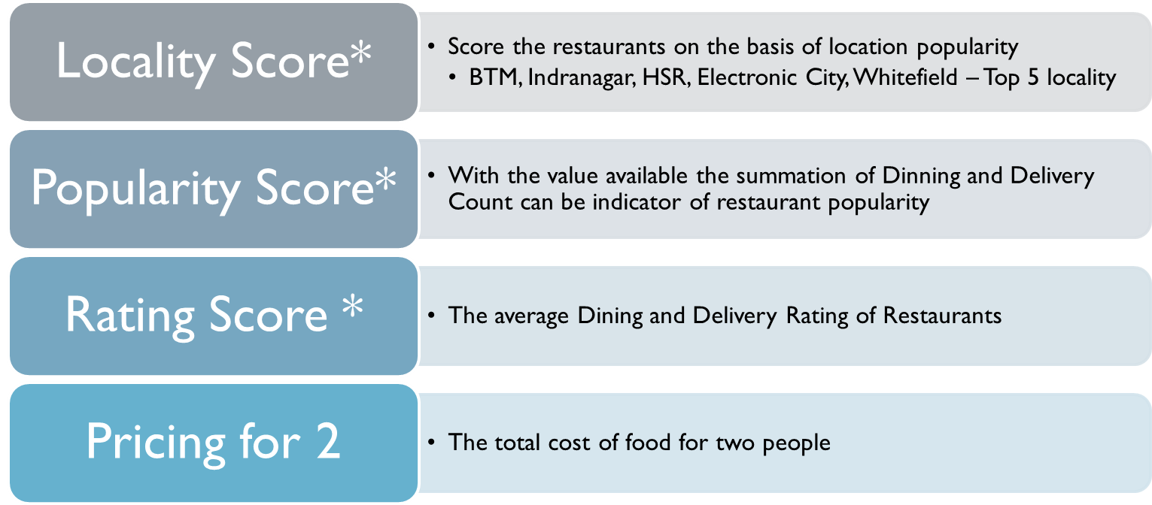
SELECTED FEATURES

Slide 6
APPROACH
It’s a Un-supervised Machine learning
Reduced/collated the dimensions for ease of model understanding
Level 1 Kmeans Clustering - With Poplularity and Rating
Get the subset of restaurants as per cluters
Level 2 Kmeans Clustering – With Pricing and Rating
Get the subset of restaurants
Final Kmeans Clustering – With Locality score and Rating
Get the final list

Slide 7
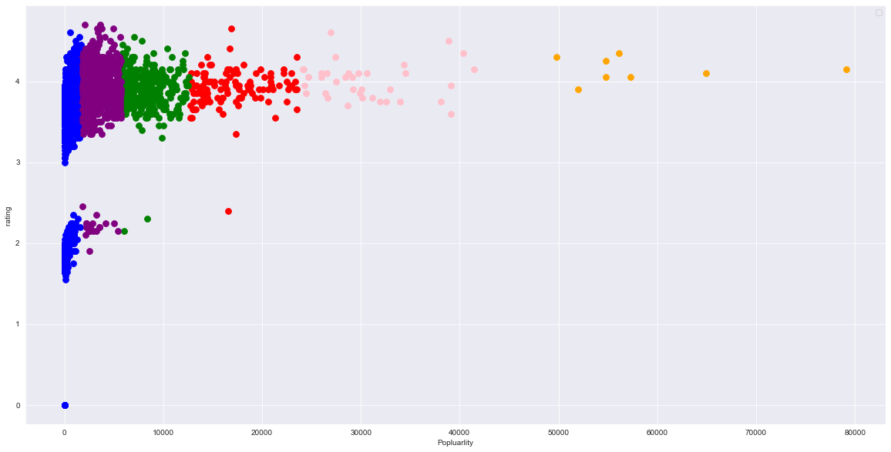
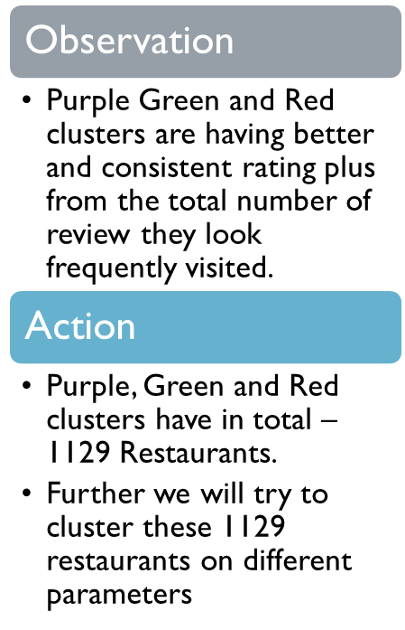
CLUSTER ON RATING AND POPULARITY

Slide 8
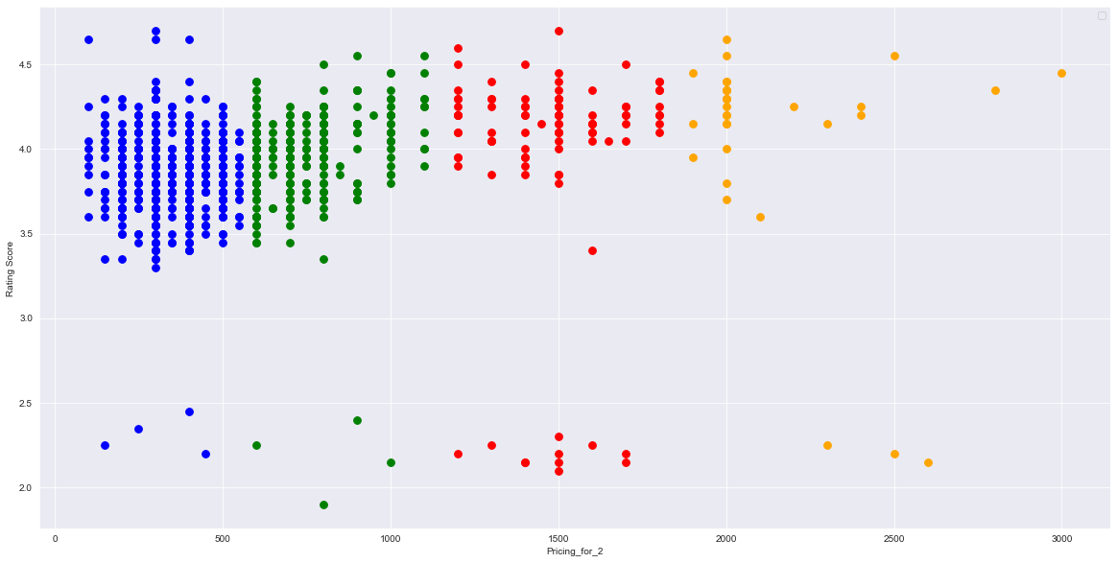
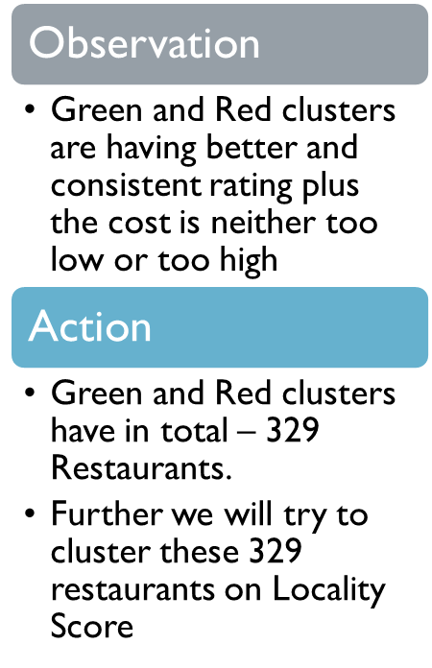
CLUSTER ON RATING AND PRICING

Slide 9
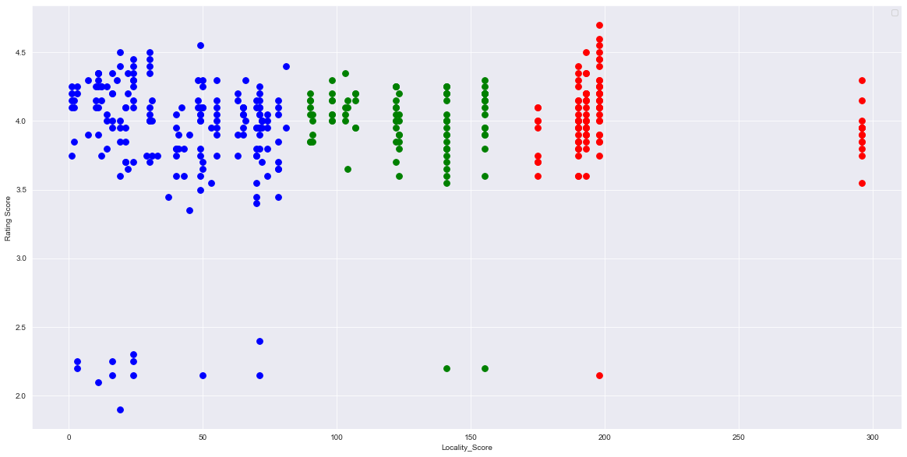
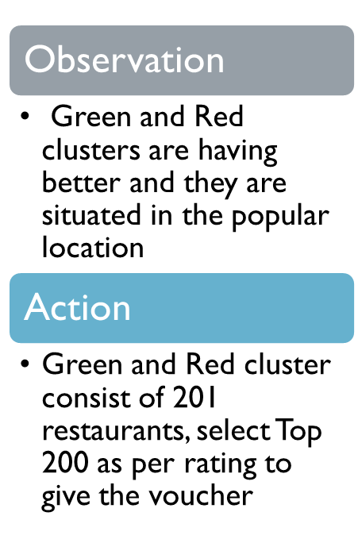
CLUSTER ON RATING AND LOCALITY

Slide 10
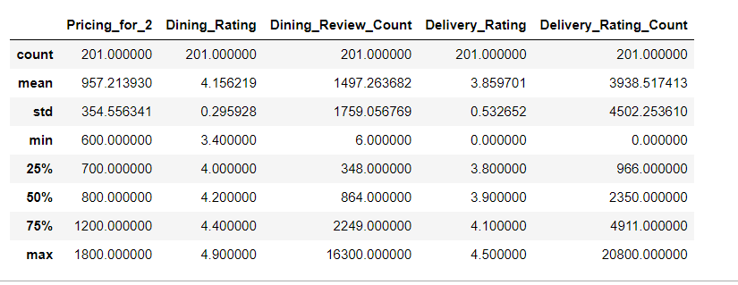
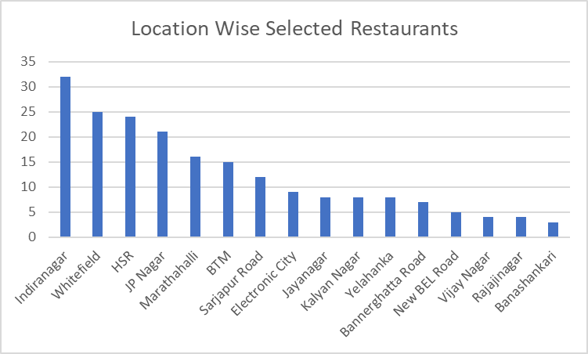
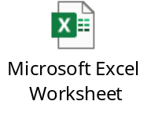
SELECTED RESTAURANTS

Slide 11
FURTHER ENHANCEMENTS
Multilevel clustering with all the selected parameters in one shot
Use the Latitude and Longitude for finding the Geo locations and plot them to understand the demographics
Instead of locality – use the Latitude and longitude to find the restaurants concentration
Explore the Category parameter and see if adding that can get a better list of restaurants
Next Step –
Have a mechanism to record the utilization of Zomato coupons given to selected restaurants and its impact on Zomato Market share

