Slide 1

Generating Tags using Multi-Label text Classification for Blogs
Group 21
Shreesha Pillangere Ramachandra
Ankush Malhotra
Gunasekaran Saravanan

Slide 2
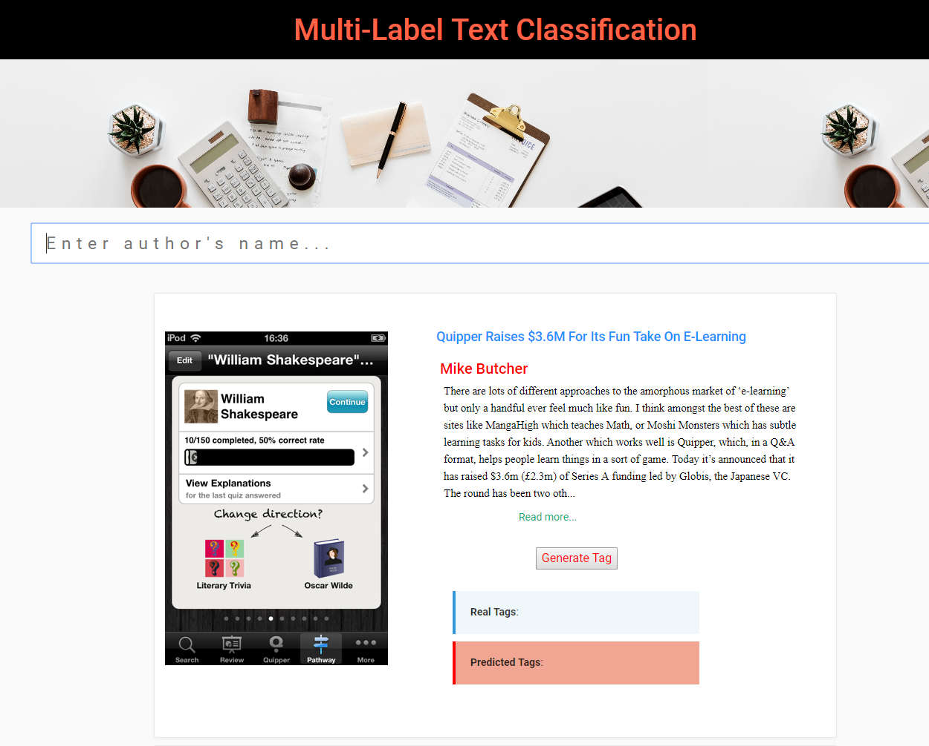

Slide 3

Motivation
A news article may cover multiple topics, such as politics and economics
A movie can have multiple Genres such as Action, Adventure and Fantasy

Slide 4
Workflow
Data Extraction
Data cleaning & Preprocessing
Modelling
Model Deployment
Scraping
API

Slide 5
Data Extraction
TechCruch News
TC Blogs
17406 Blogs, Title + Content
TC API
TechCrunch News API
Scrapping
Selenium with Chromedriver
Tag Processing
Selecting most frequent 7 Tags

Slide 6
Data Preprocessing
Removing inconsistent data: Stopwords, Regex, Punctuations
Using beautiful soup we performed HTML decoding
Converting text to lowercase
Lemmatization

Slide 7
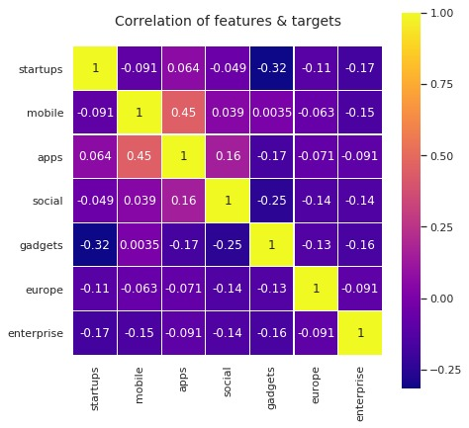
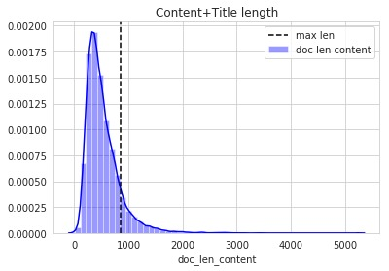
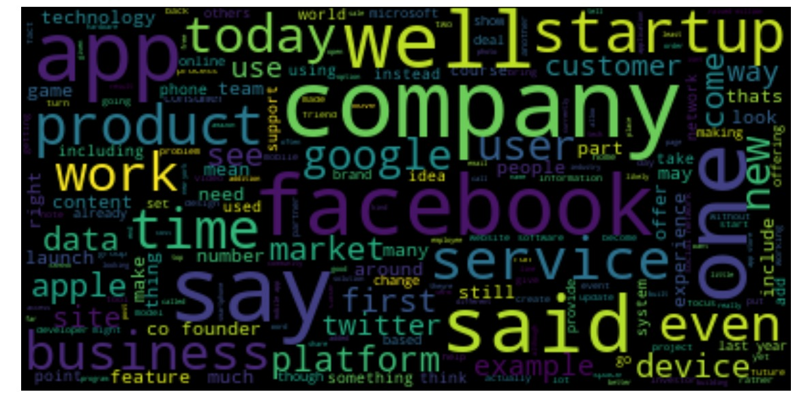
Exploratory Data Analysis

Slide 8
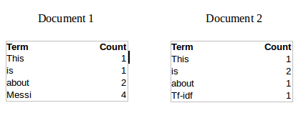

TF-IDF Vectorization
TF $=\frac{\text{(}\text{Number} \text{of} \text{times} \text{term} \text{t} \text{appears} \text{in} \text{a} \text{document}\text{)}}{\text{(}\text{Number} \text{of} \text{terms} \text{in} \text{the} \text{document}\text{)}}$
IDF = log $\frac{\text{(}\text{Total} \text{Number} \text{of} \text{Documents}\text{)} }{\text{(}\text{Number} \text{of} \text{Documents} \text{containing} \text{term} \text{t}\text{) }}$
TF-IDF = TF * IDF

Slide 9
Machine Learning Models
Model | F1 score | Accuracy | Hamming loss
Classifier Chains(DecisionTrees) | 0.6 | 0.2622 | 0.193
Classifier Chains(Logistic) | 0.74 | 0.4718 | 0.1177
Binary Relevance(Logistic) | 0.75 | 0.4583 | 0.1162
Binary Relevance(Naïve Bayes) | 0.57 | 0.1503 | 0.2937
Label Powerset(Logistic) | 0.73 | 0.5 | 0.1189
ML-KNN | 0.72 | 0.4396 | 0.1316

Slide 10
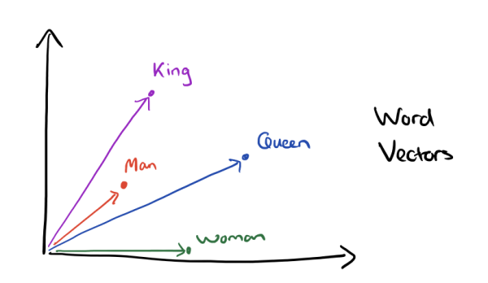
Word Embeddings
Glove
CommonCrawl,840B tokens, 2.2M Vocab, 300 dimensions
Wikipedia 2014 + Gigaword5 ,6B tokens, 2.2M Vocab, 50 dimension
FastText
CommonCrawl, 600B tokens, 2M Vocab 300 dimensions
wiki-news: 16B tokens, 1M Vocab, 300 dimensions

Slide 11

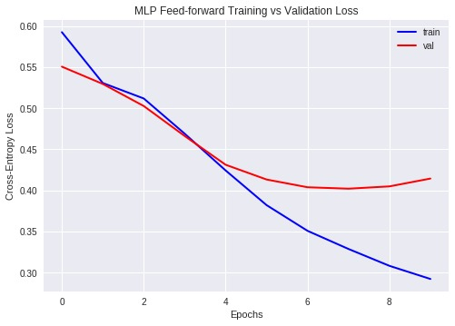
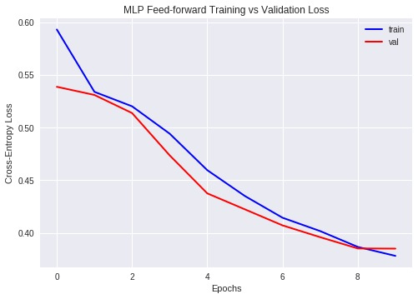
Neural Network (MLP)
F1- Score | Accuracy | Hamming Loss
0.61 | 0.3352 | 0.1690

Slide 12
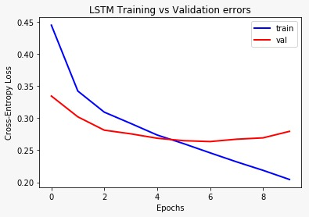
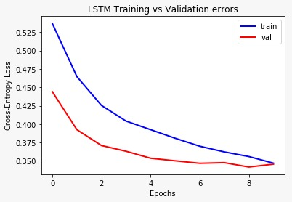
Bidirectional LSTM (Glove Embedding)
F1- Score | Accuracy | Hamming Loss
0.76 | 0.486 | 0.1119

Slide 13
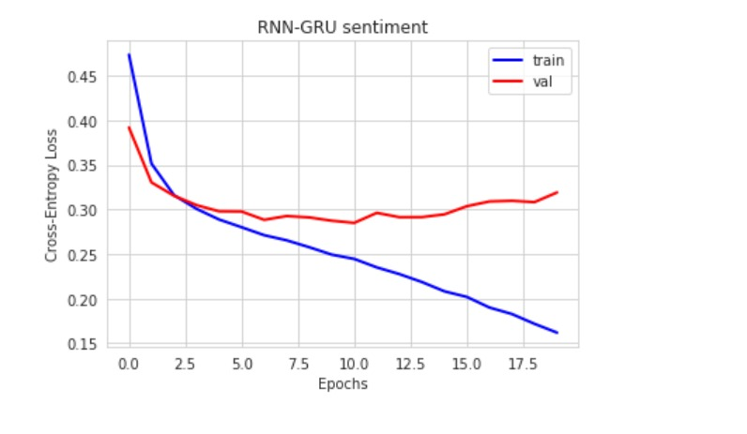
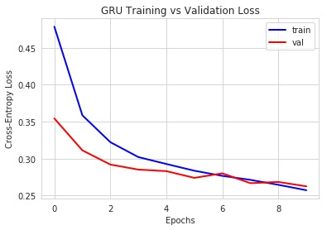
Bidirectional GRU (FastText Embedding)
F1- Score | Accuracy | Hamming Loss
0.78 | 0.5005 | 0.1073

Slide 14
Model Comparison
Model | F1-Score | Accuracy | Hamming Loss
MLP | 0.61 | 0.3352 | 0.1690
LSTM | 0.76 | 0.486 | 0.1119
GRU | 0.78 | 0.5005 | 0.1073

Slide 15
Deployment
TC Blogs
Client
React JS
Python
AWS
Keras
Flask

Slide 16
Future Work
Collect More Data
Hybrid models
Bidirectional Encoder Representations from Transformers (BERT)
Use distributed computing
Automated Pipeline to accommodate new incoming data
Hosting Front end application in AWS

Slide 17
References
Multi-label:
Zhang, Min-Ling & Zhou, Zhi-Hua. (2014). A Review On Multi-Label Learning Algorithms. Knowledge and Data Engineering, IEEE Transactions on. 26. 1819-1837. 10.1109/TKDE.2013.39.
Glove:
Pennington, Jeffrey & Socher, Richard & Manning, Christoper. (2014). Glove: Global Vectors for Word Representation. EMNLP. 14. 1532-1543. 10.3115/v1/D14-1162.
FastText:
Enriching Word Vectors with Subword Information, Piotr Bojanowski, Edouard Grave, Armand Joulin and Tomas Mikolov, 2016
Bag of Tricks for Efficient Text Classification, Armand Joulin, Edouard Grave, Piotr Bojanowski, Tomas Mikolov, 2016

Slide 18


