Slide 1
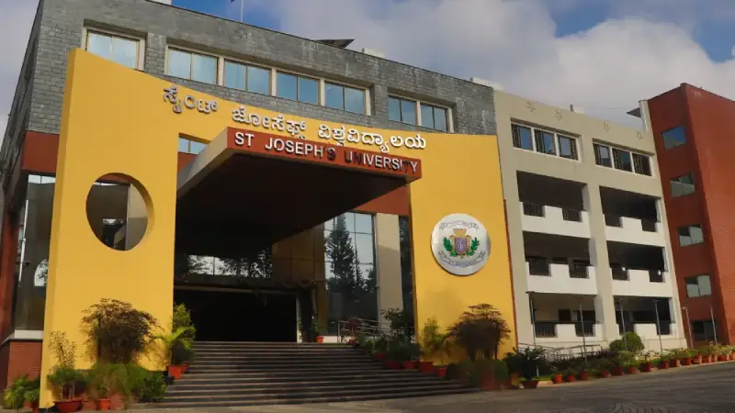

Financial Market Analysis and Stock Price Prediction Using Machine Learning
Name of the Student: Shreesha Shetty
Register Number:221BCADA32

Slide 2

Contents
Abstract
Introduction
Literature Survey
Problem Definition
Proposed Work
Methodology & Implementation
Results & Discussions
Conclusion
Reference

Slide 3
Abstract
Project Focus: Predicting stock prices using machine learning & sentiment analysis.
Problem: Investors struggle with making informed decisions due to lack of tools and data interpretation.
Solution: A hybrid ML-based system with LSTM, ARIMA, XGBoost + real-time sentiment analysis.
Goal: Help users make better investment decisions.
Output: A Streamlit dashboard showing predictions & recommendations

Slide 4
Introduction
Stock market prediction is tough due to high volatility and unpredictable trends.
Traditional methods struggle with non-linear patterns.
This project uses DLand ML to predict stock prices and offer investment advice.
Combines LSTM, XGBoost, ARIMA, and sentiment analysis from news headlines.
A user-friendly Streamlit app displays predictions and buy/hold/sell suggestions.
.

Slide 5
Literature Survey
Previous Works:
Traditional models like ARIMA work well for linear data but fail with market volatility.
Machine Learning models (like SVM and Random Forest) and Deep Learning models (like LSTM) can capture complex patterns in stock data.
Sentiment analysis using NLP tools (e.g., VADER) improves predictions by analyzing news and social media mood
Gaps Identified:
Lack of real-time prediction.
No integration of sentiment with stock forecasting.

Slide 6
Problem Definition
Retail investors lack:
Access to forecasting tools.
Live market sentiment analysis.
Integrated predictive models combining data & emotion.
Existing tools are too technical.
Need a simple, intelligent, and responsive system for stock prediction and advice.

Slide 7
Proposed Work
Build a hybrid prediction system using:
LSTM – Captures long-term trends in stock data.
ARIMA – Adds traditional statistical modeling.
XGBoost – Excellent for boosted decision trees.
Use sentiment analysis from real-time news headlines.
Display all insights in a user-friendly Streamlit dashboard.

Slide 8
Methodology & Implementation
Step 1: Fetch stock data using yfinance API.
Step 2: Preprocess data (scaling).
Step 3: Train models – LSTM, ARIMA, XGBoost.
Step 4: Scrape news & apply VADER sentiment analysis.
Step 5: Combine model predictions & sentiment to give advice.
Step 6: Create interactive dashboard with Streamlit.

Slide 9
Results & Discussions
Performance Evaluation:
LSTM gave the best performance for time-series data.
Sentiment Analysis Impact:
Added real-world emotion to predictions.
Challenges Faced:
Data volatility, mixed signals in news, model tuning.

Slide 10
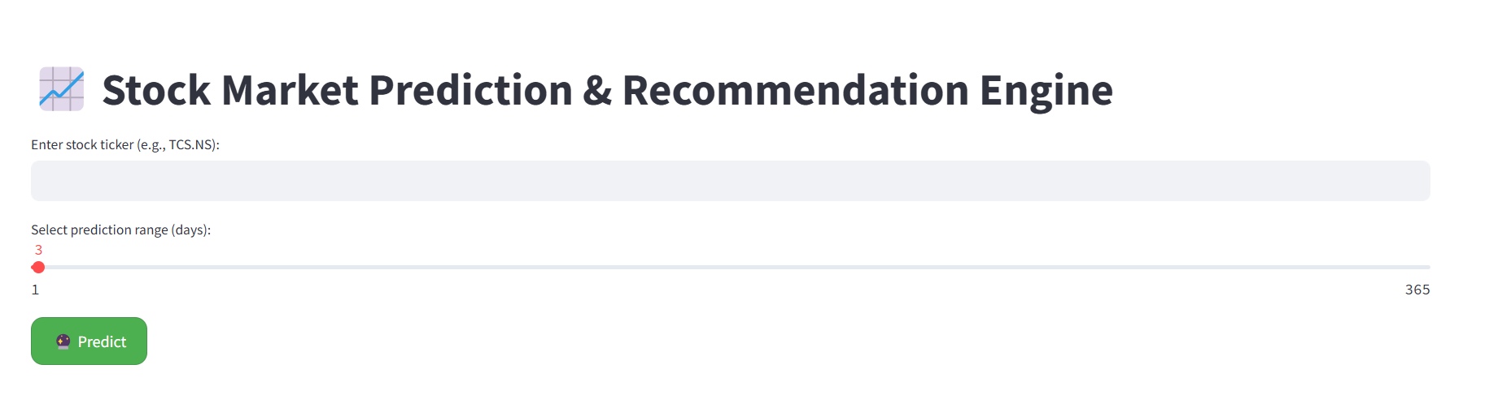
Results & Discussions
Dashboard:

Slide 11
Conclusion
Hybrid model improved accuracy and reliability of predictions.
Sentiment analysis added human-like interpretation.
The dashboard makes stock prediction accessible and useful.
Project can evolve into multi-stock, crypto, or forex prediction platforms

Slide 12
Reference
Fischer & Krauss (2018) – LSTM in financial forecasting.
Bollen et al. (2011) – Twitter sentiment predicting market trends.
Yahoo Finance – Historical stock data source.
Google News + VADER – Real-time sentiment extraction.
Patel et al. (2015) – Use of ML models for stock trend prediction

Slide 13
Thank You

