Slide 1
Oprofile
Shreesha Addala
CS854 - Experimental Performance Evaluation

Slide 2
Introduction
Complexity of computer systems
Difficult to determine what code consumes the CPU the most
Why specific code takes most of the time on the processor
Statistical profiling tools such as gprof and oprofile aid developers
Where processor spends the most of the time
Why particular section of code consumes more time

Slide 3
Oprofile
Low-overhead profiling tool for Linux
Operates on variety of architectures
Master’s thesis project by John Levon
Useful for identifying processor performance bottlenecks
Take samples periodically (time-based samples)
Which section of the code are executed
Provides access to performance monitoring counters
Performance events such as
Cache misses, memory references, instructions, processor clock cycles
Capable of profiling all running code at low overhead

Slide 4
Features
Unobtrusive
No special recompilations/wrapper libraries, Kernel patches are usually unnecessary
System-wide profiling
All code running on the system
Single process profiling
data is collected only for the specified process
Event counting
can be used to count native hardware events
Performance counter support
Call-graph support
gprof-style call-graph profiling data
Post-profile analysis
function-level or instruction-level detail, Source trees, hit list of applications

Slide 5
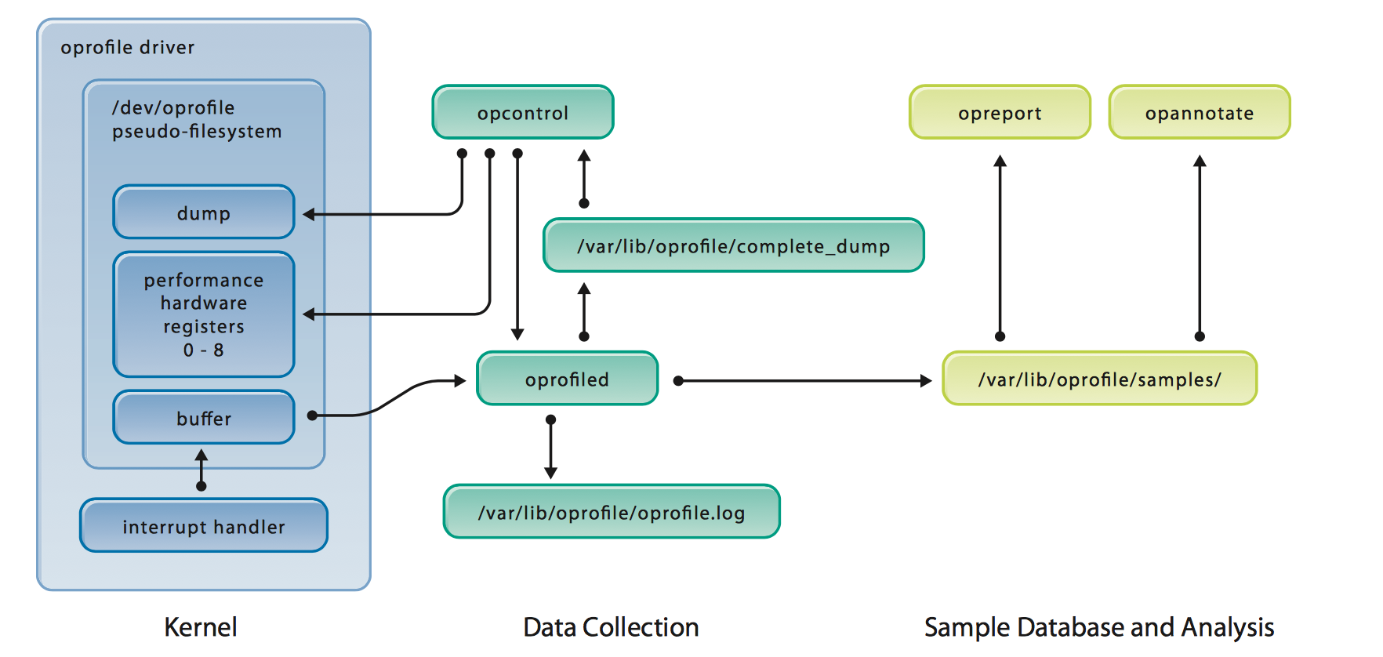
Block Diagram

Slide 6
Applications
Good when low overhead is needed
Profile interrupt handlers
Profile an application and its shared libraries
Identify stalls and bottlenecks
Examine cache misses

Slide 7
Limits
Cannot do call graphs on x86, ARM, and PowerPC
Need exact function call counts
Call graphs can be inaccurate
No support for virtual machine guests (VMs running on KVM are supported, VMware guests are not) -> list of supported events (cache misses, branch mispredict and so on) depends on CPU type.

Slide 8
System requirements
Architecture:
AMD, ARM, Intel, PowerPC, Tile, MIPS
Libraries
popt, bfd, liberty, dl

Slide 9
Tools included
Operf - Allows precise targeting for profiling ( single process or system-wide)
Ocount - Count native hardware events occurring. (single process or system-wide)
Opreport - Used for retrieving profile data
Opannotate - Used to produce annotated source or assembly code.
Opgprof - Used to output gprof-style data file
Oparchive - Generate a self-contained archive and can be moved to another machine for further analysis.
Opimport- Used when moving sample files between hosts with differing architectures.

Slide 10
Operf
Single or multiple processes
System wide -> root access required

Slide 11
Operf
Single or multiple processes
System wide -> root access required
operf [ options ] [ --system-wide | --pid=<PID> | [ command [ args ] ] ]
-> operf ./program-name arg-1 arg-2 ..

Slide 12
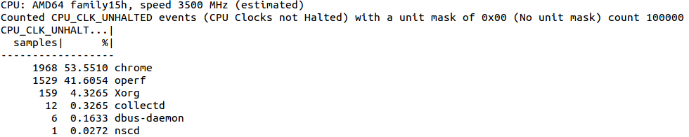
Operf: System-wide summary
> sudo operf --system-wide > opreport --exclude-dependent

Slide 13
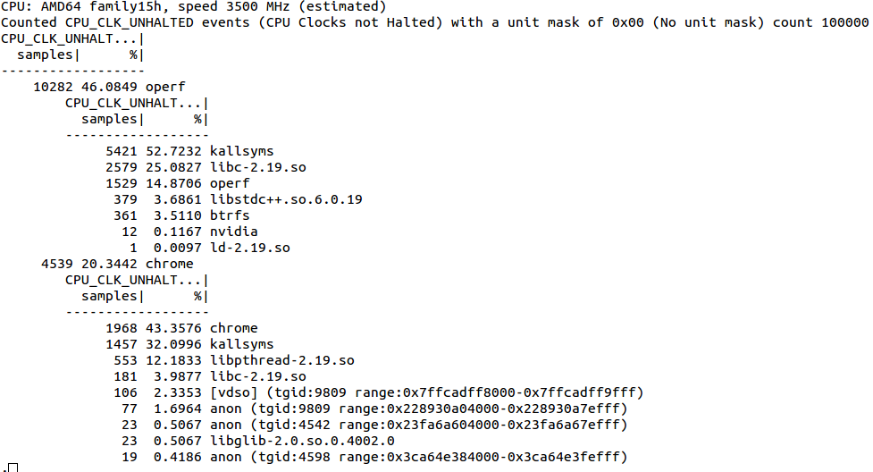
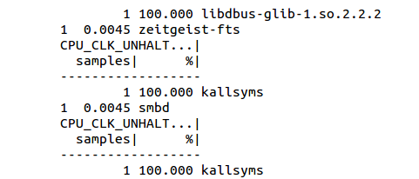
Operf: System-wide summary -> includes libraries
…………...
> opreport

Slide 14
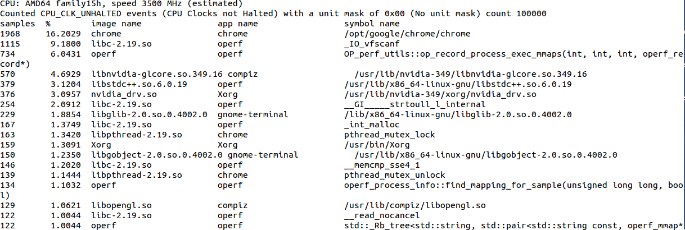
Operf: System-wide summary -> includes symbols & libraries
> opreport --symbols --image-path=/lib/modules/3.16.0-71-generic/kernel/

Slide 15
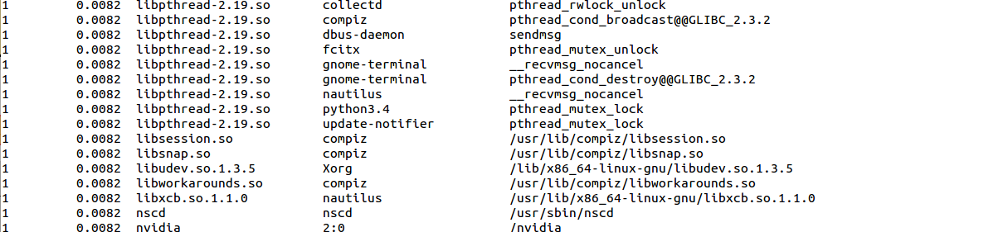
Operf: System-wide summary -> includes symbols & libraries
> opreport --symbols --image-path=/lib/modules/3.16.0-71-generic/kernel/

Slide 16
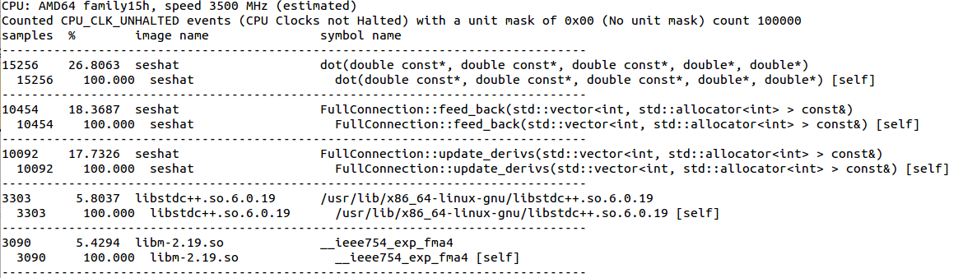
Operf: Single-application summary
> operf ./seshat -o out.inkml > opreport --callgraph

Slide 17
Ocount
Used to count the hardware events occurring in:
Processes
Threads
System processors
Entire system
No post-processing needed as data is immediately directed to stdout

Slide 18
Ocount
ocount [ options ] [ --system-wide | --process-list <pids> | --thread-list <tids> | --cpu-list <cpus> [ command [ args ] ] ]
-> ocount --system-wide --events=CPU_CLK_UNHALTED,INST_RETIRED

Slide 19
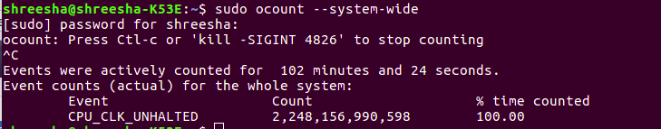
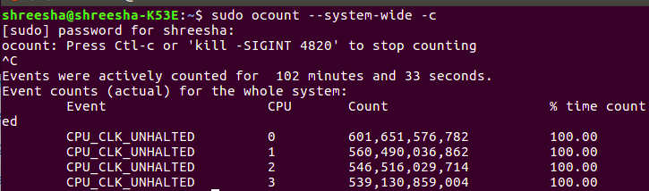
Ocount
System Wide Profiling

Slide 20
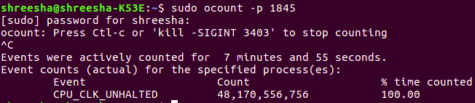
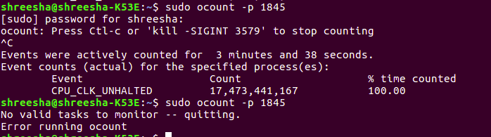
Ocount
Single Process Profiling

Slide 21
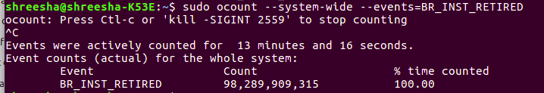
Ocount
System Wide Profiling (Event: BR_INST_RETIRED)

Slide 22
References
[1]. Levon, John. "OProfile manual." Victoria University of Manchester (2004).
[2]. Cohen, William E. "Tuning programs with OProfile." Wide Open Magazine 1 (2004): 53-62.

Slide 23
Questions? Documentation: http://oprofile.sourceforge.net/doc/index.html

