Slide 1
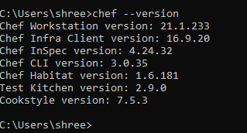

Git version 2.30.02
Chef Workstation v21.1.233
https://app.pluralsight.com/guides/using-git-and-github-on-windows

