Slide 1

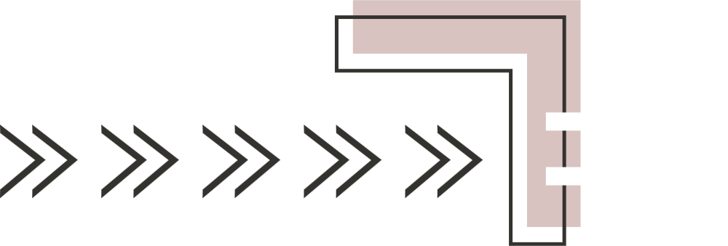

L.B.S College of Engineering
(A Govt. of Kerala undertaking)
HPC Optimization of Large-Scale Matrix Multiplication for Brain Tumor Detection Using MRI Images
Project Guide :
Dr. Anver S R /
Prof. Indu K B
Presented by :
Ayshath Afeesa P A (KSD22IT010)
Fathimmath Sanoobiya (KSD22IT015)
Shreevani M S (KSD22IT029)
Rosna Mol N V (LKSD22IT035)
Department of Computer Science & Engineering
B.TECH INFORMATION TECHNOLOGY

Slide 2
Table of Contents
Introduction
System Architecture
Problem Statement
Implementation
Motivation
Results
Objectives
Applications & Advantages
Literature Review
Limitations & Future Scope
Proposed System
Conclusion & References
2

Slide 3
Introduction
Brain tumors are abnormal growths of cells in the brain, and early detection is important for effective treatment.
MRI provides high-resolution and detailed images for medical diagnosis.
Convolutional Neural Networks are widely used for automatic analysis of MRI images to detect tumor regions.
CNN models extract features such as edges, textures, and tumor patterns through multiple layers.
Convolution operations slide filters over the image to generate feature maps.
These operations are often converted into matrix multiplication, leading to large-scale computations.
Optimizing these computations is essential to improve performance and efficiency.
3

Slide 4
Problem Statement
To propose an efficient HPC-based parallel implementation for large-scale matrix multiplication operations in CNN-based brain tumor detection to reduce execution time and improve computational efficiency using OpenMP-based parallelization
4

Slide 5
Motivation
Brain tumor detection requires accurate and timely analysis.
MRI images generate large amounts of data, making manual analysis difficult.
CNNs improve detection accuracy but involve heavy computations.
Convolution operations are computationally intensive in CNNs.
Increasing image size and filters further increases processing time.
There is a need to optimize these computations for better performance.
5

Slide 6
Objectives
To develop a CNN model for brain tumor detection using MRI images.
To analyze the computational complexity of convolution operations.
To implement and compare four methods:
Naive Convolution
OpenMP Parallel Convolution
img2col (Matrix-based Convolution)
img2col with OpenMP
To evaluate performance under varying image sizes, filters, and threads.
To measure execution time and compute speedup.
To identify the most efficient method for convolution optimization.
6

Slide 7
Literature Survey
SI No | Author | Remarks | Remarks
1 | Raviraju Balappa D, Dr. Gautam Kumar Rajput | The Role and Application of Matrices in Artificial Intelligence: Foundations, Methods, and Advancements. (IJISRT, Nov 2024 | Highlights importance of matrix operations in AI, but suffers from high computational complexity and scalability issues for large datasets.
2 | Jiawei Guo, Jieming Mab, Ángel F. García Fernández, Yungang Zhang, Haining Liang | A Survey on Image Enhancement for Low light Images. (Heliyon, Mar 2023 | Traditional image enhancement methods are efficient but may introduce noise; deep learning methods improve quality at the cost of higher computation.
3 | P Gokila Brindha, M Kavinraj, P Manivasakam and P Prasanth. | Brain tumor detection from MRI images using deep learning techniques | CNN outperforms ANN in accuracy and generalization, but requires more computational resources.
7

Slide 8
SI No | Author | Title | Remarks
4 | Tonmoy Hossain, Fairuz Shadmani Shishir , Mohsena Ashraf,MD Abdullah Al Nasim&, Faisal Muhammad Shah. | Brain Tumor Detection Using Convolutional Neural Network | FCM + CNN improves feature extraction accuracy, but increases preprocessing complexity and computation time.
5 | Awad Bin Naeem Taner Cevik, Onur Osman, Shtwai Alsubai , Abdelhamid Zaidi and Jawad Rasheed | Lightweight CNN for accurate brain tumor detection from MRI with limited training data | Lightweight CNN achieves high accuracy with fewer parameters, but may not generalize well for large or diverse datasets.
6 | Ranit Sen, Gopinath Balaji, and Harsh Kirty3 | Detection and Classification of Brain tumors Using Deep Convolutional Neural Networks | Transfer learning models provide high accuracy, but demand high computational power and careful preprocessing.
7 | Khalil Mouhah, Hind Faiz, Safae Bourhnan | Large Matrix Multiplication Algorithms: Analysis and Comparison. (ICACS ,Oct 2023) | Strassen’s algorithm reduces time complexity, but introduces additional memory overhead and implementation complexity.
8

Slide 9
SI No | Author | Remarks | Remarks
8 | Mufakir Qamar Ansari And Mudabir Qamar Ansari | Accelerating matrix multiplication: a performance Comparison between multi-core cpu and gpu | GPU-based methods achieve high performance, but require complex memory management and specialized hardware.
9 | Nizar ALHafez, Ahmad Kurdi | Parallel Paradigms in Modern HPC: A Comparative Analysis of MPI, OpenMP, and CUDA | Parallel methods like OpenMP and CUDA improve performance, but overhead affects efficiency for smaller problem sizes.
10 | Hitimana et al. | Comparative study on performance of High Performance Computing under OpenMP and MPI on Image Segmentation | OpenMP and MPI improve performance in parallel image processing, but communication overhead and load balancing issues can limit scalability.
9

Slide 10
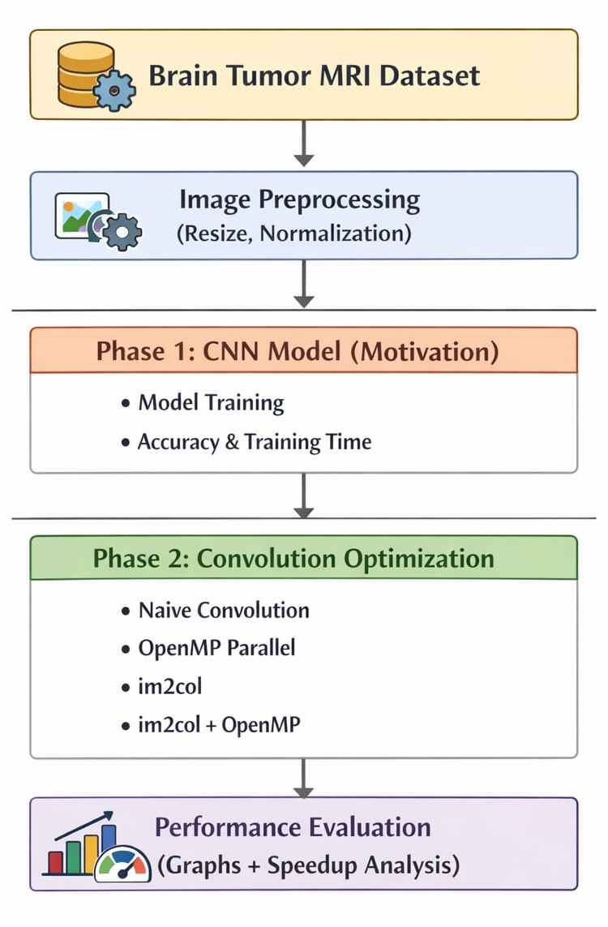
Proposed System
Dataset Collection : MRI brain tumor dataset is collected for training
Image Preprocessing : Images are resized, normalized.
CNN Model Implementation : CNN extracts features and detects tumors.
Training & Performance Measurement : Model trained and time recorded.
Optimization using HPC : Convolution optimized using OpenMP
Performance Comparison : Execution time compared before and after optimization
10

Slide 11
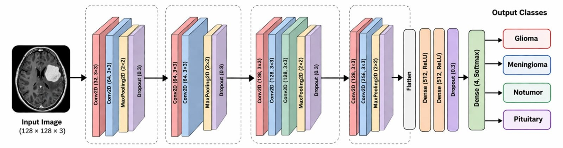
System Architecture
The CNN architecture automatically extracts hierarchical features from MRI images and performs accurate tumor classification using deep convolutional layers.
11

Slide 12
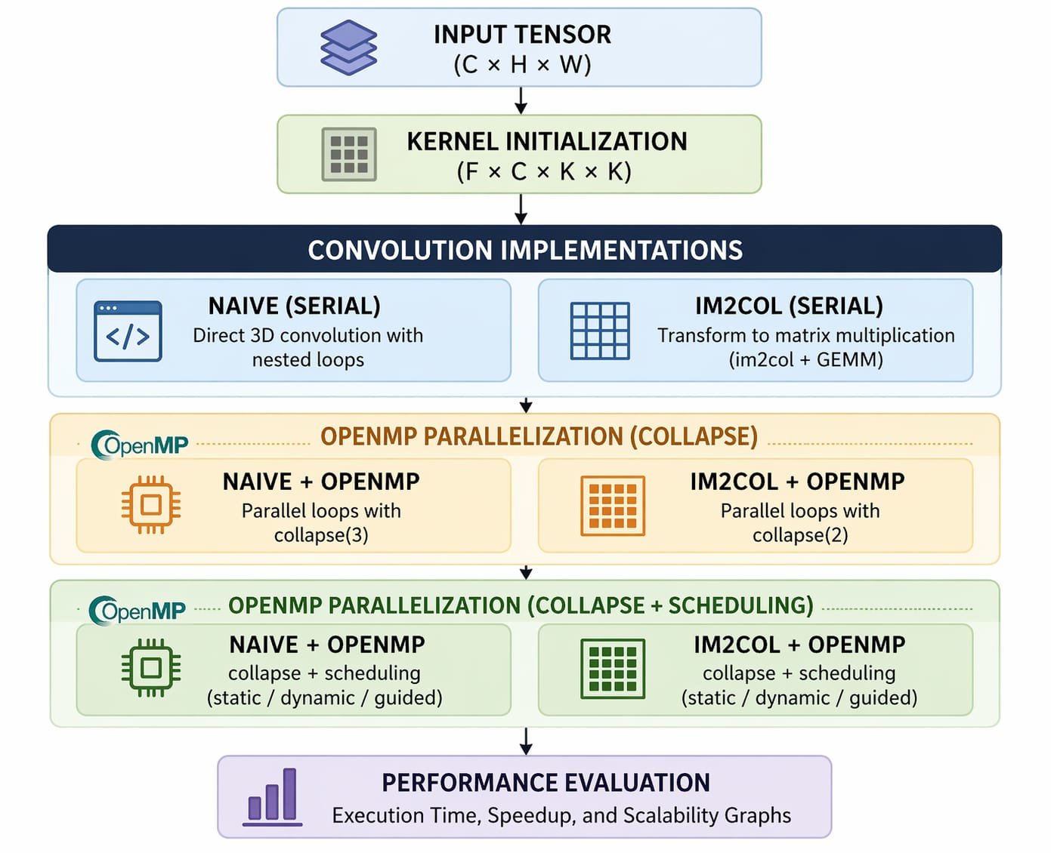
System Architecture
Convolution implemented using four methods: Naive, OpenMP, im2col, and im2col with OpenMP.
OpenMP enables parallel execution, reducing computation time.
img2col converts convolution into efficient matrix multiplication.
12

Slide 13
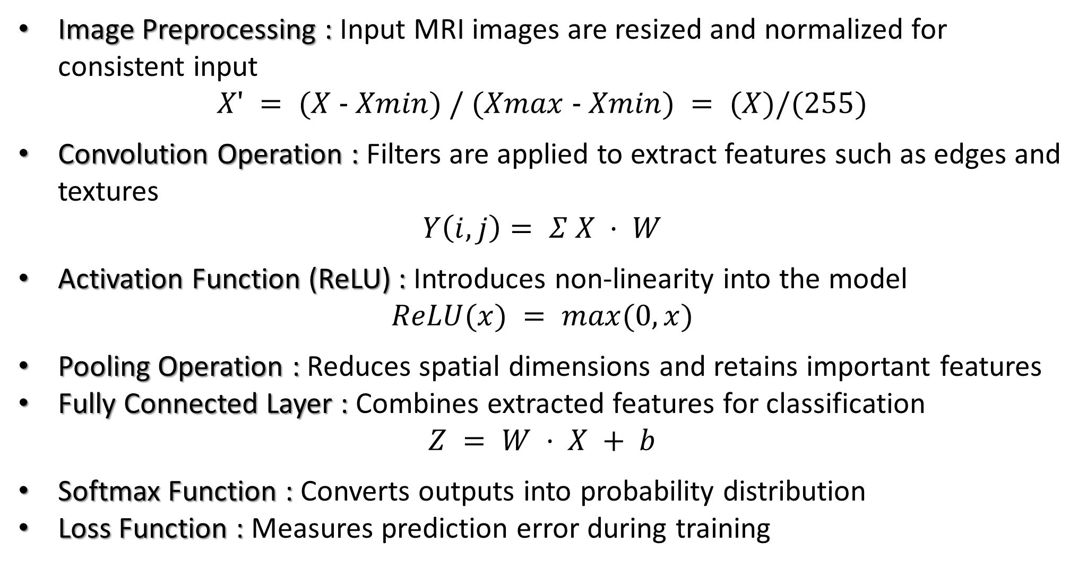
Working Principle of CNN
Image Preprocessing : Input MRI images are resized and normalized for consistent input
$$X′ = (X − Xmin) / (Xmax − Xmin) = (X)/(255)$$
Convolution Operation : Filters are applied to extract features such as edges and textures
$$Y\left(i, j\right)= Σ X · W$$
Activation Function (ReLU) : Introduces non-linearity into the model
$$ReLU(x) = max(0, x)$$
Pooling Operation : Reduces spatial dimensions and retains important features
Fully Connected Layer : Combines extracted features for classification
$$Z = W · X + b$$
Softmax Function : Converts outputs into probability distribution
Loss Function : Measures prediction error during training
13

Slide 14
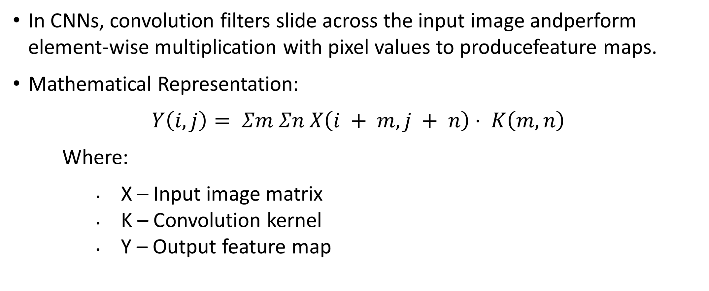
Convolution And Matrix Multiplication
In CNNs, convolution filters slide across the input image andperform element-wise multiplication with pixel values to producefeature maps.
Mathematical Representation:
$$Y\left(i, j\right)= Σm Σn X\left(i + m, j + n\right)· K\left(m, n\right)$$
Where:
X – Input image matrix
K – Convolution kernel
Y – Output feature map
14

Slide 15
To enable efficient computation, convolution is converted into matrix multiplication using the img2col technique.
In this method, small image patches are rearranged into a matrix and multiplied with the filter weight matrix.
Example :
Image size = 128 × 128
Kernel size = 3 × 3
Input channels = 64
Number of filters = 128
After transformation using img2col:
(16,384 × 576) × (576 × 128)
These large matrix multiplications are repeated across CNN layers,
resulting in high computational workload.
15

Slide 16
Tools And Technologies
Dataset
Brain Tumor MRI Dataset (Kaggle)
Programming Languages
Python - CNN Model Development
C - HPC Convolution Implementation
Libraries & Frameworks
TensorFlow / Keras – CNN model building and training
OpenCV – Image preprocessing
NumPy – Numerical computations
Parallel Computing
OpenMP – Multithreading and parallelization
Visualization
Matplotlib – Graph plotting
16

Slide 17
Implementation
CNN-Based Tumor Detection :
Dataset Preparation – Brain Tumor MRI dataset (7,200 images) with four classes: glioma, meningioma, pituitary, and no tumor; split into training (5,600) and testing (1,600).
Image Preprocessing – Images resized to 128 × 128 and normalized.
CNN Model – Convolution layers for feature extraction, MaxPooling for dimensionality reduction, Dropout to prevent overfitting, and Dense layers for classification.
Model Training – Adam optimizer, learning rate 0.0001, 25 epochs, batch size 16.
Evaluation – Accuracy and loss measured on test data, and training time recorded.
17

Slide 18
Convolution Optimization Using HPC :
Convolution implemented in C for performance benchmarking
Methods used: Naive, Naïve + OpenMP, im2col (serial), im2col (OpenMP)
Naive Convolution: Uses 6 nested loops (filters, height, width, channels, kernel height, kernel width) to compute each output element directly.
Naive + OpenMP: Same 6-loop structure, but outer loops are parallelized using collapse() to distribute work across threads.
img2col (serial): Converts input patches into a matrix (im2col) and kernels into another matrix, then performs matrix multiplication instead of nested loops.
img2col + OpenMP: Matrix multiplication loops are parallelized using OpenMP for faster computation.
OpenMP parallelization approaches used:
collapse only
collapse with scheduling
18

Slide 19
Collapse Only Method :
Nested loops combined using collapse()
Treated as a single iteration space
Work divided among threads
Each thread computes output elements in parallel
Collapse + Scheduling Method –
Loop collapsing combined with scheduling techniques
Workload distributed dynamically among threads
Improves load balancing and efficiency
Scheduling Types :
Static – Equal distribution with low overhead
Dynamic – Assigned during execution for uneven workloads
Guided – Large chunks first, smaller later for balance
19

Slide 20
Analysis of Results
CNN Model Performance :
Training Accuracy: 95.7%
Validation Accuracy: 89.06%
Test Accuracy: 89.06%
Training Time: ~6048 seconds (~100.8 minutes)
Number of Epochs: 25
The model achieves good accuracy, but training time is high. In real-world scenarios with larger datasets, computation increases further, highlighting the need for efficient optimization of convolution operations.
20

Slide 21
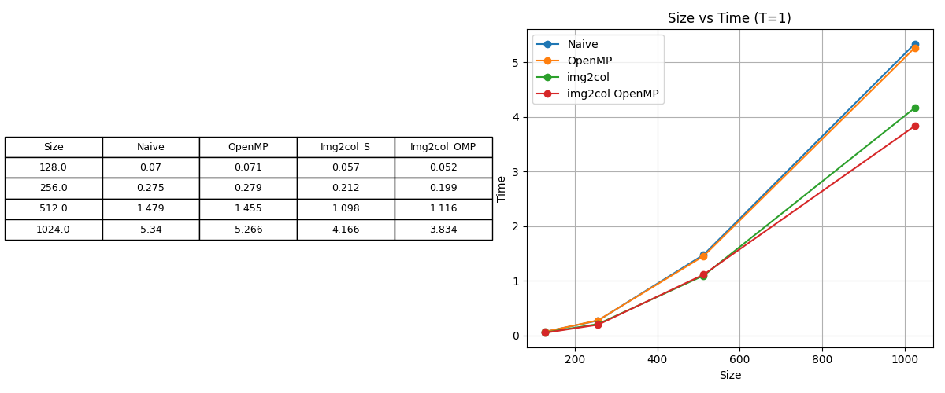
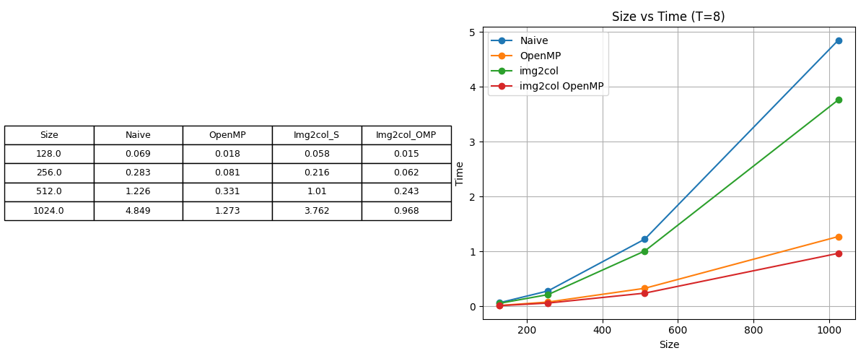
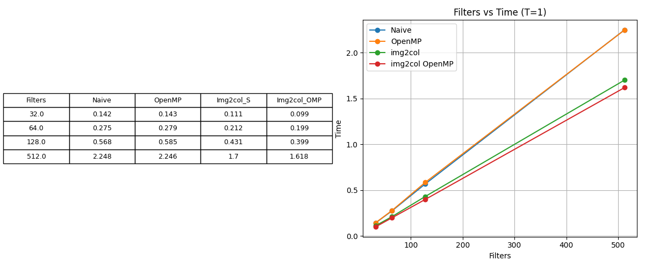
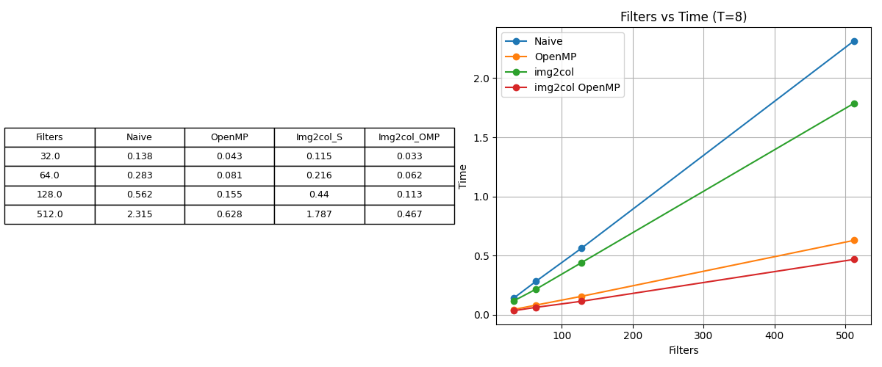
Convolution Optimization using OpenMP (Collapse)
Experiments are conducted using image sizes (128, 256, 512, 1024), filters (32, 64, 128, 512), threads (1, 2, 4, 8, 12), and for scheduling, chunk sizes (2, 4, 8, 16, 32) with static, dynamic, and guided methods.
With size = 256, filters = 64, and threads = 8 fixed, execution time is compared across different convolution methods.
Execution time increases with image size and number of filters.
At Thread = 8, execution time is significantly lower than Thread = 1.
21

Slide 22
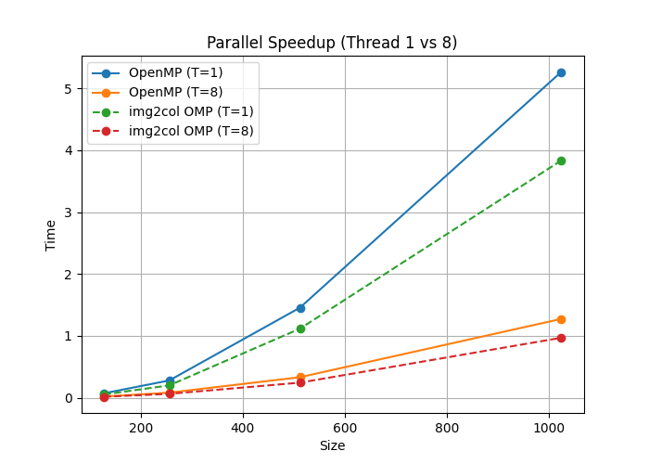
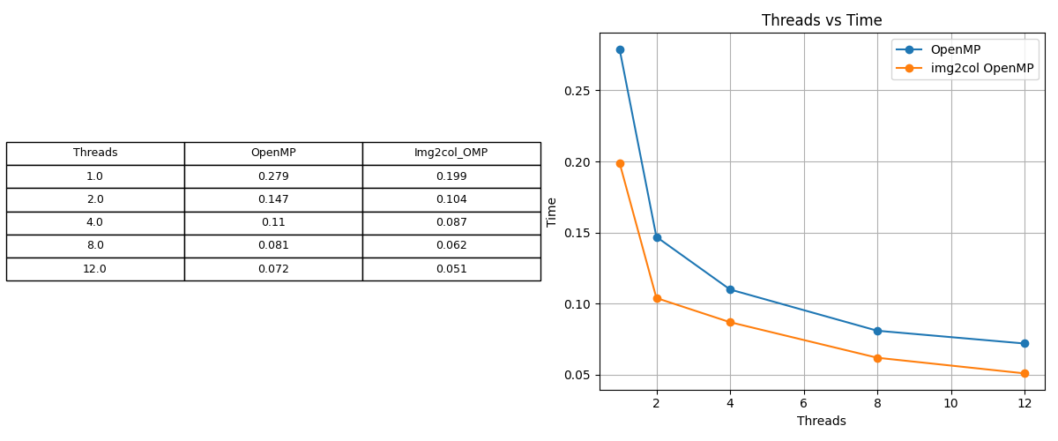
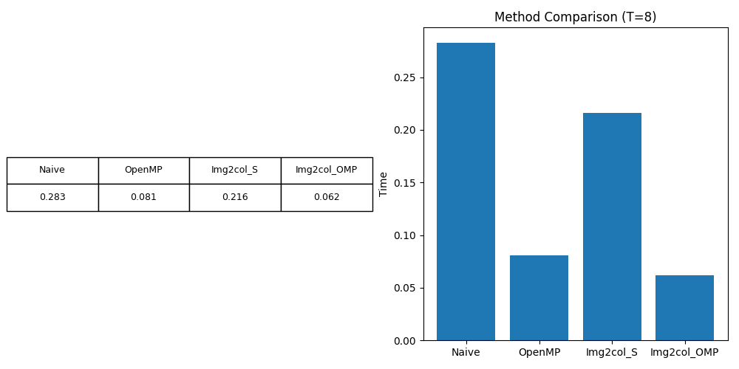
Performance improvement is more noticeable for larger sizes and higher filters.
Execution time decreases as the number of threads increases.
Significant improvement is observed from 1 to 8 threads, with smaller gains at 12 threads.
Parallel methods outperform naive implementation.
img2col + OpenMP achieves the best performance and highest speedup.
22

Slide 23
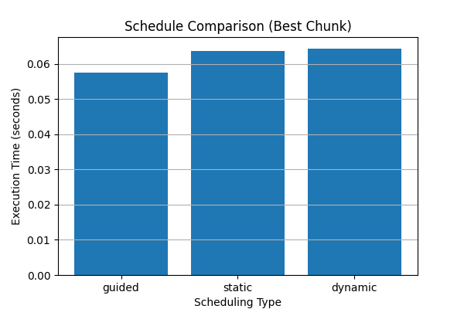
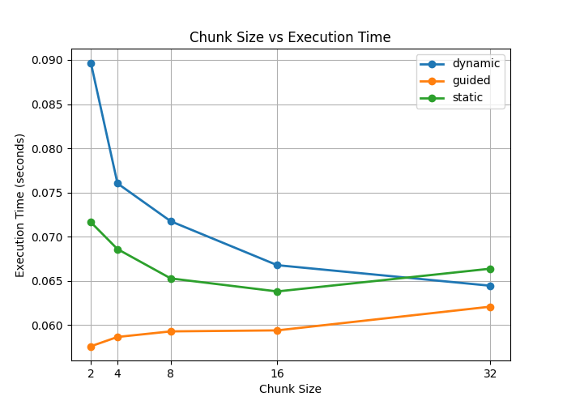
Convolution Optimization using OpenMP (Collapse + Scheduling)
Size (256), Filters (64), and Threads (8) are fixed, while schedule type (Static, Dynamic, Guided) and chunk size (2–32) are changed.
Guided scheduling gives the lowest time, so it performs the best.
Dynamic scheduling becomes faster when chunk size increases.
Static scheduling stays almost the same but is less efficient.
Chunk size affects how work is divided and impacts performance.
23

Slide 24
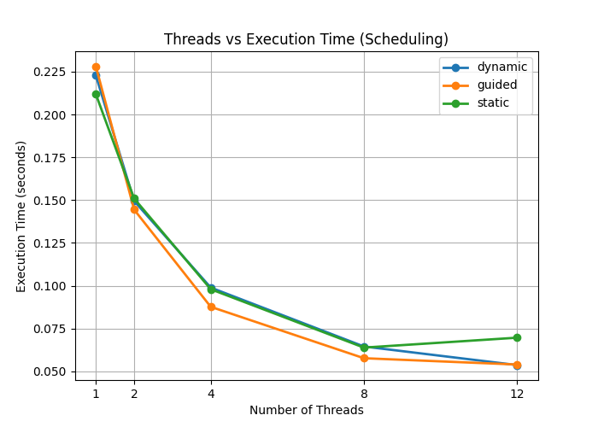
Size (256) and Filters (64) are fixed, while number of threads (1–12) and schedule type are changed.
Execution time decreases when the number of threads increases.
Big improvement is seen from 1 to 8 threads.
Guided scheduling performs better compared to others.
Slight variation at higher threads happens due to overhead.
24

Slide 25
Applications
Brain tumor detection from MRI images using CNN for faster and automated medical diagnosis.
High-performance optimization of CNN-based image processing tasks such as detection, classification, and segmentation.
Advantages
Reduces execution time significantly using parallel computing techniques.
Improves scalability and efficiency for handling large images and complex CNN models.
25

Slide 26
Limitations
The model is trained on a limited dataset, so performance may reduce on unseen real-world data.
Experiments are performed on CPU without GPU acceleration, leading to higher training and computation time.
Future Scope
Extend the system using GPU/accelerator-based parallel computing for faster training and inference.
Apply advanced architectures and larger datasets to improve accuracy and real-world performance.
Integrate optimized convolution techniques directly into CNN models to further improve computational efficiency.
26

Slide 27
Conclusion
A CNN-based model is developed for brain tumor detection using MRI images with good accuracy.
Convolution is identified as the main computational bottleneck.
Four methods are implemented: Naive, Naive + OpenMP, img2col, and img2col + OpenMP.
Using OpenMP (collapse), img2col + OpenMP achieves the best performance.
Further improvement is obtained using collapse + scheduling, where guided scheduling gives the lowest execution time.
27

Slide 28
References
Raviraju Balappa D, Dr. Gautam Kumar Rajput. “The Role and Application of Matrices in Artificial Intelligence: Foundations, Methods, and Advancements”, International Journal of Innovative Science and Research Technology , Volume 9, Issue 11, November 2024.
Jiawei Guo, Jieming Mab, Ángel F. García-Fernández, Yungang Zhang, Haining Liang. “A Survey on Image Enhancement for Low-light Images”, Heliyon,2023.
P. Gokila Brindha, M. Kavinraj, P. Manivasakam, and P. Prasanth, “Brain Tumor Detection from MRI Images Using Deep Learning Techniques,” IVC RAISE, 2020.
Tonmoy Hossain, Fairuz Shadmani Shishir, Mohsena Ashraf, MD Abdullah Al Nasim, and Faisal Muhammad Shah, “Brain Tumor Detection Using Convolutional Neural Network,” IEEE, 2019.
Awad Bin Naeem, Onur Osman, Shtwai Alsubai, Taner Cevik, Abdelhamid Zaidi, and Jawad Rasheed, “Lightweight CNN for Accurate Brain Tumor Detection from MRI with Limited Training Data,”2025.
Ranit Sen, Gopinath Balaji, and Harsh Kirty, “Detection and Classification of Brain Tumors Using Deep Convolutional Neural Networks,” 2022.
28

Slide 29
Khalil Mouhah, Hind Faiz, and Safae Bourhnane, “Large Matrix Multiplication Algorithms: Analysis and Comparison,” Proc. 7th International Conference on Algorithms, Computing and Systems (ICACS ’23). 2024.
Mufakir Qamar Ansari and Mudabir Qamar Ansari, “Accelerating Matrix Multiplication: A Performance Comparison Between Multi-Core CPU and GPU,” Independent Research Report, 2025.
Nizar AlHafez and Ahmad Kurdi, “Parallel Paradigms in Modern HPC: A Comparative Analysis of MPI, OpenMP, and CUDA,”Higher Institute for Applied Sciences and Technology (HIAST), Damascus, Syria, 2025.
Eric Hitimana, Eric Nizeyimana, and Gaurav Bajpai, “Comparative Study on Performance of High-Performance Computing under OpenMP and MPI on Image Segmentation,” University of Rwanda–College of Science and Technology, 2016.
Ethan Davis, “High Performance Matrix Multiplication,” Independent Research Study, Mar. 2025.
Prudhvi Naayini, Srikanth Kamatala. “High-Performance Data Computing: Parallel Frameworks, Execution Strategies, and Real-World Deployments” . International Journal of Scientific Advances ISSN: 2708-7972 Volume: 4, Issue: 6 , Nov– Dec 2023.
Mohanarajesh Kommineni. ” Study High-Performance Computing Techniques for Optimizing and Accelerating AI Algorithms Using Quantum Computing and Specialized Hardware “, International Journal of Innovations in Applied Sciences and Engineering
29

Slide 30
Thank You

